Slide 1
CEOS WGCV-56 / LSI-VC-19
Joint Meeting
CEOS FRM assessment framework
Update on second pilot assessment exercise
Paolo Castracane
Starion for ESA/ESRIN
Agenda Item WP3.1
WGCV-56 / LSI-VC-19 Joint Meeting
Sioux Falls, SD, USA
20-24 April, 2026

Slide 2
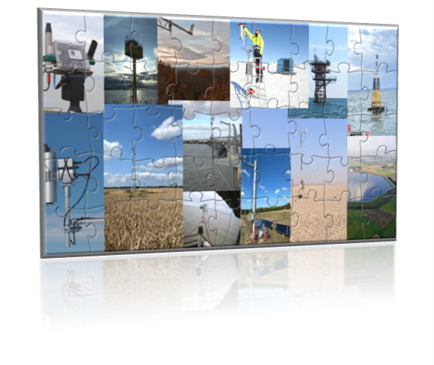
Table of Contents
Background and Objectives
Endorsment Process: the CEOS-FRM Maturity Matrix
2nd round of exercises
Way forward

Slide 3

ACTION
ID | Description | Due Date | status
WGCV-55-03 | Paolo Castracane to organise a second FRM Assessment Framework exercise to include PGN, FRM4DOAS, and RadCalNet, ACTRIS, ISMN. | Q4 2025 | In progress
WGCV-55-04 | WGCV to confirm the readiness of operationalisation and conduct a pre-launch review of the FRM Assessment Framework, and to define candidates for operational usage of the tool e.g. HYPERNETS. | WGCV-56
WGCV-55-08 | Paolo to work with the CEOS Communications Team to develop an FRM Assessment Framework logo and CEOS News article post. | WGCV-56 | Close

Slide 4
Background and Objectives
The concept of a Fiducial Reference Measurement (FRM) has been developed to highlight the need for precise and well-characterised measurements tailored explicitly to the post-launch calibration and validation (Cal/Val) of Earth Observation satellite missions [1].
Recently, this need has been enhanced with the emergence of new commercial satellite operators to ensure that users have a transparent and fair means to judge the adequacy of data products to meet their needs.
The Committee on Earth Observation Satellites (CEOS) Working Group Cal/Val (WGCV) has put in place a framework to assess the maturity and compliance of a “Cal/Val reference measurement” in terms of a set of community-agreed criteria which define it to be of CEOS-FRM quality. The assessment process is based on a maturity matrix that provides a visual assessment of the state of any FRM against each of a set of given criteria, making visible where it is mature and where evolution and effort are still needed. General information and the last version of the guidelines are available on the CEOS Cal/Val Portal [2].
[1] Goryl, P.; Fox, N.; Donlon, C.; Castracane, P. Fiducial Reference Measurements (FRMs): What Are They?
Remote Sens. 2023, 15, 5017. https://doi.org/10.3390/rs15205017
[2] FRMs Assessment Framework on CEOS Cal/Val Portal: https://calvalportal.ceos.org/web/guest/frms-assessment-framework
Slide ‹#›

Slide 5
CEOS FRM Endorsement process
The proposed framework takes a pragmatic approach relying on self-assessment and transparency/accessibility of evidence against a set of criteria which are subject to peer review through a board of experts led by CEOS WGCV
In order to be flexible, maximise inclusivity and encourage the development and evolution of FRM from new or existing teams compliance with criteria will be based on a gradation scaling rather than a simple pass/fail
The degree of compliance and associated gradation is presented in a Maturity Matrix model - to allow intended users of the FRM to assess suitability for their application and indeed funders to decide on where and what aspects to focus any investment. The matrix model provides a visual “simple” assessment of the state of any FRM for all given criteria making visible where it is mature and where evolution and effort needs to be expended.
In addition to this broad-based summary an overall classification of the degree of compliance will be provided based on meeting specific gradations for particular criteria.

Slide 6

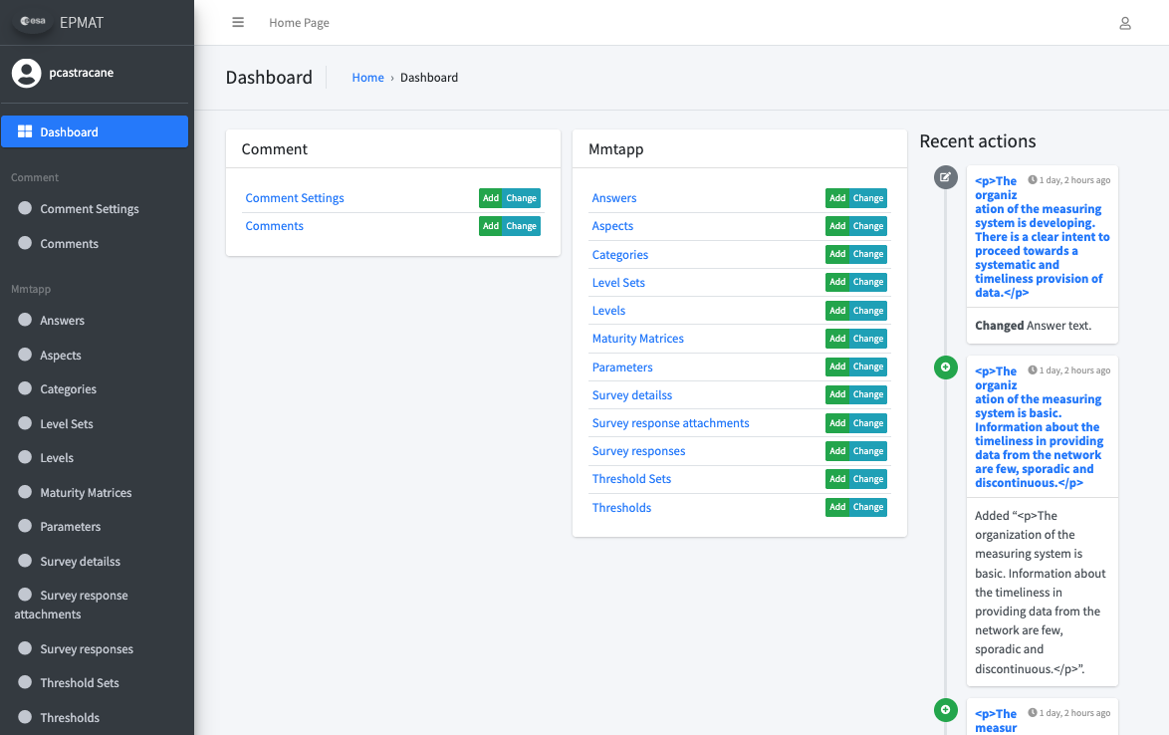
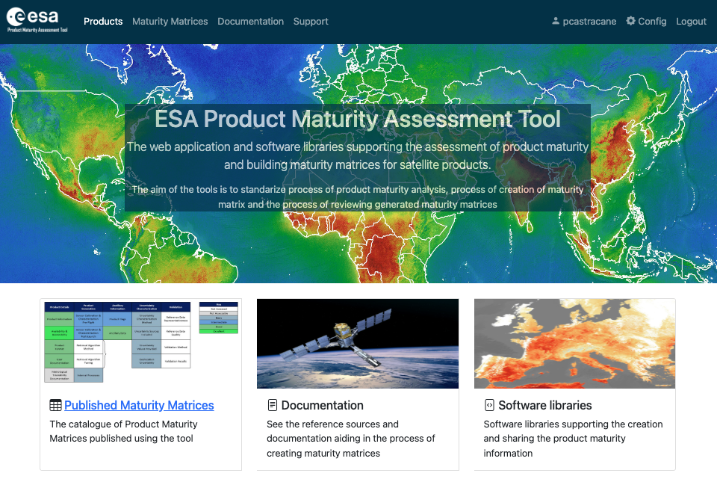
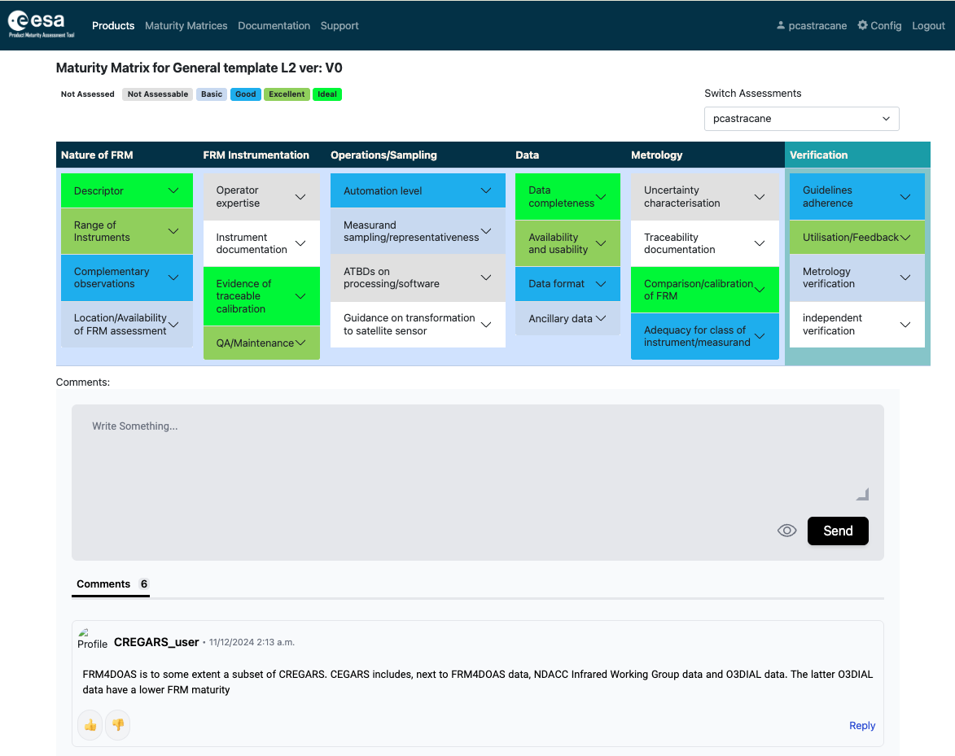
Maturity Matrix Tool

Slide 7
FRM Maturity Matrix
Self-Assessment |  |  |  |  |  | Independent Assessor
Nature of FRM | FRM Instrumentation | Operations/ Sampling (single instrument) | Data | Metrology | Completeness, coverage and distribution | Verification
Descriptor | Instrument documentation | Automation level | Data completeness | Uncertainty characterisation | Validation capacity | Guidelines adherence
Location/ availability of FRM | Evidence of traceable calibration | Measurand sampling/ representativeness | Availability and Usability | Traceability documentation | Geographical coverage | Utilisation/ Feedback
 |  |  |  |  | Temporal sampling
Range of sensors | QA Maintenance | ATBDs on processing/software | Data format | Comparison/ calibration of FRM | Centralized data, processing, quality assessment and adherence to community standards | Metrology verification
Complementary observations | Operator expertise | Guidelines on transformation to satellite sensor | Ancillary data | Adequacy for class of instrument/ measurand | Timeliness | Independent verification
FRM CLASSIFICATION |  |  |  |  |  | A B C D
Class A – Where the measurement fully meets all the criteria necessary to be considered an FRM for a particular class of instrument and measurand.
Class B – Where the measurement meets many of the key criteria and has a path towards meeting the Class A status in the near term.
Class C – Meets or has some clear path towards achieving the criteria needed to reach a higher class and provides some clear value to the validation of a class of satellite instruments/measurands.
Class D – Is a relatively basic adherence to the FRM criteria but there is a strategy and aspiration to progress towards a higher class. This can be considered an entry level class for those starting out on developing an FRM.
Grade
Not Assessed
Not Assessable
Basic
Good
Excellent
Ideal
Not Public

Slide 8
Pilots for CEOS FRMs Maturity Matrix Assessment:
1st round of exercise
PGN (Pandonia Global Network) - Stefano Casadio (Serco)
RadCalNet (Radiometric Calibration Network) - Marc Bouvet (ESA/ESTEC)
ICOS (Integrated Carbon Observation System – Ecosystem Component) - Fabrizio Niro (Serco)
FRM4DOAS (Ground-Based DOAS Air-Quality Observations) - Michel Van Roozendael and Jean-Christopher Lambert (BIRA)
BAQUNIN (PREDE-POM LUNAR) – Stefano Casadio (Serco)
CSIRO (DION) –Janet Anstee and Matt Garthwaite (CSIRO)
Brewer Spectrometer - NO2 Vertical Column Densities (VCDs) Measurements - Henri Diémoz (ARPA Valle d’Aosta) – BAQUNIN project
FRM4GHG 2.0 project –COCCON (EM27/SUN) XCO₂, XCH₄, and XCO data. – Mahesh Kumar Sha (BIRA) - FRM4GHG team. [Sha, M.K.; De Mazière, M.; Notholt, J.; Blumenstock, T.; Bogaert, P.; Cardoen, P.; Chen, H.; Desmet, F.; García, O.; Griffith, D.W.T.; et al. Fiducial Reference Measurement for Greenhouse Gases (FRM4GHG). Remote Sens. 2024, 16, 3525. https://doi.org/10.3390/rs16183525]
Tropical Centre for reactive trace gas remote sensing (CREGARS) in ACTRIS – Martine De Mazière (BIRA)
Maturity Matrix Tool
https://mmt.skytek.dev
Support provided by Jarek Dobrzanski (Skytek, Ireland https://skytek.com/)
Dedicated credentials provided for all the selected users

Slide 9
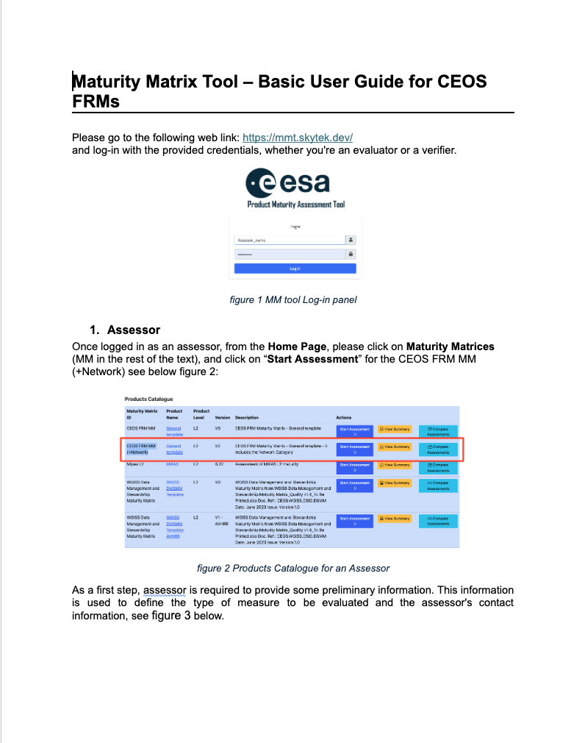

Pilots for CEOS FRMs Maturity Matrix Assessment:
2st round of exercise – March-April 2026
Pilots divided by Assessor and Verifier
16 Measurement types invoved in the exercise
The following items provided to the pilots:
CEOS FRM Assessemnt framework guidelines
Maturity Matrix Tool (MMT) User Guide
Credentials for MMT

Slide 10
Pilots for CEOS FRMs Maturity Matrix Assessment:
2st round of exercise – March-April 2026
Username | type | name | email | invited | Self-assessment | verification | comments
USGS_asr | assessor | Gross, Garrison | ggross@contractor.usgs.gov | 02/03/2026 | x |  | Landsat sensors
USGS_vr | verifier | Anderson, Cody H | chanderson@usgs.gov | 02/03/2026
FRM4SM_asr | assessor | Alexander Gruber | alexander.gruber@geo.tuwien.ac.at | 02/03/2026 | x
FRM4SM_vr | verifier | Philippe Richaume | philippe.richaume@univ-tlse3.fr | 02/03/2026 |  | x
FRM4drones_asr | assessor | Agnieszka Bialek | agnieszka.bialek@npl.co.uk | 02/03/2026 | x
FRM4drones_vr | verifier | Nigel Fox | nigel.fox@npl.co.uk | 02/03/2026
RadCalNet_asr | assessor | Marc Bouvet | Marc.Bouvet@esa.int | 02/03/2026 | x
RadCalNet_vr | verifier | Fabrizio Niro | Fabrizio.Niro@ext.esa.int | 02/03/2026 |  | x
LANDHYPERNET_asr | assessor | Pieter De Vis | pieter.de.vis@npl.co.uk | 02/03/2026 | x
LANDHYPERNET_vr | verifier | Nigel Fox | nigel.fox@npl.co.uk | 02/03/2026 |  | x
WATERHYPERNET_asr | assessor | Kevin Ruddick | kruddick@naturalsciences.be | 02/03/2026
WATERHYPERNET_vr | verifier | Nigel Fox | nigel.fox@npl.co.uk | 02/03/2026
EUBREWNET_asr | assessor | Alberto Redondas | aredondasm@aemet.es | 03/03/2026
EUBREWNET_vr | verifier
NDACC_Dobson_asr | assessor | Glen McConville? | Glen.McConville@noaa.gov | 03/03/2026
NDACC_Dobson_vr | verifier
NDACC_FTIR_asr | assessor | Jim Hannigan? Emmanuel Mahieu? | jamesw@ucar.edu emmanuel.mahieu@uliege.be | 03/03/2026
NDACC_FTIR_vr | verifier
NDACC_Lidar_asr | assessor | Thierry Leblanc? Wolfgang Steinbrecht? | thierry.leblanc@jpl.nasa.gov Wolfgang.Steinbrecht@dwd.de | 03/03/2026
NDACC_Lidar_vr | verifier
NDACC_MWR_asr | assessor | Eliane Maillard Barras? Gerald Nedoluha? | Eliane.MaillardBarras@meteoswiss.ch gerald.nedoluha@nrl.navy.mil | 03/03/2026
NDACC_MWR_vr | verifier
NDACC_sonde_asr | assessor | Elisabeth Asher? Ryan Stauffer? Roeland van Malderen? | elizabeth.asher@noaa.gov Ryan.M.Stauffer@nasa.gov roeland.vanmalderen@meteo.be | 03/03/2026
NDACC_sonde_vr | verifier
NDACC_3_asr | assessor
NDACC_3_vr | verifier
ACTRIS_CREGARS_asr | assessor | Bart Dils | Bart.Dils@aeronomie.be | 03/03/2026 | x
ACTRIS_CREGARS_vr | verifier
FRM4DOAS_asr | assessor | Michel Van Roozendael | michel.vanroozendael@aeronomie.be | 03/03/2026
FRM4DOAS_vr | verifier
PGN_asr | assessor | Alexander Cede? | alexander.cede@luftblick.at | 03/03/2026 | x
PGN_vr | verifier
Atmo

Slide 11
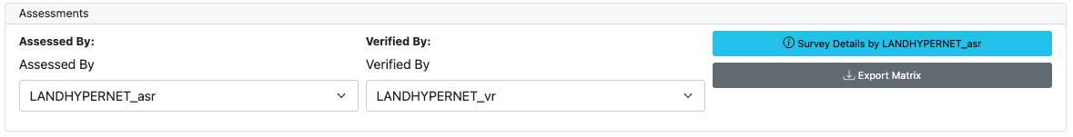
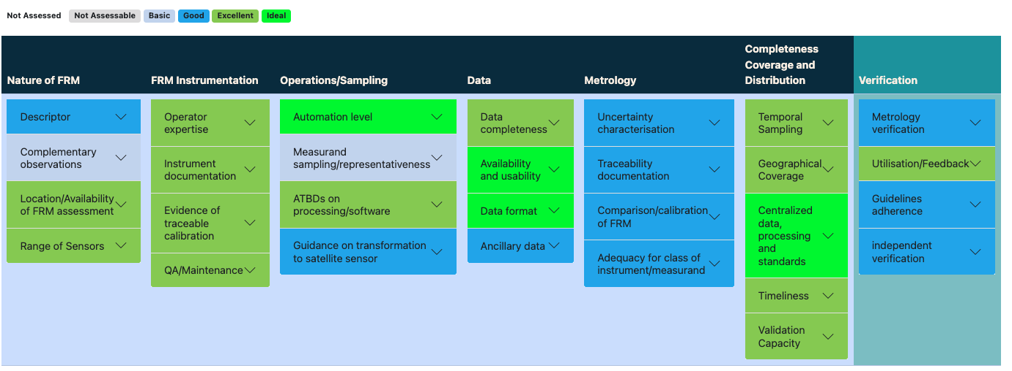
LANDHYPERNET
LANHYPERNET_Report
CEOS-FRM Overall Classification | Class C

Slide 12
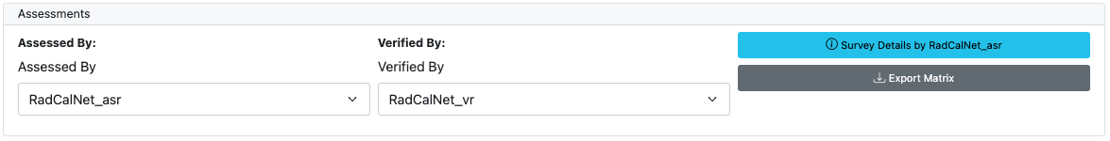
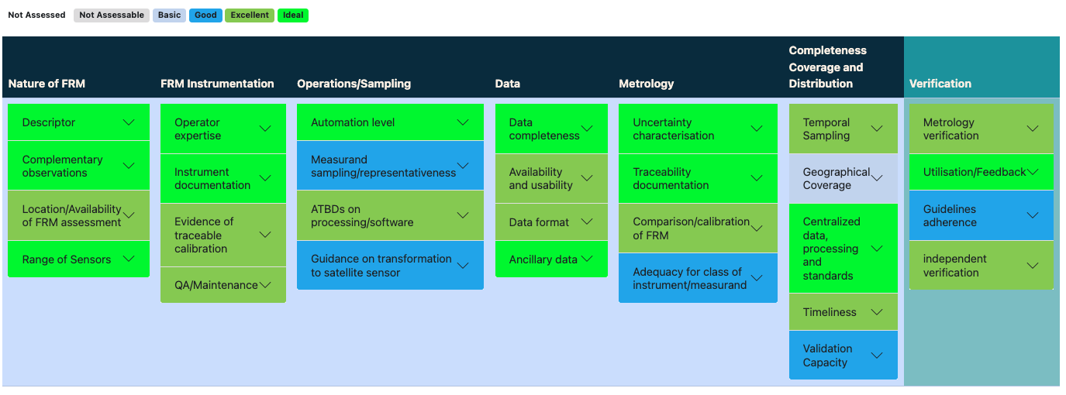
RADCalNet
RADCalNet_Report
CEOS-FRM Overall Classification | Class C

Slide 13

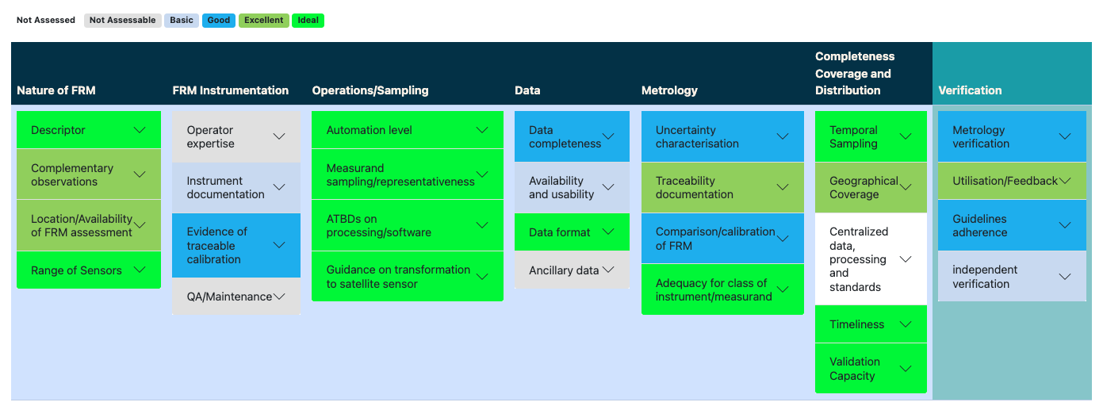
FRM4SM
FRM4SM_Report
CEOS-FRM Overall Classification

Slide 14
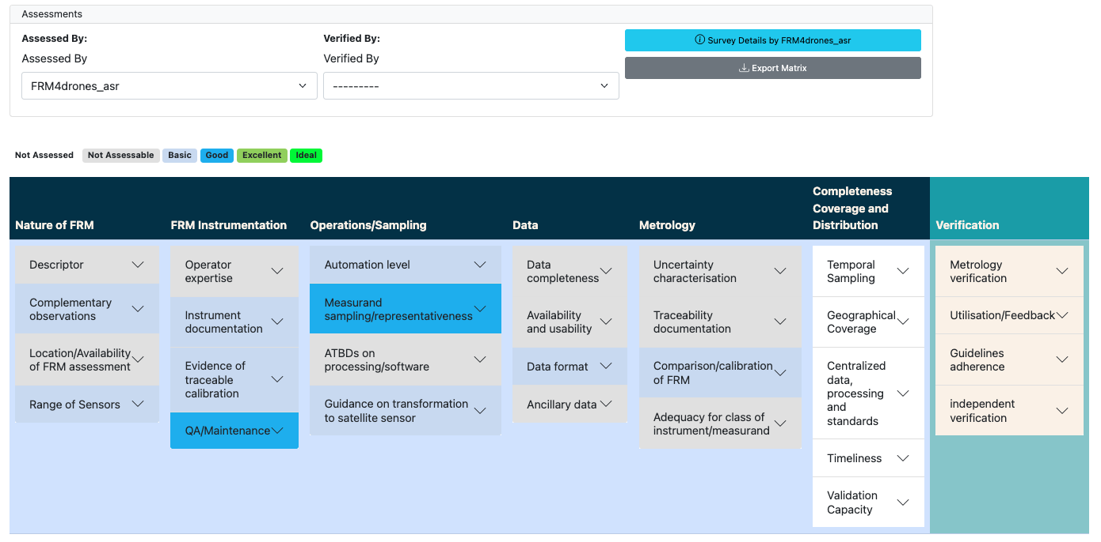
FRM4drones

Slide 15
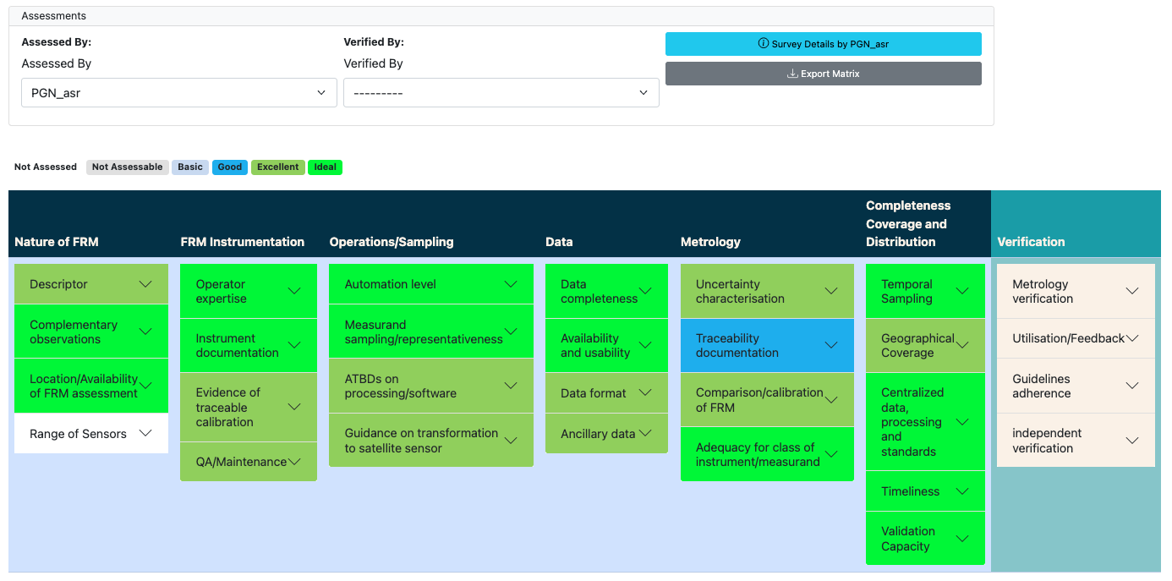
PGN

Slide 16
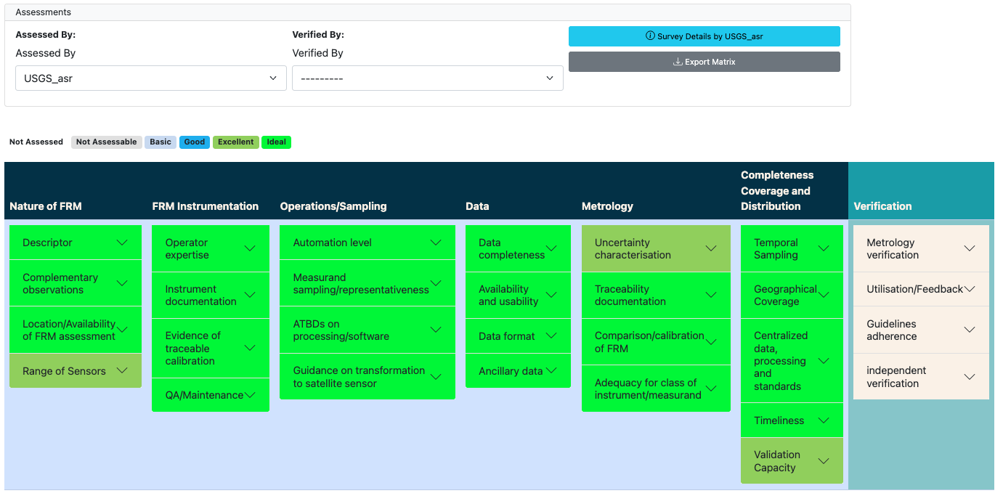
USGS

Slide 17
Way Forward
Exercise still in progress
Interesting case from USGS (use of satellite sensor as FRM) – to be discussed (“FRMsat”, use and update of the current guideline)
Possible improvement in the MMT tool:
Better visualization of the matrix contents (Export Matrix -> xml only)
Automatize the overall classification and reporting
Other?

Slide 18
Backup slides

Slide 19


FRM Definition
Fiducial Reference Measurements (FRMs) are a suite of independent, fully characterised, and traceable (to a community agreed reference ideally SI) measurements, tailored specifically to address the calibration and validation needs of a class of satellite borne sensor and that follow the guidelines outlined by the GEO/CEOS Quality Assurance framework for Earth Observation (QA4EO).

Slide 20
FRM Principles
The mandatory defining characteristics for CEOS-FRMs are:
Traceability- FRMs should have documented evidence of their traceability to a community agreed reference, ideally tied to the International System of units, SI.
Independence from satellite under test- FRMs are independent from the satellite (under-comparison) geophysical retrieval process.
Uncertainty budget- A comprehensive uncertainty budget for all instruments used in deriving FRM of a particular measurand, including any transformation of the measurand to match that of the satellite product, is available and maintained.
Documented protocols- FRM protocols, procedures and community-wide quality management practices (measurement, processing, archive, documents, etc.) are defined, published and adhered to by FRM instrument deployments and usages.
Accessibility- FRM data, including metadata and documentation of processing, are accessible to other researchers allowing independent verification of processing systems. All data and information should be made available in a timely manner and in a form that is readily utilisable by a satellite operator.
Representativeness- FRM data allow the determination of the on-orbit uncertainty characteristics of satellite geophysical measurements via independent validation activities. It thus requires that the degree of representativeness of the FRM to that of the satellite observation and/or associated retrieval as well as the satellite vs FRM comparison process needs to be documented and the uncertainty assessed.
Adequacy of uncertainty- The uncertainty of the FRM measurements, including the comparison process, must be commensurate with the requirements of the class of satellite/instrument/measurand they are specified to support.
Utility (Return on Investment)- FRM data are designed to apply to a class of satellite missions (several). They should not be mission-specific.

