Slide 1
Landsat FRM Grading Exercise
April 2026
Garrison Gross
USGS
ggross@contractor.usgs.gov
KBR, contractor to the U.S. Geological Survey (USGS)
U.S. Geological Survey (USGS) Earth Resources Observation and Science (EROS) Center, Sioux Falls, SD 57198, USA.

Slide 2
Outline
Site and Tool Feedback
L8/L9 Constellation Exercise
Other Landsat Exercise Possibilities

Slide 3
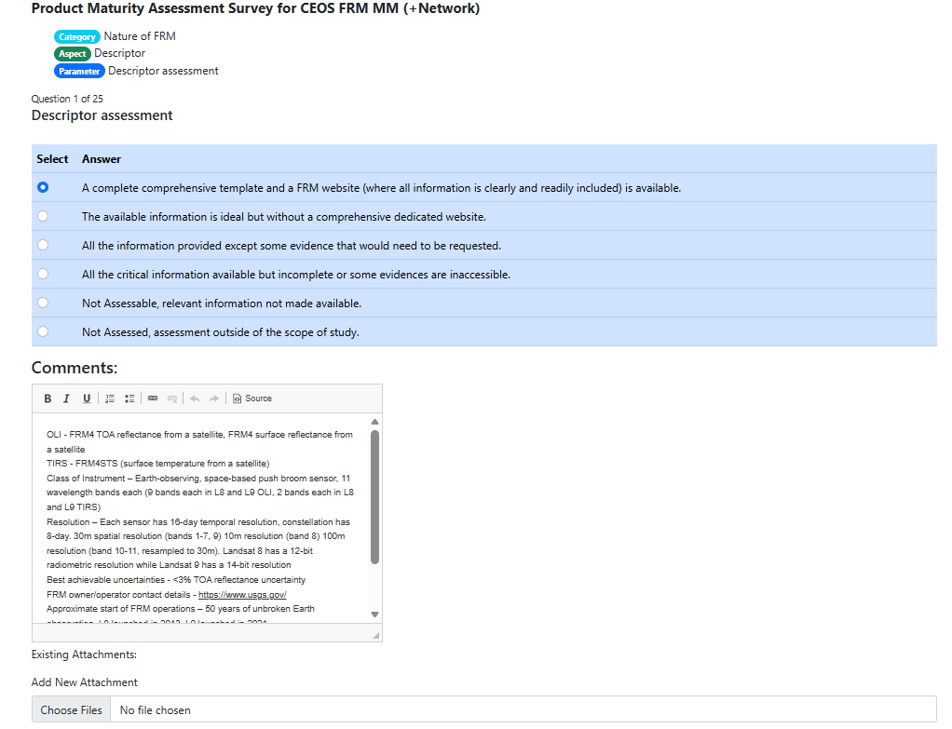
Tool Feedback - Positive
The answer select is easily readable and understandable. A reviewer or assessor could theoretically do this without necessarily reading through the assessment framework document
I like having html for the comment section, can easily copy and paste from an external source or add hyperlinks for supporting evidence

Slide 4
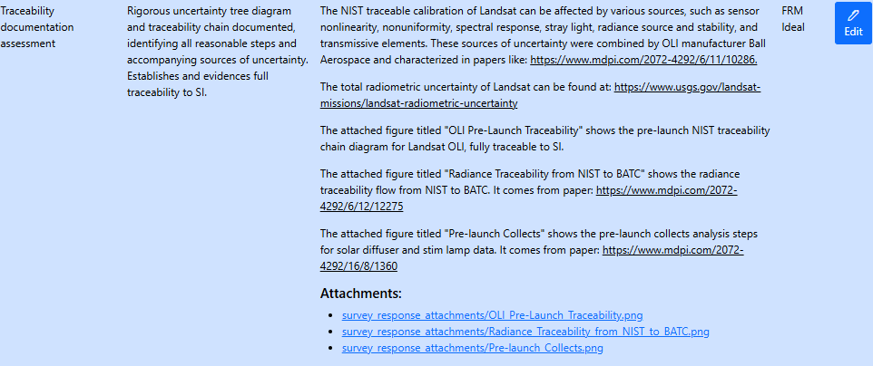
Tool Feedback - Constructive
It might be nice to see attachments from the maturity matrix page, especially if they’re traceability diagrams
I had to come back to the tool a couple times to finish. At least on first time through, it didn’t feel like there was an easy way to get to the exact cell I wanted to edit. Maybe a link or a way to edit directly from the matrix page

Slide 5
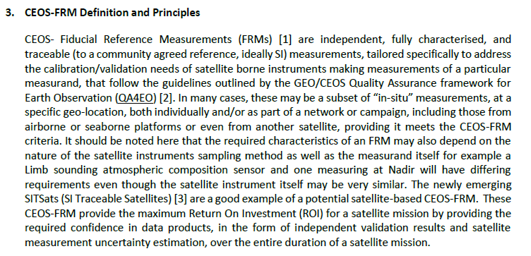
Landsat Assessment Exercise
From the FRM Assessment Framework Document:
FRMs are usually thought of as a subset of in-situ measurements for satellite cal/val (ASD), but they can also be from another satellite if the sensor meets CEOS-FRM criteria
  SI Traceable Satellites (SITSats) are a good example for these
  We believe Landsat currently displays properties of a high-level FRM platform
  Language in requirements promotes interoperability with a large number of satellites
    Main concern that reduces any of Landsat’s grades in maturity matrix

Slide 6
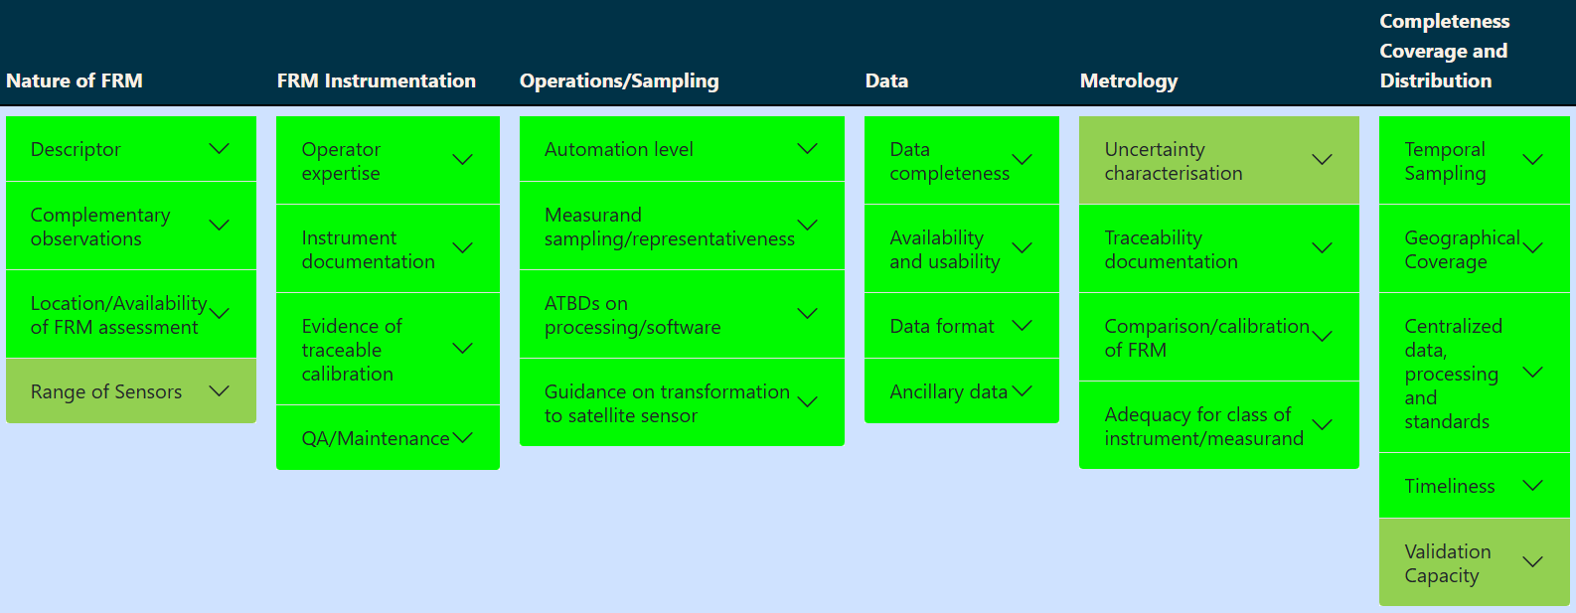
L8/L9 Constellation

Slide 7
Nature of FRM
Descriptor | OLI - FRM4 TOA reflectance from a satellite, FRM4 surface reflectance from a satellite TIRS - FRM4STS (surface temperature from a satellite) Class of Instrument – Earth-observing, space-based push broom sensor, 11 wavelength bands each (9 bands each in L8 and L9 OLI, 2 bands each in L8 and L9 TIRS) Resolution – Each sensor has 16-day temporal resolution, constellation has 8-day. 30m spatial resolution (bands 1-7, 9) 10m resolution (band 8) 100m resolution (band 10-11, resampled to 30m). Landsat 8 has a 12-bit radiometric resolution while Landsat 9 has a 14-bit resolution Best achievable uncertainties - <3% TOA reflectance uncertainty FRM owner/operator contact details - https://www.usgs.gov/ Approximate start of FRM operations – 50 years of unbroken Earth observation, L8 launched in 2013, L9 launched in 2021 L9 information - https://www.usgs.gov/landsat-missions/landsat-9 L8 information - https://www.usgs.gov/landsat-missions/landsat-8 Access to FRM Data - https://earthexplorer.usgs.gov/
Location / Availability of FRM | Landsat 8 and 9 provide year-round, global coverage where data is available for public download and free of charge
Range of Instruments | Given that Landsat 8 and 9 OLI are multispectral sensors, they may not be as universally transferable to other instruments as a hyperspectral sensor would. Instruments with similar spectral band coverage can be more easily compared with an SBAF correction, such as Sentinel and MODIS. Spectral and spatial differences will increase uncertainty
Complementary Observations | Several products are produced with the OLI and TIRS sensors on board Landsat 8 and 9, such as Level 1 TOA reflectance, Level 2 Surface Reflectance, and Surface Temperature, all of which are FRM quality

Slide 8
FRM Instrumentation
Instrument Documentation | The manual providing instrument documentation, radiometric characterization and calibration, and data usage for Landsat 8 is available here - https://www.usgs.gov/media/files/landsat-8-data-users-handbook and for Landsat 9 is available here https://www.usgs.gov/media/files/landsat-8-data-users-handbook. Documentation for all atmospheric, radiometric, and geometric processing algorithms for L8 and L9 sensors is found here - https://www.usgs.gov/media/files/landsat-8-9-calibration-validation-algorithm-description-document
Evidence of Traceable Calibration | Exhaustive documentation for each instrument and product is available and continuously updated. Both a radiance and reflectance based calibration: radiance cal tied to NIST standard of spectral irradiance and reflectance cal tied to NIST through STARR calibrated reference sensor. Both are provided to users, with each separately traceable to their standards. Landsat Quarterly Calibration and Validation Reports can be found here - https://www.usgs.gov/calval/landsat-calibration-and-validation. Uncertainty estimates for Landsat 8 can be found here - https://www.usgs.gov/landsat-missions/landsat-radiometric-uncertainty with unceratinties <3% in reflectance space and <5% in radiance space. Landsat 9 was cross-calibrated to match with Landsat 8, having uncertainties within 1% according to https://www.mdpi.com/2072-4292/15/7/1788.
Q/A Maintenance | Operation and maintenence are exhaustively documented. Landsat performance is monitored for sensor decay. Calibration parameter files (CPFs) are constantly updated to provide radiometric and geometric coefficients needed for processing Landsat iamge data. Each CPF in a specific timeframe contains calibration coefficients that have been adjusted to correct for the time-varying performance of L8 and L9. This documentation can be found here - https://www.usgs.gov/media/files/landsat-8-9-calibration-parameter-file-data-format-control-book
Operator Expertise | There is an excellent level of operator expertise as the EROS center has been in operation for over 50 years with dedicated teams for flight operations, data management, calibration/validation, science, and more

Slide 9
Operations/Sampling
Automation Level | Landsat data acquisition, calibration, processing, quality assurance, and data distribution is fully automated and centralized at the EROS data center. A large data center such as EROS may be suffer from data access outages which must be manually attended to, while the Landsat sensors may suffer from GPS faults that will require manual intervention from flight ops. Certain processes such as reprocessing after calibration and CPF calculation may also require manual intervention from the cal/val team. Even with these manual interventions, the teams make sure there is a continuous stream of high-quality data.
Measurand Sampling / Represenativeness | Landsat 8 and 9 are global, Earth-observing sensors that combined collect ~1,500 scenes everyday. The products acquired come from across the planet with a wide range of varying climates, biomes, land covers, and illumation conditions, which make equal use of the entire spectrum of bands aboard the sensor. Lunar measurements are also performed by Landsat.
ATBDs on Processing / Software | All algorithms used for Landsat 8 and 9 are described in the Landsat 8-9 Calibration and Validation (Cal/Val) Algorithm Description Document, which can be found here - https://www.usgs.gov/media/files/landsat-8-9-calibration-validation-algorithm-description-document. This document "details all atmospheric, radiometric, and geometric processing algorithms for the data processing and image assessment of the Landsat 8 (L8) and Landsat 9 (L9) sensors". These algorithms include OLI and TIRS geometric and radiometric algorithms, as well as the Land Surface Relectance Code (LaSRC) Level 2 Surface Reflectance Product algorithm.
Guidelines on Transformation to Satellite Pixel | Landsat 8 and 9 are already Earth-observing instruments that have data products with satellite pixels. These products include both Level 1 TOA reflectance and Level 2 surface reflectance, and conversion from digital numbers (DNs) to respective reflectance (or radiance) units can be found in the Landsat 8 and 9 User Handbooks. Landsat's interoperability with other satellite instruments with different-sized spatial pixels and differing spectral bands such as Sentinel and MODIS have been discussed in papers like the following - https://ntrs.nasa.gov/api/citations/20190028665/downloads/20190028665.pdf. Discussion on geometric harmonization between Landsat and Sentinel can be found here - https://www.usgs.gov/publications/co-registration-accuracy-between-landsat-8-and-sentinel-2-orthorectified-products

Slide 10
Data
Data Completeness | All Landsat data characteristics are fully documented and machine readable. They are integrated within the delivered data as a metadata file (MTL). This includes data filename, instrument ID, processing level, measured quantity name, point of contact, data access, and time stamp. Spatial and temporal resolutions are also included, while spectral resolution and uncertainty can be found here - https://landsat.usgs.gov/spectral-characteristics-viewer. Data is available through an open access portal with automated delivery capability.
Availability and Usability | Landsat Collection 2 data fully meets the FAIR principles of Findable, Accessible, Interoperable, and Reusable data and has an associated data management plan. Data is openly available for public download and is free of charge at https://earthexplorer.usgs.gov/
Data Format | Data are provided in GEOTIFF format with accompanying information, flags, and metadata. Data is a widely used and not proprietary file format. The flag and metadata provide an appropriate breadth of information and the naming conventions are standard
Ancillary Data | Comprehensive auxiliary data is fully specified per FRM observations, such as the MODIS Fused and VIIRS ozone and water vapor retrieval data inputs for the surface reflectance product, which can be downloaded from https://earthexplorer.usgs.gov/ with FPM observations. Other data inputs, such as ETOPO5 surface pressure calculation, Landsat 8-9 Ratio Map for LaSRC aerosol retrieval, and the Landsat atmospheric correction of a Lambertian surface Look Up Tables can be found at https://www.usgs.gov/landsat-missions/landsat-collection-2-atmospheric-auxiliary-data#SRNCEPNCAR. The surface temperature product has input data in the form of the GEOS models for atmospheric profile retrieval and ASTER for emissivity calculation, which can be downloaded with the FRM observations from EarthExplorer. More information on the auxiliary data can be found here: https://www.usgs.gov/media/files/landsat-atmospheric-auxiliary-data-dfcb. All inputs are fully SI traceable.

Slide 11
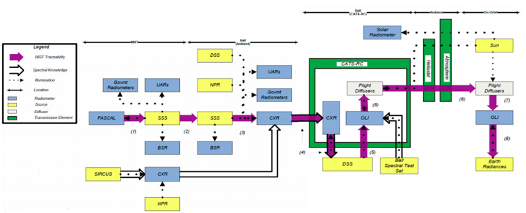
Metrology
Uncertainty Characterization | The radiometric calibration of Landsat OLI is metrologically traceable to the standards of NIST and GUM. The USGS calibration sources used for pre-launch calibration were calibrated to NIST radiance and reflectance standards, and their calibration was transferred to at least one on-board calibration device that would remain radiometrically stable through launch. Uncertainty between L8 and L9 has been characterized with distinctions made between random and systematic sources of uncertainty, however correlations between sources of uncertainty have only been briefly studied. Level 2 product and per-pixel radiometric uncertainty characterizations are being finalized. (Level 1 by itself may qualify as ideal)
Traceability Documentation
Comparison / Calibration of FRM | Landsat 8 and 9 are routinely validated with various vicarious methods, including RadCalNet sites, an FRM-like network of sites. Psuedo invariant calibration sites are also used to test stability of the sensors. The sensors are also compared to Sentinel-2 and other satellite instruments to verify consistency.
Adequacy for Intended Class of Instrument / Measurand | Landsat's uncertainty is typically smaller than that of any instrument in its class. Landsat TOA reflectance uncertaities are sufficiently in line with (and exceed) high radiometric accuracy requirements (<3% TOA reflectance)

Slide 12
Completeness, Coverage, and Distribution
Validation Capacity | Landsat 8 and 9 have a great capacity for validation of other satellites, with a radiometric uncertainty characterization of <3%. The only drawbacks for validation are strict sensor paths with a temporal resolution of 8 days, compensating for banded spectral responses between sensors, and spatial/pixel differences between sensors
Graphical Coverage | Landsat 8 and 9 provide total global coverage between 82.6 degrees north latitude and 82.6 degrees south latitude. They each have a 15 degree FOV and a 185 km swath width
Temporal Sampling | Landsat 8 and 9 individually have a temporal resolution of 16 days. As a constellation and with an offset of 8 days, the instruments together have a temporal resolution of 8 days, with some overlapping regions on the WRS-2 projection
Centralized data, processing, quality assessment and adherence to community standards | Landsat 8 and 9 data can be downloaded from Earth Explorer, processing quality is constantly reviewed and refined with quarterly CPF updates, and Landsat data deliverables follow community standards with over 200 million downloads
Timeliness | Landsat 8 Level 1 products are initially processed as Real Time products within 4-6 hours. Tier 1/Tier 2 versions of the L8 Level 1 products are made available about 10 days later, and Level 2 products are delivered within 24 hours after that. Landsat 9 Level 1 products are processed as tiered products, so those are made available with 4-6 hours of acquisition, and Level 2 products are delivered around 3 days after acquisition. Analysis Ready Data for both sensors are made available 2-3 days after their respective Level 2 products are generated. These timeframes can be found here - https://www.usgs.gov/landsat-missions/landsat-collection-2

Slide 13
Maturity Matrix Points
Ideal cells come from leveraging:
  Landsat’s prelaunch NIST traceability
  Cal/Val, Science, Flight Ops, Data Management Teams at EROS
  50 years of data and experience
Excellent cells come from the inherent nature of being an Earth-observing sensors for comparison
  Spatial, spectral, and temporal differences from other satellites will introduce uncertainty
Received feedback on our matrix
  There is probably enough evidence of excellent grades, maybe not ideal
  Add more detailed procedures for pixel transformations or other satellite comparison steps

Slide 14
Other Possible Exercise Submissions
L8/L9 Sensors Separately
  Very similar to constellation exercise, main difference is temporal resolution reduction
Landsat Earth Explorer Archive as a whole
  Over 50 years of data
  Retroactively calibrate sensors

Slide 15
Thank you!

Slide 16
Bonus Slides

Slide 17
FRM Grading L8 and L9 Separately
Grades mostly stay the same if L8 and L9 are graded independently of each other
(with different reasonings)

Slide 18
FRM Grading L8 and L9 Separately
Notes:
  One advantage of independent grading of sensors is that L8 is interoperable with L9 (and vice versa), improving its range of instruments. There are already examples of L8 being used to calibrate L9. Temporal resolution, however, decreases
  Sensor independence is a large part of the language with FRMs and assessment often uses independence as a measure of excellence. L9’s development and initial cross-calibration were dependent on L8. A note is made in L9’s assessment to justify its grade considering this

Slide 19
FRM Grading Legacy Landsat Sensors and USGS Archive
Grades largely stay the same as L8/L9 constellation, due to using the similar levels of traceability, documentation, and data distribution. There are notes on cross-cal uncertainty propagating back to L1, differences in spectral/spatial/radiometric resolution, and differences in algorithms and ADDs such as LEDAPS vs LaSRC

Slide 20
FRM Grading Legacy Landsat Sensors and USGS Archive

