Slide 1
CEOS WGCV-56 / LSI-VC-19 Joint Meeting WGCV Collaboration updates: GSICS
Mounir Lekoura (EUMETSAT)
Paolo Castracane,
Starion for ESA/ESRIN
Agenda Item W4.2
WGCV-56 / LSI-VC-19 Joint Meeting
Sioux Falls, SD, USA
20-24 April, 2026

Slide 2
ToC
GSICS Overview
GSCIS Annual meeting 2026
CEOS WGCV and GSICS cooperation
Related actions and topics for discussion

Slide 3
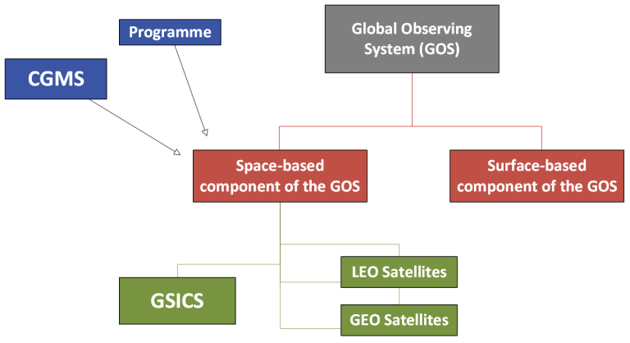
GSICS Overview
The Global Space-based Inter-Calibration System (GSICS) is an international collaborative effort initiated in 2005 by the World Meteorological Organization (WMO) and the Coordination Group for Meteorological Satellites (CGMS) to 1-monitor, 2-improve and 3-harmonize the quality of observations from operational weather and environmental satellites of the WMO Integrated Global Observing System (WIGOS).
GSICS aims at ensuring consistent accuracy among space-based observations worldwide for climate monitoring, weather forecasting, and environmental applications.
This is achieved through a comprehensive calibration strategy which involves:
monitoring instrument performances
operational inter-calibration of satellite instruments
tying the measurements to absolute references and standards
recalibration of archived data
GSICS delivers calibration corrections needed for accurately integrating data from multiple observing systems into products, applications and services.
GSICS International collaborative framework

Slide 4
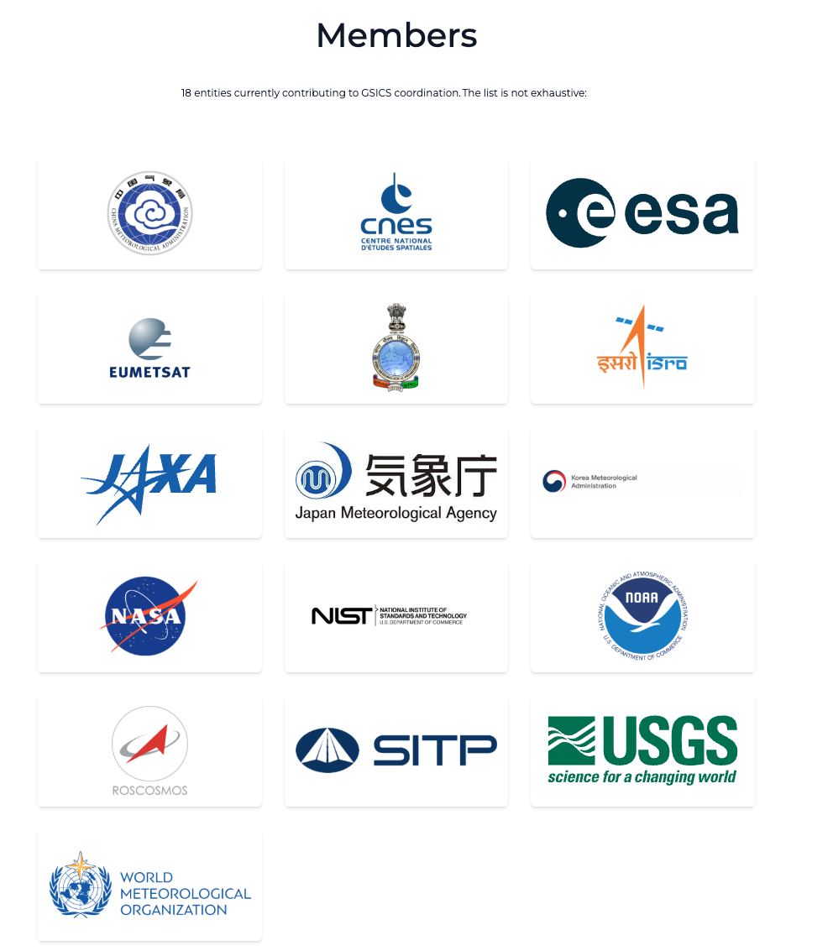
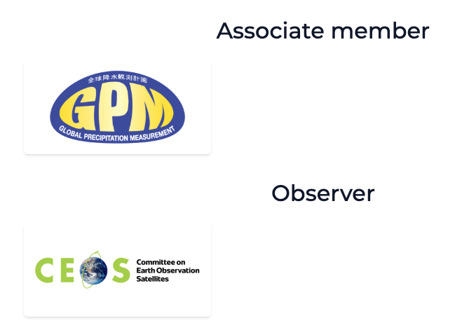
GSICS Overview
Main web resources
GSICS Developer Website
WMO GSICS
Services
GSICS Product Catalogue
GSICS Coordination Centre
Dataserver EUMETSAT
Dataserver NOAA
Dataserver CMA

Slide 5
GSICS internal structure
GSICS Exec Panel
Chair : Bojan Bojkov (EUM)
GSICS Coordination Centre
GSICS Research Working Group
Chair: Mounir Lekouara (EUM)
GSICS Data Working Group. Chair Paolo Castracane (Starion for ESA)
Space Weather Sub-Group
Chair: Tsutomu Nagatsuma (NICT)
UVN Spectrometer Sub-Group
Chair: Lawrence Flynn (NOAA)
VIS/NIR Sub-Group
Chair: David Doelling (NASA)
IR Sub-Group
Chair: Chengli Qi (CMA)
MW Sub-Group
Co-chairs: Shengli Wu(CMA)
Flavio Iturbide (NOAA)
Lunar Calibration
Sub-Group
Chair: Tom Stone (USGS)

Slide 6
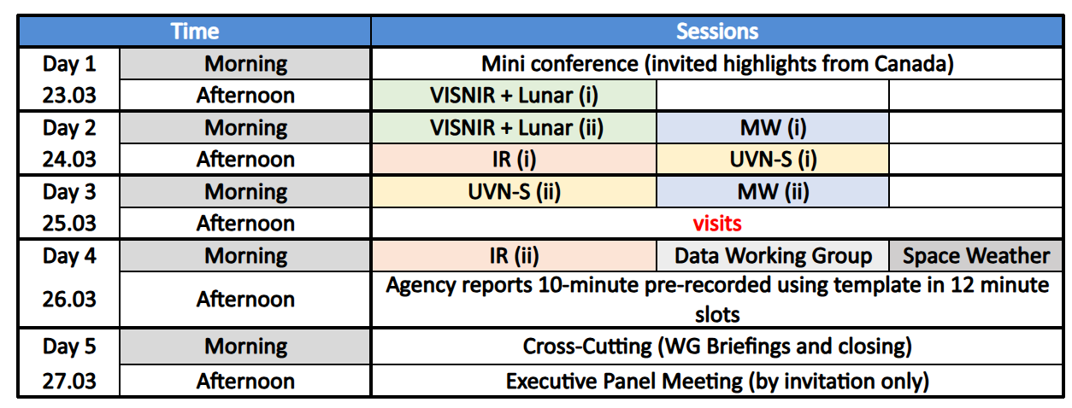
GSICS Annual meeting 2026: Agenda
GSICS Annual and Executive Panel Meeting 2026
The GSICS Annual and Executive Panel meeting was held on 23-27 March 2026 in Ottawa, Canada. The meeting was co-organised by the National Research Council Canada and EUMETSAT.

Slide 7
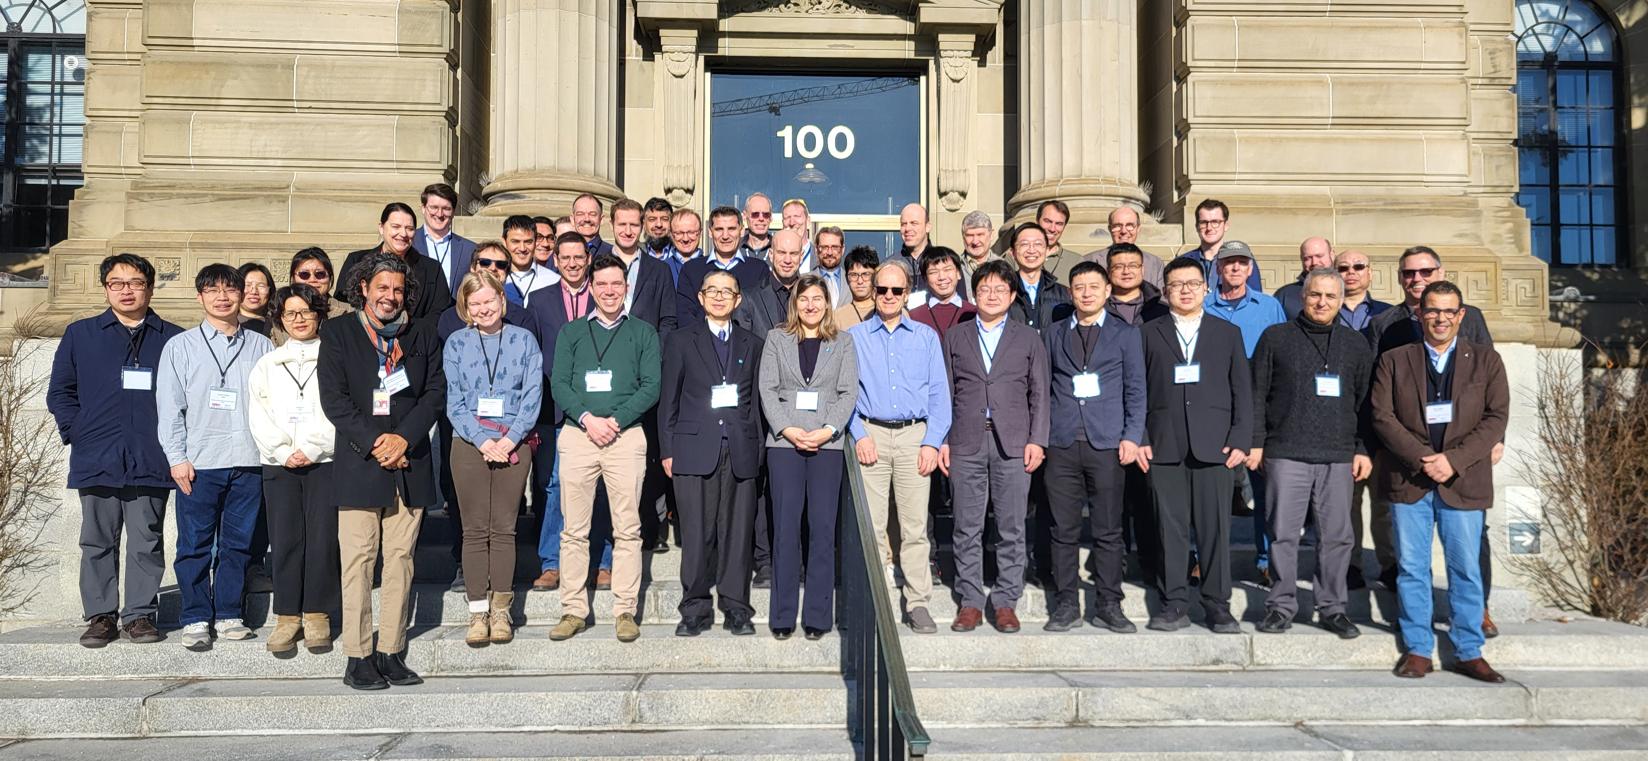

GSICS Annual meeting 2026
Group photo at National Research Council of Canada- NRC, Ottawa.
Group photo at Mer Bleue Supersite

Slide 8
GSICS Annual meeting: Main outcomes
Technical topics
The NASA SBAF tool, which serves as an input for many vicarious calibration tools (e.g. EUMETSAT MICMICS, potentially DIMITRI/VICALOPS?), is planned for decommissioning.
GSICS intends to preserve the code in an internal repository
A community-driven maintenance effort may be initiated
NOAA confirmed that the Suomi-NPP satellite will be deorbited by December 2026, with very little chance of reversal.
This has implications for Sentinel-5P processing, although a fallback solution is already in place
Several joint GSICS ATBDs are planned for VIS-NIR vicarious calibration methods:
Deep Convective Clouds (DCC) – led by NASA
Ray-matching – led by JMA
Desert calibration – led by EUMETSAT
SBAF considered to be handled as GSICS development
Eumetsat GSICS Product Sever will be decommissioned in H2 2026 - after a period of parallel operations (2 months) for all services
A new GSICS Dashboard will be made available as a centralised tool for GSICS products generated by agencies
Discussion with the sub-groups and member organisations to define the further products to be included.
All currently available GSICS webpage resources, i.e. WMO GSICS, GCC and the GSICS developer site, will be merged into a single website hosted and maintained by EUMETSAT, but under the CGSM domain. Ongoing discussion on use of collaborative environment for subgroups and use of different level of access rights.
Discussion on Terms of Reference ToR. New ToR are going to be finalised. An internal review is requested for GDWG subgroup.

Slide 9
GSICS Annual meeting: Main outcomes
High-Level topics
Several sessions addressed key calibration challenges. These included best practices and methodological advances in vicarious calibration, with in particular technical discussions on:
Spectral Band Adjustment Factors (SBAF)
Ray-matching techniques
Lunar calibration approaches and current performances (Outlook: Lunar models were discussed as a way to move beyond simple monitoring toward true absolute radiometric calibration)
Foster collaboration through joint initiatives and dedicated workshops, for example as happened in the past:
Joint CEOS-WGCV & GSICS Pre-Launch Calibration Workshop @ESTEC
The Lunar Spectral Irradiance Calibration System (LSICS) as a comparison framework across existing lunar calibration models
GSICS plans for a dashboard tool enabling comparison of normalized radiances across sensors and methods (e.g. lunar, DCC, ray-matching SNO), including reference sensor intercomparisons.
Next GSCIS Annual Meeting planned 12-16 April in Europe.

Slide 10
GSICS Lunar Calibration Progress
The lunar calibration activities are a very good example of GSICS inter-agencies collaborative development.
Improvement of lunar calibration systems was achieved ingesting improved lunar measurements (e.g. air-LUSI, SCHIAMACHY, GOME-2). Some models have reached 2-3% absolute accuracy in the VIS-NIR. The objective is to find a consensus lunar model serving as lunar calibration reference for periodic inter-comparisons.
The stability of the moon combined with accurate lunar models adjusting for the different observation geometries allow very precise trending and inter-sensor comparisons.
LSICS: a new framework for operating lunar irradiance models is being co-developed by NOAA-USGS-EUMETSAT. Many state-of-the-art models have been integrated by their agencies. Their utilization and detailed comparison are facilitated by the LSICS framework.
On-going developments on lunar radiance models, as well as IR and MW models.
The 5th CGMS GSICS / CEOS WGCV lunar calibration workshop will take place on 16-20 November 2026 in EUMETSAT.

Slide 11
Area of cooperation
The collaboration between CEOS WGCV and GSICS is ever evolving. This collaboration occurs at multiple levels: the CEOS and CGMS Working group levels and GSICS Executive Panel Level.
Several areas of work between GSICS and WGCV are being actively pursued. These include methods, protocols, and organization of joint workshops (e.g. Pre-flight Calibration and Characterization Workshop).
Outreach: CEOS Cal/Va Portal shares GSICS Newsletter (Via X @CEOS_WGCV).

Slide 12
Actions from previous WGCV
ID | Description | Due date | Reference
WGCV-54-07 Identify in-situ networks for FRM Assessment | Philippe and Nigel to initiate a discussion with WMO representatives on key in situ networks that could be brought in line with the FRM Assessment Framework / labelling. We would like to see broad utilisation of the FRM label. | WGCV-55 | CEOS WGCV 54 Actions and decision
WGCV-54-20 Demonstration of the impact of WGCV on specific applications / virtual constellations | Cody to hold a discussion on the demonstration of the impact of WGCV on specific applications / virtual constellations (CF GSICS) | WGCV-55 | CEOS WGCV 54 Actions and decision

