Slide 1
WGCV-56
Report from ESA WS on Science and Cal/Val activities at Gobabeb
Fabrizio Niro (Serco/ESA)
WGCV-56
USGS-EROS, 20-24 April 2026

Slide 2
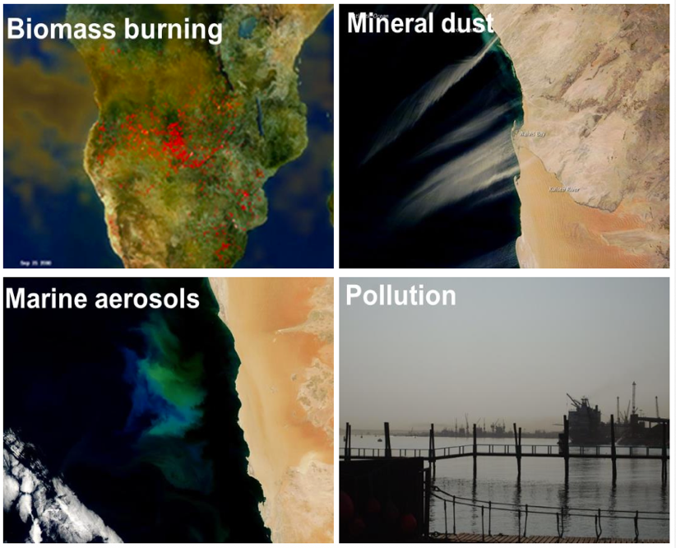
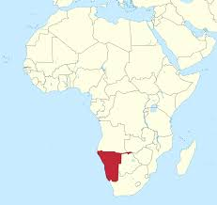
Unique natural laboratory
Aerosol properties and dynamic
  Crossroad of diverse aerosol sources: biomass burning, desert dust, sea spray, anthropogenic
Regional climate change hot-spot
  Very fragile ecosystem depending heavily on coastal fog
  Very low and highly variable rainfall
Science interest
  Aerosol-cloud-radiation interactions
  Chemistry-transport, climate models

Slide 3
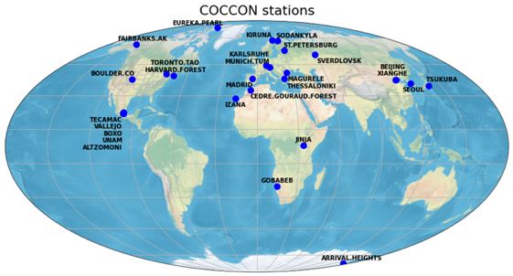
Multi-purpose cal/val site
Unique strengths and advantages
  Predominantly cloud free conditions with low atmospheric influence
  Very stable surface properties, flat terrain with little vegetation cover
  Spatially homogeneous with minimal human perturbances
  Well established site with decades of continuous observations
  Part of several cal/val networks: RadCalNet, TIRCalNet, AERONET, HYPERNETS, BSRN, GBOV, COCCON

Slide 4
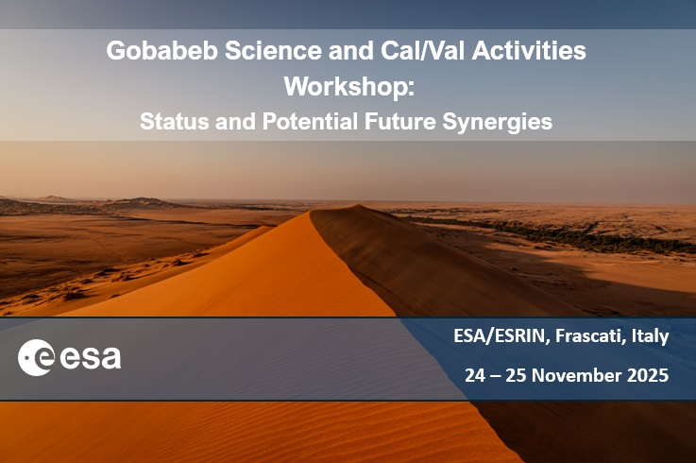
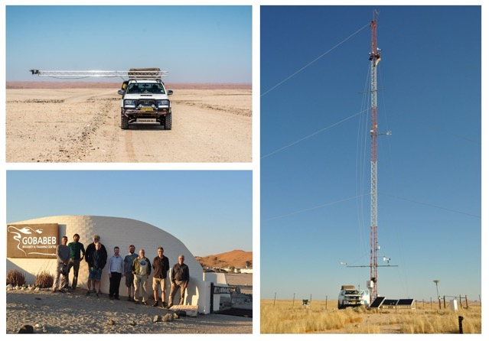
Motivations and objectives
Motivations
  Current and planned initiatives often progressed independently
  Limited synergistic exploitation of co-located measurements
Objectives
  Gather stakeholders from agencies and science community
  Identify gaps, align efforts, foster synergies,
  Promote Gobabeb as science and cal/val 'supersite'

Slide 5
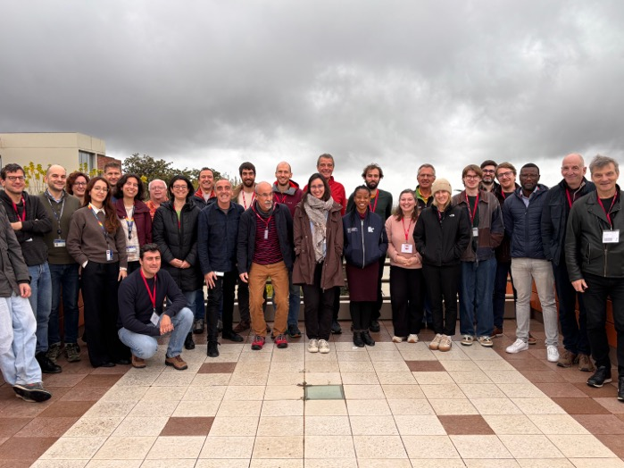
Agenda
Good attendance, participants from academia, industry, agencies
  30+ in-person, 25+on-line
Agenda included reports from:
  Agencies: ESA, CNES, DWD, South Africa SA, Namibia Space Science Council (NSSC)
  Networks: RadCalNET, HYPERNETS, TIRCalNet, BRSN, AERONET, COCCON
  Campaigns: AEROFOG, AEROCLO-sA
  Modelling: aerosol microphysics, soil BRDF, 3D RTM simulations, atmospheric chemistry and transport

Slide 6
Discussion topics
The discussion revolved around the following main topics:
  Operations and sustainability
  Observations and modeling gaps
  Synergies across science and Cal/Val activities
  Align efforts across agencies

Slide 7
Operations and sustainability
Operations
  Limited connectivity is a common issue across network operators
  Improved procedures for delivering advanced technical training to Gobabeb staff should be established
  Extending the validity period of research permits would facilitate visa applications for long-term observation activities
Sustainability
  Need to limit anthropogenic impact due to off-road driving and an increase in speculative mineral exploration
  Sustained long-term funding is paramount to maintain the infrastructure and the hosted observational programs

Slide 8
Observations and modeling gaps
Observations
  Need to deploy a Lidar system to complement surface and column-integrated aerosol with vertically-resolved observations
  Complement land with ship-borne aerosol measurements along the Namibian coastline to study aerosol transport
Modeling and characterisation
  Improve characterisation of surface anisotropy (BRDF), surface emissivity and spatial heterogeneity across different scales
  Further assess long-term temporal stability of surface properties (spectrally resolved surface reflectance and albedo)
  Multi-sensor observations of aerosol properties and vertical structure could be exploited by synergistic retrieval approaches (e.g., GRASP)

Slide 9
Synergies across activities
Conduct a comprehensive survey of sensors and measurements currently operating at Gobabeb
  This survey should include a detailed map of instrument locations and identify potential opportunities for synergistic use.
  The survey should cover routine measurements, as well as past and planned field campaigns, and be made publicly available
Establish a scientific user committee
  This committee, will ensure that scientific priority areas are addressed in a coordinated manner
  It will facilitate synergies across existing and planned science and Cal/Val activities

Slide 10
Align efforts across agencies
It is advocated to organise regular Gobabeb workshops, e.g., every 3 years, to monitor advances, share resources, and foster continued collaboration among stakeholders
Raise awareness at a strategic CEOS-WGCV level by pursuing endorsement of Gobabeb as a “supersite”
  It will secure sustained national funding for maintaining and evolving the infrastructure
  It will also facilitate addressing (with high priority) the operational issues, e.g., connectivity, research permits, …, which strongly impact operations at the site

Slide 11
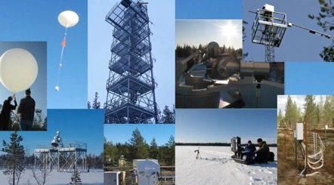
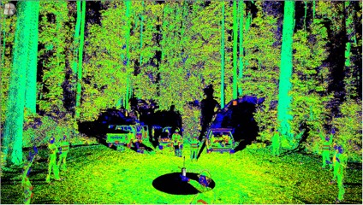
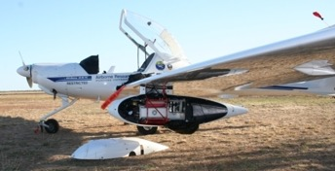
Proposed generic criteria
While domain-specific criteria should be identified for each area (land, atmosphere, water…) a common set of generic criteria could be established to apply across domains
Permanent infrastructure with sustained funding
  Support long-term operational validation of live missions
Measurements / data follow community protocols / standards
  Suitable for satellite cal/val, ideally CEOS-FRM-compliant
  Compliancy with FAIR principles
Multi-variables, multi-themes
  Cross-variables physical consistency, e.g., albedo, LAI, BA
  Validate full algorithmic chain, e.g., TOA→BOA→L2B
Very well characterized
  For land: Surface canopy structure and key variables for 3D RTM simulations
  For land: Supported by airborne / UAV acquisitions using hyperspectral / Lidar

Slide 12
Conclusion
Criteria for “supersites” will vary across domains (land, atmosphere, water), while a core set of common principles can be defined across all domains
There is growing interest within the satellite validation community in achieving formal recognition of supersites
Such endorsement is key to at national and international levels securing sustained support and funding
This, in turn, enables the long-term operation of these sites and ensures the continuous provision of high-quality reference data for the benefit of the broader Earth observation community

Slide 13
Thank You!

