Slide 1

USGS – Agency Update
Cody Anderson, USGS (WGCV Chair)
WGCV-56 / LSI-VC-19 Sioux Falls, SD, USA
20-23 April, 2026

Slide 2

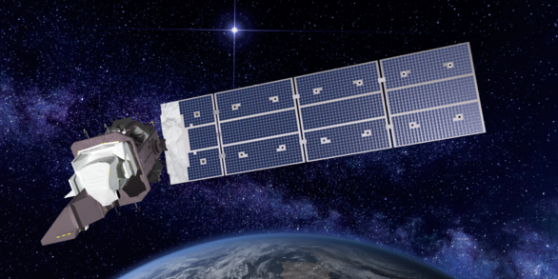
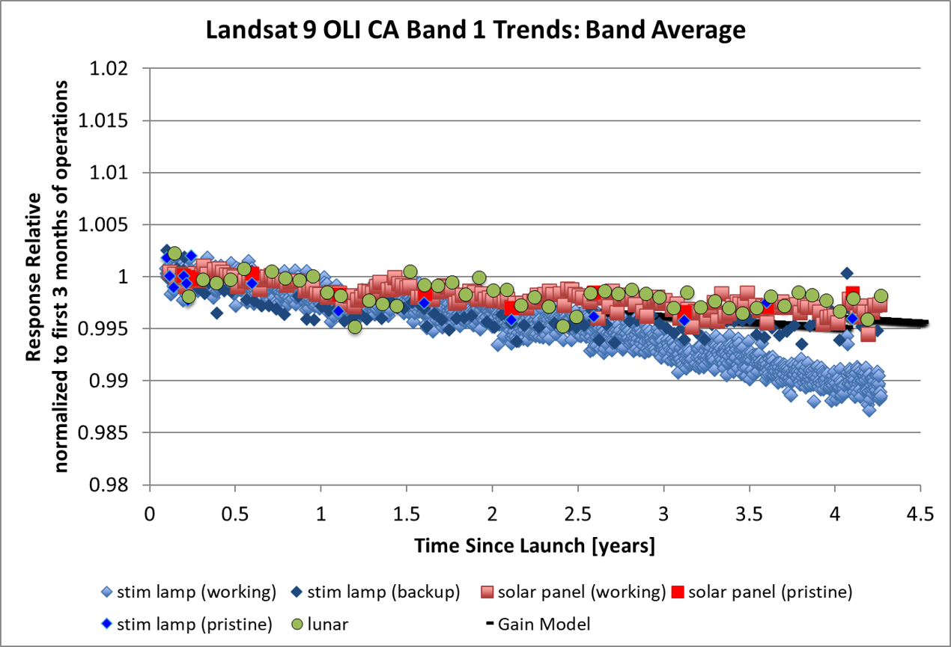
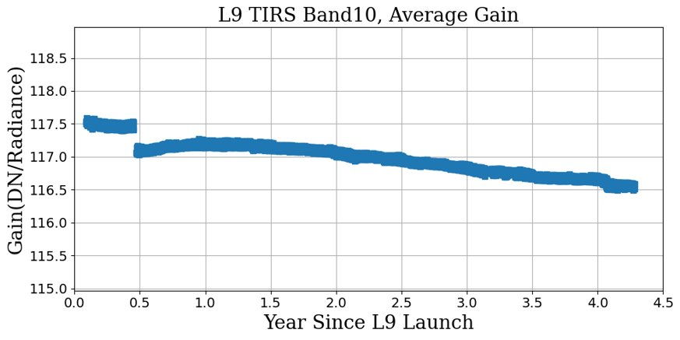

Landsat 9 - Radiometry
Landsat 9 continues to be stable and in-line with Landsat 8 for both Reflective (Left) and Thermal (Right) Bands

Slide 3
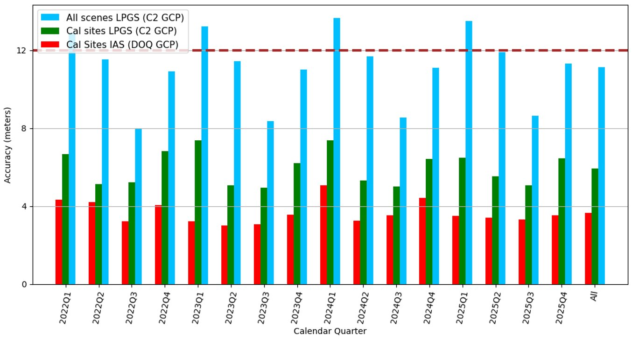
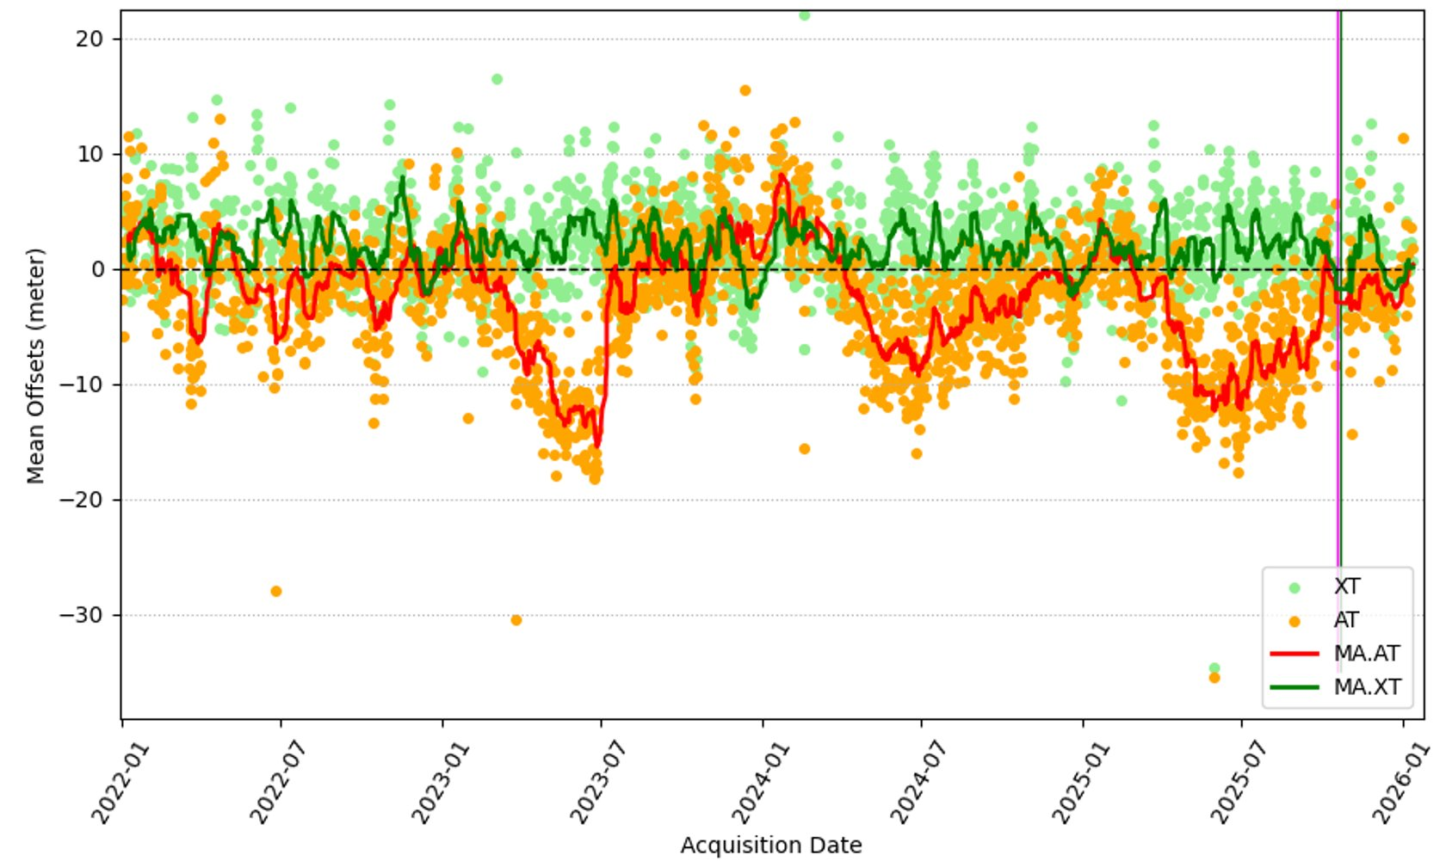
Landsat 9 - Geometry
Geodetic, sensor pointing, accuracy is around 1 pixel
Geometric, pixel, accuracy is well with a pixel (~1/10 of a pixel)
Geodetic Accuracy
Geometric Accuracy

Slide 4
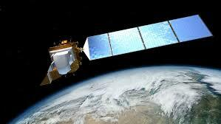

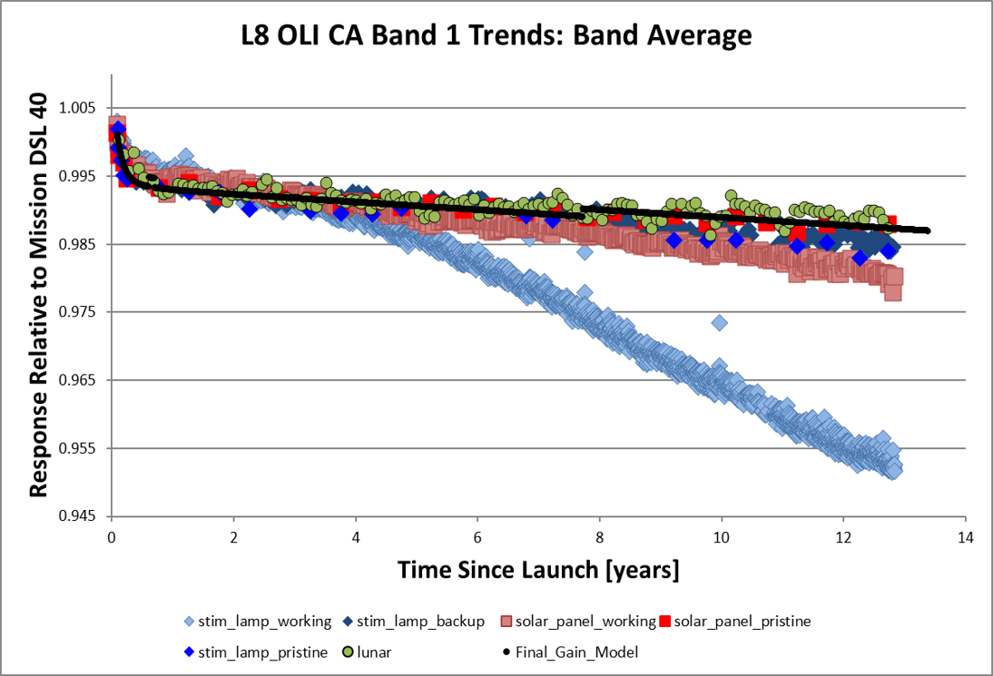
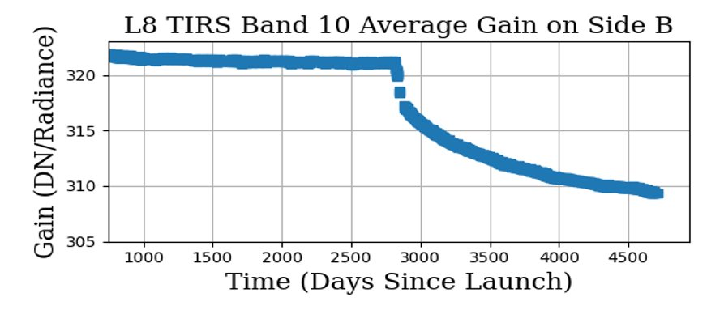
Landsat 8 - Radiometry
Degradations in Reflective band plot are due to on-board calibrator degradations
Degradations in thermal band plot are due outgassing/condensation which is accounted for with calibration

Slide 5
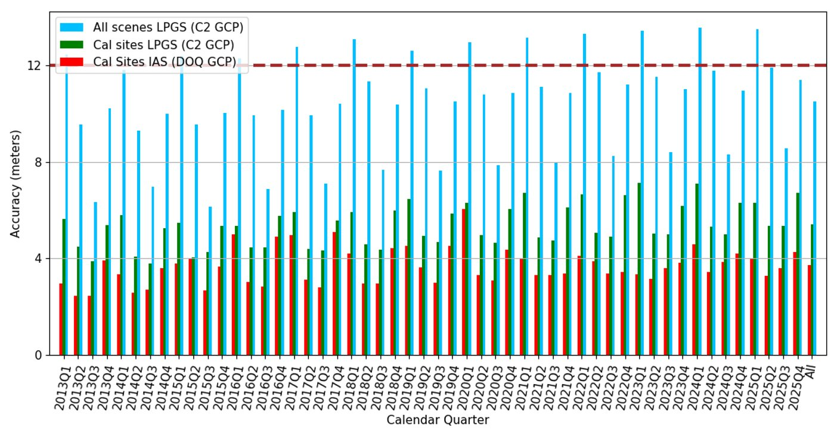
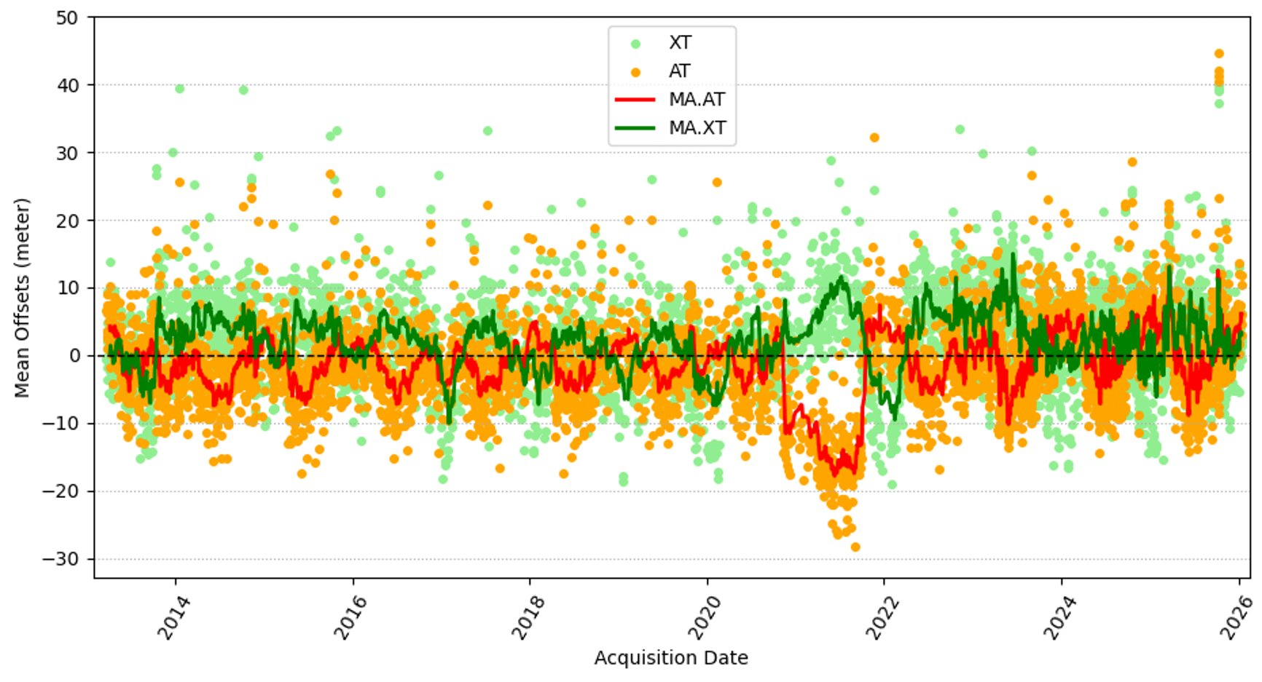
Landsat 8 - Geometry
Geodetic, sensor pointing, accuracy is around 1 pixel
Geometric, pixel, accuracy is well with a pixel (~1/10 of a pixel)
Geodetic Accuracy
Geometric Accuracy

Slide 6
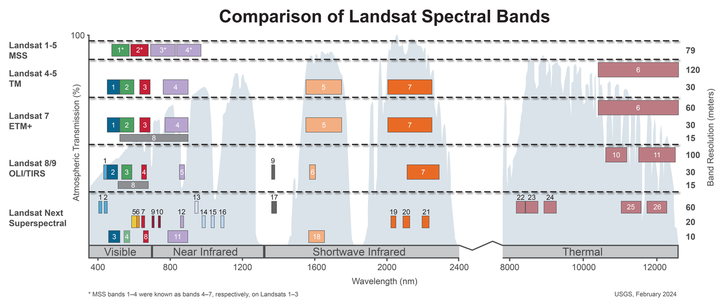
Landsat Next/10
Number of spectral bands: 26
Expected launch date: TBD

Slide 7
Landsat Collection 3
~2028
Planned improvements
Aquatic Reflectance Product
Surface Reflectance and Temperature Improvements
Per-pixel Uncertainty Reporting
Global Equal-Area Projection
Upper-Left Corner Pixel Indexing
Landsat 9 Radiometric Reference for Whole Archive
Native Resolution for Thermal Products
Geometric Improvements
10m Reference (in preparation for LNext)
Multi-Resolution Consistency
Geometric Correction Algorithm Improvements

Slide 8
EROS “Supersite”
https://www.usgs.gov/calval/eros-instrumentation
Ecosystem Phenology Web Camera Network – PHENOCAM
USDA Natural Resources Conservation Service – SCAN
NOAA Earth System Research Laboratory – SURFRAD
NOAA National Climatic Data Center – CRN
Canada Climate Reference Station Network – RCS
Advanced National Seismic System (ANSS)
Aerosol Robotic Network (AERONET)
RadCalNet – Coming Soon…

Slide 9

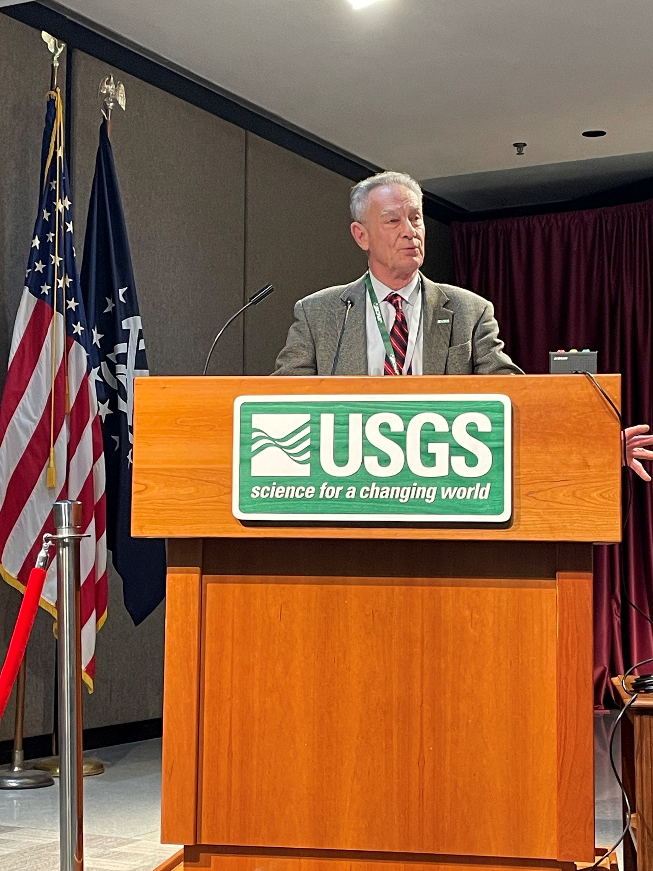
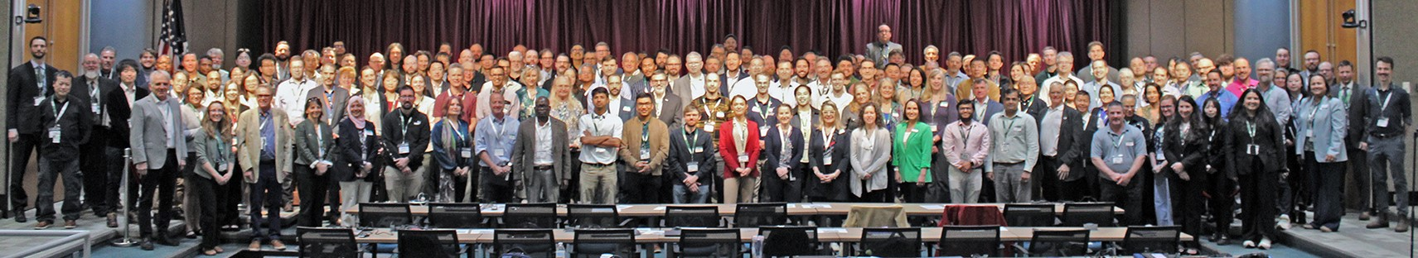
JACIE
April 13-18, 2026
https://www.usgs.gov/calval/jacie-2026-workshop
USGS Director
Ned Mamula

Slide 10
Thanks Cody Anderson, USGS – WGCV Chair chanderson@usgs.gov

