Slide 1

SI-Traceable Satellite (SITSat) Task Group
Nigel Fox, NPL/UKSA
Yolanda Shea, NASA
Agenda Item W8.1
WGCV-56,
Sioux Falls, USA
20th - 24th Apr 2026

Slide 2

Overview
Joint Task group established in 2023
ToR and membership agreed (although new members representing agencies are welcome)
Objectives also defined (initial priority Solar reflective SITSats)
Co:chairs agreed
Approx quarterly virtual meetings with aim of at least one in person per year
      - October 2024 in person/hybrid meeting aligned with CEOS WGCV plenary
      Note have increased frequency of virtual meeting to bi-monthly
      Definition of SITSat agreed – shortened version also now developed
      GSICS web pages established – Common SITSat web-site underdevelopment
        - Priority Communications and key messages
Progress not as quick as desired!

Slide 3
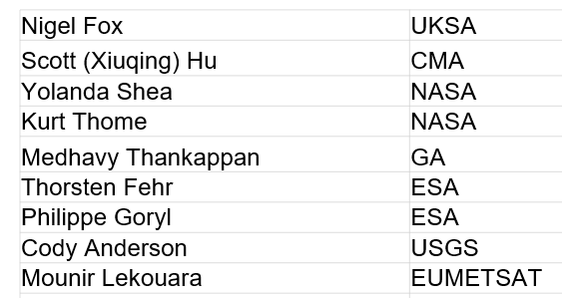
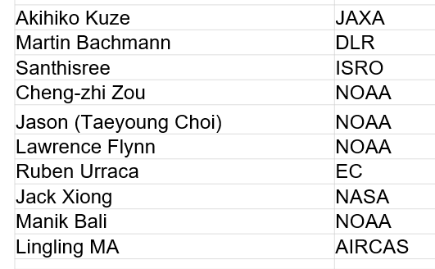
Task Group Members
Thomas August
Co:chairs: Nigel Fox UKSA, Yolanda Shea NASA

Slide 4
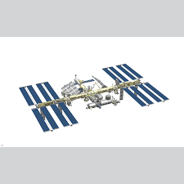
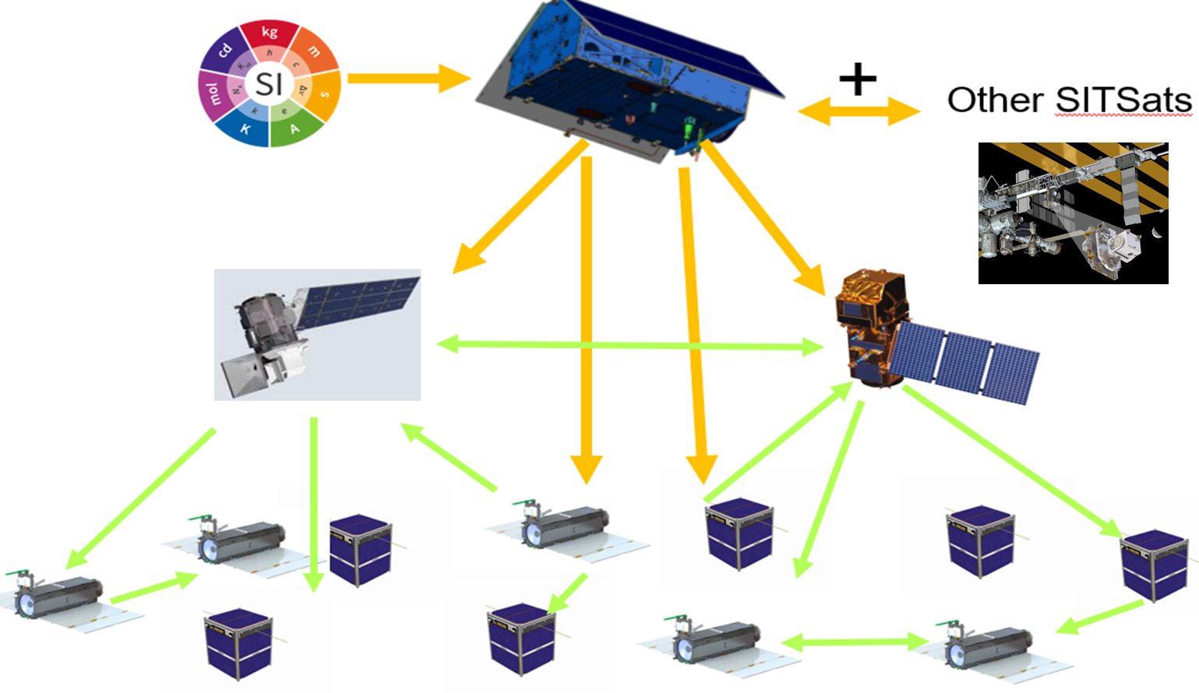
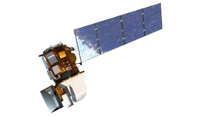
Motivation for SITSats
Desire for ‘Reference/Fiducial’ data that enable unequivocal change detection in relatively short time-scales and mitigate ‘data gaps’ (particularly for climate)
    - Robust, transparent quantified evidence of traceability to a reference (ideally SI) - ‘QA4EO’
    - Small comprehensively evaluated uncertainties
    - Allowing ‘stability’ criteria for climate to be robustly tied to invariant reference (SI)
‘System of systems’ Integrated EO data, interoperable/harmonised
knowledge of/removal of biases
- ARD
- SI-Traceability provides unambiguous trust, space agency agnostic, longevity
New space – reliance on post-launch calibration, no on-board calibration
  - Reduced cost, complementary observations (temporal/spatial coverage)
  - Level playing field, maximal utilisation of investments and assets
CEOS/GSICS initiatives to establish international references and SI-Traceability
- Coherent, comprehensive/flexible, reliable anchor to well-established methods
- Mimics calibration methodologies of all terrestrial ‘industries’
- Provides a clear label of a specific sensor property but generic to ‘application’
Space-based Intercalibration

Slide 5
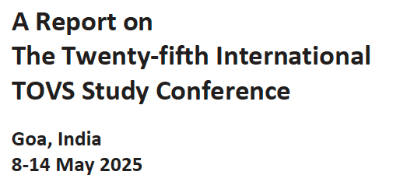
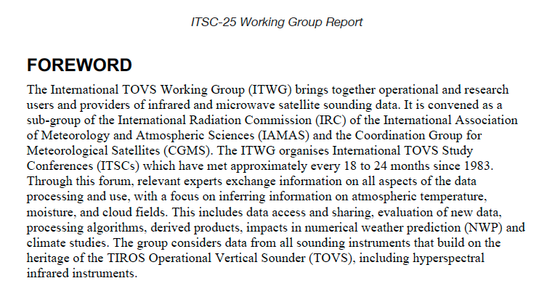
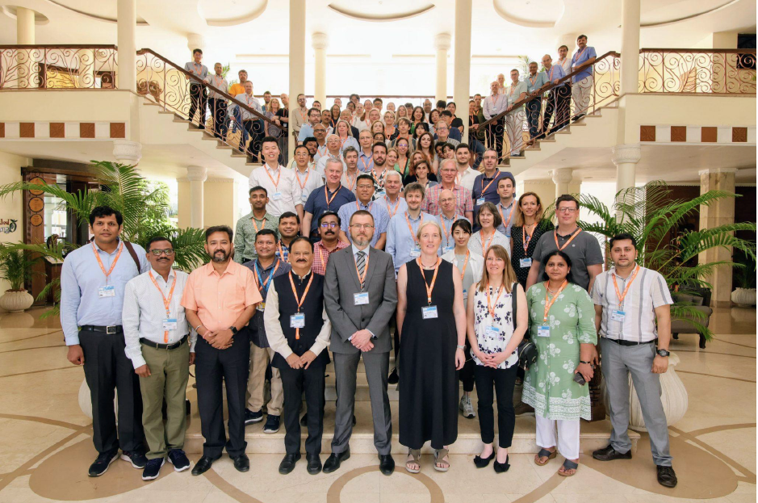
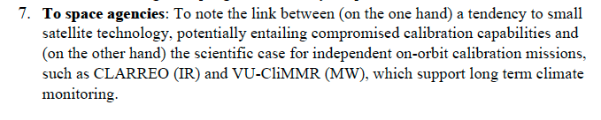
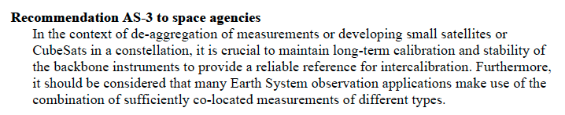
Meanwhile, around the World…
TIROS Operation Vertical Sounder (TOVS)
(Television InfRared Observation Satellite (TIROS)

Slide 6
Task Group – Objectives
Establish clear definitions of what constitutes a SITSat and minimal requirements needed to evidence this status.
Serve as a forum for agencies developing/planning SITSat missions to share experiences and knowledge.
      - Create common messaging, Communication of benefit to all stakeholders, (website)
Discuss collaboration opportunities, joint cal/val activities, campaigns, data sharing, etc.
Provide an opportunity for mission coordination, gap analyses, efficient tasking, acquisition planning, etc.
Facilitate coordination on technical topics, reporting of uncertainty and traceability information, interoperability, methods of dissemination, etc.
Aim for a systems-based approach, rather than having missions being developed and operated in isolation, along the lines of a CEOS Virtual Constellation.

Slide 7
Task Group Deliverables
Establish a clear definition of what constitutes a SITSat and minimal requirements needed to evidence this status
    - How and what to present as Uncertainty/SI-traceability evidence (standardized content and/or format)
Develop a roadmap (whitepaper) of what a SITSat enabled observing system looks like
Data sharing based on a systems approach
- Common (interoperable?) reporting/archive grid for climate? (Spectral/spatial)
- Common Grid for S2S calibration?
- Format – what info to report and how? (note volume of information when including uncertainties)
- Mirrored data stores/access?
- Minimal set of common ‘targets’ (comparison/gap filling etc)
Communications strategy for awareness raising / key messages / utility for observing system / integrated multi-SITSat observing system
Visibility of new class of sensors and their benefits to senior executives in agencies

Slide 8
Communications:
CEOS Cal/Val portal SITSat group page
Potential Content
  Define SITSats and why they are important for global climate observing system
    How to evidence it is a SITSat – Traceability & Uncertainty
    How they can transfer calibrations – Link to full cal val architecture – expected performance improvement - utilize COVE tool (orbit propagator) to illustrate Cal opportunities
    What they don’t do i.e. cannot correct without assumptions of sensor under test
  Purpose of the SITSat group
  SITSat group members & how to contact the group
  Overview of SITSats in development/planned & expected operational timeframes
  Future: Past and upcoming group activities (meetings, etc)
  Future: Relevant Documentation (To be created by this group)
General
  Key simple common messages for end of a talk or opportune meeting
  Poster for common useage

Slide 9
Outline of Website
Page: Landing Page
  SITSat Description (brief summary)
  Mission of Task Team
  Terms of Reference
  Membership (CEOS WGCV & GSICS collab)
  Leadership & Contact
  Related Links
    GSICS, GSICS Wiki
    SITSats Operational & in Development
    CEOS, WGCV
Sub-Page: What is a SITSat (sub-page)
  More detailed definition
  Underpinning challenge (& how SITSats support it)
    Within this include how instruments currently calibration and differences for SITSats
  SI-Traceability & what is enables
  What they do (and don’t do)
  Information to be provided & method

Slide 10
Outline of Website
Sub-Page: SITSat Expected Impact
  Success Story (Solar Irradiance and downstream impact)
  Other potential benefits (applications supported)
    Climate sensitivity, cloud properties trends, etc)
Sub-Page: Vision
  Observation system with SITSats as the backbone
  SITSats under development (repeat) with some summary
  Timeline (preferred)
Sub-Page: Case studies
e.g. Aerosols, albedo, PMx, Veg Ind, OC
Sub- page (per SITSat under development)
Sub-page (how data products will be communicated

Slide 11



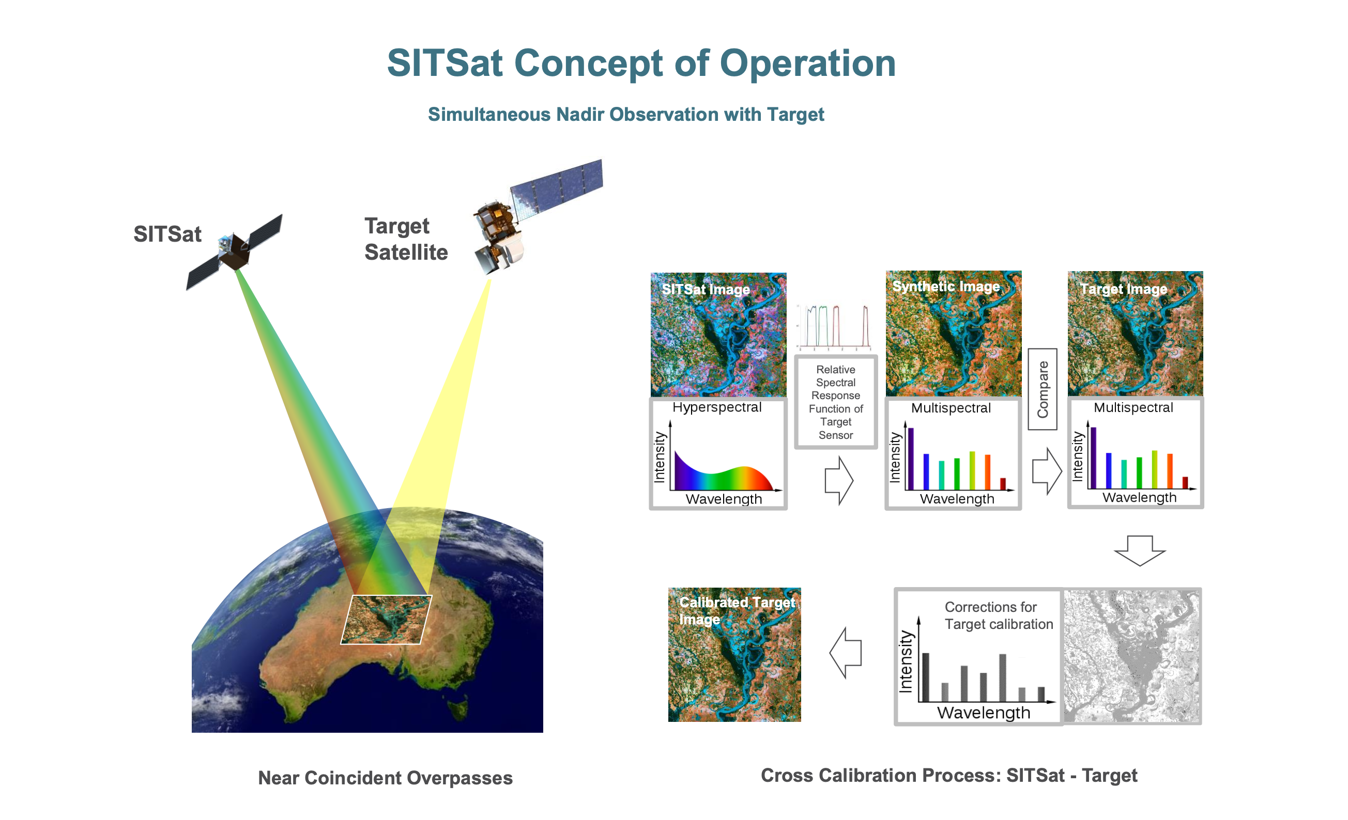
SITSat: SI-traceable Satellites
Joint CEOS-WGCV and WMO-GSICS
initiative
Home | What is a SITSat | Expected Impact | Vision | Contacts
Background
With the emergence of a number of SI-Traceable Satellite missions (SITSats) the CEOS WGCV has considered the need for a group to coordinate on issues of common interest and to foster mutual benefits. SITSats have great potential to increase the accuracy of climate and other Earth observation records and can also serve as high quality references for both CEOS Agency missions and the commercial sector. The WGCV has proposed the establishment of a joint Task Team with the Global Space-based Intercalibration System (GSICS) which will include representatives from agencies operating, developing and utilising these missions, and others as interested, as a means to promote dialogue and coordination.

Slide 12
Name!
Reasons to consider changing the name:
SI-traceability may not be sufficient to distinguish the reference sensors we're describing,
Evidenced by questions folks have gotten about why "x" sensor wouldn't be considered a SITSat
Opportunity to devise a name (acronym or otherwise) that may better invoke the qualities of these reference sensors
Reasons to keep SITSat
There is also already fairly widespread recognition of the term and its meaning
Literature (peer-reviewed and presentations) already contains several references to term SITSat
It is easy to convey a collection/class of satellite sensors, rather than just one mission.
Its short and easy to pronounce (from discussion forum)

Slide 13
Inputs/options
SITSat – SI-Traceable Satellite (Status –Quo)
  (on-line comments (three! Favour keeping the status quo)
  Variation- SITSAT - SI Traceable Satellite Advisory Team
VERITAS - "Verifiable Reference for International Traceable Accuracy Standards.“
Clearview – not an acronym just a concept indicating quality
Aletheia/Alethes – Greek goddess of Truth
Or ??
Comment: Name should relate to the concept of a ‘class’ of sensors which are clearly
distinguishable from other classes of sensor and should not be technology
domain limited. Need to clearly define this distinction and make it transparent.
Name is for a ‘class’ of sensor so does not need to be an acronym but should readily useable as
the name of such a grouping of sensors able to serve as ‘references’ i.e. of undisputable trust and with an
inherent measurement uncertainty significantly below others and close to the best achievable.

Slide 14
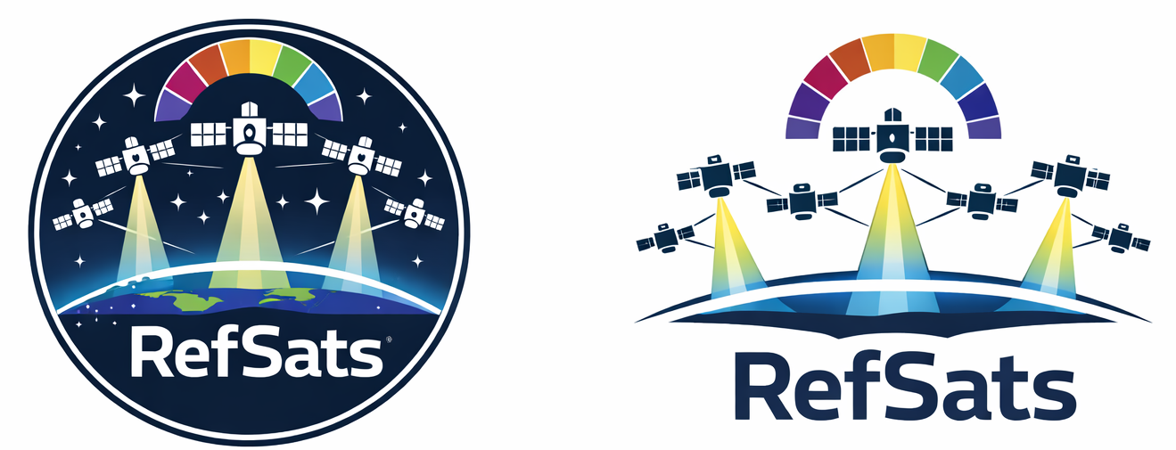
Considered RefSat
Enables pluralisation to ensure the sensor class distinction can be made.
The underpinning criteria to define the sensor class shouldn’t change, but just the name.
Keen to keep ‘SI’ somewhere, in the logo or one-liner definition.
Paolo created a chain in the logo to visualise a link to traceability.
  Discussed the chain may convey the satellite seeming to be “trapped”
Thomas generated logo ideas for RefSat.

Slide 15
Feedback on RefSat from WGCV Members
The reference satellite term is widely used
  Land imaging missions such as Landsat and Sentinel 2 as references for commercial satellites
  GSICS uses the term in a definition for their in-orbit calibration system.
Our repurposing RefSat/reference satellite would refer to the high accuracy sensors (i.e. SITSat), but it may dilute the intent/messaging because of how it’s used elsewhere

Slide 16
A New Suggestion: FRMsat
FRMsat – Fiducial Reference Measurement Satellite
Opportunity to also define Fiducial Reference Measurement for audiences
FRM a good generic definition works for what we are striving to achieve
  Currently mainly refers to ground-based cal/val measurements because it has been challenging to justify previous/current satellite missions as FRM.
FRMs are required to have an uncertainty commensurate with the stated application
  In our case the application is to provide a satellite-based reference that is of climate quality.
Link to existing FRM definition as this is already achieved together with a compliance assessment framework enabling CEOS endorsement
From the CEOS-FRM Assessment Framework guidelines
  “The newly emerging SITSats (SI Traceable Satellites) [3] are a good example of a potential satellite-based CEOS-FRM of class A quality for climate applications.”

Slide 17

Request approval to rename to FRMsat

Slide 18
What is a FRMsat ?: Full definition
A FRMsat is a satellite-based sensor which can provide and verifiably evidence, in a fully open and transparent manner, all significant contributions to the uncertainty of its measurements, metrologically traceable to the international system of units, SI, at the location and time from where they are made. In addition, this uncertainty must be at a level that is considered by the community to be of ‘Fiducial reference’ quality, i.e., that for a defined spectral domain/application it can be considered ‘state-of-the-art’ and able to unequivocally serve as a reference for similar measurements from other sensors. The uncertainty of a FRMsat should be expected to reach or at least approach that required for key climate science objectives such as those identified in the “SI-Traceable Space-based Climate Observing System: a CEOS and GCICS Workshop” ( https://doi.org/10.47120/npl.9319 ). When used as a reference a FRMsat would be expected to have a measurement uncertainty of <0.5 compared to that of its non-FRMsat peers and be of CEOS-FRM Class A quality.
Note:
1/ If used as a reference, the method used to compare with other sensors and its associated uncertainty to SI, should also be fully documented and evidenced.
2/ The nominal threshold uncertainty to be considered a FRMsat for a particular type of measurement/application may increase or reduce over time commensurate with scientific consensus, currently this requires 2-10x improvement over current sensors. Although desirable in the long-term, it is not essential to have a FRMsat for all applications and sensor domains and thus the assignment of the classification to a sensor should only be made when the maturity and technology of a particular domain justifies it. However, other satellites may still be able to justify delivery of FRM quality observations.
3/ A FRMsat peer group would constitute ALL sensors making similar measurements (e.g., spatial and spectral range)

Slide 19
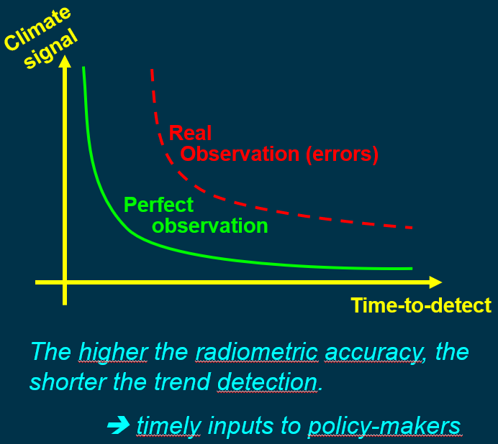
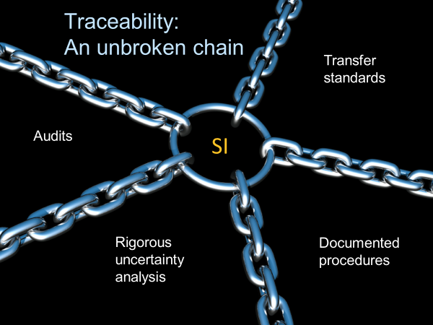
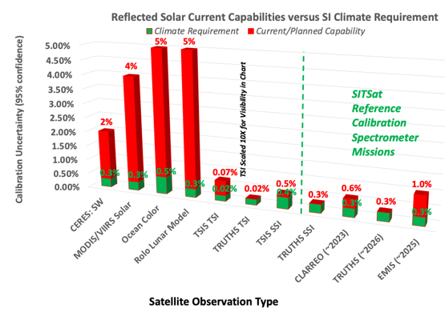
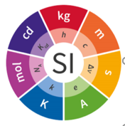
What is a FRMsat?: simple definition
A FRMsat is a space-based instrument making measurements of the Earth that can transparently evidence their metrological traceability to the international system of units (SI) with an uncertainty commensurate with the most demanding needs of climate https://doi.org/10.47120/npl.9319 and be classified as a class A CEOS-FRM
When used as a ‘reference to calibrate other satellites its uncertainty should be at least half that of the satellite instrument under test and similar instruments.

Slide 20
2026 Goals
Website
Communications Strategy
  Decide on name (use SITSat or switch?)
  Refining Content for presentations/agency and org leadership (30 second and 2 min elevator overview)
  Create a baseline public website (summer)
First Objective within ToR: “Establish clear definitions of what constitutes a FRMsat and minimal requirements needed to evidence this status.”

