Slide 1
CEOS WGCV-56 / LSI-VC-19 Joint Meeting CEOS Cal/Val Portal
Paolo Castracane
Starion for ESA/ESRIN
Agenda Item 8.3
WGCV-56 / LSI-VC-19 Joint Meeting
Sioux Falls, SD, USA
20-24 April, 2026

Slide 2
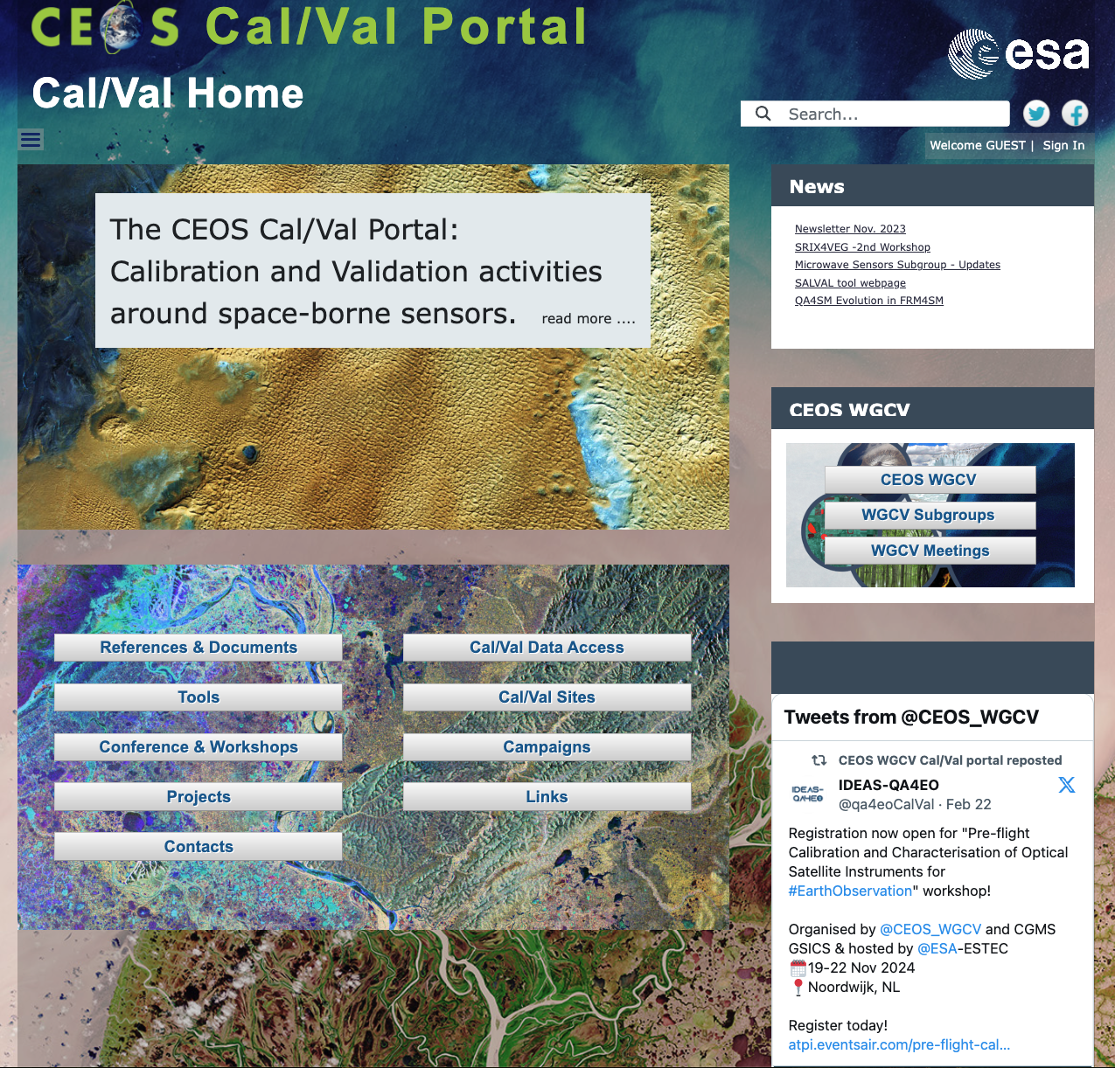
Table of Contents
CEOS Cal/Val Portal Overview
ACTIONs from WGCV-55
Content Updates
Outreach
Conclusion
https://calvalportal.ceos.org

Slide 3
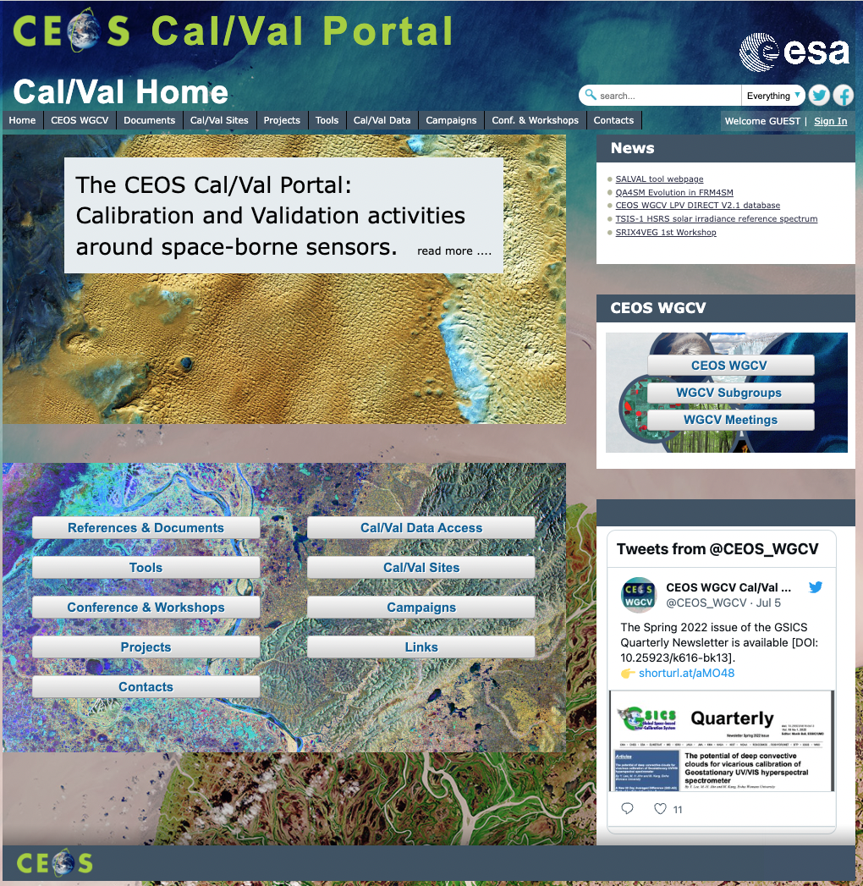
CEOS Cal/Val Portal Overview
The CEOS CalVal portal (https://calvalportal.ceos.org/) serves as the main forum for exchange and information sharing for the CEOS Working Group on Calibration and Validation.
it provides access to agreed good practices and Cal/Val protocols to the wider Earth Observation community within CEOS and beyond.
It connects users to reference data and networks and provides reliable, up-to-date and user-friendly information useful for Cal/Val tasks, facilitating data interoperability and performance assessment through an operational CEOS coordinated and internationally harmonised Cal/Val infrastructure consistent with QA4EO principles.

Slide 4
Overview - numbers
https://calvalportal.ceos.org
Some numbers: 18th April 2026:
Users
1441 Registered Users
163 CEOS WGCV SAR Subgroup and 3 super-users
71 MTF Members
25 GCPs Members
23 SITSat Members
12 Cal/Val Doc Repository (rights for editing)
24 Terms and Definitions (rights for editing)
- System availability
BC uses Nagios (http://www.nagios.org/) for monitoring the IT services.
The availability of the Cal/Val Portal is close to 100%.
https://calvalportal.ceos.org

Slide 5
ACTIONS
ID | Description | Due Date | status
WGCV-55-01 | WGCV Subgroup chairs to communicate subgroup activities to Paolo to be shared on the Cal/Val Portal at https://calvalportal.ceos.org/wgcv. | WGCV-56 | Lasting action
WGCV-55-02 | Paolo Castracane to work with Nigel Fox to establish on the Cal/Val Portal an IVOS database on radiometric calibration capabilities. | Q4 2025 | Open
WGCV-55-09 | Medhavy and Paolo to communicate with Bruce and Stephane that WGCV Membership should be notified when new SARCalNet site submissions are ready for approval. A step in the review and approval process for SARCalNet sites should include that WGCV membership is notified. | Q3 2025 | close
WGCV-55-12 | Pre-flight Calibration Workshop team (Nigel, Albrecht, Philippe, Paolo) to develop a good practice guidance document to summarise the workshop’s outcomes and recommendations. | Q1 2026 | In progress

Slide 6
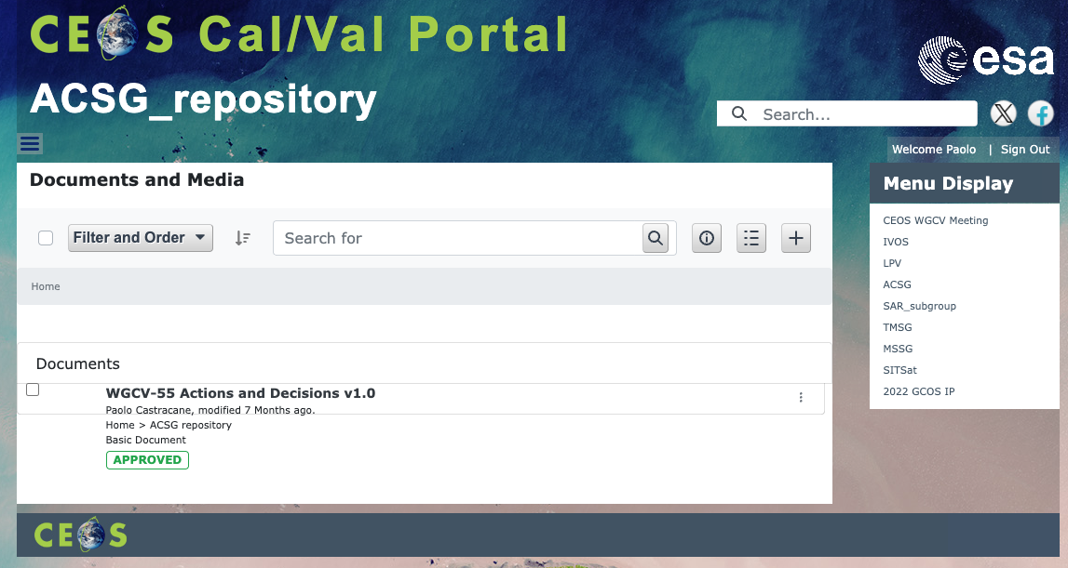

ACSG subgroup webpage
Structure for ACSG subgroup webpage
Current pages:
Entry-page -> https://calvalportal.ceos.org/acsg1
Page1 -> https://calvalportal.ceos.org/acsg_page1
Page2 ->https://calvalportal.ceos.org/acsg_page2
Repository -> https://calvalportal.ceos.org/acsg_repository
Chair has now “ACSG_superuser” role, allowing to edit content (of the ACSG pages) and add documents and materials to the ACSG repository.

Slide 7
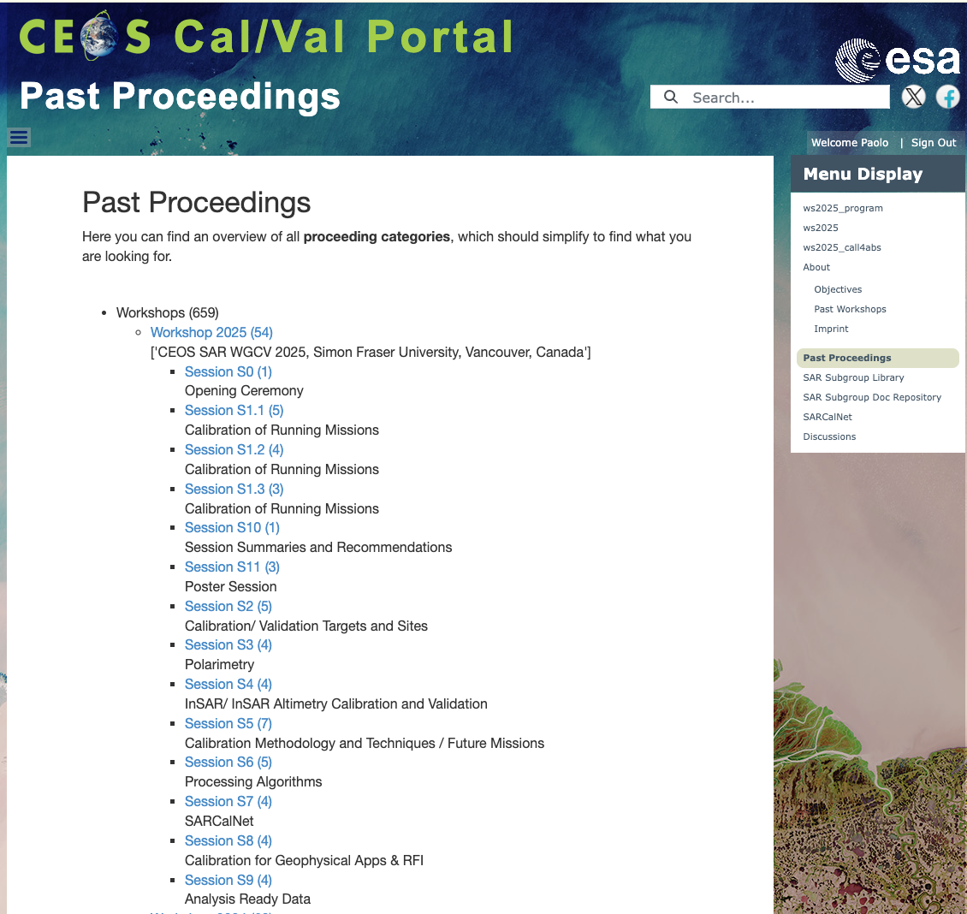

SAR Subgroup webpage
The CEOS Cal/Val portal hosts:
Announcement
Program
Presentations ( available on Past Proceeding page)
For SAR Cal/Val Workshop 2025 in Vancouver Canada, 27-30 Octovber 2025.
Action on SAR Group Registration – Form to aoutomatize the registration and mailing list maintenance
(in progress)

Slide 8
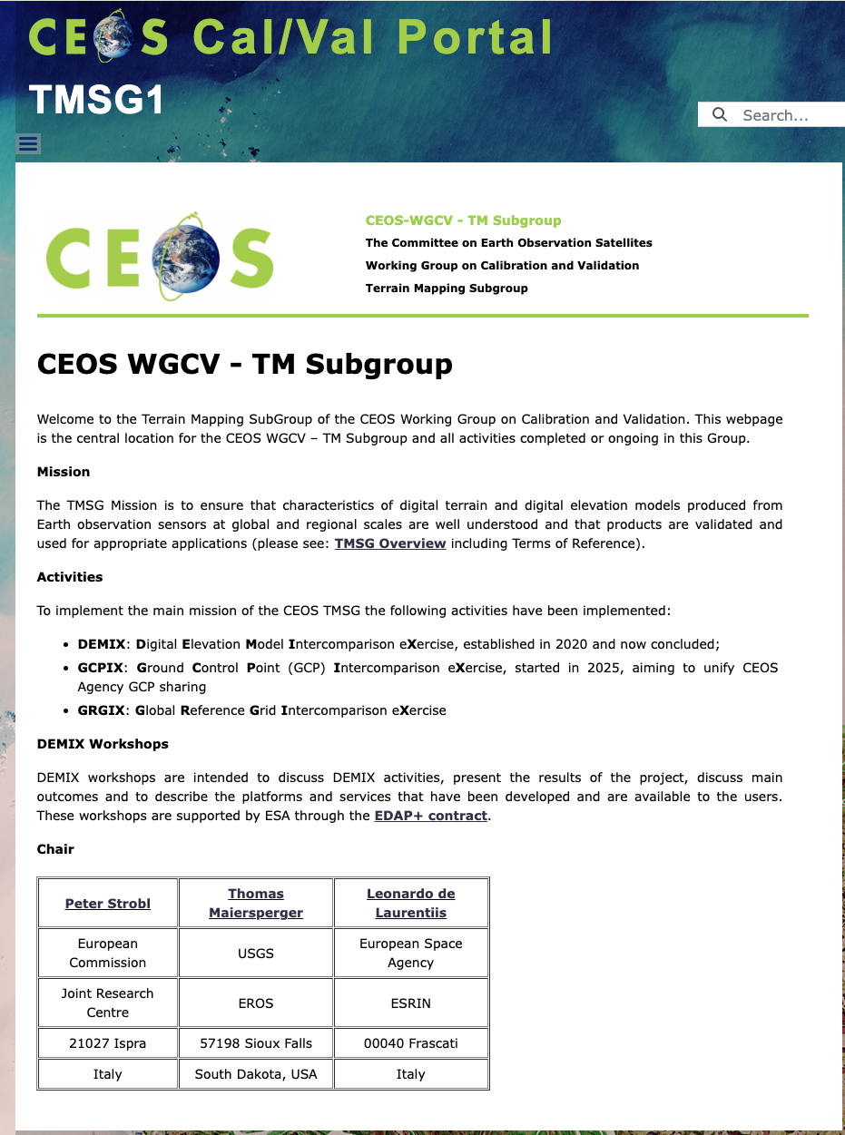
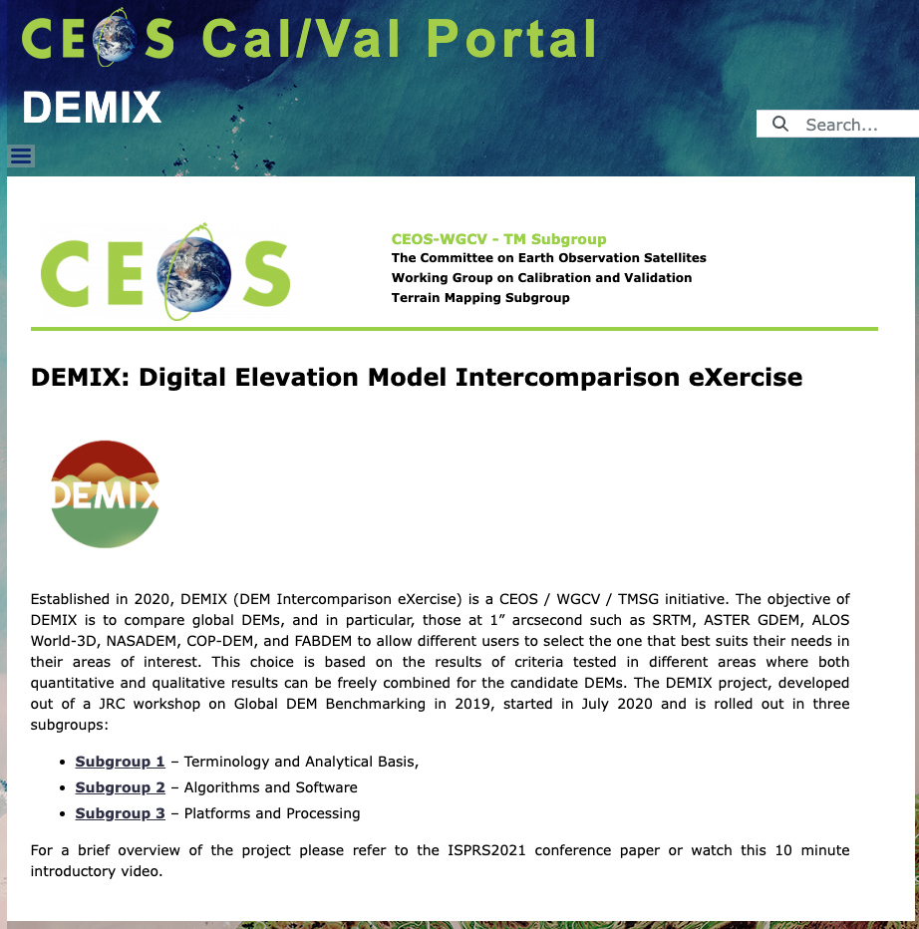
TM Subgroup webpage
Terrain Mapping SubGroup (main page)
TMSG Overview
DEMIX
SG1-Terminology and Analytical Basis
SG2-Algorithms and Software
SG3-Platforms and Processing
DEMIX workshops
DEMIX workshops 2023
DEMIX workshops 2025
GCPIX
TMSG presentations at WGCV
Input from Sabrina Pinori (Serco)
In progress 90%

Slide 9
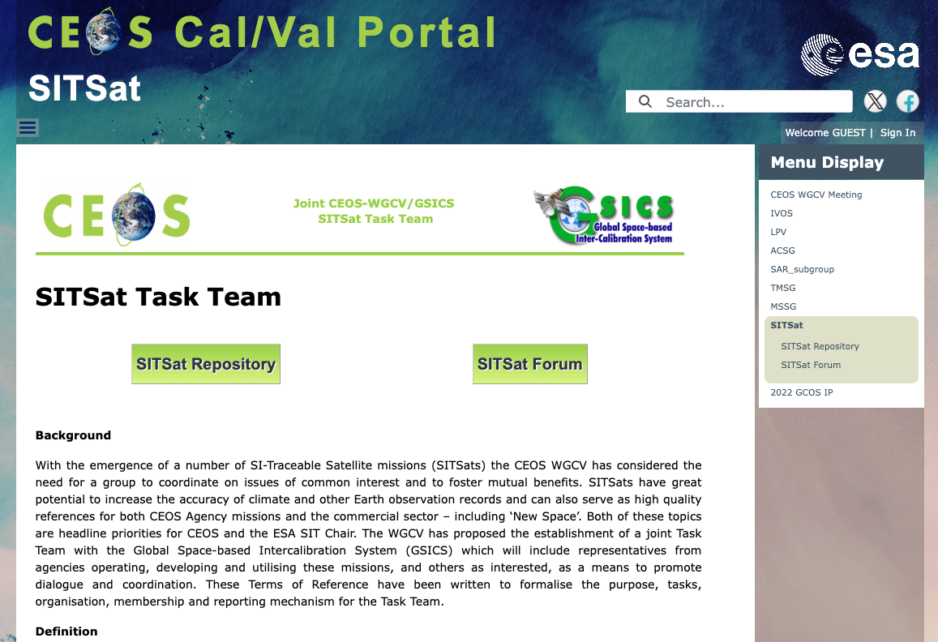
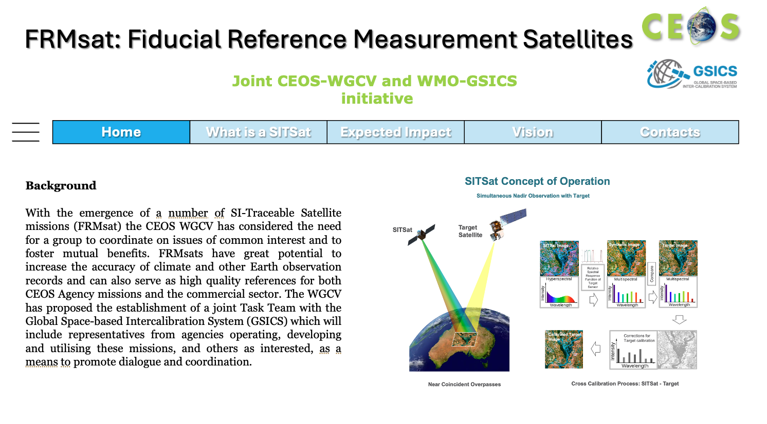

SITSat FRMsat
Notes: SITSat Task Team Meeting - 9 April 2026
Attendees: Nigel Fox, Yolanda Shea, Thomas August, Paolo Castracane, Harvey Jones, Medhavy Thankappan, Kurt Thome, Larry Flynn
Actions:
All to share thoughts on the ‘FRMSat’ name proposal.
Thomas to share the presentation for TRUTHS lessons learned and foundational report executive summary.
Yolanda to provide Thomas with a slide noting the benefits that CLARREO-PF will provide (e.g. for VIIRS and CERES validation).
Paolo and Nigel to review the CEOS-FRM Guidelines and criteria to identify areas requiring update to accommodate FRMsats.
..proposal for new logo [Thomas August]

Slide 10


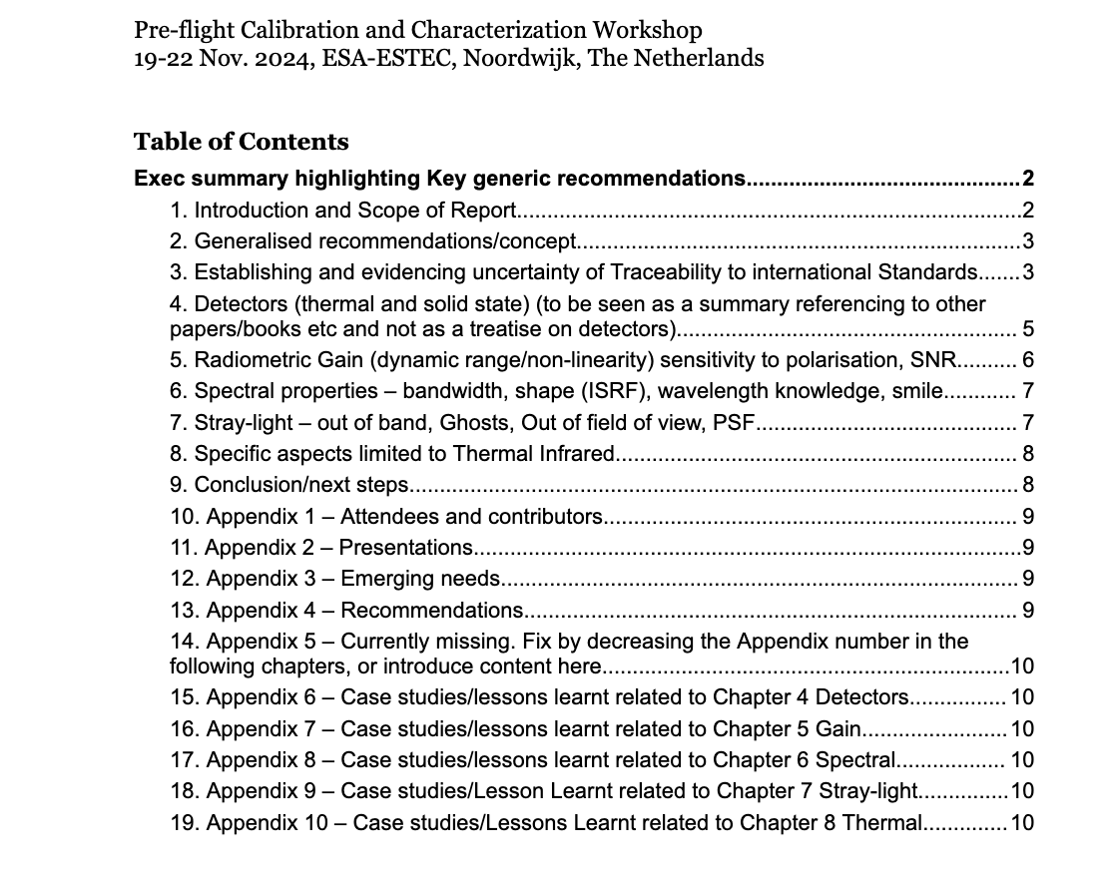
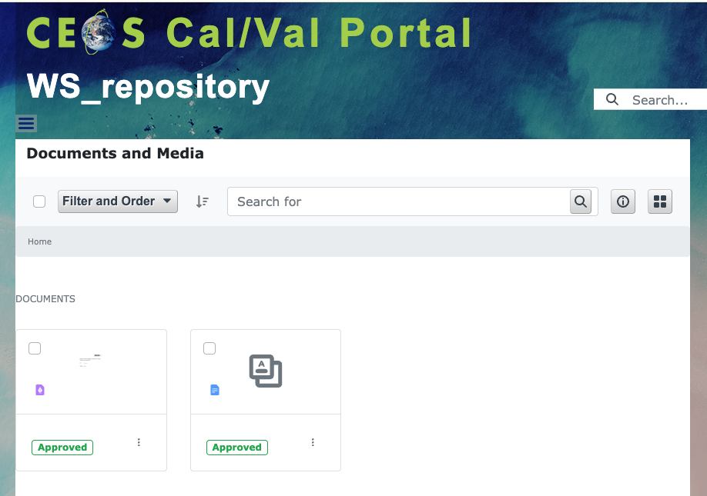
Pre-flight Calibration WS forum
Workshop dedicated Forum
Shared doc for Executive Summary and Recommendations
Presentations available!
Workshop Repository

Slide 11
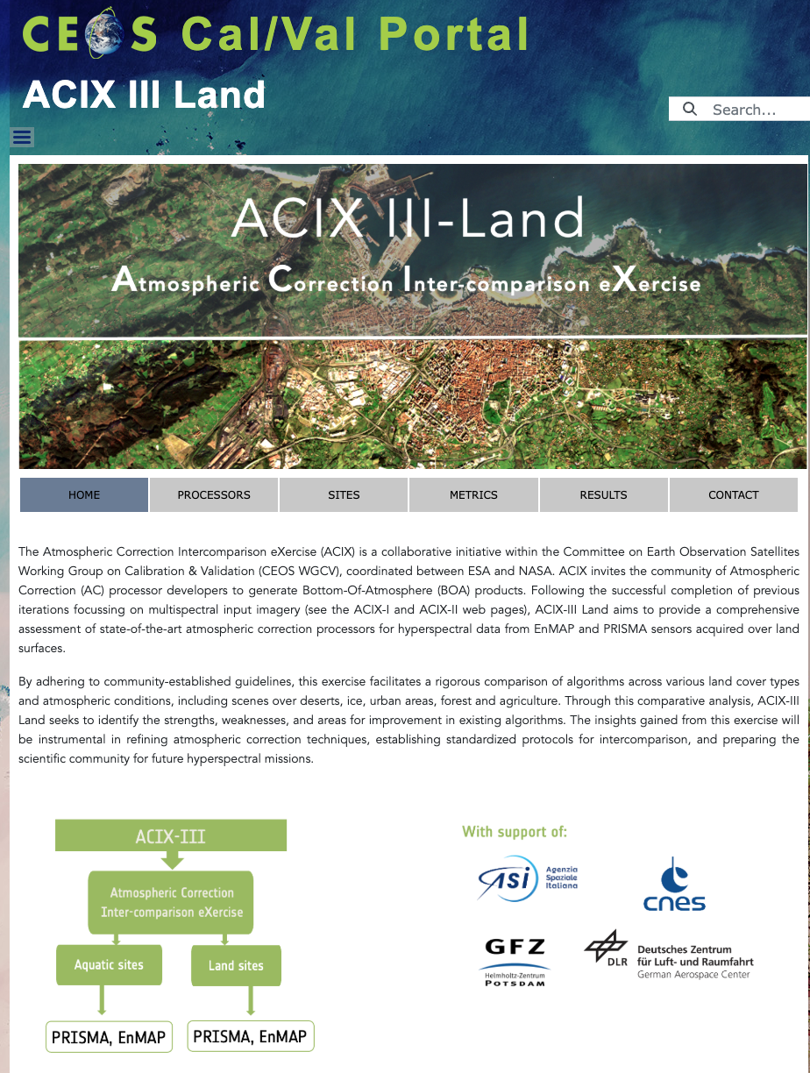

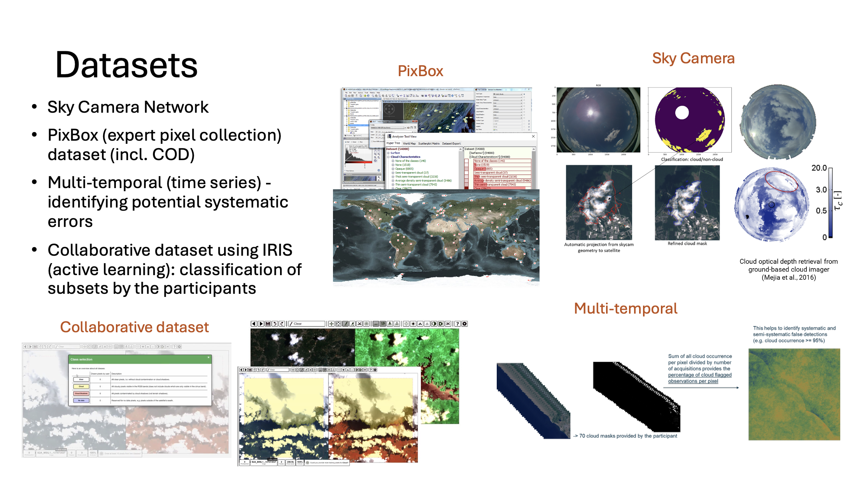
ACIX-III land/Aqua and CMIX II
Intercomparison Exercises:
ACIX III Land (ready except Result Form)
ACIX III Aqua
CMIX II
Input material collected from
Noelle Cremer and
Michela Perrone (Serco)

Slide 12

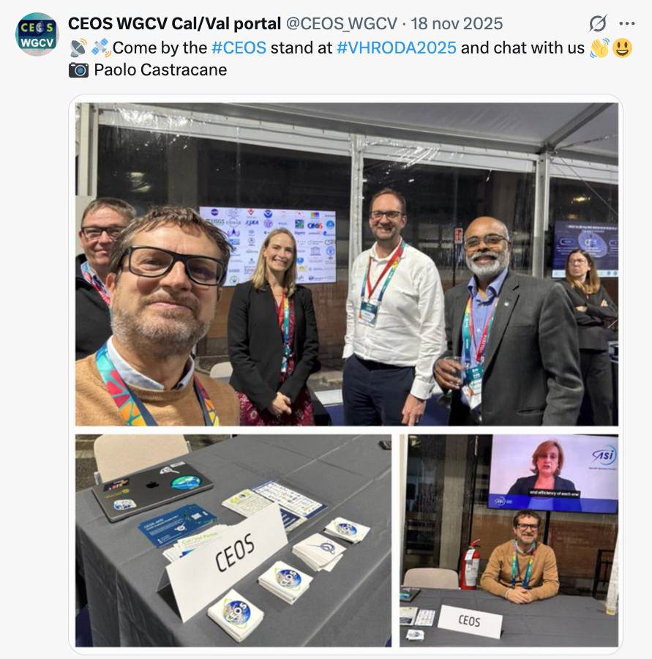

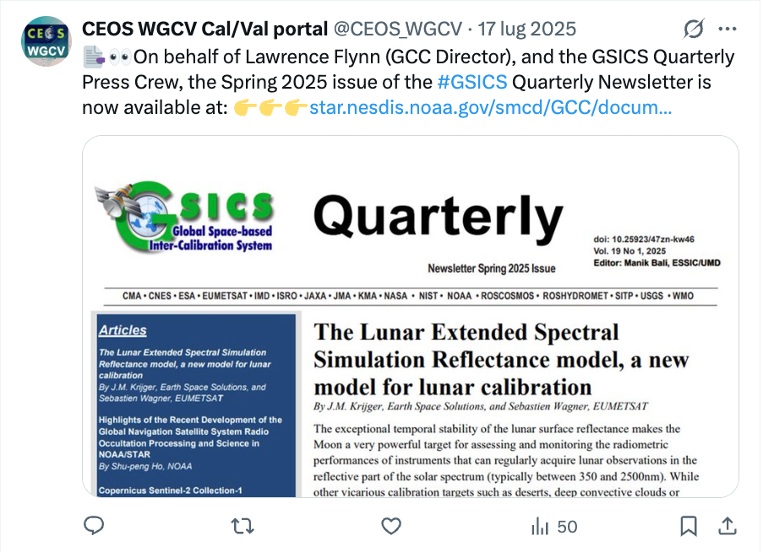
Outreach
News content updates
Outreach, video tutorials, X post, contact and support
Newsletter

Slide 13
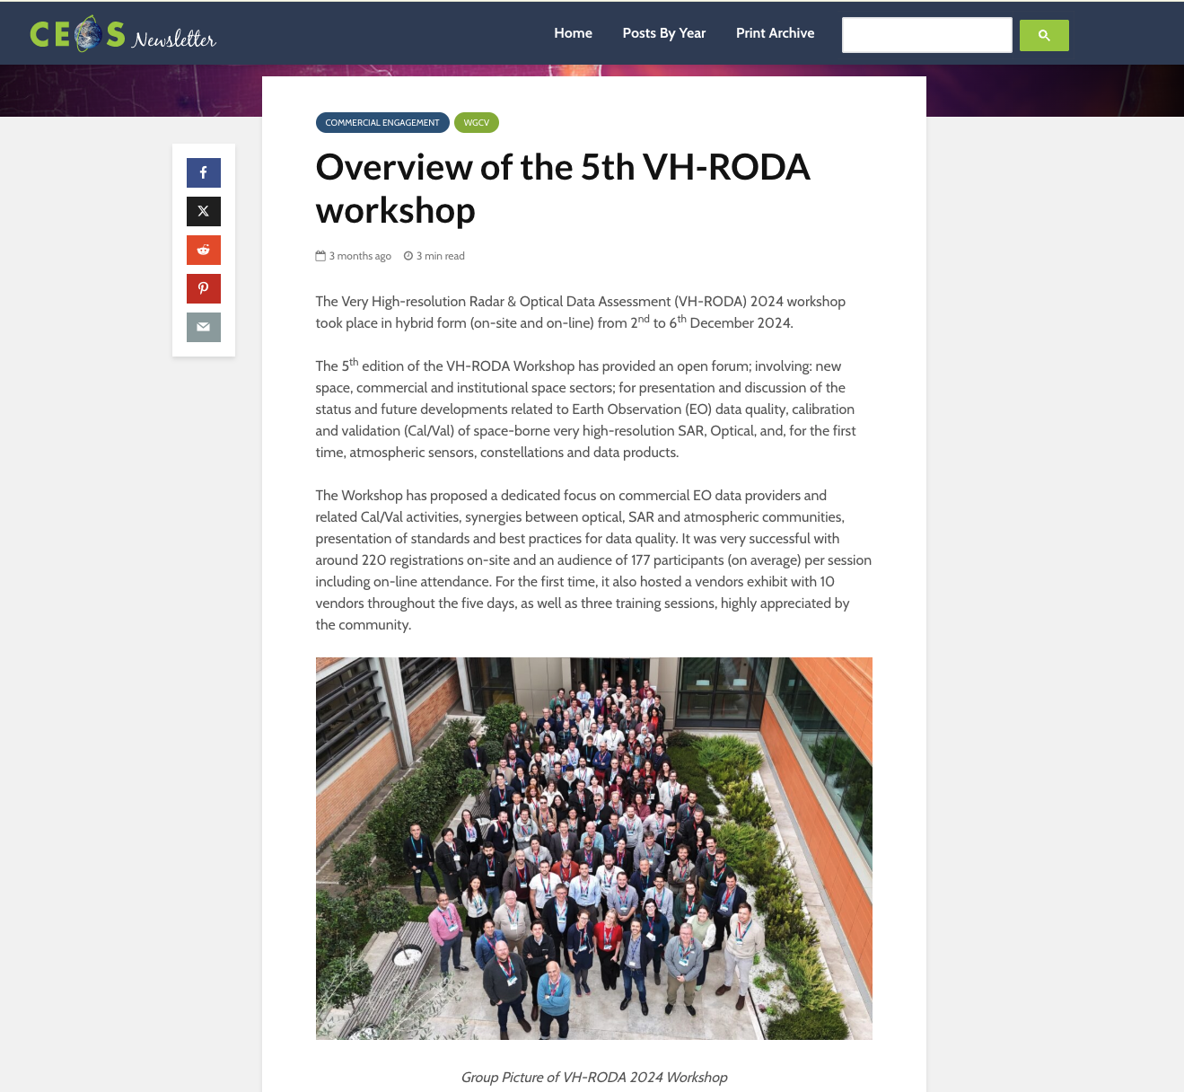
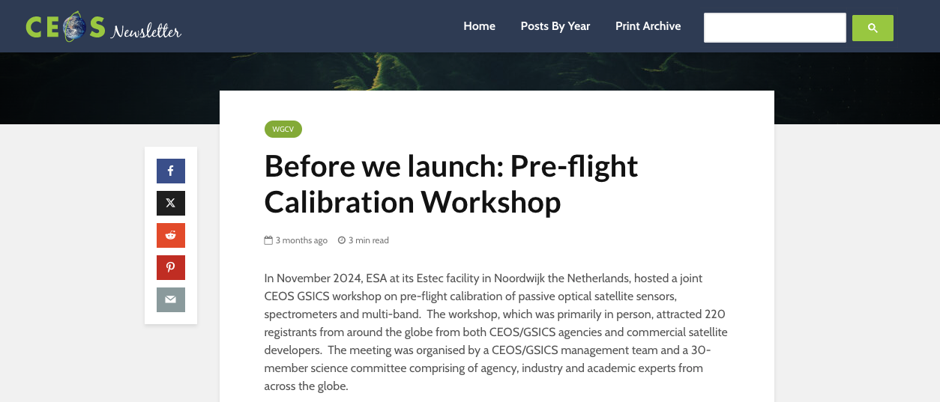
Conclusion
Several ongoing activities (e.g. Subgroups updates, FRMSat webpage, pre-flight Calibration, ACIX and CMIX exercises, etc.)
Continue collaboration with CEOS WGISS (e.g. WGISS Data Management and Stewardship Maturity Matrix teams and the Interoperability team) and WMO GSICS
Coordinate outreach with CEOS.org team – CEOS Newsletter examples:

