Slide 1
WGCV-56
Potential candidacy WGCV Vice-chair-Chair Nov 26 – Nov 30
Nigel Fox, NPL/UKSA
Agenda Item:W9.1
WGCV-56,
Sioux Falls
20th - 24th Apr 2026

Slide 2
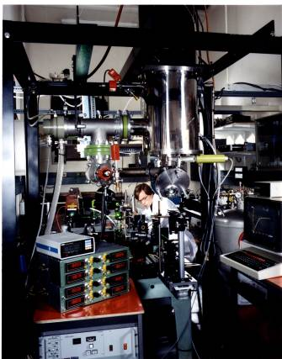
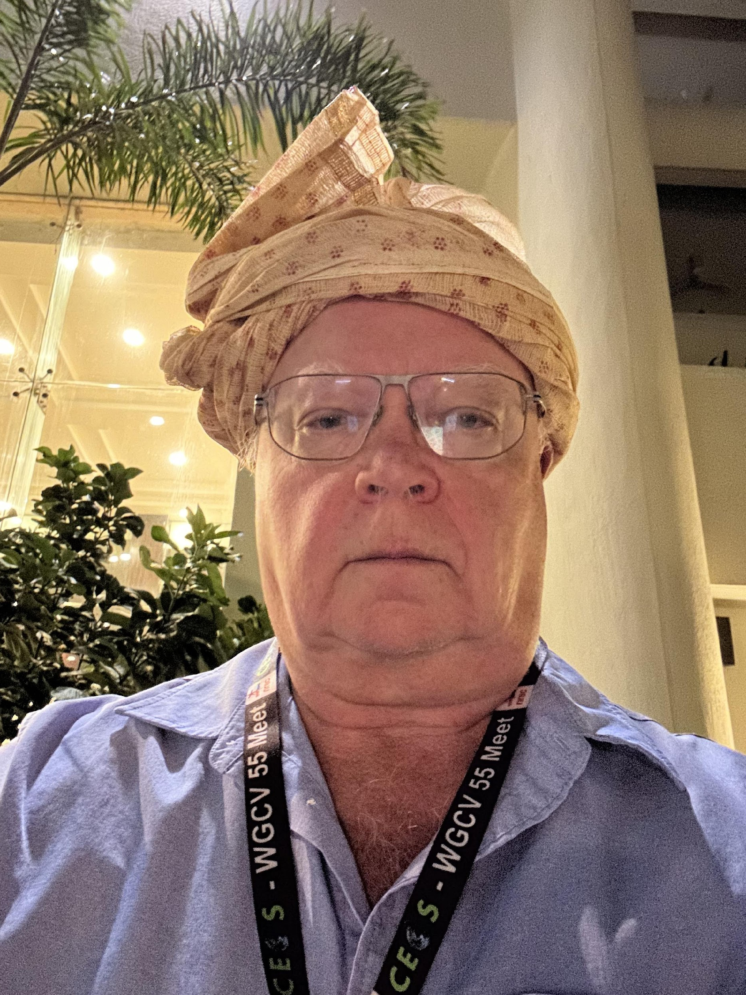
Who am I?
(Visiting Professor Univ Reading) Dr Nigel Fox
Born 1960
Graduated BSc Physics and Astronomy, Uni Coll Lon 1981
Joined NPL 1981 to work on developing new primary optical radiometric scales
Laser Radiometry
Cryogenic Radiometer
Filter Radiometry
Synchrotron
UV -TIR
PhD 1994 (Establishing a primary Radiometric scale)
2025
1985

Slide 3
Who am I?
Started active work related to EO (primarily pre-flight Cal) ~1990
Only area needing high accuracy now achievable
Now engaged with all aspects; post-launch, level 2 products, climate …
Engaged with CEOS WGCV & IVOS ~ 1996/7 IVOS chair ~2006 (from Mike Rast)
Attended pretty much every meeting
Bringing Metrology focus,
Active on various initiatives many with cross-cutting focus e.g. QA4EO, RadCalNet, EDAP, FRM, ….
First Proposed TRUTHS in 2001 (as essentially a CEOS focussed mission for Cal/Val)
Driver came from IVOS meetings and members many were CIs in proposal

Slide 4
Motivation?
Still keen to promote importance of ‘fit for purpose’ Cal/Val and QA in general
Going forward can probably find more time
Can commit to 4 more years
Within IVOS have shown I can be a facilitator of the groups members ideas
Whilst not an expert in other sub-group domains believe I am sufficiently versed that with their support can attempt to represent all sub-groups effectively
Believe that we are moving into an era where commercial sector becomes increasingly important and am keen to engage - particularly in supporting initiatives such as Future ARD
Have worked with Medhavy in various guises so think this can be a good partnership
Whilst formally representing a space agency am not part of a space agency but one which has, with sister NMIs an authority of independence on SI-Traceability
Require formal and financial backing from UKSA
Will need to find successor for IVOS

