Slide 1


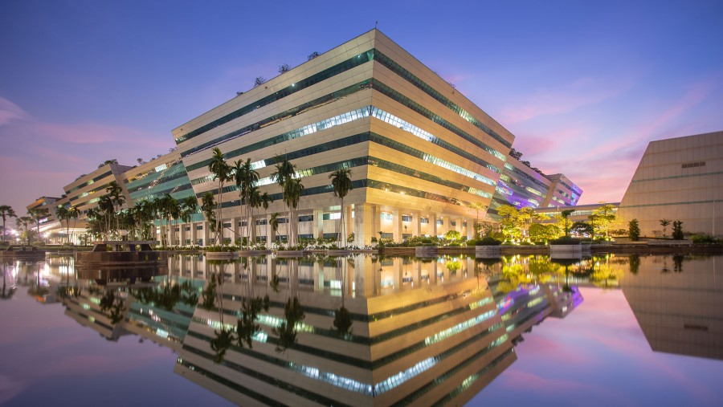
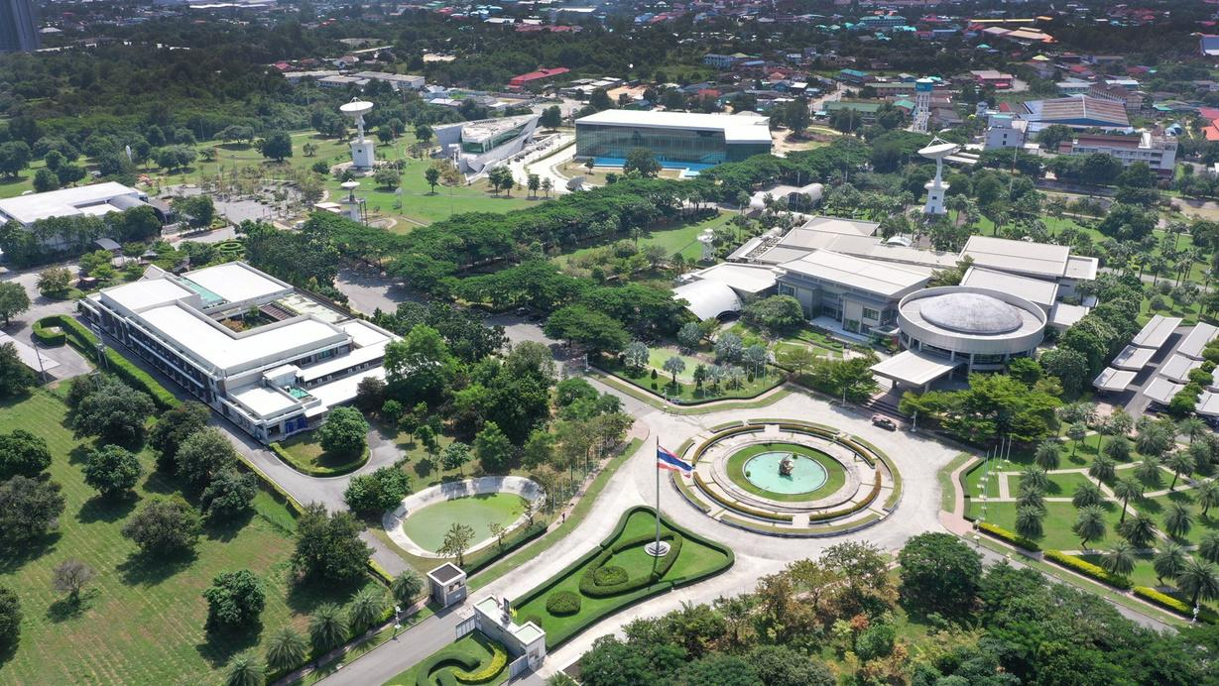
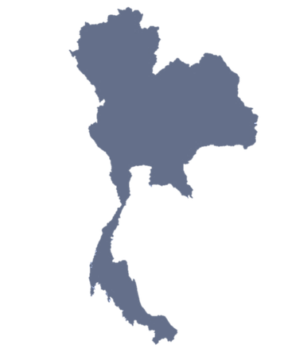


Plans for WGCV-57 Plenary Meeting
GISTDA Headquarter (Government Complex)
Bangkok, Thailand
GISTDA Ground Station
Chon Buri, Thailand
Bangkok
สำนักงานพัฒนาเทคโนโลยีอวกาศและภูมิสารสนเทศ (องค์การมหาชน)
Geo-informatics and Space Technology Development Agency (Public Organization)
Chon Buri
CEOS WGCV-56, 20-24 April 2026
Slide 1

Slide 2
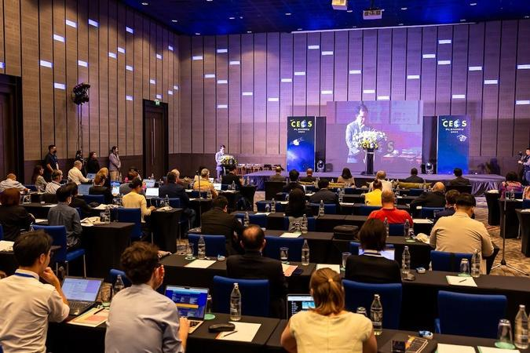
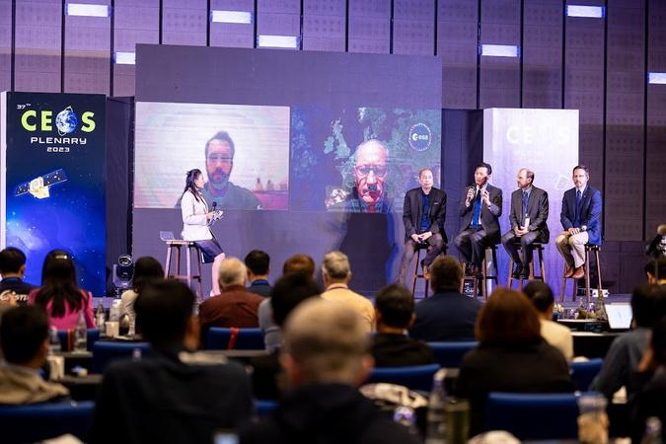
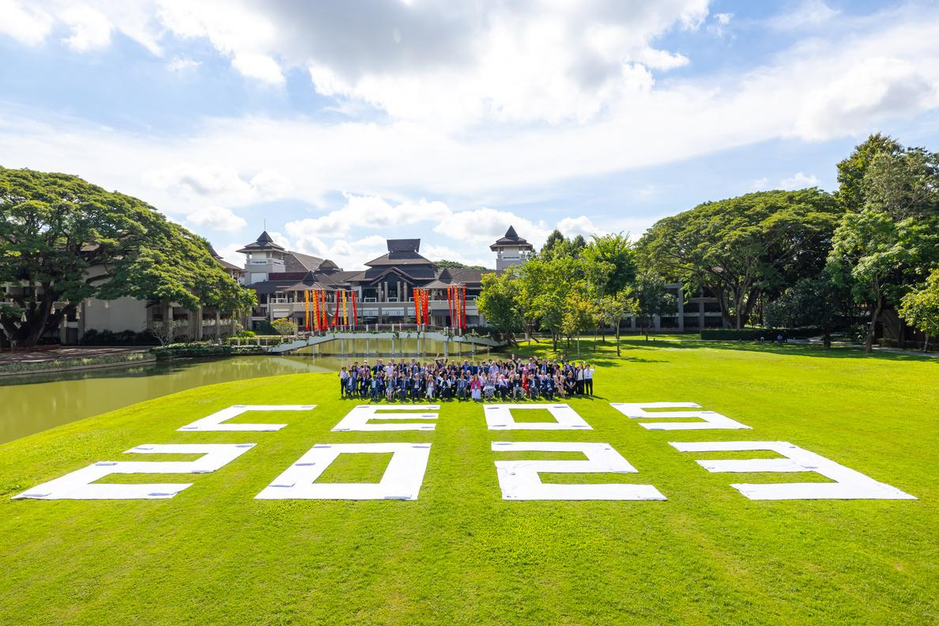
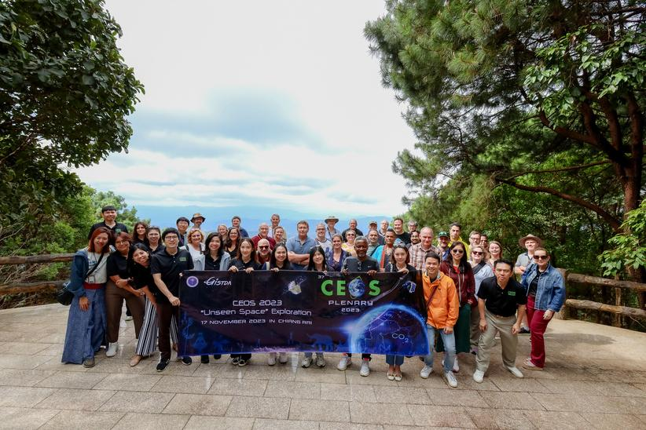
Plans for WGCV-57 Plenary Meeting
Experience in Hosting CEOS Meetings
37th CEOS Plenary, Chiang Rai, November 14th - 16th, 2023
Host:
Geo-Informatics and Space Technology Development Agency (GISTDA), Thailand
About GISTDA:
A Thai space agency and space research organisation that has experience in supporting CEOS collaborations and meetings.
Location:
Thailand (Venue TBC)
Timeframe:
January–February 2027
Note (optional):
Further details to be confirmed
GISTDA looks forward to welcoming
CEOS WGCV community to Thailand!
CEOS WGCV-56, 20-24 April 2026
Slide 2

