Slide 1
Activities @ DLR’s Remote Sensing Technology Institute
Committee on Earth Observation Satellites
Michael Eineder, DLR
Agenda Item #6
CEOS 6th Working Group for Capacity Building and Data Democracy (WGCapD)-6 Annual Meeting
DLR Oberpfaffenhofen, Germany
27th-29th March, 2017

Slide 2
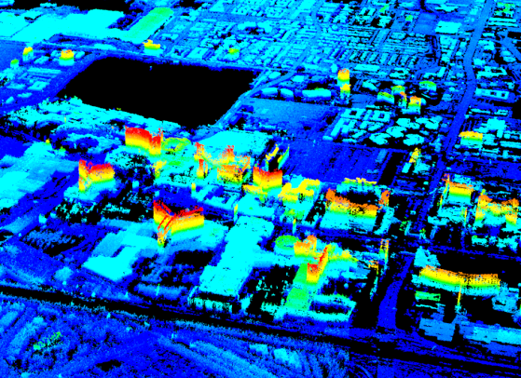
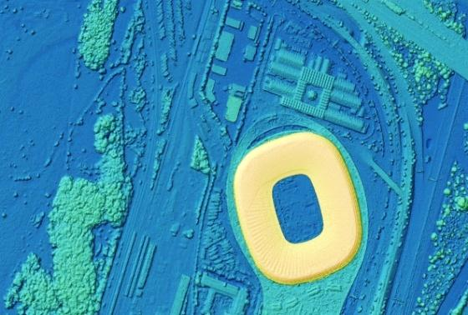
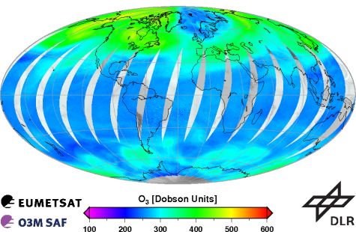
DLR Remote Sensing Technology Institute (IMF) Competences
Synthetic Aperture Radar (SAR)
Processors for TerraSAR-X, TanDEM-X, PAZ, Tandem-L, etc.
Imaging geodesy
4D imaging: PSI, SAR tomography et al.
SAR oceanography, maritime security
Optical Imaging
Processors for EnMAP and DESIS
CATENA: generic processing chain for 15+ sensors
3D: dense stereo matching and object reconstruction, computer vision
Hyperspectral methods: retrieval, unmixing, classification, fusion
Ocean color, water quality
Calibration Home Base and airborne systems
Atmospheric Spectrometry and Lidar
Processors for GOME-2, ADM, MERLIN, Sentinel 5p/4/5, etc.
Spectrometry laboratory
Scattering theory, radiative transfer, inversion methods

Slide 3
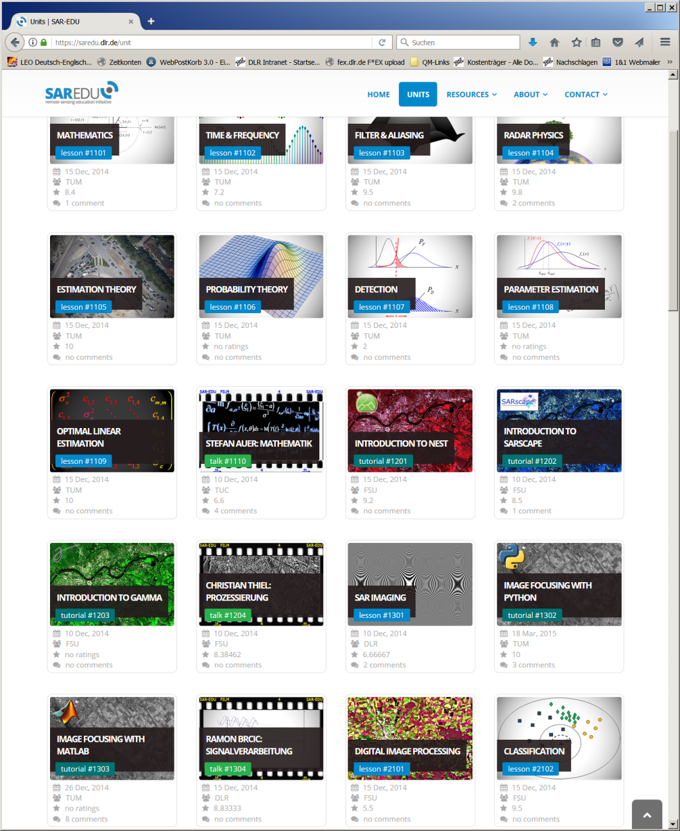
DLR IMF National Educ. Activities
Many contributions to German SAR-EDU Remote Sensing Initiative:
Radar Physics
SAR
SAR Interferometry
Estimation Theory
…
Material and Videos available freely

Slide 4
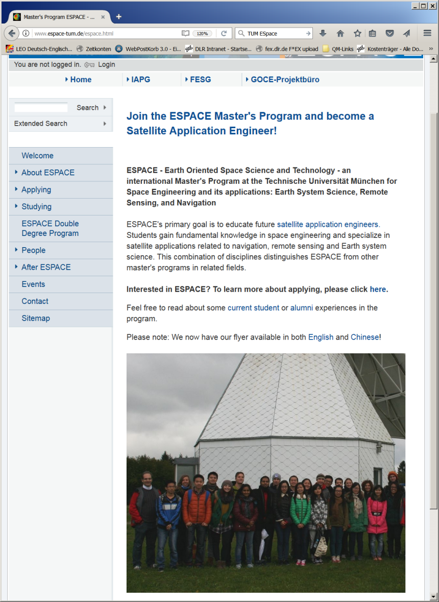
DLR IMF University Activities
International Earth Oriented Space Science and Technology (ESPACE) Master's Program @ Technical University of Munich
~10 IMF scientists teaching remote sensing technology
No university tuition fees
Double degree program with Wuhan University / CN
Other regular lectures @ Uni: Bukarest, Alcala, Osnabrück, Hannover, Leipzig, München

Slide 5
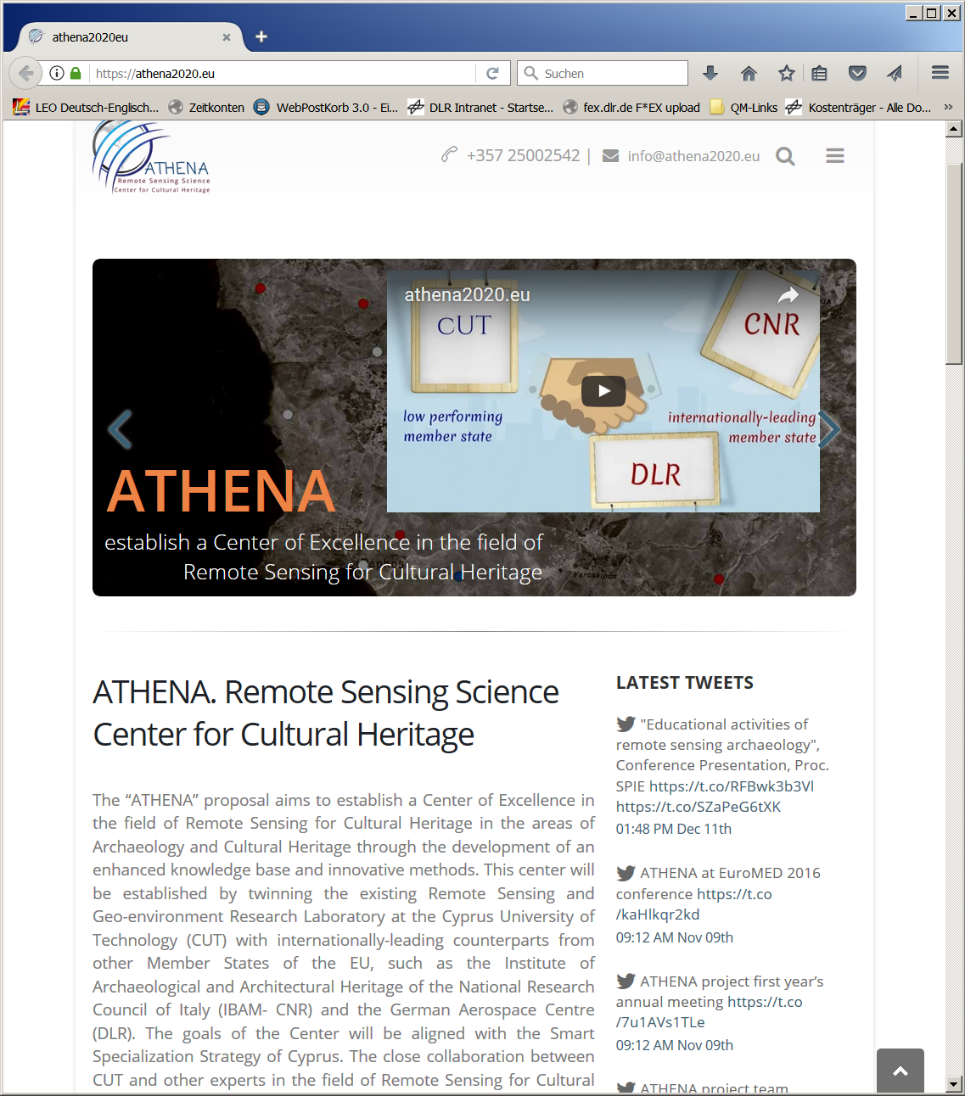
DLR IMF Non University Activities
Carl-Cranz-Gesellschaft e.V.
Tutorial ats conferences (IGARSS etc.)
EU FP2020 Project ATHENA: “… improve and expand the capabilities of collaboration between lowperforming and leading institutions, … with remote sensing technologies … related to Cultural Heritage protection, management and best practice”
DLR School lab: scientific advisory of student experiments

