Slide 1
New Activities and Suggestions for the Work Plan: 38th ACRS: Report on Preparation
Committee on Earth Observation Satellites
Senthil Kumar, ISRO
Agenda Item # 40
CEOS 6th Working Group for Capacity Building and Data Democracy (WGCapD)-6 Annual Meeting
DLR Oberpfaffenhofen, Germany
27th-29th March, 2017

Slide 2
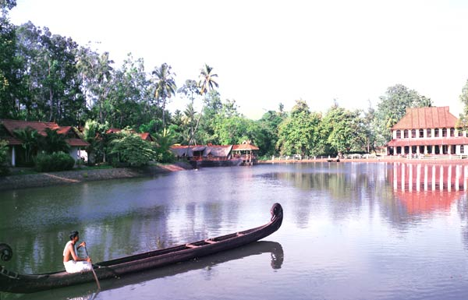
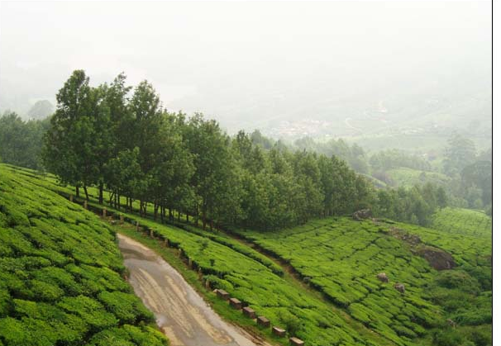
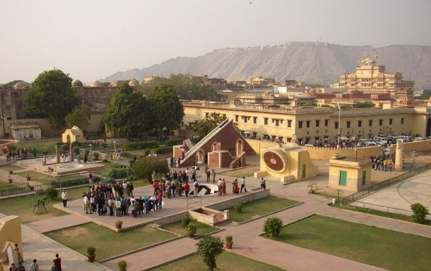
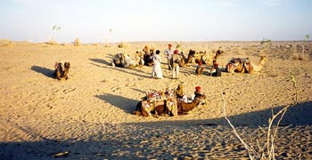
ACRS 2017
Space Applications: Touching Human lives
Dr. A. Senthil Kumar, Chair, LOC
October 23-27, 2017
Venue: The Ashok, Niti Marg, New Delhi
Asian association on Remote Sensing
Indian Society of Remote Sensing
Indian Society of Geomatics
Indian Space Research Organization
Email: acrs2017ind@gmail.com
Website: www.acrs2017.org

Slide 3
Asian Conference on Remote Sensing
History
1st ACRS: November 5-7, 1980, Bangkok, Thailand
Last 5 years ACRS
ACRS 2016:Colombo, Srilanka
ACRS 2015: Manila, Philippines
ACRS 2014: Bali, Indonesia
ACRS 2013: Nay Pyi Taw, Myanmar
ACRS 2012: Pattaya, Thailand
In India
ACRS 1985: Hyderabad, India
ACRS 1994: Bangalore, India
ACRS 2017: New Delhi, India (October 23-27, 2017)

Slide 4
Proposed Schedule for ACRS-2017
Main Conference
October 23-27, 2017
Day 1
Day 2
Day 3
Day 4
Day5
Opening Ceremony
Plenary 1
Lunch
Exhibition
TS 1-8
Cultural Night
Plenary 2
TS 9-16
TS 17-24
Lunch
Poster Sess 1
Exhibition
AARS GC1
Plenary 3
TS 25:WEBCON
TS 26:White Elephant Session
TS: 27-32
TS 33-39
Lunch
Poster Session 2
Exhibition
Industries Presentation.
TS: 40: Student’s
Night
Plenary 4
TS 41-48
TS 49-56
Lunch
AARS GC2
Half day
City tour
Plenary 5
Closing Ceremony
Technical Sessions (TS) : include Oral presentations, Webcon, Space Agencies sessions.
There are about 56 sessions in all, of which 6 will be spared for ISPRS sessions.
Expected No. of participants: 1000+
Pre conference: GEOGLAM (MNCFC)
Post conference: ISPRS Summer School, Citizen Science

Slide 5
Tentative Events
Plenary Sessions (Space Programs, Applications…)
Special Sessions (ISPRS, Webcon, Jaxa, ISRO, White elephant, student session, VIIRS night time imaging etc.)
Eminent lectures (V.S. Memorial, Millennium, …)
Industrial Presentations and Exhibitions
Visit/Field Excursion/ sight seeing
Cultural Evening depicting Asian Heritage
Students night
AARS General Conference
Side meetings …
ISPRS Summer School and Tutorial

Slide 6
Themes
Natural Resources Management
Agriculture & Soils
Forestry and Environment
Geology and mineral resources
Marine and coastal
Water Resources and Cryosphere
Atmosphere, Ocean, Weather & Climate
Atmospheric parameter retrieval and modelling
Weather monitoring and modelling
Ocean applications
Climate change and its impact
Disaster monitoring, damage assessment and risk reduction
Hydro-meteorological
Geological
Environmental
Infrastructure and development planning
Infrastructure mapping and development planning
Urban and regional planning and Smart city planning
Rural development planning

Slide 7
Theme-Specific Sessions
S.No. | Topic | Session Chair/Co-Chair
1 | PolSAR and Its Applications
2 | Geological RS & Mineral Exploration
3 | GEOGLAM -
4 | Geoinformatics in Disaster Management
5 | Forest and Climate Change
6 | Urban Planning & Infrastructure using RS/GIS
7. | Advances in Lidar RS & Applications
8 | NISAR
9 | Calibration / Validation
10 | Web-based Education

Slide 8
Themes
Emerging trends in
EO Sensors and data processing : Optical, Thermal and Microwave
Data acquisition and Cloud computing
UAS and Applications
Mobile Apps, Crowd Sourcing and Citizen Science
Big data analytics and information Science
Cultural heritage monitoring
Health GIS
Information mapping from social media
…
Education and outreach
Needs and requirements in different countries
Active Learning models
Cross-border education through web-resources sharing
Tools development for training and outreach
….

Slide 9
Important Dates
Conference Dates: October 23-27, 2017
Abstract submission started on: Feb 15, 2017
Abstract submission deadline: July 1, 2017
Notification of Acceptance: July 31, 2017
The deadline for submission of full paper: Sept. 10, 2017

Slide 10
visit us: www.acrs2017.org
Welcome to ACRS-2017 @ New Delhi
Thank you

