Slide 1
Celebrating 10 years of…
WGCapD
Identifying work plan priorities: 2022-2023
Nancy D. Searby, WGCapD Chair
Pham Thi Mai Thy, WGCapD Vice-chair

Slide 2
WGCapD Plans for 2022-2023 and beyond
Revisit what’s in our newly updated 2021-2023 workplan
Discuss what we should plan to add next year
Discuss out-year planning
Review next steps for meetings

Slide 3
WGCapD Work Plan Summary - Part 1

Slide 4
WGCapD Work Plan Summary - Part 2

Slide 5
WGCapD Work Plan Summary: Recently Closed Deliverables

Slide 6
WGCapD Plans for 2022-2023 and beyond
What we should plan to add next year?
What about into the future? Vision for the next decade?

Slide 7
Upcoming WGCapD Meetings
WGCapD team will add annual meeting participants to WGCapD Community distribution list to be invited to these meetings:
Monthly WGCapD meetings
First Thursday of a month at 13:00 UTC, next one is April 1st
EOTEC DevNet Regional Community of Practice
Meetings planned for June, exact dates TBD
WGCapD in-person (?) gathering in Germany
September 2021, before or after CGMS VLab’s convening

Slide 8
Celebrating 10 years of…
WGCapD
Thank you!
WGCapD website: https://ceos.org/ourwork/workinggroups/wgcapd
WGCapD-10 page: https://ceos.org/meetings/wgcapd-10

Slide 9
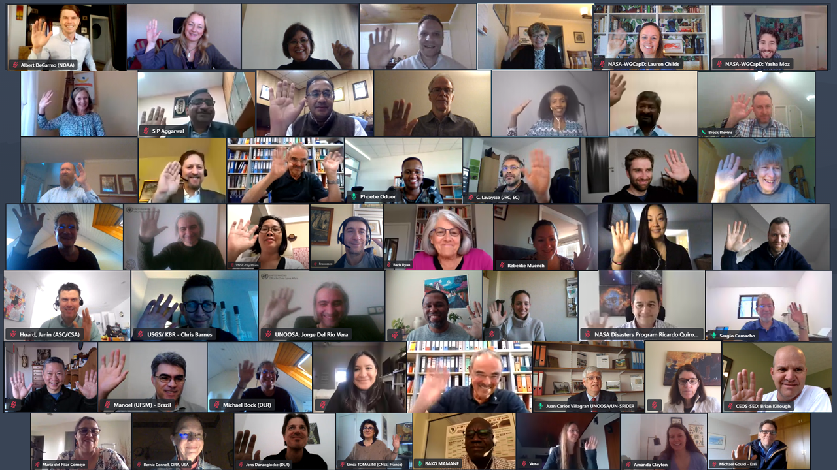

Slide 10
Backup

Slide 11
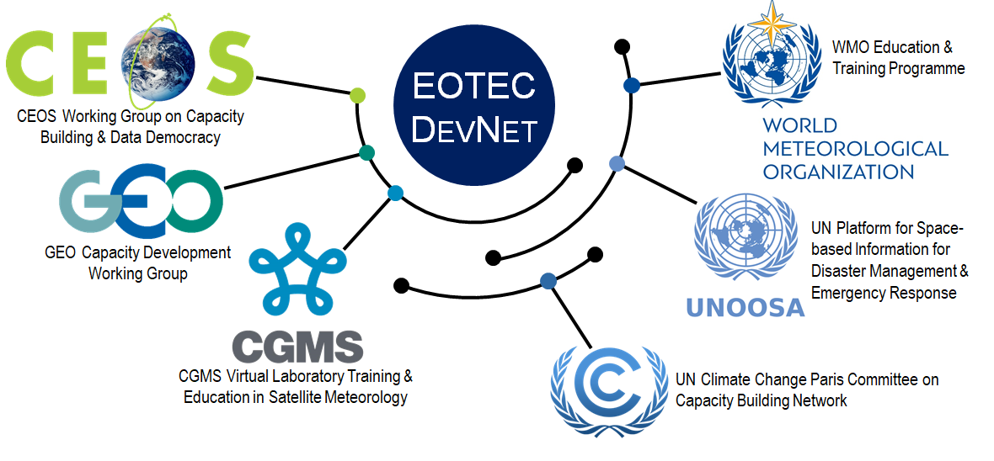
Earth Observation Training, Education, and Capacity Development Network

