Slide 1
Celebrating 10 years of…
WGCapD
WGCapD-10: Preliminary take-aways
Presenter: Nancy Searby, WGCapD Chair

Slide 2
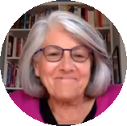
High level insights and lessons
Barb’s enabling framework:
open data, building on what’s been done, integration and coordination (internally and nationally, regionally and globally), and hyper-partnering
The EO community has grown tremendously, largely because of access to open data: “You no longer need to have a PhD to engage on EO”
Need strategic thinking about how to leverage increasing private sector engagement
True inclusion involves: 1) advocacy on costs of EO application and 2) use of languages other than English
Strong support for EOTecDevNet; interest in learning more about how it aligns with other activities
Consensus that a flood dashboard would be useful
What else?

Slide 3
Insights from Session 2 panel:
EO CapDev in the decade ahead
Key need: foster EO literacy among various target audiences, recognizing that each have their own interests and needs
Need to articulate the value proposition of EO to decision-makers/funders
Need to systematically assess barriers to use for developing countries, including: the costs of processing in the cloud, infrastructure limitations, internet limitations, sustaining local/national skills, etc.
Integration and coordination more effective with that literacy
Importance of fostering diversity and inclusion, especially among youth and via use of languages other than English
Important to keep building the community of practice, especially outreach to private sector, thinking about ways to support start-ups
Critical to CB to integrate space applications into existing decision-making processes
CEOS should be a catalyst for “hyper-partnering” regionally and nationally:
Will help WGCapD conduct accurate needs assessments
Should foster fit-for-purpose solutions, with emphasis on fostering awareness, coordination and collaboration, rather than implementing

Slide 4
Insights from Session 3 panel:
Opportunities to build flood resilience capacity
Need greater investment in urban flood models
Learning from recent India landslide-induced Uttarakhand flood:
simpler threat assessment tools needed, with skilled personnel to use them
need better early warning and better integration of climate models
WGCapD opportunity: bring together domain experts and those with expertise in developing tools for new users
Suggestion to create a regional flood dashboard so that what is learned and data is shared
Mandated by UN General Assembly to promote use of space based information, UN SPIDER orients its work toward both policy-makers and technical experts, seeking to leverage ongoing decision-making and reporting through global development frameworks
Technical advisory missions have helped identify strengths, weakness and needs, but sustained presence and/or connection is required to move processes forward
WGDisasters pilot is focused primarily on advancing flood risk monitoring and mapping with new datasets and evidence

Slide 5
General take-aways on CB & flooding
Importance of linking up with WGDisasters on flooding
Need better hydrologic mapping and storm surge mapping at regional and local level
To support DRR, need to connect EO to local decision-making, e.g. land use and planning
Lots of existing expertise within CEOS; WGCapD should continue to play connecting/connector role
Example: WGCapD could facilitate a global group on DEMS
Timely data key to disaster management; time lag is still a barrier to response
Critical to simplify rich data sets into usable tools. WGCapD can play a role in helping national/regional users determine which tool, for which geography, for which scale.
Partnership of CEOS with regional GEOS could focus on a regionally calibrated operational flood service

Slide 6
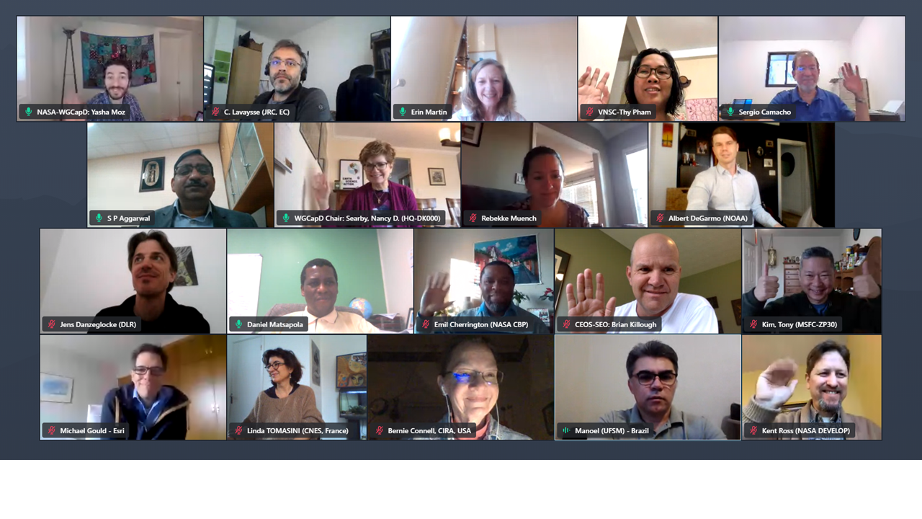
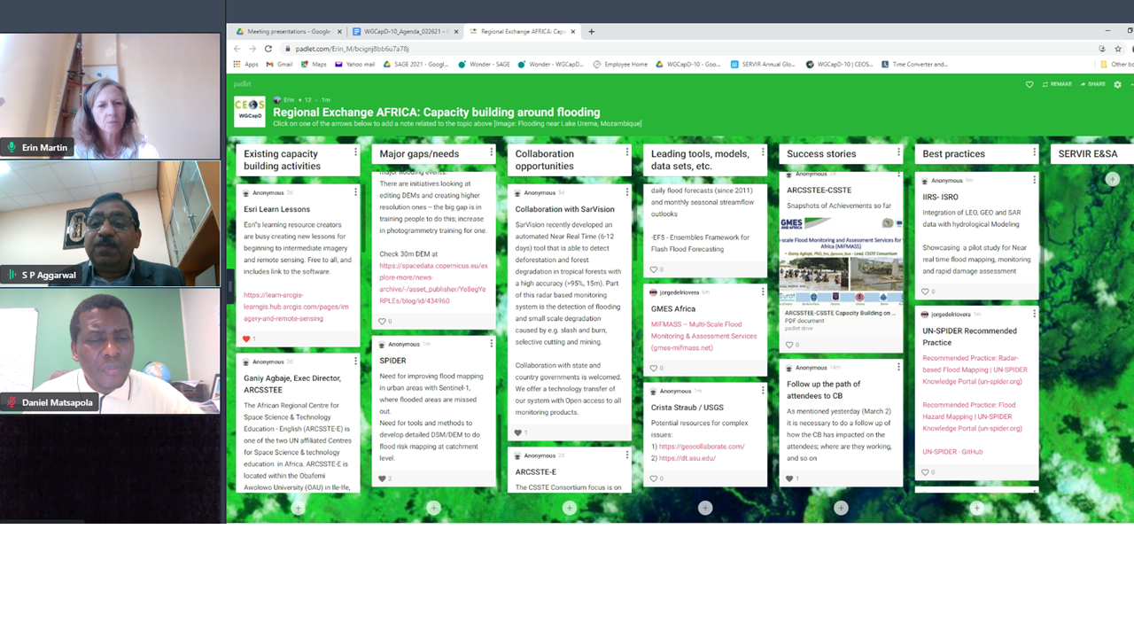
Regional Exchange: Africa
Key needs:
Speed up turn-around time of information
Package information for policy makers to effectively respond
Addressing availability and cost implications of HR images
Need better ground observations, flood calibration, urban flood mapping
Big gap on uptake of EO data for decision-making
Opportunities:
RCMRD, Hummingbird Project, ESRI, SarVision, ARCSSTTEE interested in collaboration
Application of GloFAS
WGCapD can help facilitate closer ties between global data providers and national met services

Slide 7
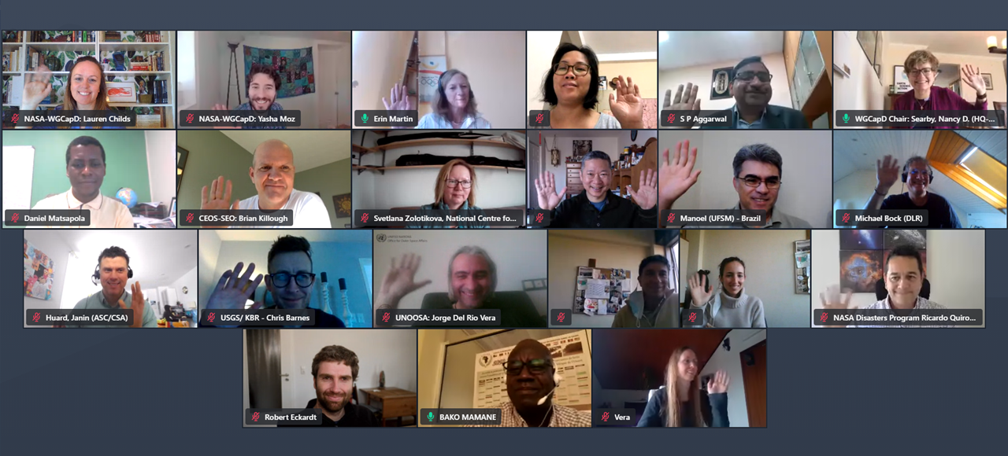
Regional Exchange: Europe
EFAS, GloFAS, Copernicus Emergency Mapping Service and Charter are key data providers and collaborators
Would be useful to help users develop fit-for-purpose applications
Need for tools/materials in languages other than English
UN SPIDER raising awareness of GloFAS in the developing world and piloting hydrological modeling to compliment GloFAS data
Opportunity to build on existing EO College resources with a series of flood-related MOOCs

Slide 8
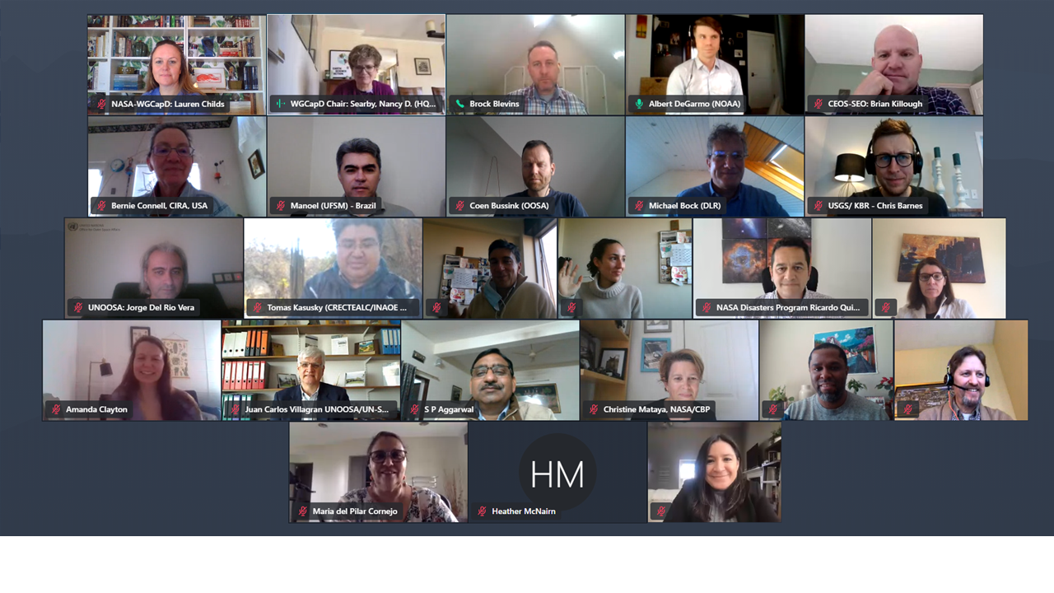
Regional Exchange: Americas
Lack of hydrologists at local level
More localized hydrologic modeling required
Pilots ongoing to create local dashboards to support disaster response
Lots of potential partners in the region to help in disseminating WGCapD resources
Critical to engage policymakers in integrating EO in their decision-making, e.g. around land use and flood risk
Need support developing an approach to flood risk mapping

Slide 9
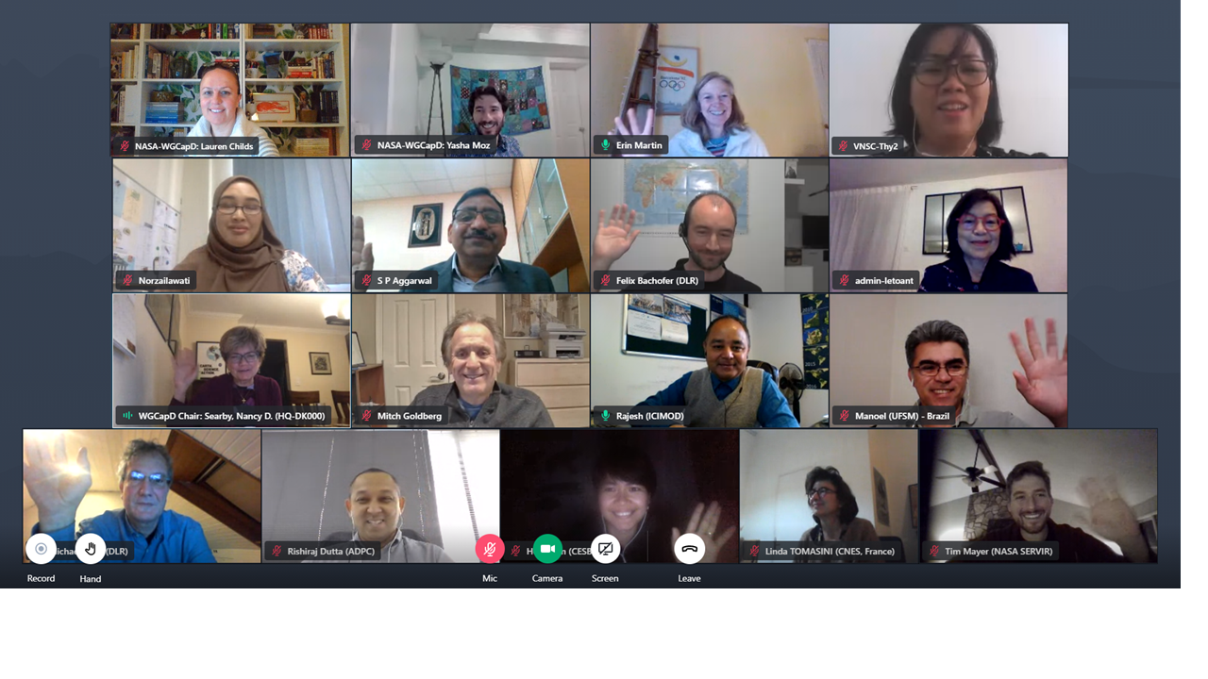
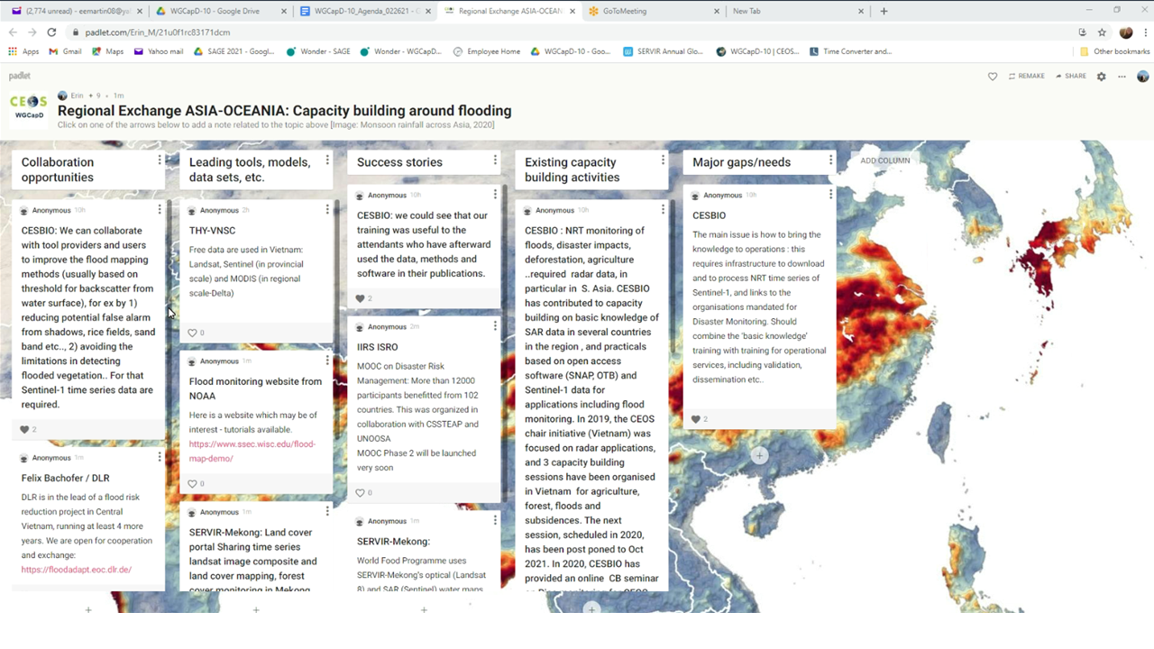
Regional Exchange: Asia-Oceania
Improved flood mapping and monitoring is critical.
Big gap in terms of the connection to users, and the need to facilitate policymaker uptake and application of data.
Infrastructure challenges are significant.
So much climatic and geographic diversity, need to tailor models and tools to each area

Slide 10
Other suggestions/ideas
Workshop to look at theories of change and approaches to assessing capacity development impact
WGCapD should play a role in fostering trust among partners
Create an “evidence toolkit” to foster EO literacy

Slide 11
Any other points to add?

Slide 12
The path for WGCapD?
From the discussions, what can/should WGCapD do? What are the priorities:
for the long-term (10-year vision)
for the short-term (next 2-3 work plan years)
How should we sustain the momentum of these regional exchanges?
As we consider opportunities to support other development challenges (e.g., vulnerability and climate adaptation/resilience) what did we learn from using floods as a case?

