Slide 1
Canadian Space Agency
WGCapD initiatives under development
Guy Aubé
Dirk Werle
Corinne Brunelle
Jonathan Lajoie
Dalia Laoubi
CSA smartEarth
WGCapD - 15
September 3, 2026

Slide 2
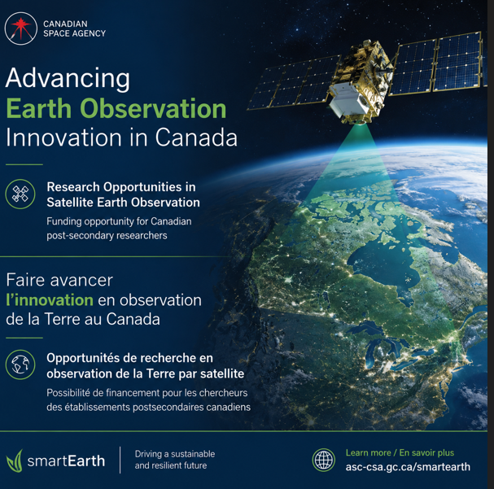
Recent Accomplishments
New capacity building initiative for the academic sector: CSA smartEarth ROSEO AO launched on Sept. 1 2026
https://www.asc-csa.gc.ca/eng/funding-programs/funding-opportunities/ao/2026-research-opportunities-in-satellite-earth-observation.asp
Stream 1: Applications and R&D to advance knowledge and research capacity in remote sensing and EO by fostering cross-sector collaboration and supporting the development of space-based solutions, including low Application Readiness Level (ARL) from ARL 1 to ARL 4.
Stream 2: Acting collectively to bridge EO and society, aiming to generate societal and economic benefits, through high Application Readiness Level from ARL 5 to ARL 7 for Canadian academia and industry collaborations to incubate and integrate EO applications, solutions and tools for use by non-traditional end-users (e.g., municipalities, provinces and territories, Indigenous communities).
Stream 3: Exploitation of available data of RADARSAT missions to advance Canadian Synthetic Aperture Radar (SAR) applications and partnerships through the use of RADARSAT Constellation Mission (RCM), RADARSAT-1 and RADARSAT-2 data and in preparation for the utilization of next-generation of SAR satellites, including ARL 1 to 7.
This AO also intends to support Canada's international commitments related to space and EO partnerships by encouraging applicants to include partners or collaborators in their proposals, including Canada–Europe and academia–industry collaborations.
Notes:
AO infos:
https://www.asc-csa.gc.ca/eng/funding-programs/funding-opportunities/ao/2026-research-opportunities-in-satellite-earth-observation.asp

Slide 3
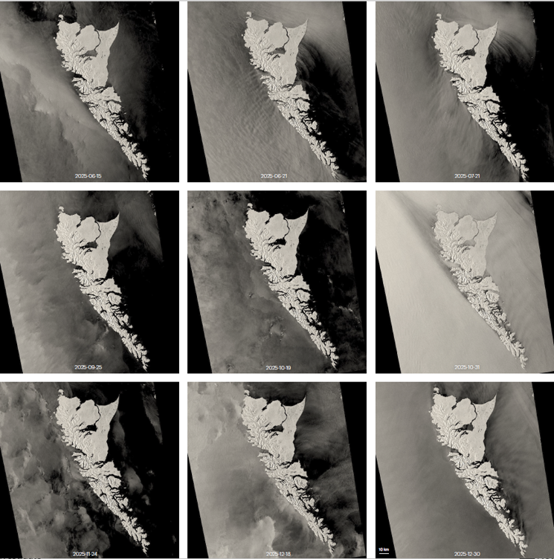
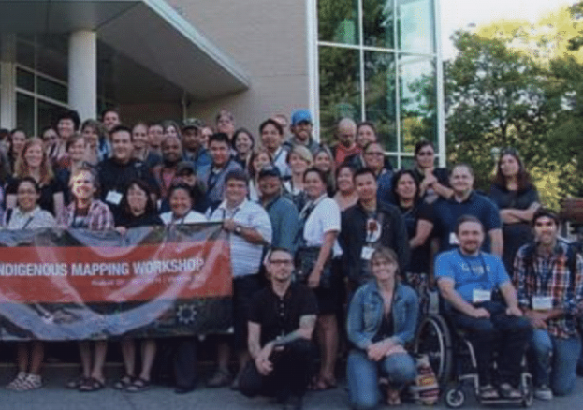

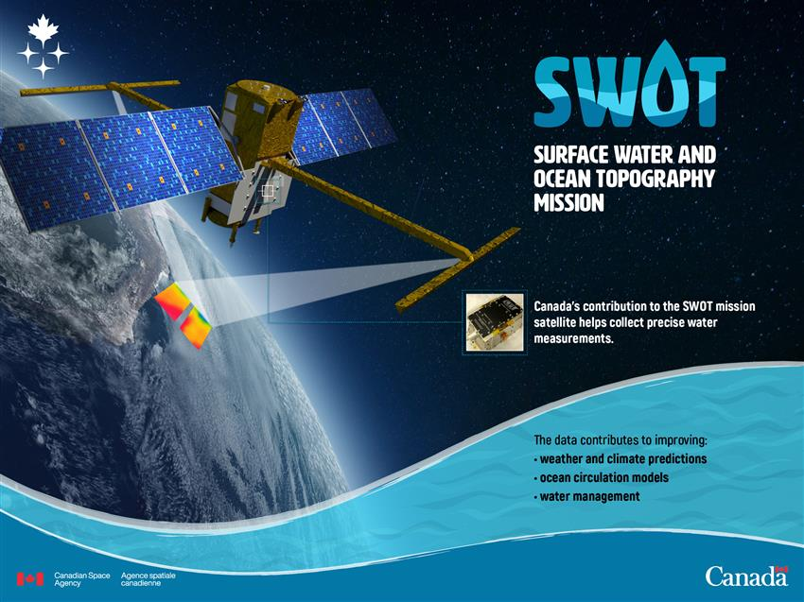

Upcoming programs / initiatives
CEOS Deliverable (proposal): CSA-NASA EO Training Sessions at Indigenous Mapping Workshop (IMW) 2026
-Delivery by CSA and NASA trainers at Vancouver, BC, Canada, Sept. 21-23, 2026
-Session 1: EO data access; Session 2& 3: EO and AI (Pt 1&2); Session 4: Moon, Sky and Artemis Story
-We are implementing these sessions in the IMW 2026 program with the help of the IMW organizing committee.
-Our goal is to attract participants at the entry level and at the intermediate level. Participation numbers will depend on overall workshop registration, which is expected to be on the order of 150 participants.
-Formal CEOS- Task proposal to follow a.s.a.p. (currently awaiting approval by NASA mgmt./external affairs office).
CEOS Deliverable (proposal): CSA-CNES SWOT Information Session: “From Science to Applications - Advancing the Understanding of Canada's Terrestrial Surface Waters : information session on the Surface Water and Ocean Topography (SWOT) satellite mission and its potential to transform our understanding of Canada's terrestrial surface waters”.
-When: Canadian Space Agency (CSA) EO Forum 2026, October 27, 2026, 10:45 a.m. to 12:50 p.m. ET - Speakers: Representatives from the CSA, CNES, Université of Sherbrooke (Canada), ASL and H2O Geomatics, COAST-VC.
-This presentation will explore the mission's scientific foundations, the data it provides, and its practical applications for monitoring lakes, rivers, reservoirs, and water resources.
-Learn how SWOT observations can support research, environmental management, and informed decision-making to address water-related challenges and climate change impacts.

Slide 4
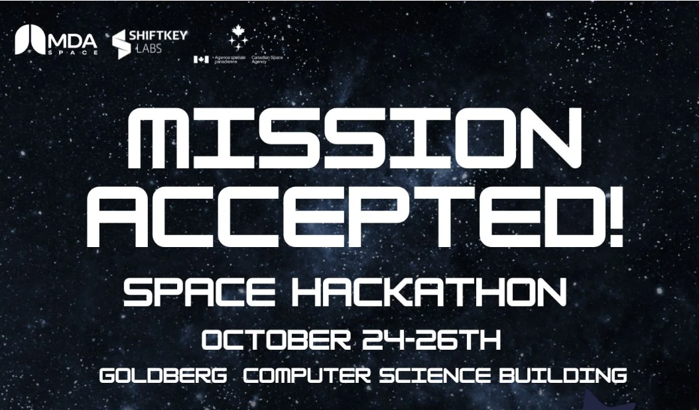
Upcoming programs / initiatives
Mission Accepted Space Hackaton
🚀 Hands-on multidisciplinary hackathon bringing together post-secondary students, industry partners, and technology mentors to tackle real-world challenges inspired by space, observation, space exploration and emerging technologies.
💡 Main objective: work in teams to develop a practical solution to a complex challenge and pitch it to a panel of judges.
🧠 Skills developed: software development, AI, data, design, business, problem-solving, and collaborative teamwork in an industry-connected environment.
🛰️ Key role of industry partners: provide expertise in satellite technology, space applications, Earth observation, and real-world industry challenges.
🤝 Student benefits: direct mentorship, expert feedback, hands-on experience, and exposure to career opportunities in the space, satellite, and Earth Observation sectors.
🌱 Partner benefits: connect with emerging talent, showcase expertise, gain fresh perspectives, support future recruitment and talent development, and strengthen relationships with the post-secondary and innovation ecosystem.
The hackathon offers a unique opportunity to highlight Canadian satellite data — especially from the RADARSAT Constellation Mission (RCM) and RADARSAT-2 — and to apply it to a variety of challenges such as:
Environmental monitoring
Earth observation
Data visualization
Development of educational and public engagement tools

