Slide 1
EOTEC DevNet:
5 years of Learning on Partnership and Community-building
Erin Martin
Martyna Stelmaszczuk-Górska
Yasha Moz
EOTEC DevNet
WGCapD - 15, September 3, 2026

Slide 2
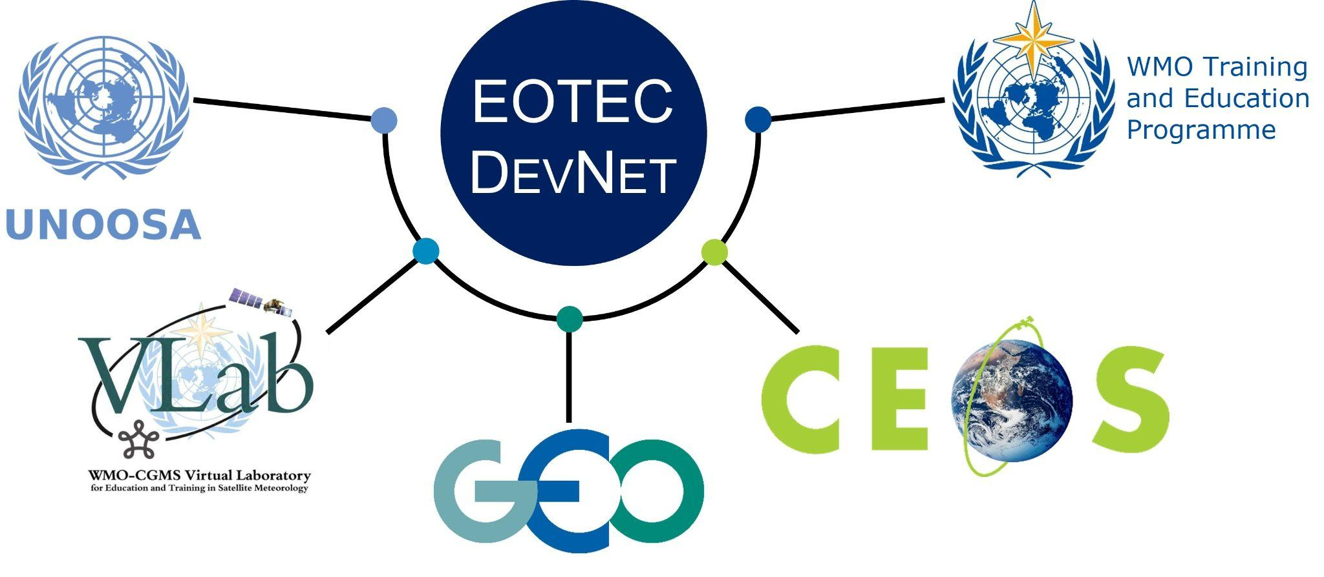



EOTEC DevNet in brief
Promoting collaboration among EO capacity providers
AIMS
Improve collaboration among EO-capacity building providers
Foster exchange of capacity building resources
Reduce duplication
THEMATIC FOCUS
Disaster risk reduction
Climate adaptation and mitigation
eotecdev.net @EOTEC DevNet @EOTECDevNet

Slide 3
EOTEC DevNet History
Born out of WGCapD
Endorsed by
CEOS SIT-36
Founding partners committed
First regional CoP task team meetings
First regional CoP Flood WG meetings
First regional CoP Drought WG meetings
🌟2026🌟
2,500+ people involved
Quarterly CoP meetings with 50-70% repeat attendance
Volunteer engagement in tool trackers, guidance, and other products
March 2021
June 2021
April 2022
April 2025
WGCapD-15, 3 September 2026
Notes:
Very happy that EOTEC is marking its 5th year this year.
This slide gives you a sense of the timeline.
The idea came from WGCapD. A handful of people including Senthil Kumar of ISRO and Nancy Searby of NASA build the partnership with the global partners you see here.
CEOS - Committee on Earth Observation Satellites
UNOOSA - United Nations Office for Outer Space Affairs
GEO - Group on Earth Observations
WMO - World Meteorological Organization (Training and Education)
WMO-CGMS Vlab
We have accomplished a lot. Today we have more than 2000 people involved in the network (through meeting attendance, social media, or newsletter distribution.)
Vibrant regional and thematic CoPs; we have hosted meetings for 940+ participants with 50–70% repeat attendance.

Slide 4
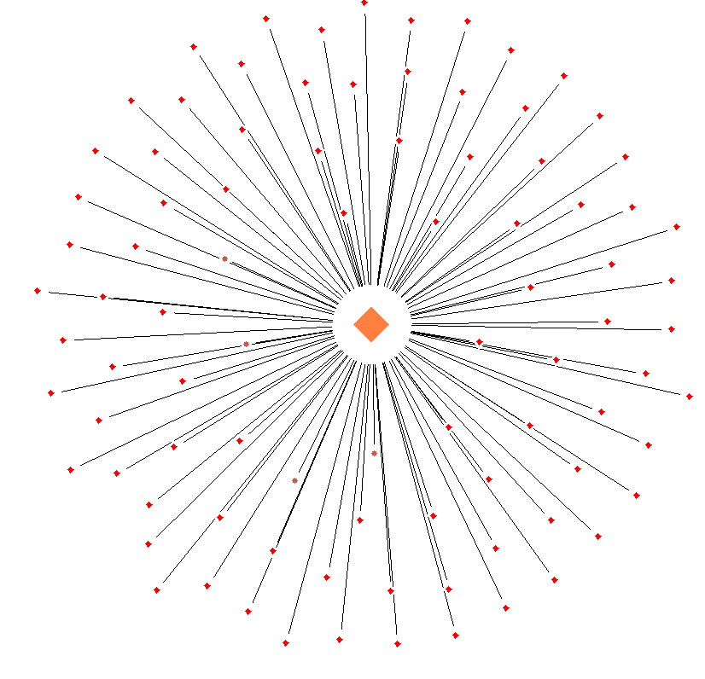
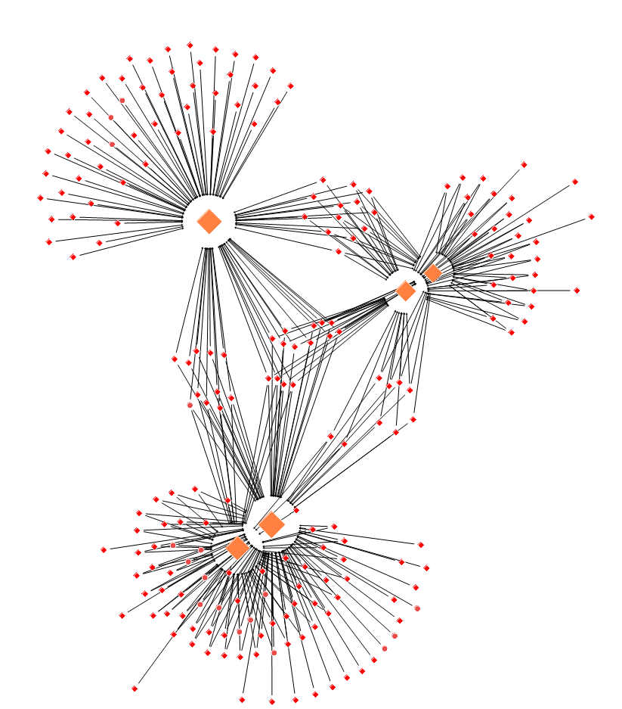
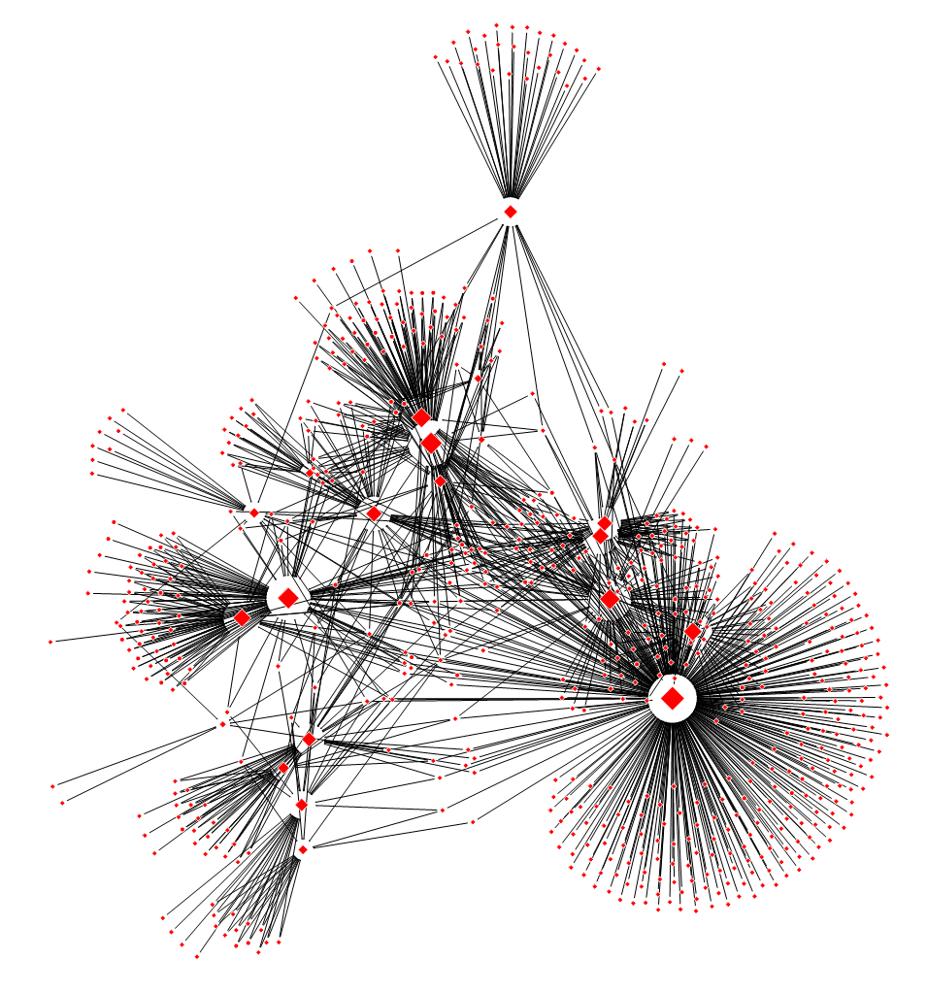
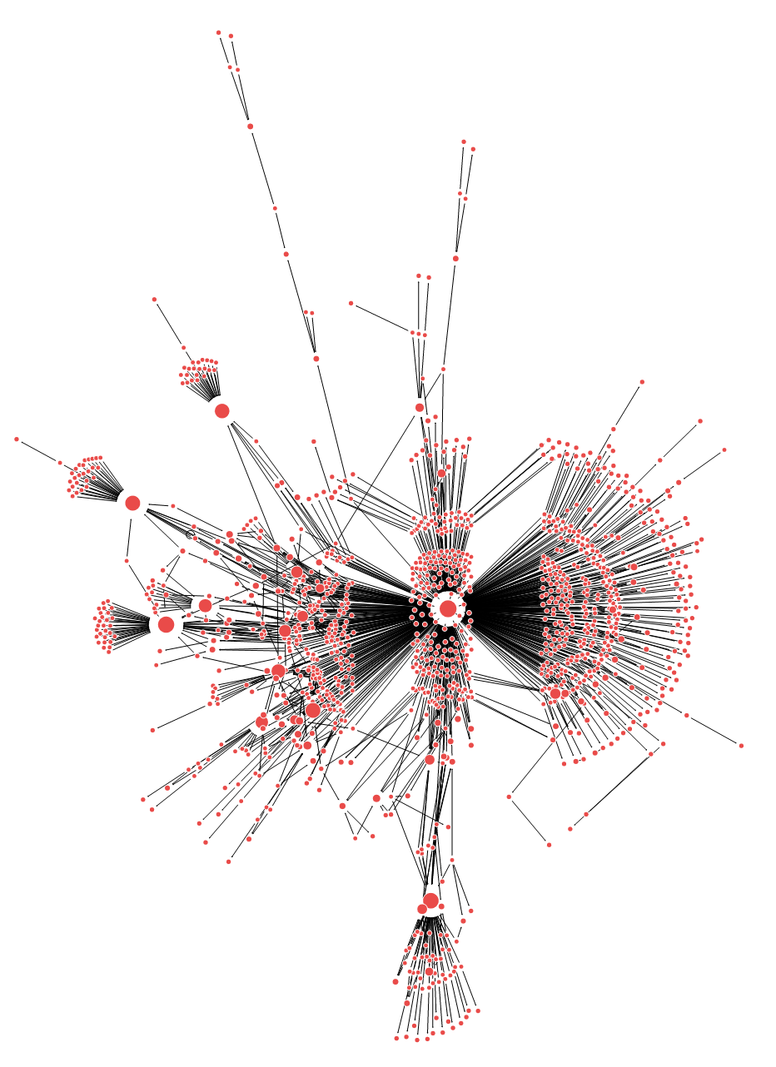
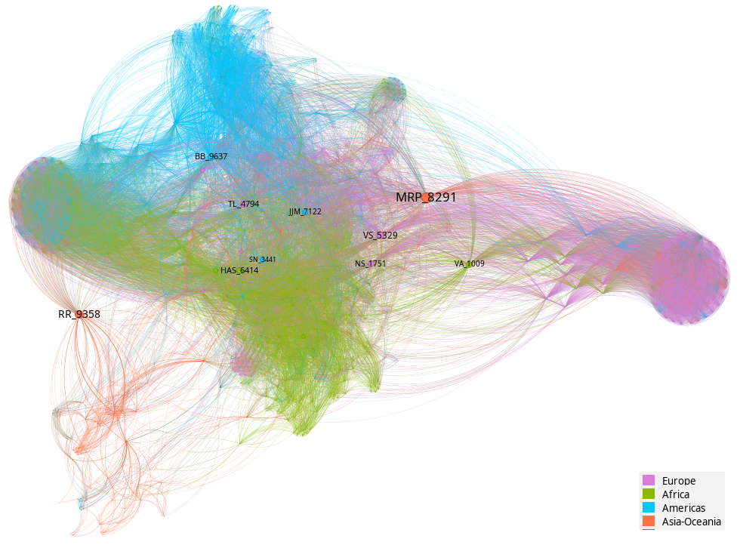
Progress over 5 years
Steady growth of geographic and thematic reach
June 2021
April 2022
February 2023
February 2026
September 2023

Slide 5


Lessons learned after 5+years
Building a community of practice: what we’ve learned
Positives
Ongoing Challenges
Global/Regional leadership engagement+networks indispensable
Knowledge-sharing is our currency
CoP meetings must deliver value
Consistency is key, especially on communications and meetings
Community scaling (consultations, partnerships) created strong foundation
Champions emerge over time
Interns with the “right” skills helped us do more
Hard to build true “community” online; discussions are often quiet
Still striving to reach our original core audience: decision-makers/ capacity builders
Long-term sustainability is critical
Geography matters: Asia-Oceania has been challenging
Engagement in member platform relatively low
Human resources are never enough
WGCapD-15, 3 September 2026

Slide 6
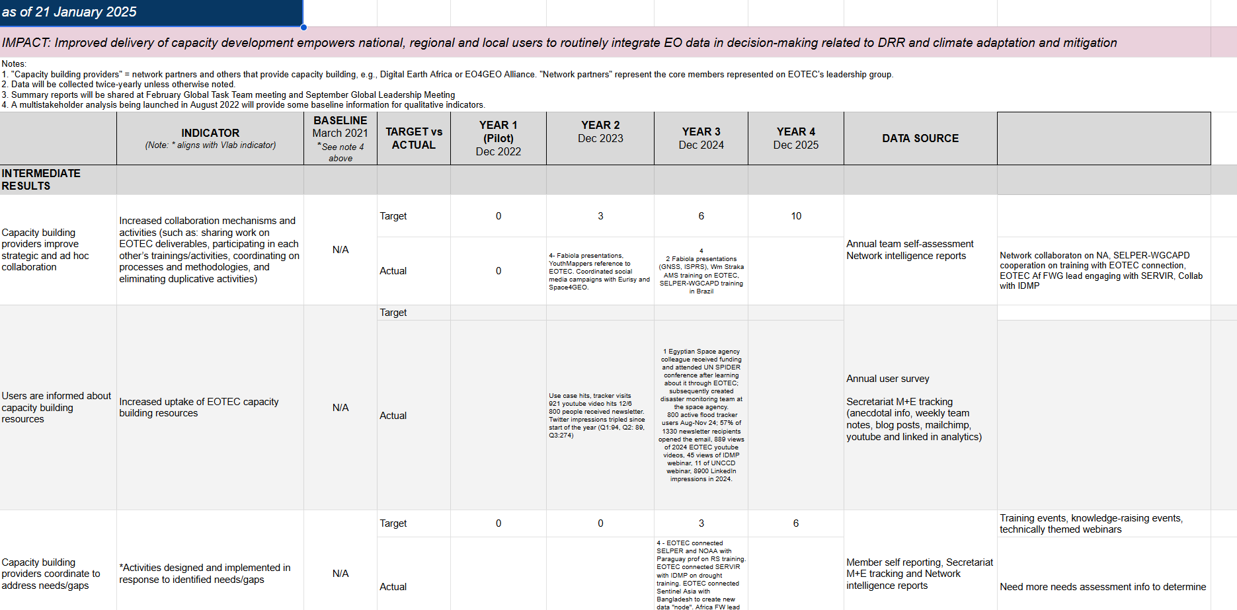
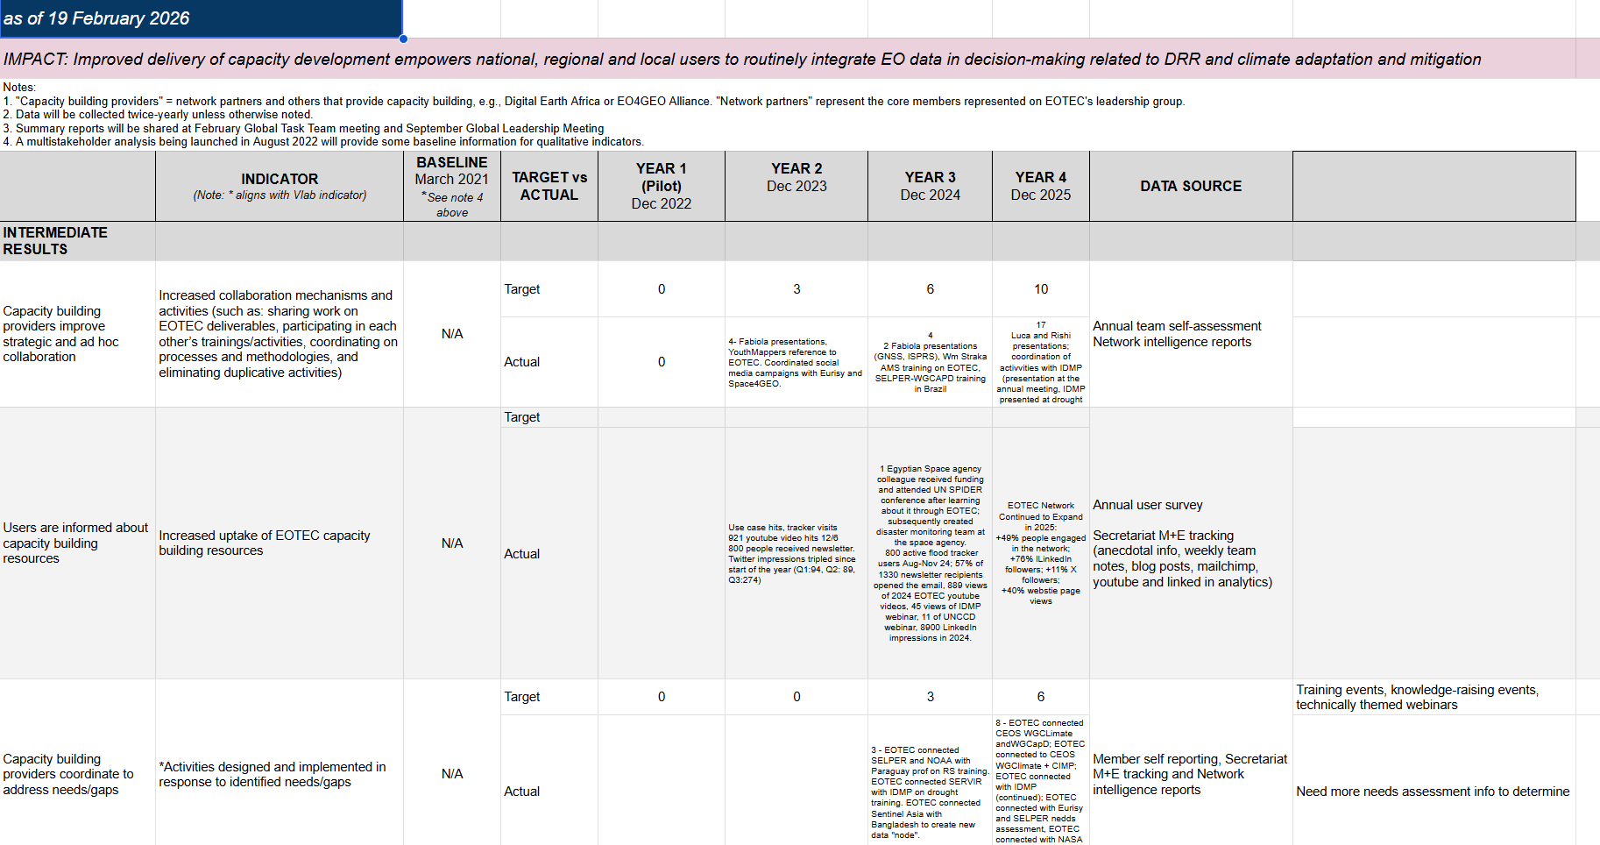
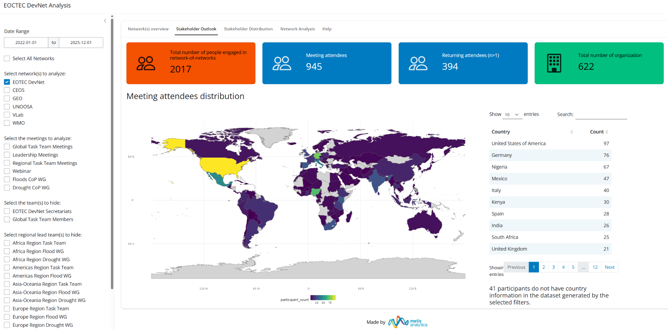
How We Learned these Lessons
Internal Monitoring and Evaluation
Network Analysis
CoP Outreach and Surveys
WGCapD-15, 3 September 2026
Notes:
Very happy that EOTEC is marking its 5th year this year.
This slide gives you a sense of the timeline.
The idea came from WGCapD. A handful of people including Senthil Kumar of ISRO and Nancy Searby of NASA build the partnership with the global partners you see here.
CEOS - Committee on Earth Observation Satellites
UNOOSA - United Nations Office for Outer Space Affairs
GEO - Group on Earth Observations
WMO - World Meteorological Organization (Training and Education)
WMO-CGMS Vlab
We have accomplished a lot. Today we have more than 2000 people involved in the network (through meeting attendance, social media, or newsletter distribution.)
Vibrant regional and thematic CoPs; we have hosted meetings for 940+ participants with 50–70% repeat attendance.

Slide 7
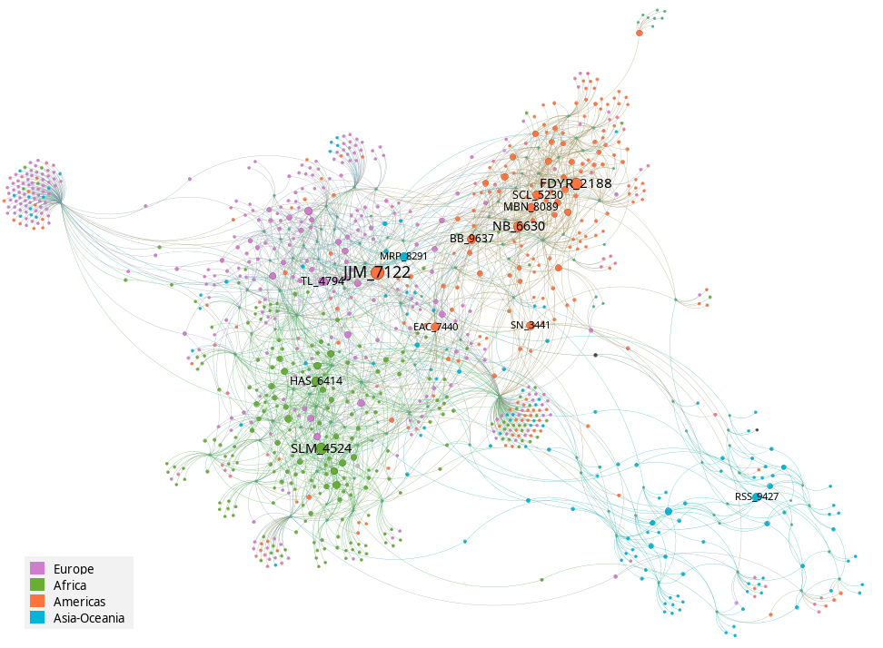
Our Learning Path
Network Analysis to Answer Key Management Questions
For example:
Direct Outreach (people and organizations)
Scope (countries and regions)
EOTEC Value added
Key people and organizations
Focus themes and service activities of the network
Social media outreach and engagement
Web page outreach and engagement
Bipartite network showing participant–meeting attendance, with participant nodes colored by continent of affiliation and sized by meeting attendance frequency.
WGCapD-15, 3 September 2026
Notes:
Very happy that EOTEC is marking its 5th year this year.
This slide gives you a sense of the timeline.
The idea came from WGCapD. A handful of people including Senthil Kumar of ISRO and Nancy Searby of NASA build the partnership with the global partners you see here.
CEOS - Committee on Earth Observation Satellites
UNOOSA - United Nations Office for Outer Space Affairs
GEO - Group on Earth Observations
WMO - World Meteorological Organization (Training and Education)
WMO-CGMS Vlab
We have accomplished a lot. Today we have more than 2000 people involved in the network (through meeting attendance, social media, or newsletter distribution.)
Vibrant regional and thematic CoPs; we have hosted meetings for 940+ participants with 50–70% repeat attendance.

Slide 8
Our Learning Path
5 Insights from Network Analysis
A Truly Global "Network of Networks
Resilient, Non-Hierarchical Structure
"Small-World" Communication Efficiency
Diverse Global Brokerage
Strong Regional Integration
Bipartite network projected to a one-mode network. Node size is proportional to betweenness score. Node color shows each participant’s region of affiliation.
WGCapD-15, 3 September 2026

Slide 9
Our Learning Path
5 Management Recommendations
Engage "Structural Bridges" for New Initiatives
Utilize the Core as a Broadcasting Cohort
Adopt Tiered Communication Strategies
Promote Inter-Agency Data Sharing
Targeted Outreach to Missing Stakeholders
Bipartite network showing participant–meeting attendance, with participant nodes colored by continent of affiliation and sized by meeting attendance frequency.
WGCapD-15, 3 September 2026

Slide 10
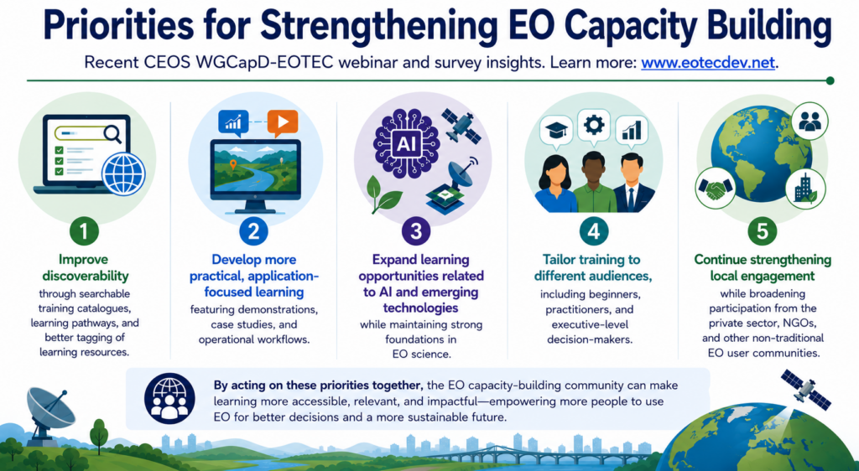
Our Learning Path
Most Important: Listening to our Users
Based on responses to a pre-event survey – 200+responses
WGCapD-15, 3 September 2026
Notes:
Very happy that EOTEC is marking its 5th year this year.
This slide gives you a sense of the timeline.
The idea came from WGCapD. A handful of people including Senthil Kumar of ISRO and Nancy Searby of NASA build the partnership with the global partners you see here.
CEOS - Committee on Earth Observation Satellites
UNOOSA - United Nations Office for Outer Space Affairs
GEO - Group on Earth Observations
WMO - World Meteorological Organization (Training and Education)
WMO-CGMS Vlab
We have accomplished a lot. Today we have more than 2000 people involved in the network (through meeting attendance, social media, or newsletter distribution.)
Vibrant regional and thematic CoPs; we have hosted meetings for 940+ participants with 50–70% repeat attendance.

Slide 11
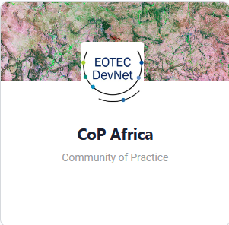
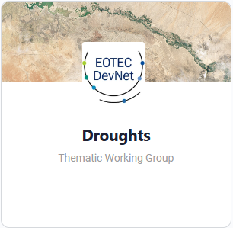
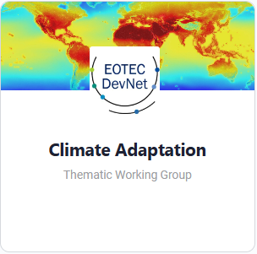
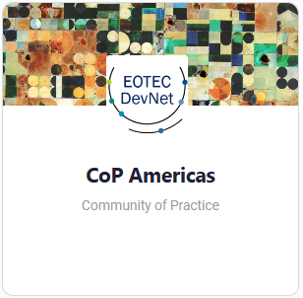
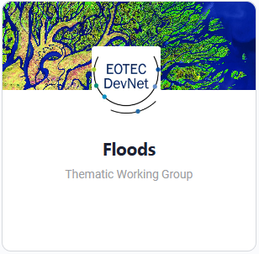
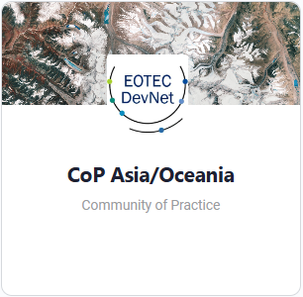
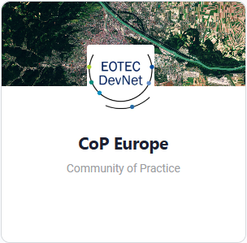
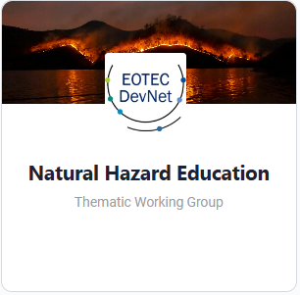
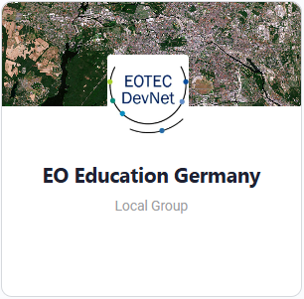
How EOTEC Can Support
EOTEC DevNet’s Added Value: Extending the reach of WGCapD
  Amplification of CEOS activities on social media, website and Communities of Practice meet-ups
  Coordination with CEOS working groups on common technical areas
  Discoverablity and training and resources: CEOS training calendar, EOTEC Opportunities Roundup, Places to Find Training
  Access to tools, data and best practices: Floods and Drought Tools Trackers, Needs Assessment Guidance
  Channel to key partners: GEO, WMO/CGMS Vlab, UNOOSA, WMO ETR (CONECT)
  Channel to a diverse community of ~400 members across national agencies, space institutions, academia, UN bodies, regional climate centres, and private sector organisations with interest in climate topics
  Network of volunteer CoP contributors: e.g., tool trackers
WGCapD-15, 3 September 2026

Slide 12
Thank You!
Erin Martin
Martyna Stelmaszczuk-Górska
Yasha Moz
EOTEC DevNet
WGCapD - 15, September 3, 2026

Slide 13
5 Insights from Social Network Analysis
A Truly Global "Network of Networks": EOTEC DevNet has successfully engaged 2,017 individuals from 609 organizations across 120 countries, with all five founding partner networks actively represented.
Resilient, Non-Hierarchical Structure: The network has a low centralization score (0.30), meaning coordination does not rely on a single leader; instead, leadership is distributed, making the network highly resilient to the loss of any single actor.
"Small-World" Communication Efficiency: With an average path length of 2.3, information typically requires only two "handshakes" to reach almost any participant, allowing for extremely rapid dissemination of knowledge across the global community.
Diverse Global Brokerage: Unlike many international initiatives, key structural "bridges" (participants who connect isolated clusters) are not heavily concentrated but are distributed across regions.
Strong Regional Integration: The network features a dense core where African and European participants are heavily interwoven, while the Americas and Asia-Oceania operate as cohesive regional "lobes" connected via key brokers.
Bipartite network projected to a one-mode network. Node size is proportional to betweenness score. Node color shows each participant’s region of affiliation.

Slide 14
5 Recommendations for Management
Engage "Structural Bridges" for New Initiatives: When launching new projects, prioritize early engagement with identified high-betweenness participants to prevent "knowledge silos" and ensure cross-regional buy-in.
Utilize the Core as a Broadcasting Cohort: Rather than relying only on formal leaders, treat the high-closeness "dense core" as a distributed team of broadcasters to ensure information saturates the network through multiple parallel pathways.
Adopt Tiered Communication Strategies: To maximize efficiency, focus on a "Strategic Communications Core" of 15–20 key connectors; the network’s 2.3-step efficiency will naturally cascade information to the remaining participants.
Promote Inter-Agency Data Sharing: Integrating activity data between CEOS, GEO, WMO, and others with EOTEC DevNet’s will provide a more complete "network-of-networks" view and further reduce duplication of effort.
Targeted Outreach to Missing Stakeholders: Use the interactive dashboard to guide recruitment from under-represented groups, i.e. Small Island Developing States, development finance institutions, and major national data providers.
Bipartite network showing participant–meeting attendance, with participant nodes colored by continent of affiliation and sized by meeting attendance frequency.

Slide 15

Creating drought working groups
Consultation + collaboration helped us build partnerships and find our niche
Dec 2022/
April 2023
Dec 2022/
April 2023
2024
April/
Oct 2025
2 EOTEC community meetings
Inaugural global meeting
Active partnership
Biannual EOTEC drought WG mtgs
CONSULTATION on capacity building on DROUGHTS
25 participants at two meetings
PARTNERED with UNCCD, IDMP, others
Engaged experts on the DROUGHT TOOLS TRACKER
2 JOINT WEBINARS and SIDE EVENT at WMO Drought Resilience +10 event, more work on tracker
EXPERTS come together by region based on priorities set by each task team
Notes:
with flood working group meetings, we started the regular meetings and then worked through our network to get people to attend. with droughts, we started networking and consulting the community and ended up with a stronger foundation for launch. we would anticipate following this model with any future CoP.

