Slide 1
ESA’s Capacity Building Activities
Connor Heeney
ESA
WGCapD - 15
September 3, 2026

Slide 2
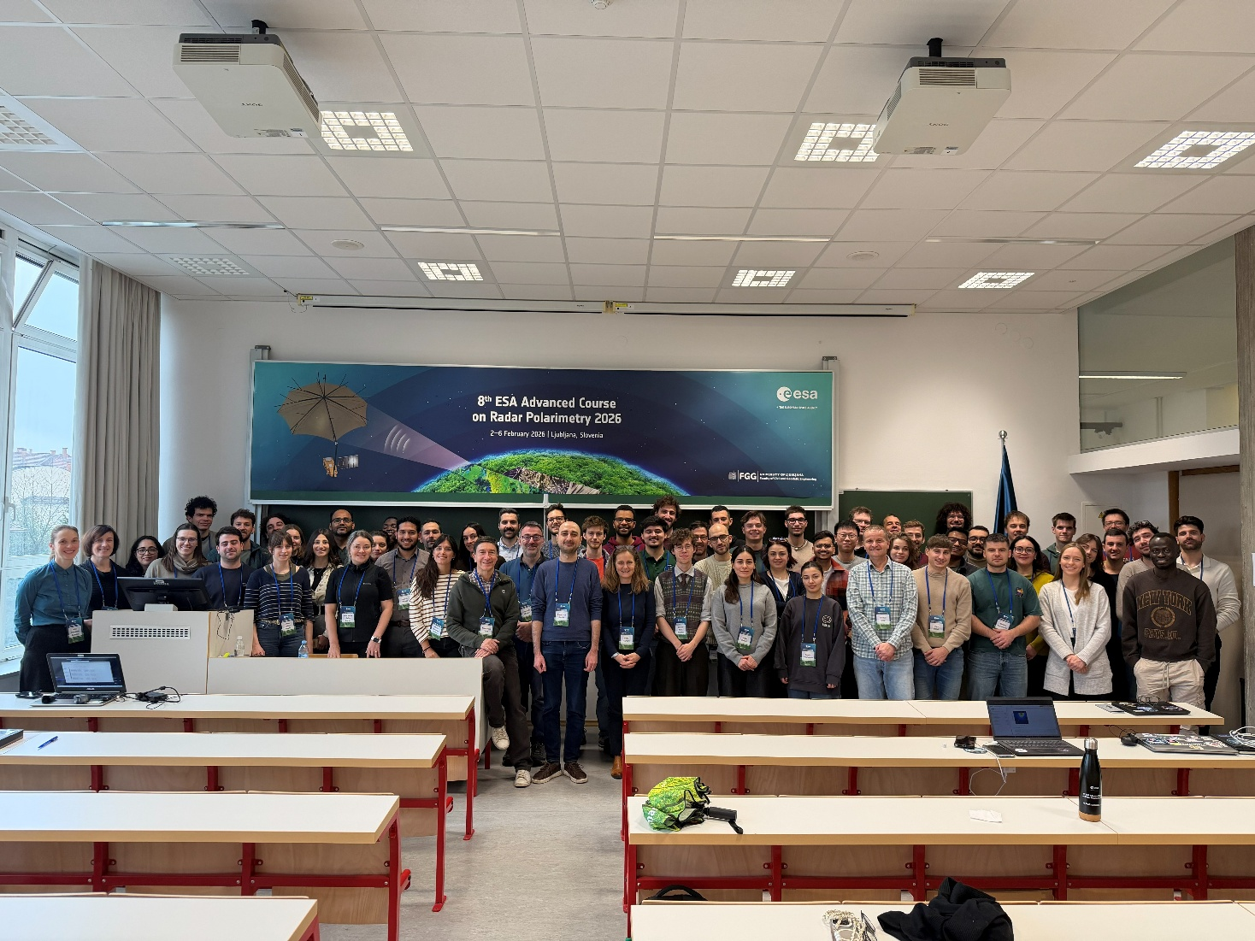
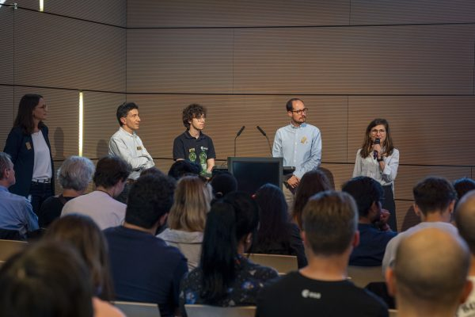
Recent Accomplishments
Delivered the ‘8th Advanced Course on Radar Polarimetry’ highlighting early use cases from ESA’s BIOMASS mission (February 2026)
Participated in the ‘From Space to Prague’ event held at the Italian Embassy (May 2026)
Contributed to the 2026 edition of EGU’s Geosciences Information for Teachers (GIFT) workshop (May 2026)
Delivered ESA’s 2026 InSAR training course in Krakow, Poland (June 2026)
Contributed to ETH Zurich’s first Summer School at their campus in Heilbronn (June 2026)

Slide 3
Upcoming programs/initiatives
Drafting an ITT inviting universities to collaborate on the development of a pan-European Earth observation training course.
Delivering a webinar series with IOGP on applications of Earth observation across the energy sector, beginning in November 2026.
Developing a formal framework to assess the impact of ESA’s capacity-building activities.
Training courses:
-ESA’s 2026 Advanced Land Training – Perugia, Italy (September 2026)
- EO for Fragility – Frascati, Italy (September 2026)
- ESA-ECMWF-EUMETSAT Atmospheric Composition training course – Thessaloniki, Greece (October 2026)
- Science Hub Challenges – Frascati, Italy (September & November 2026)
- Night-Light Remote Sensing and other specialised EO courses (2027)

Slide 4
Areas of Interest for Collaboration
Contributing speakers or case studies to the EO for Energy webinar series.
Co-designing and delivering joint training courses and capacity-building initiatives.

