Slide 1
The GEO Indigenous Alliance
Diana Mastracci Sanchez
GEO Indigenous Alliance
WGCapD - 15
September 3, 2026

Slide 2
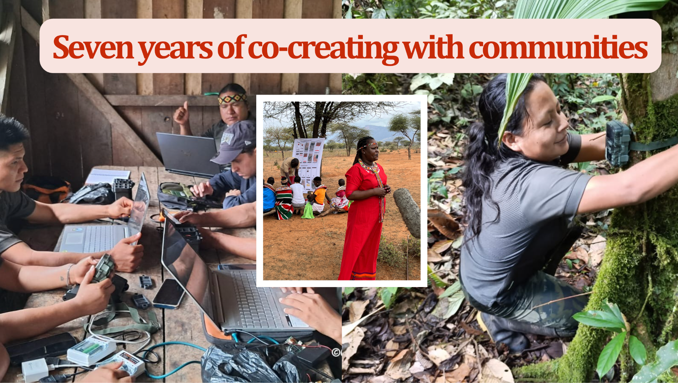
Indigenous led EO systems

Slide 3

From projects to frameworks

Slide 4
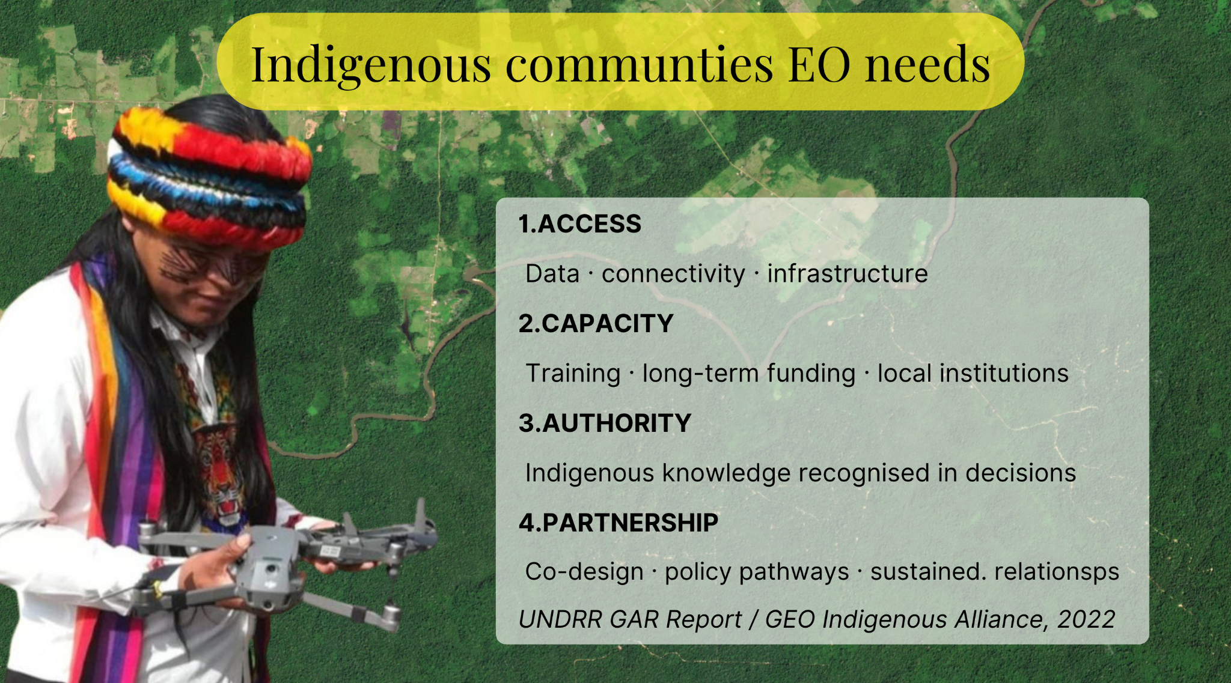
EO needs

Slide 5
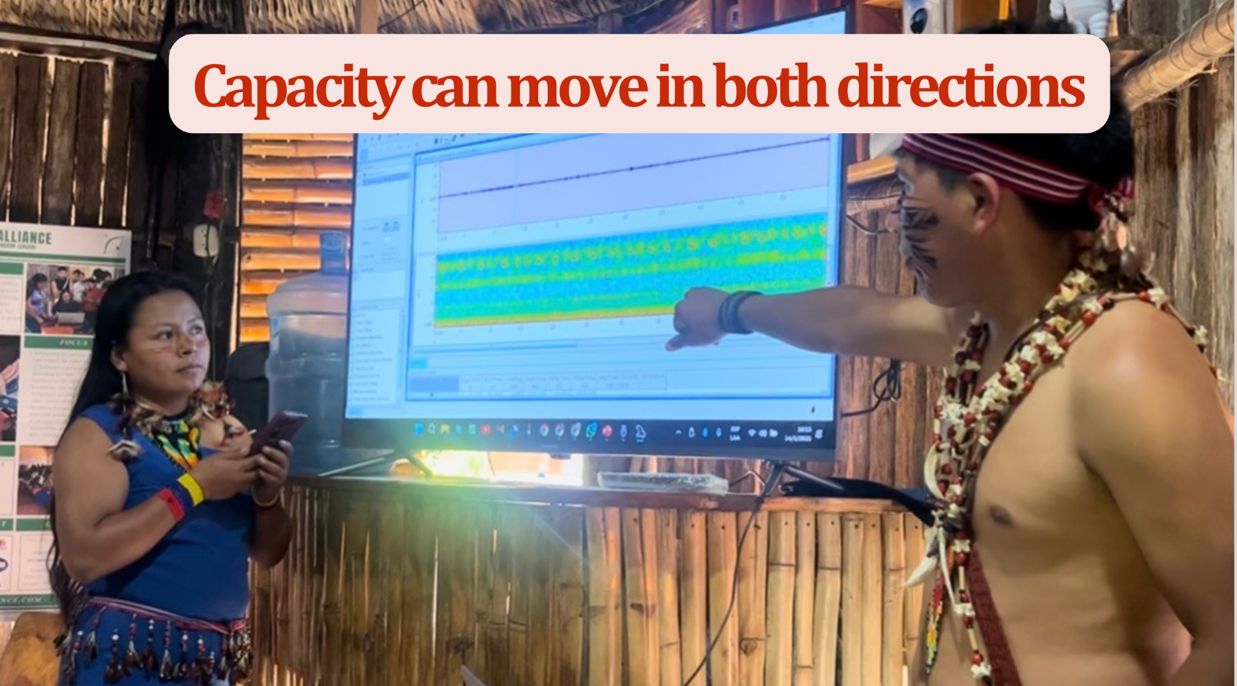

Slide 6
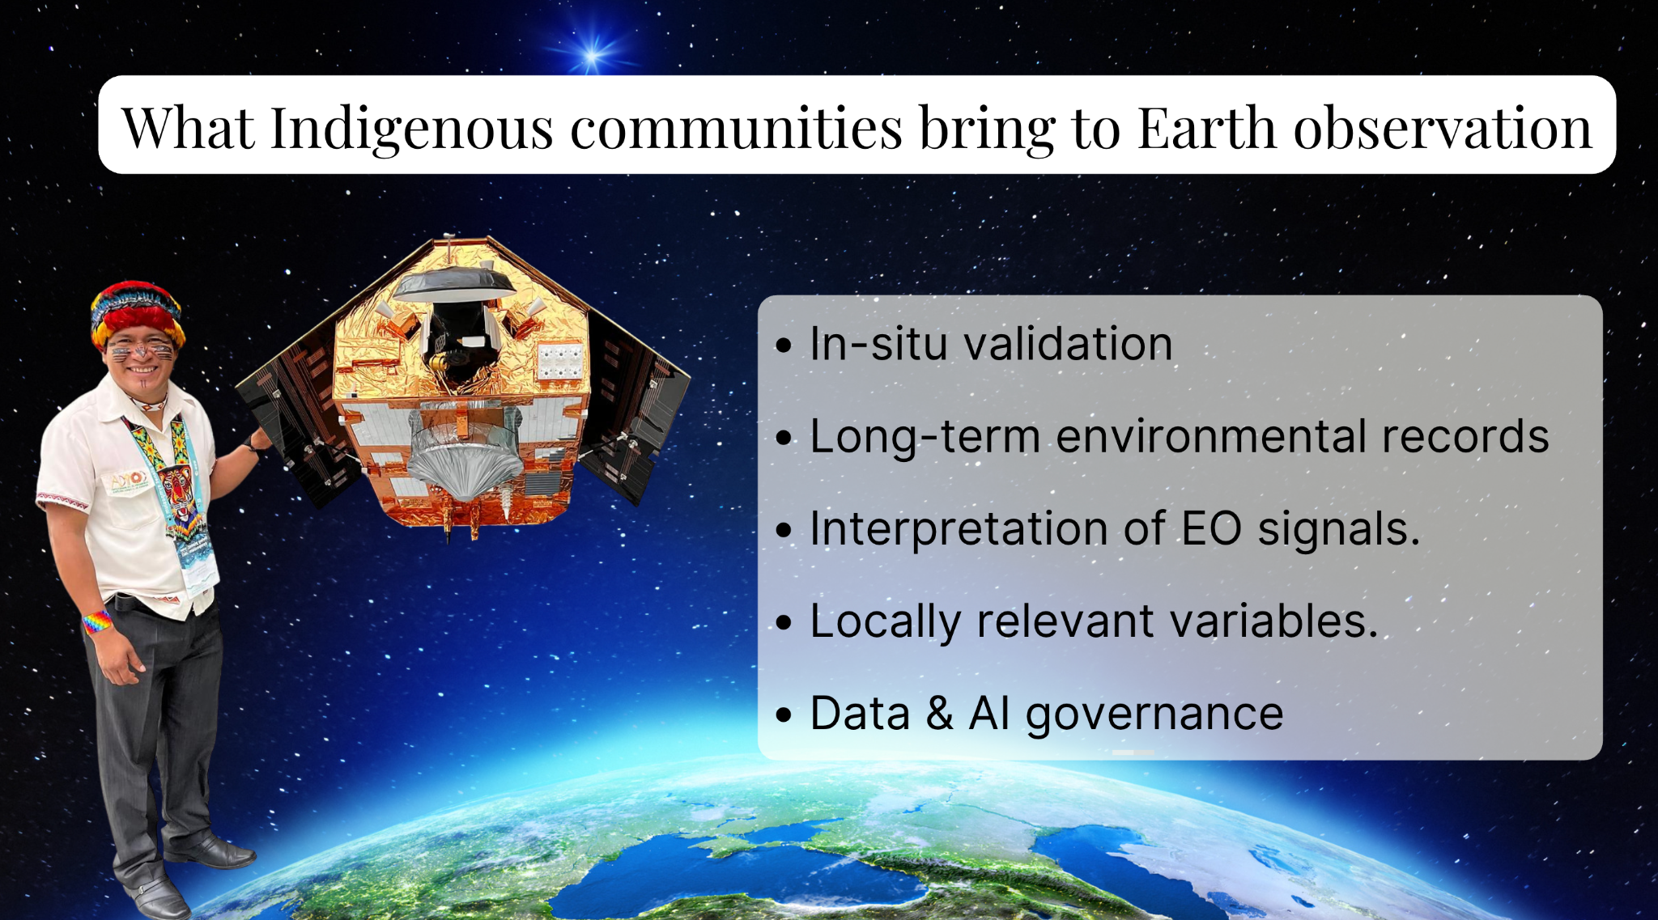

Slide 7
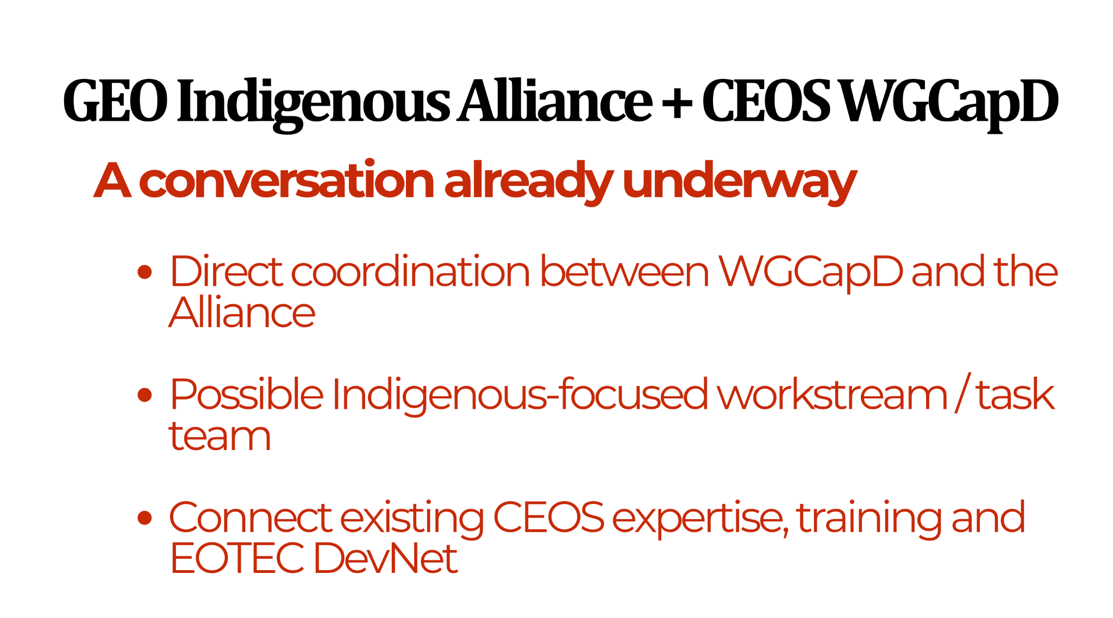
GEO Indigenous Summit 2026

Slide 8
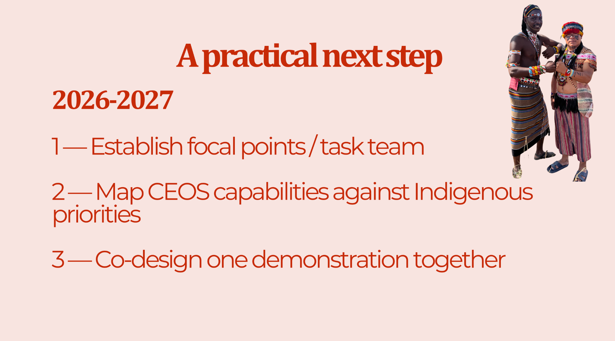
2026-2027

Slide 9

Yohaku (余白)

