Slide 1
NASA
Capacity Building Initiatives and Updates
Melanie Follette-Cook
NASA Goddard Space Flight Center
WGCapD - 15
September 3, 2026

Slide 2
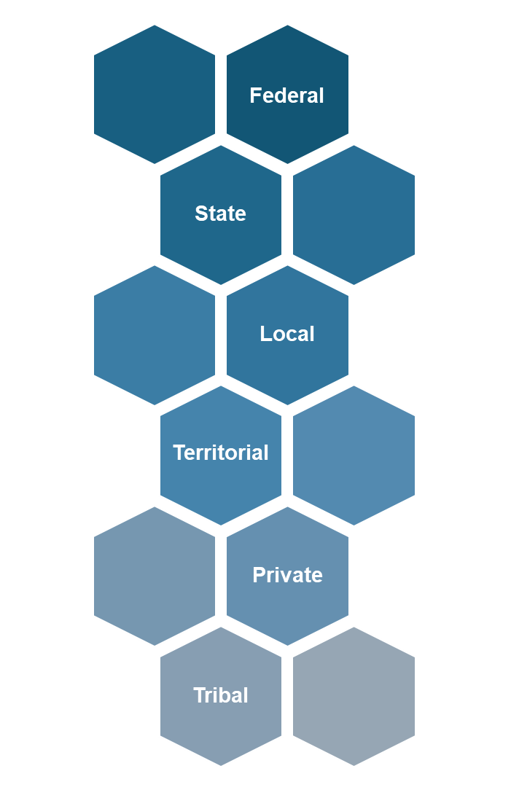
Capacity Building Program → Satellite Needs Portfolio
The NASA Satellite Needs Portfolio is made up of synergistic programs that identify and meet user needs for satellite data in science and applications across thematic areas and sectors.
Interagency Satellite Observation Needs (ISON): identifies challenges, amplifies opportunities, and develops solutions that meet federal needs, including through NASA’s Satellite Needs Working Group Implementation Team (NSITE)
EarthRISE: supports partner resilience across new sectors through last mile support and co-development, achieves greater horizontal integration in Earth Action, and facilitates user/application-based workforce development. EarthRISE continues the workforce development and solutions co-development legacy of DEVELOP and SERVIR with a domestic focus
ARSET: offers free online and in-person training on the Earth observation applications, including basics of satellite observations, data processing, analysis methods, and ready-to-use tools
Partnerships/Coordination: builds communities for global impact with other key NASA partners (this includes CEOS-related engagements)
Tribal
Territorial

Slide 3
Recent Accomplishments
NASA ARSET, online training for the global community
                New webpage: www.earthdata.nasa.gov/data/projects/arset
                2025: 29,000+ participants trained across 176 countries and 8,600+ unique organizations
                Topics included: Calculating spectral indices, landslide monitoring, waterborne and infectious disease risk, wildfire and smoke monitoring and management, terrestrial surface water monitoring, animal tracking, atmospheric lidar profiling, sea level change, snow and ice data products for water resources management, using downscaled projections to assess extreme weather risk, invasive species mapping, change detection using SIF, monitoring vegetation structure and biomass, and coastal and near-shore bathymetry
                Launched learning management system and Fundamentals of Remote Sensing course (English and Spanish available) for asynchronous learning – 26,361 enrolled since launch, Feb 2025 (43% completion rate)
                Additional courses on Hyperspectral Data for Land and Coastal Ecosystems and Building Sustainable Earth Science Applications
                2026 to date: ~25,000 participants, 169 countries, 6,400+ unique organizations. Available 2026 online trainings have focused on the use of remote sensing observations for reservoir and water resources management, estimating PM2.5, species distribution modeling, flood monitoring, heat island mapping, and estimating biomass change.
NASA Earthdata
                Available webinars on PACE land products, HLS products on FIRMS, ICESat-2 snow depth and surface water products, near real time flood products, and python libraries for cloud access to NASA data.
Notes:
Average training participation = ~1,100

Slide 4
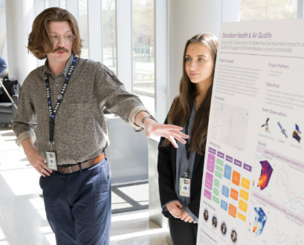
Recent Accomplishments
EarthRISE Developers Academy builds the emerging generation of Earth science leaders through hands-on projects working directly with partners to apply NASA’s cutting-edge satellite data to real-world challenges.
Builds on the 25+ year legacy of the DEVELOP Program
Geospatial workforce development for students, recent graduates, & early career professionals
Demonstrates EO capabilities and solutions for informing action for state, local, tribal, territorial, & private sector partners
10 to 14-week immersive Earth science opportunities in-person at a NASA center or virtually
https://science.nasa.gov/earth-science/earthrise-developers-academy/
Contact: NASA-DL-ERDA@mail.nasa.gov

Slide 5
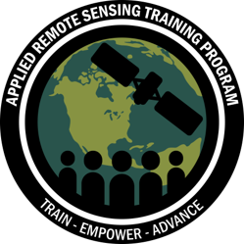
Upcoming programs/initiatives
ARSET 2027 Workplan in final stages of approval
    Online, Instructor-led trainings in 2027: Minerology, Agriculture, Geostationary Observations of Air Quality, biodiversity and forest structure (and more!)
    Online, asynchronous training: Fundamentals of Remote Sensing for Air Quality Applications
    (available Fall 2026)

Slide 6

Areas of Interest for Collaboration
Identifying future training priorities
Helping users find relevant capacity building resources
Training development/case studies
Geostationary Observations for Air Quality, online ARSET training
Date: Summer/Fall 2027
Level: Intermediate/Advanced
Language: English, Spanish
Draft Description:
Sensors in geostationary orbit provide a unique vantage point for observing changes in air quality for different regions of the world at multiple times per day. Geostationary hyperspectral instruments providing data on trace gases in the atmosphere include the Geostationary Environment Monitoring Spectrometer (GEMS) over East Asia, the Tropospheric Emissions: Monitoring of Pollution (TEMPO) over North America, and Sentinel-4 over Europe and North Africa. Together, these satellites form a constellation capable of providing high spatial and temporal resolution insights for air quality managers in the Northern Hemisphere. This training will provide an overview and status update on these instruments, present case studies for the use of their data, and showcase resources for accessing and visualizing information from these missions.

