Slide 1
PhilSA’s Capacity Development Efforts:
Recent Accomplishments, Priorities, and Collaboration Opportunities
Emmanuel Ganancias
Philippine Space Agency
WGCapD - 15
September 3, 2026

Slide 2
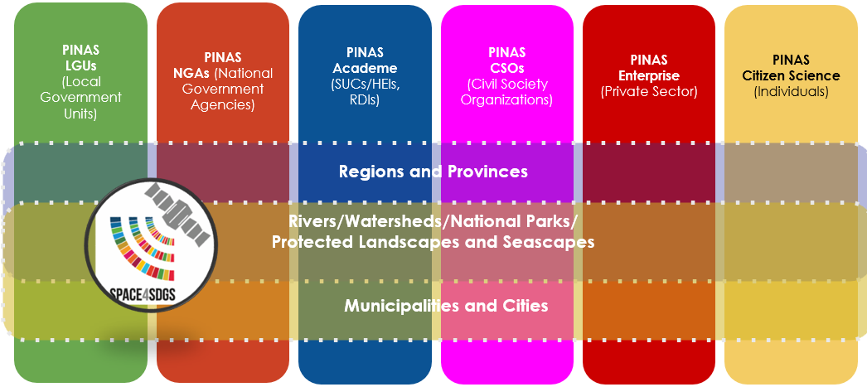
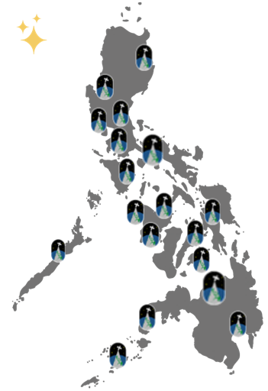
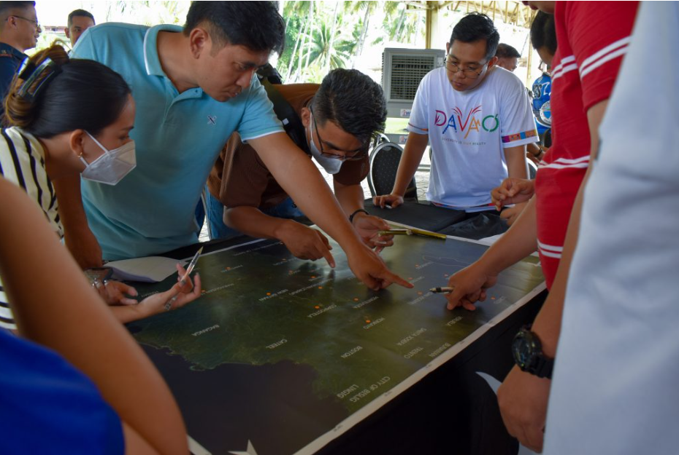
Recent Accomplishments
PINAS (https://philsa.gov.ph/pinas/)
  An active network of institutions and people working together toward sustainability using space data and information
  Since pre-implementation in 2022, it has expanded and reached:
    18 provinces: workshops + symposium + caravans
    18 regions: online EO and space data discussions
    33 CapDev activities (EO, GIS, ground truthing, UAVs)
    3,279: capacitated individuals/agency reps
    38,686: person-hours training
  Distributed data packages to 387 agencies/orgs
    61,000+ maps and data nationwide
Philippine Space Week 2026 (Aug 8 to 14)
  SSTA Training w/ University-Partners + OpenDronePH Launch & Training + Space Business Innovation Camp
EU-Philippines Partnership through CopPhil
  In situ Data Collection and Data Sharing Workshop (June 9)
  EU-PH collaboration on EO Interagency Workshop (Aug 12)
  10 regional LGU Training on EO, GIS, and Copernicus Data (recently in Davao City, last week of July)

Slide 3
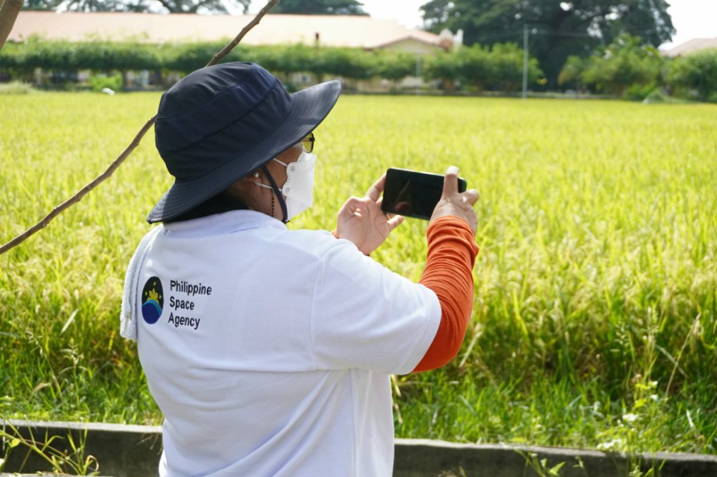
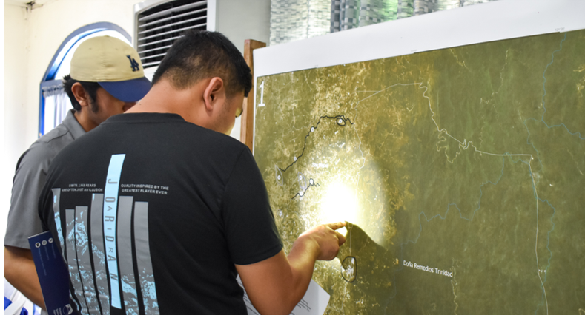
Upcoming programs/initiatives
PINAS Phase 2 (2026-2027)
  Follow-through to initial activities, with emphasis on applications identified through stakeholder needs assessments
  Sustained use of EO data and stronger institutional networks
  Academe partners: Strengthen local networks of space-data users and expand R&D collaboration with universities through joint activities and co-development of products
PhilSA Capacity Development Program (2026–2027)
  Advanced DRRM training (Nov 2026)
  GIS–Remote Sensing training with partner agencies
  Continued technical training and knowledge-sharing aligned with stakeholder needs
CopPhil Technical Assistance & Training (2027)
  Planned LGU technical assistance and training in Cotabato City and Manila, supporting wider operational uptake of EO and Copernicus data for local applications.

Slide 4
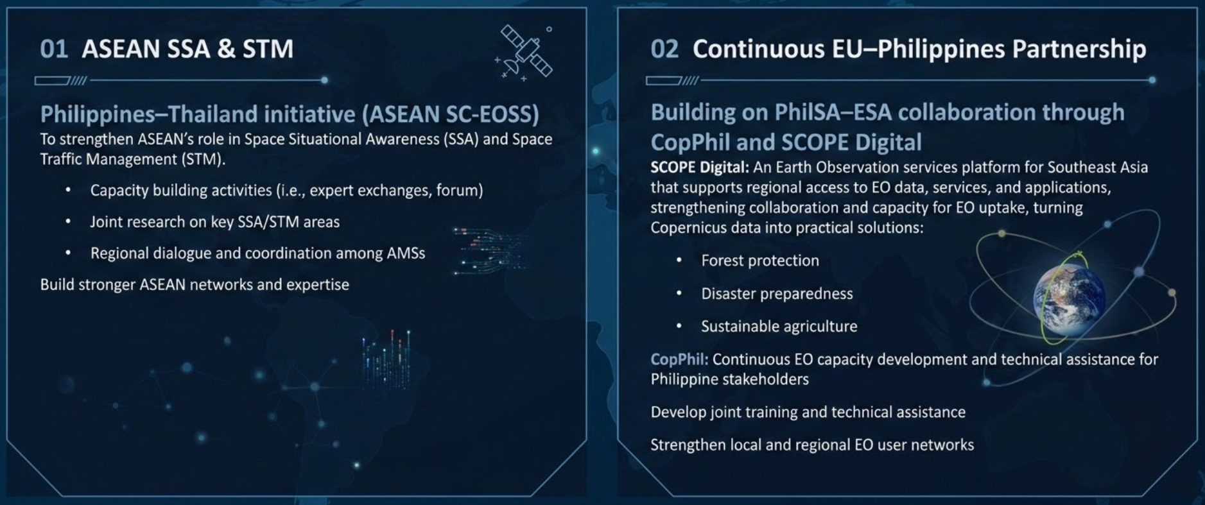
Areas of Interest for Collaboration

