Slide 1
CNES Capacity Building Activities
Linda Tomasini
CNES
WGCapD - 15
September 3, 2026

Slide 2
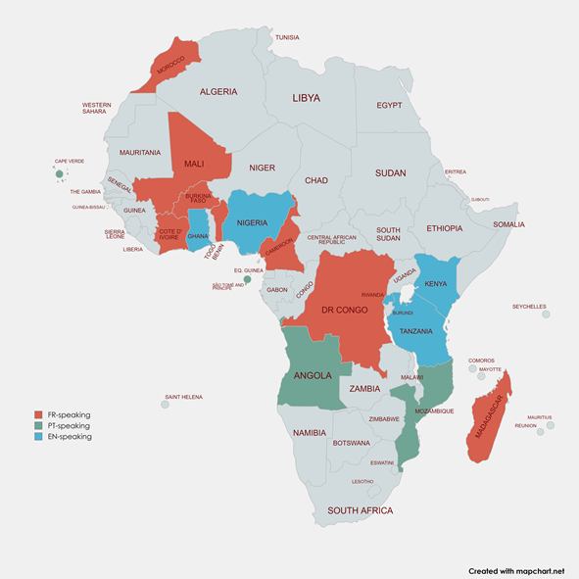
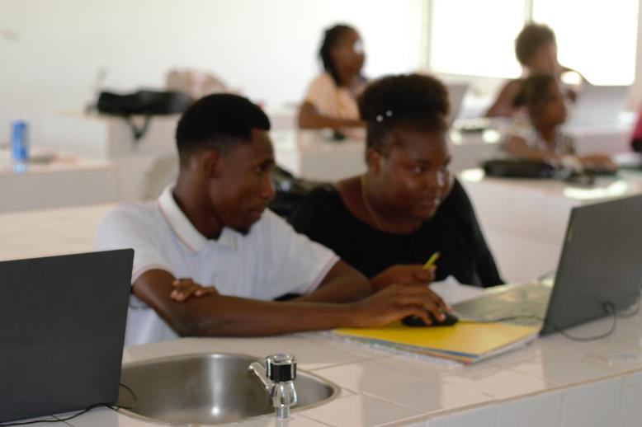
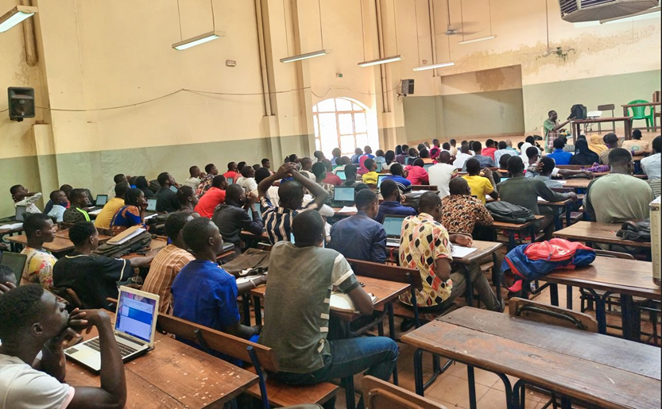
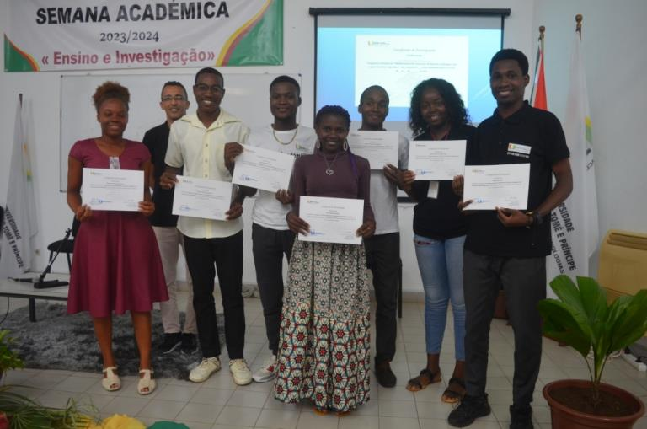
Recent Accomplishments
Participation to UNOOSA training on Resilience and Humanitarian Aid on the use of AI and VHR optical images
Vietnam School of Earth observation #5 on the topic of Ocean Color (October 2025)
WG Africa Training of Trainers Program in 3 languages (PT, EN, FR) (co-funded by the Copernicus User Uptake program from European Commission) in partnership with CEOS members (PTSpace, ASI, …), European and African Partners : 🡪 20 African trainers from 15 African countries who have delivered local training sessions to a total of 1800 trainees + follow-up webinars (hydrology, mangroves, landslides, ocean color, forest monitoring…))

Slide 3
Upcoming programs/initiatives
September 7-11 in Quy Nhon : VSEO6 Vietnam school of Earth Observation #6 in cooperation with VNSC, ICISE, USTH… on the topic of Altimetry for hydrology : participants from Vietnam and neighbouring countries : Philippines, Thaïland, Cambodia
October 26-28 : Contribution to the Forum National d’observation de la Terre organized by CSA. SWOT Training: From Science to Applications. Better understanding of the world’s Oceans and its Terrestrial Surface Waters. In collaboration with CEOS COAST-VC.
From September to December 2026 : webinars on the use of Copernicus in Africa
Upgrade and maintenance of the WG Africa and VSEO Digital Learning platforms

Slide 4
Areas of Interest for Collaboration
Copernicus Capacity development in Africa
Contribution to webinars
Recovery Observatory (in collaboration with WGDisasters)
SWOT mission, hydrology, oceanography
TRISHNA mission, infrared data
BIOMASS mission
AI techniques for disasters mapping, change detection, 3D modelling,…

