Slide 1
CONAE
CONAE
WGCapD - 15
September 3, 2026

Slide 2
Recent Accomplishments
CEOS in Schools Youth Initiative
In collaboration with the Australian Bureau of Meteorology (BOM).
As part of the Initiative, on 23 July, students aged 11-17 from ETec School (Mendoza, Argentina) attended the webinar, "Monitoring Fires from Space", which was presented in Spanish by Dr. Nicolas Younes (Bushfire Research Centre of Excellence, Australia).
Following the webinar, the students were invited to join the CEOS Youth Initiative Poster & Video Challenge, an opportunity to bring their perspectives and voices into the CEOS process.
As a result, on 27 August, they submitted three posters and one video, sharing their vision for a joint space mission designed to support wildfire and earthquake response.
The selected works will be showcased at the CEOS Plenary in November 2026..

Slide 3
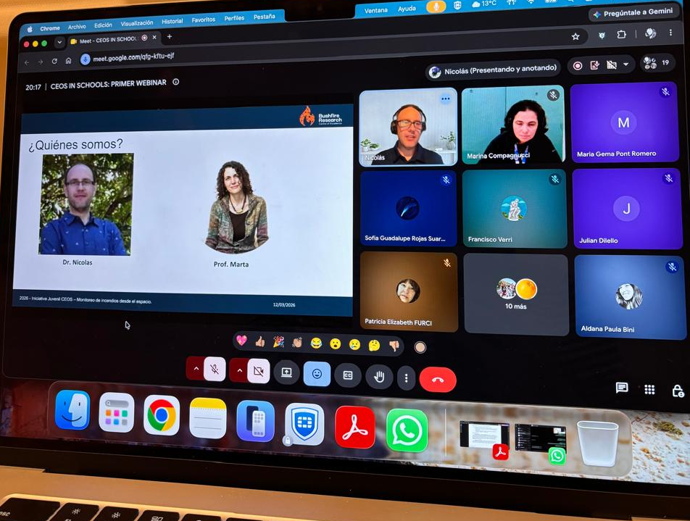
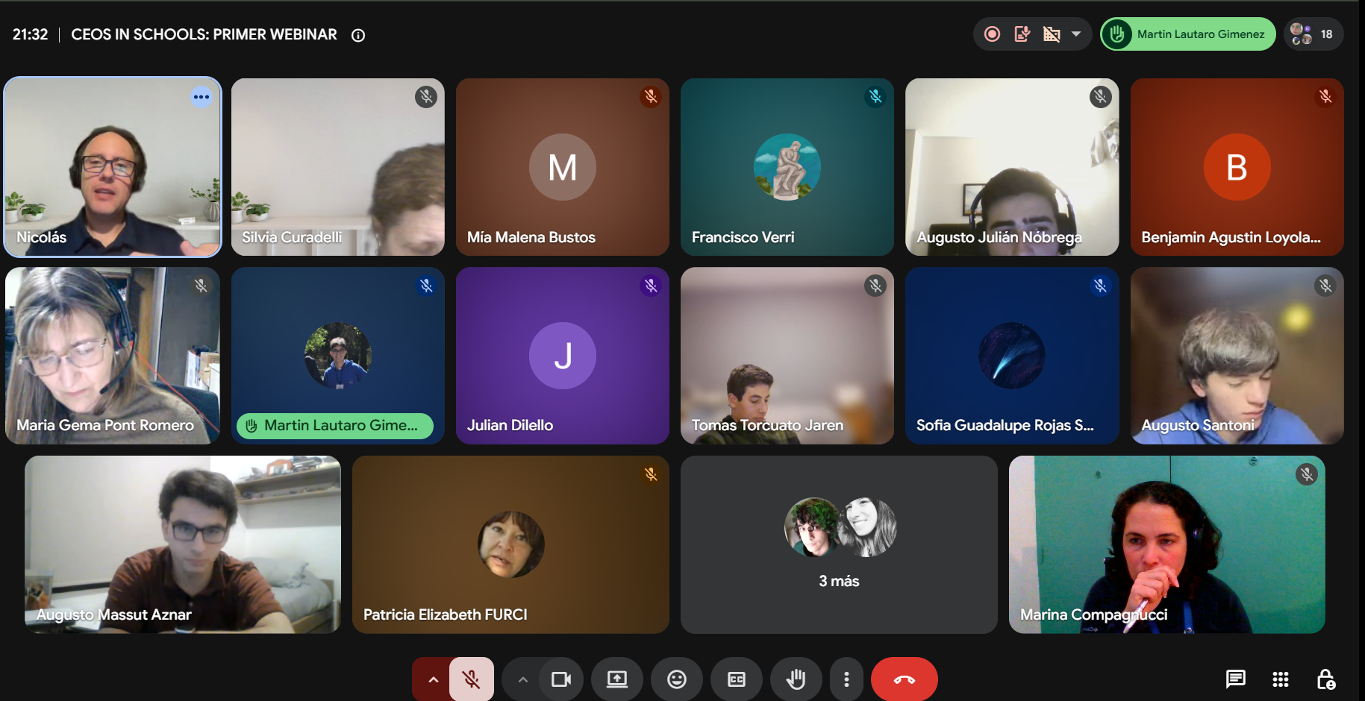
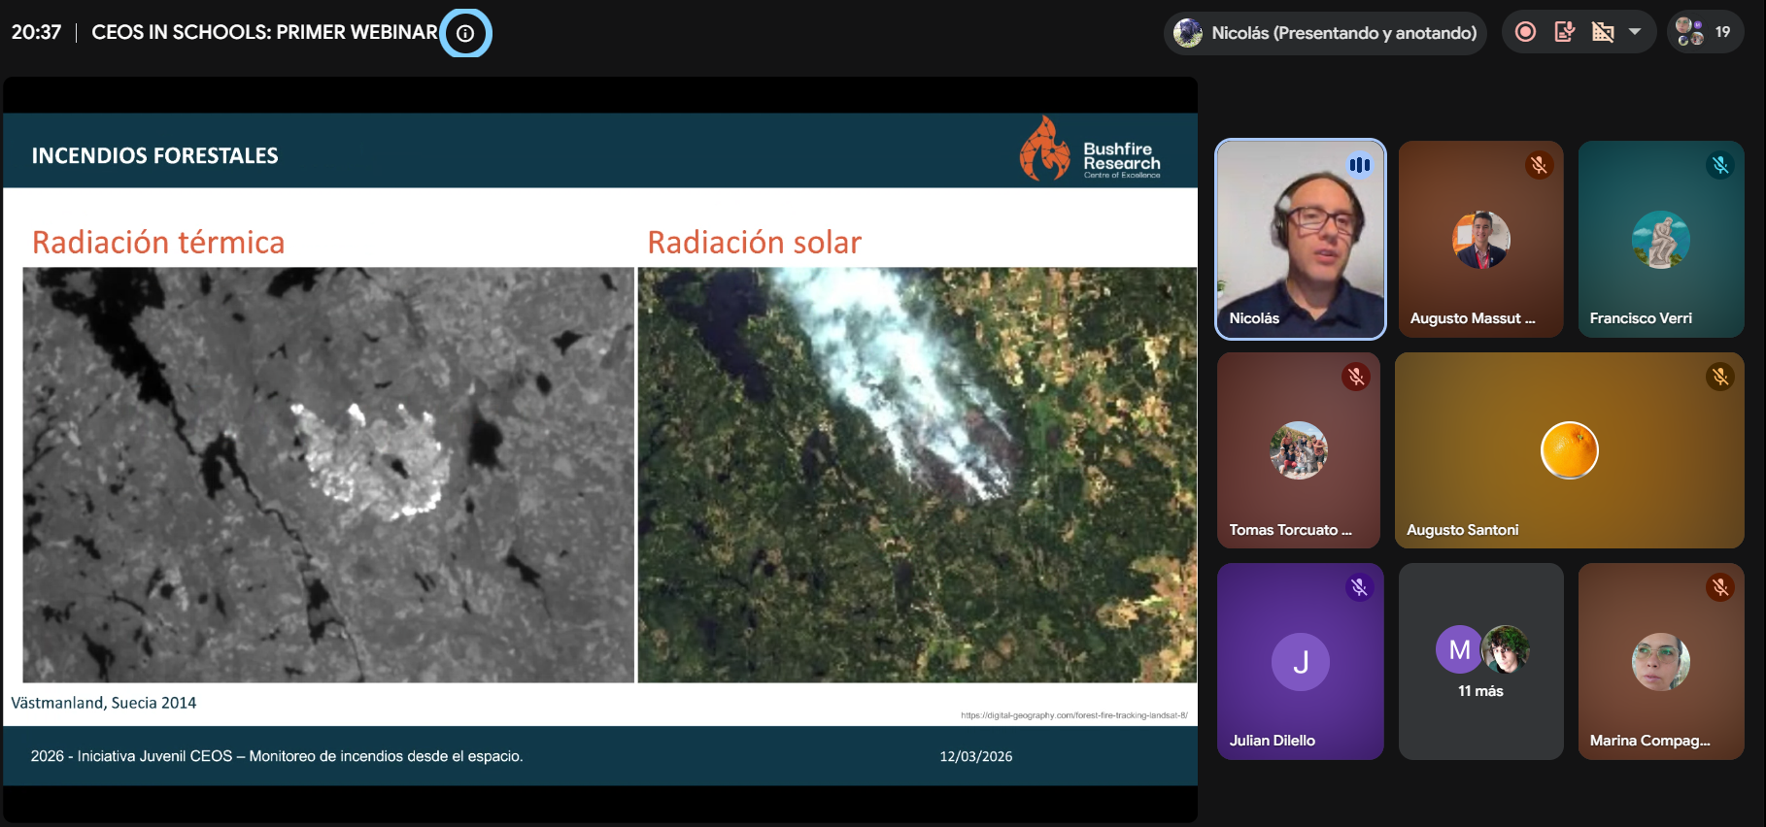
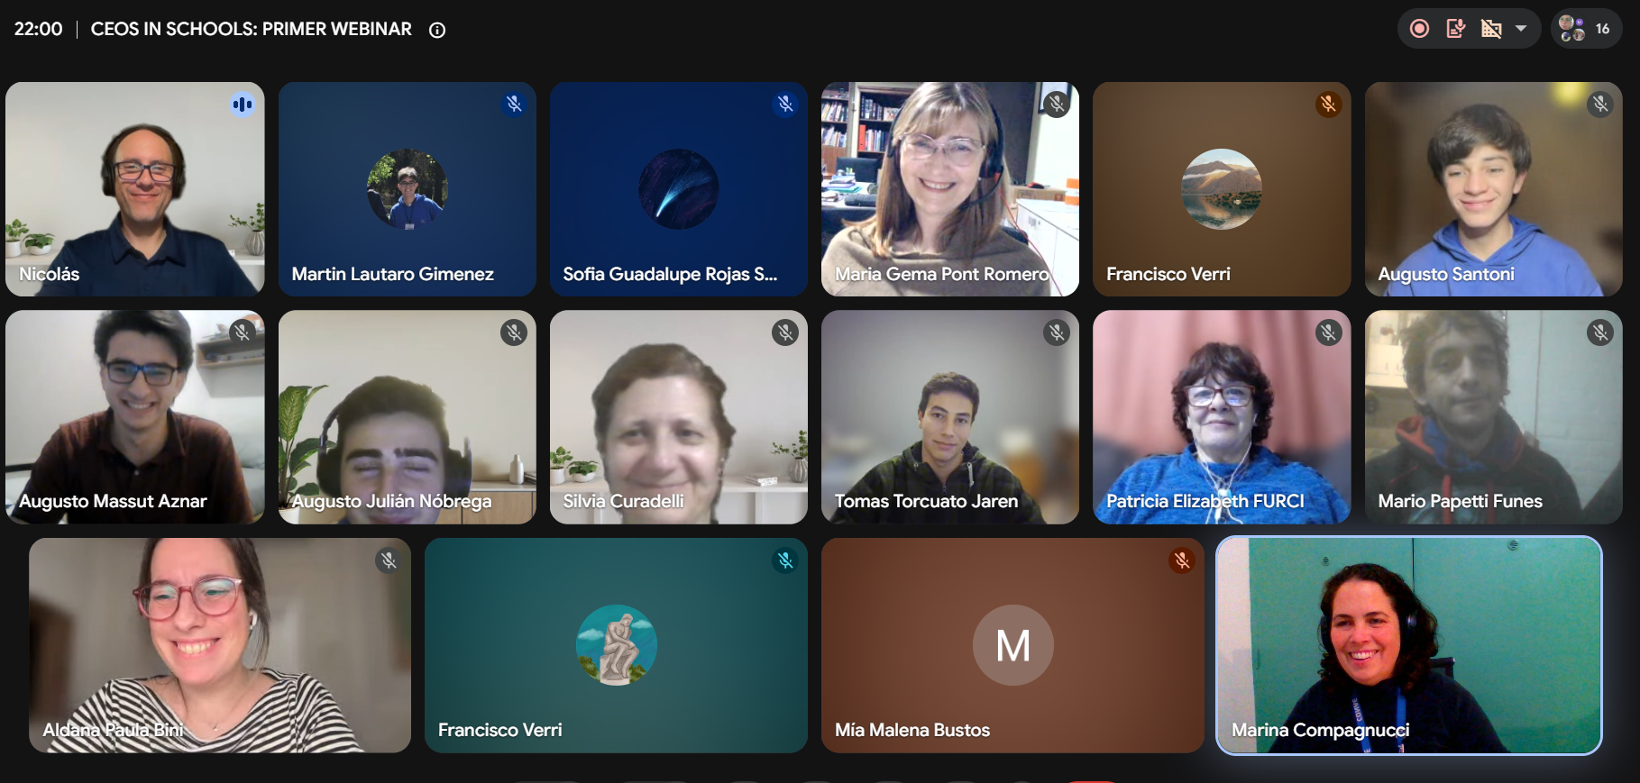
Recent Accomplishments
Webinar
"Monitoring Fires from Space“
Students of ETec Mendoza
with Dr. Nicolas Younes
23/JUL/2026

Slide 4
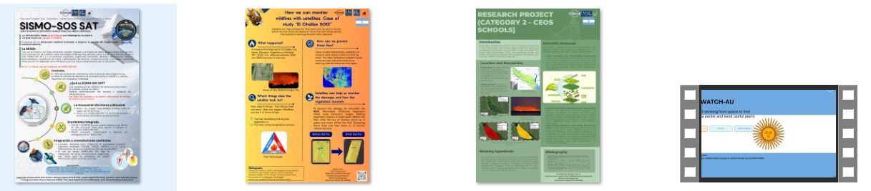
Recent Accomplishments

