Slide 1
Biodiversity –VC
Collaboration opportunities with WGCapD
Yoseline Angel (NASA),
Lucie Viciano (CSA), and Marc Paganini (ESA)
CEOS B-VC
WGCapD - 15
September 3, 2026

Slide 2
CEOS B-VC Overview
The Biodiversity Virtual Constellation (B-VC) was established in April 2026 SIT 41
Co-lead by: Lucie Viciano (CSA), Marc Paganini (ESA), Yoseline Angel (NASA)
Advance biodiversity understanding, monitoring, and conservation for the benefit of society
by strengthening the community’s use of space-based Earth observations
and data products
Core Activities
Users
Fill data product gaps
Enhance analytical tools
Build Users Capacity
Increase user engagement
Develop prototype monitoring systems
GEO BON GBiOS “Space Arm”
GEO BON
GOOS BioEco
IPBES
Ramsar Convention on Wetlands
UNCBD
UNCCD
UNSEEA
Nature Finance
National agencies

Slide 3
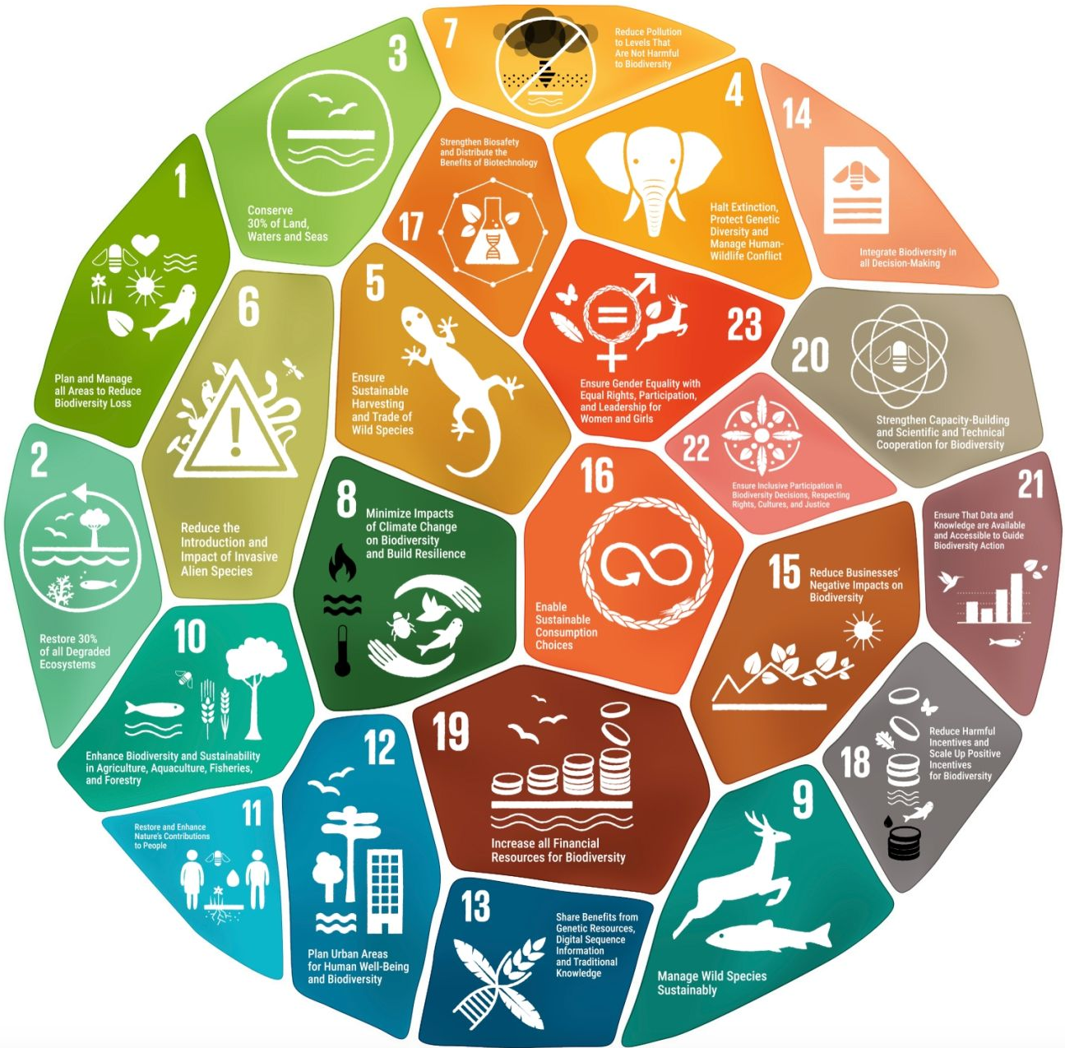
Areas of Interest for Collaboration
Reach
B-VC seeks WGCapD :
Support to develop a coordinated outreach strategy with GEO, regional GEOs, and GEO BON activities (e.g. AmeriGEO week 2026).
Understand Needs
Use engagements to better understand user and institutional needs, identify priorities, and inform the planning and development of future B-VC activities.
Engage
Support with workshops, trainings, and other capacity building activities to reach and connect with institutions leading biodiversity efforts, particularly
the *UNCBD TSCCs.
* The UN Convention on Biological Diversity (CBD) operates a global network of regional and subregional Technical and Scientific Cooperation Support Centers (TSCCs) to help countries implement the Kunming-Montreal Global Biodiversity Framework.

Slide 4
Upcoming initiatives
Pre-event Training/Outreach opportunity
Topic: SAR for Biodiversity and applications overview
Status: TBD
B-VC is proposing a webinar that will follow on from NASA’s in-depth NISAR training at the
AmeriGEO week, Nov. 30- Dec. 4, 2026
Goal: Showcase the broader potential of satellite SAR observations for biodiversity applications, while using the session as an outreach opportunity to identify institutions interested in applying SAR for biodiversity and better understand their needs and priorities.
We expect institutions leading biodiversity efforts to participate, particularly the UNCBD Technical Support Centres (TSCs) in the region.
Formal proposal currently under discussion.

