Slide 1
WGClimate Capacity Building Needs
WGCapD Annual Meeting 2026
3 September, 2026

Slide 2
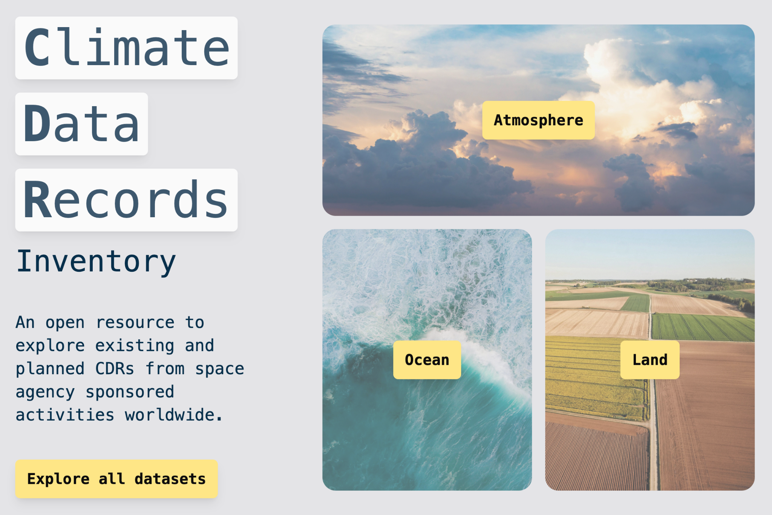
Capacity Building Gap
Remote sensing for climate has improved significantly in the last decade
  Climate Data Records are now routinely provided by CEOS Agencies
How can we ensure the data is in the hands of decision makers, so it can support data-led decision making?

Slide 3
From the GST Strategy
Recommendations:
6. WGCapD should work with subject matter experts on the AFOLU, GHG TT and AC-VC GHG teams and with the NGHGI community to develop capacity building materials that provide a transparent explanation of the information content and uncertainties of these products
14. CEOS should reinforce its partnership with EOTEC DevNet and engage in the Climate Adaptation Working Groups (CAWG), to develop and deliver capacity building activities to support the adaptation goals of the Global Stocktake.
Proposed actions:
WGCapD to develop specific use cases to provide transparent explanations of the information content and uncertainties associated with these products and collaborate with EOTEC DevNet to provide trainings on using EO to support adaptation and resilience.
EOTEC DevNet to develop capacity building materials on using EO to support adaptation and resilience.

Slide 4
Capacity development
Activities/Actions | Responsible Entities | Resources needed​ | Duration​ (years) | Draft GST Roadmap Recommendations Addressed​
Develop specific use cases to provide transparent explanations of the information content and uncertainties associated with these products and collaborate with EOTEC DevNet to provide trainings on using EO to support adaptation and resilience. (Consider further refinement by WGCapD and 2026 Chair before adding to workplan) | WGCapD (primary) ACVC LSIVC 2026 CEOS Chair WGClimate | ​Significant resources for demonstrators and long-term commitment for trainings | Annually | 6. WGCapD should work with subject matter experts on the AFOLU, GHG TT and AC-VC GHG teams and with the NGHGI community to develop capacity building materials that provide a transparent explanation of the information content and uncertainties of these products 14. CEOS should reinforce its partnership with EOTEC DevNet and engage in the Climate Adaptation Working Groups (CAWG), to develop and deliver capacity building activities to support the adaptation goals of the Global Stocktake.
Develop a 2026 EO Handbook on Adaptation and Resilience, along with an accompanying web portal featuring case studies. (Consider further refinement by 2026 Chair before adding to workplan) | 2026 CEOS Chair ESA EO Handbook Team CEOS comms Team | ​CEOS Chair theme activities | ​Periodical | 11. CEOS should showcase adaptation use cases that employ EO data. Establish a repository of successful examples where EO has been applied to support adaptation actions across various sectors (e.g., agriculture, urban planning, disaster risk reduction, ecosystem management). These case studies, potentially drawn from agency-led projects, would demonstrate the value and feasibility of using EO for adaptation and encourage wider adoption
Reinforce the partnership with EOTEC DevNet to develop capacity building materials on using EO to support adaptation and resilience. (Consider further refinement by 2026 Chair before adding to workplan) | ​WGClimate WGCapD 2026 CEOS Chair | Multi-year engagement in a new partnership | ​1-2 | 14. CEOS should reinforce its partnership with EOTEC DevNet and engage in the Climate Adaptation Working Groups (CAWG), to develop and deliver capacity building activities to support the adaptation goals of the Global Stocktake.

Slide 5
UNFCCC Capacity Building
UNFCCC provides an annual synthesis report on capacity building, referencing the capacity building framework for developing countries
  Important to strengthen institutional and individual capacities
  Peer-to-peer learning is very important
UNFCCC Secretariat manages the Capacity Building Portal, which showcases a range of tools, projects, courses, and other resources to enhance the capacity and ability of developing countries to respond to the challenges posed by climate change at national, regional and local levels.

Slide 6
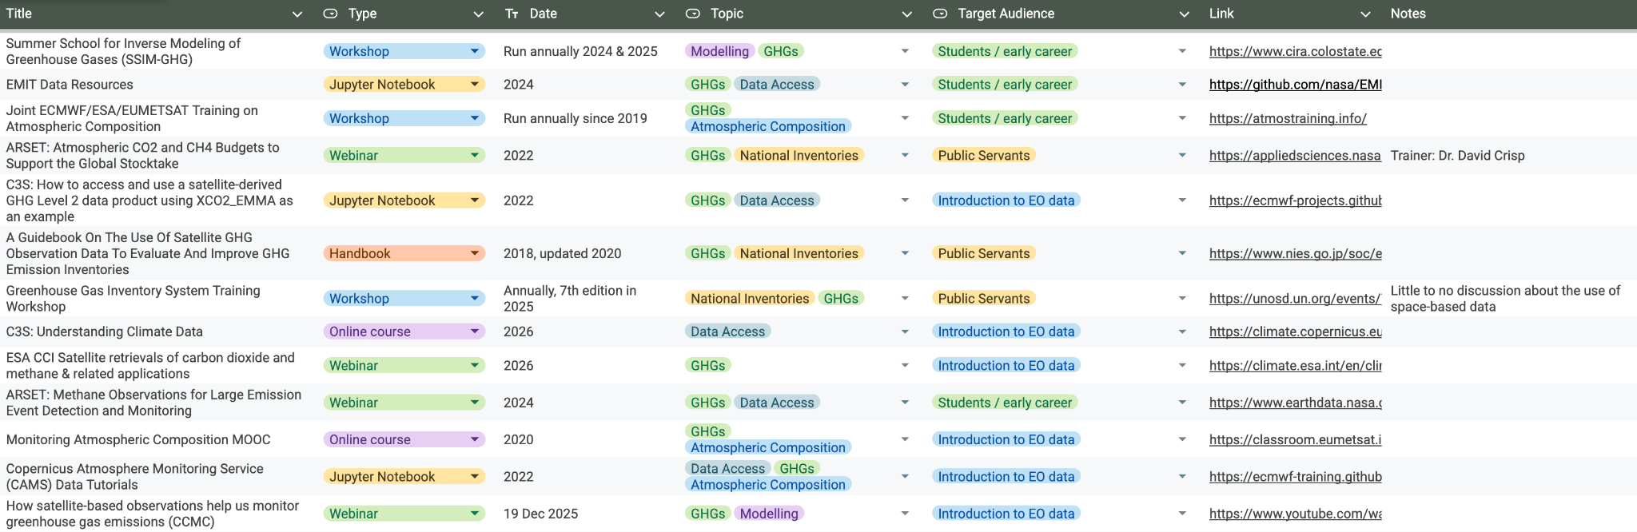
From the GHG Roadmap
Develop a list of existing training/workshop/outreach materials for GHG Remote Sensing
  In progress - initial spreadsheet developed, considering how best to promote / populate

