Slide 1
CEOS Water Portal
Yasha Moz
NASA, EOTEC DevNet
WGCapD - 15
September 3, 2026

Slide 2
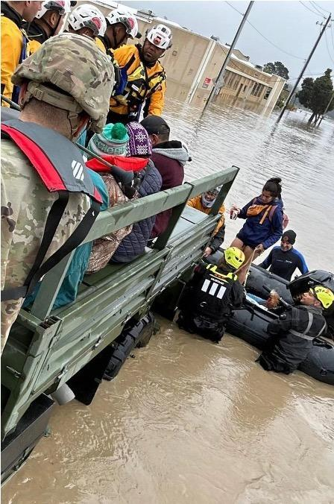

NASA SIT Chair Priorities
Priority 1: Water Planet- Seeing Earth's Water from Space
Advance understanding of Earth's water cycle by monitoring terrestrial waters, coastal regions, and oceans from space. Transform this knowledge to actionable insights to enhance water use efficiency, improve water quality, and enhance resilience to water-related hazards such as droughts, floods, and storms.

Slide 3
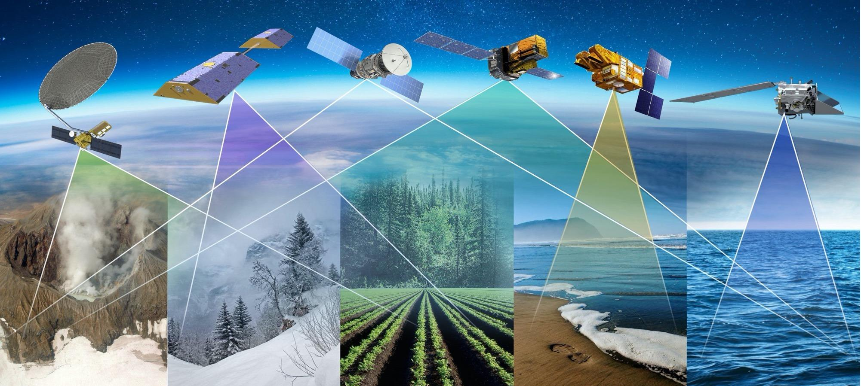
Priority 1: Key Objectives
Coordinated Water Observations
Accessible and Interoperable Water Data Products
User-Center Solutions for Water Challenges
Assessment of Benefits & Impact

Slide 4
Priority 1: Deliverables Timeline
Seeing Earth’s Water from Space
Plenary
2025
SIT-41
SIT TW
2026
Plenary
2026
SIT-42
SIT TW
2027
Plenary
2027
Objectives
Coordinated Water Observations
Gap analysis of water variables
Best practice guidance for integrating multispectral (optical + SAR) data for water
Coordinate and promote multisource integrated water products
Accessible & Interoperable Water Data Products
Define application specific requirements for water variables
CEOS-ARD Self Assessments
CEOS-ARD for Water
Encourage and contribute CEOS ARD Water products related to water resources & quality
Align and promote user-driven tools for water management and resilience
User-centered Solutions for Water Challenges
Water Quality Workshop Series
Advancing EO data for water resources solutions (TBD)
Assess data needs for water resources / water quality management
Assess Impact & Benefits
Impact assessment of existing CEOS activities related to water/resilience (w/ Priority 2)
Use cases on the benefits of EO for water

Slide 5
CEOS Water Portal Idea
Create an online, practitioner-focused gateway designed to streamline water managers’ access to actionable data, specialized tracking tools, and tailored training resources.
  Potential partners: WGCapD members, EOTEC DevNet, NASA Water Program, others.
To ensure accessibility for water managers with varying levels of familiarity with space-based observations, the portal's long-term roadmap features an AI-powered matchmaking assistant.
  Potential partners: EO College, ESA’s Φ-lab, NASA's EarthRISE Developers Academy, others.

Slide 6
Potential Portal Modules
Portal Module | Key Contents & Core Focus | Examples
1. Earth Observation Datasets | Direct, curated links to advanced satellite products. Emphasizes interoperability and readiness. | CEOS MIM database, NASA data pathfinders, SWOT (surface water elevation), PACE (hyperspectral water quality), NISAR (soil moisture), SMAP, etc.
2. Flood & Drought Tools Trackers | Centralizes disaster response, forecasting, and early warning tools. Allows sorting by risk cycle, tool category, and domain. | EOTEC Floods and Droughts Tools Trackers
3. Training & Capacity Building | Curated directories of cost-free remote sensing courses and calendars for institutional and individual capacity development. | WGCapD Training Calendar, EOTEC Places to Find Trainings.
4. Solutions & Use Cases | A living catalog of real-world multisensor integration demonstrations (e.g., optical + SAR fusion) and best practices. | Post-storm water quality (Helene/Milton), vegetation water content for agriculture/food security, and algal bloom monitoring.

Slide 7
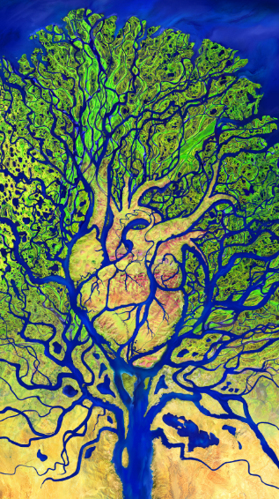
Outstanding Questions
Defining user community and co-developing solution with their input
Accessing technical expertise on remote sensing for water applications beyond floods/droughts
Hosting and maintaining the portal
Identifying partner agencies to discuss this further

