Slide 1
German Aerospace Center (DLR)
DLR_School_Lab Oberpfaffenhofen
Dieter Hausamann
February 28, 2012

Slide 2
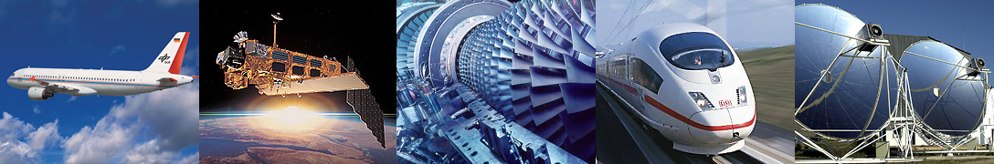
DLR
German Aerospace Center
Research Institution
Space Agency
Project Management Agency

Slide 3
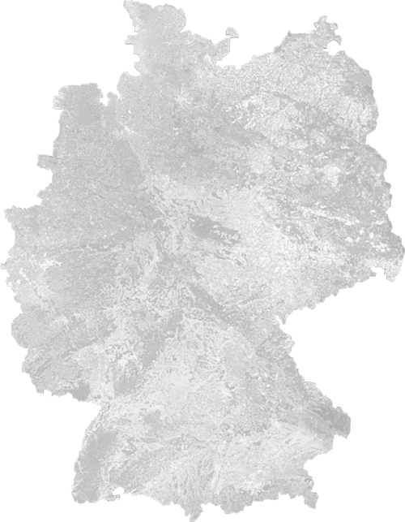
Locations and employees
7000 employees across
32 institutes and facilities at
  16 sites.
Offices in Brussels,
Paris and Washington.
Stade n
n Hamburg
n Neustrelitz
Bremen n
n Trauen
Berlin n
Braunschweig n
n Goettingen
Juelich n
n Cologne
n Bonn
Lampoldshausen n
Stuttgart n
Augsburg n
n Oberpfaffenhofen
Weilheim n

Slide 4
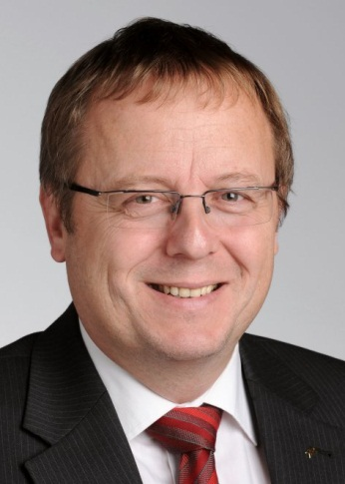
DLR
bodies
General Assembly
Space
Committee
Senate
Chairman: State Secretary of the Federal Ministry of Economics and Technology (Homann)
Executive Board
Scientific
Technical
Council
Chairman
Prof. Dr. Wörner
Vice Chairman
Administration/Technology
Marketing and Project
Management Agency
Hamacher
Space Administration
Dr. Gruppe
Space Research
and Technology
Prof. Dr. Dittus
Aeronautics
Prof. Henke
Energy and Transport
Prof. Dr. Wagner
Strategy and
International Relations
Corporate
Communications
Political and
Economic Relations
Technology Transfer
ESA-Council
Executive Office
Capital Expenditure
Management
Program Coordination
Security Research
Human Resources,
Finance and Corporate
Organization
Infrastructure
Quality Assurance
Internal Auditing and
Joint Venture
Management
Technology Marketing
Information Technology
Project Management
Agency
Project/
Program Directorates
Institutes and
Facilities
Program Directorate
Institutes and
Facilities
Program Directorate
Institutes and
Facilities
Program Directorates
National-/
ESA Program
Integrated
Space Program
Budget Officer
Space Administration
Programs
Projects
Technology Transfer
Programs
Projects
Technology Transfer
Approved Design
Organization
Programs
Projects
Technology Transfer

Slide 5
Percentage of overall income from research and operations 2010
Space Research and Technology
Aeronoautics
Transport
Energy

Slide 6
Financing of DLR and research funding 2012 (planned)
www.DLR.de • Chart 6
> Standard presentation > Jan. 2012
without settlement of cross-financing

Slide 7
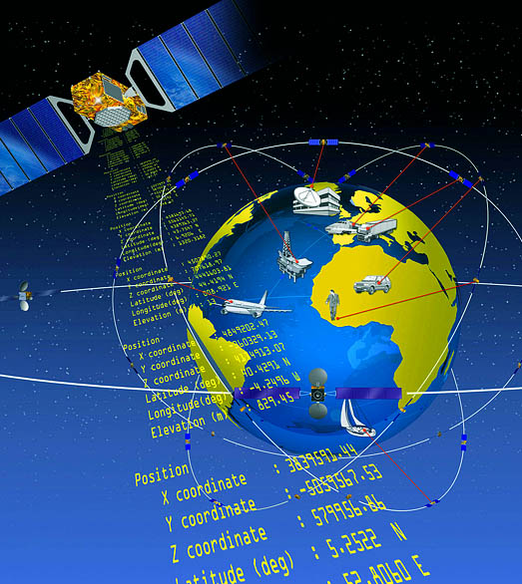
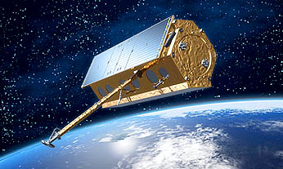
DLR’s tasks as the National Space Agency
Defining German space planning on behalf of the federal government
Representing German space-related interests in the international arena, in particular in ESA
Tendering, award and support of space projects in the context of the National Space Program

Slide 8


Slide 9
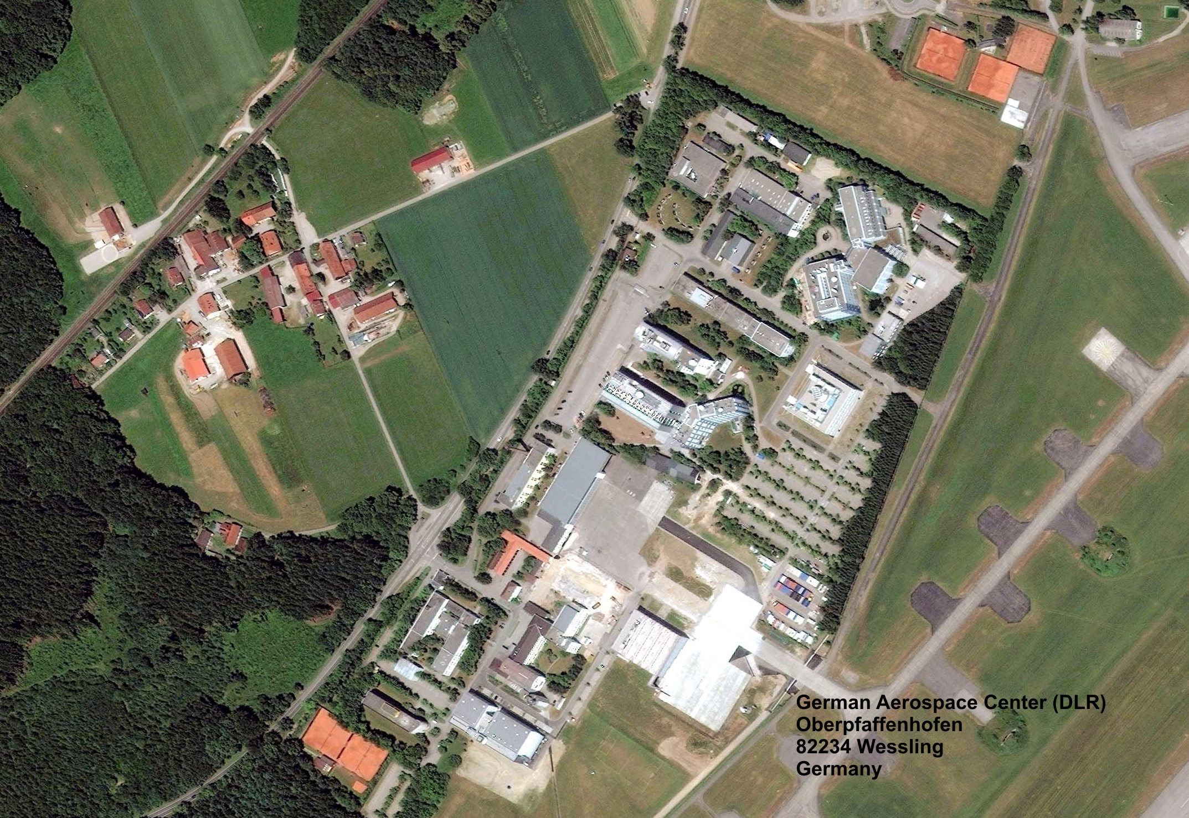
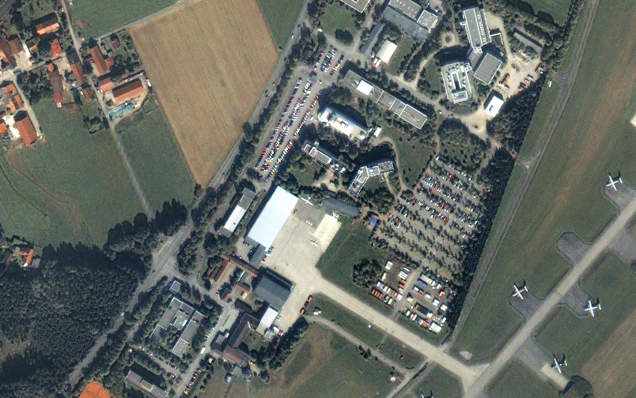
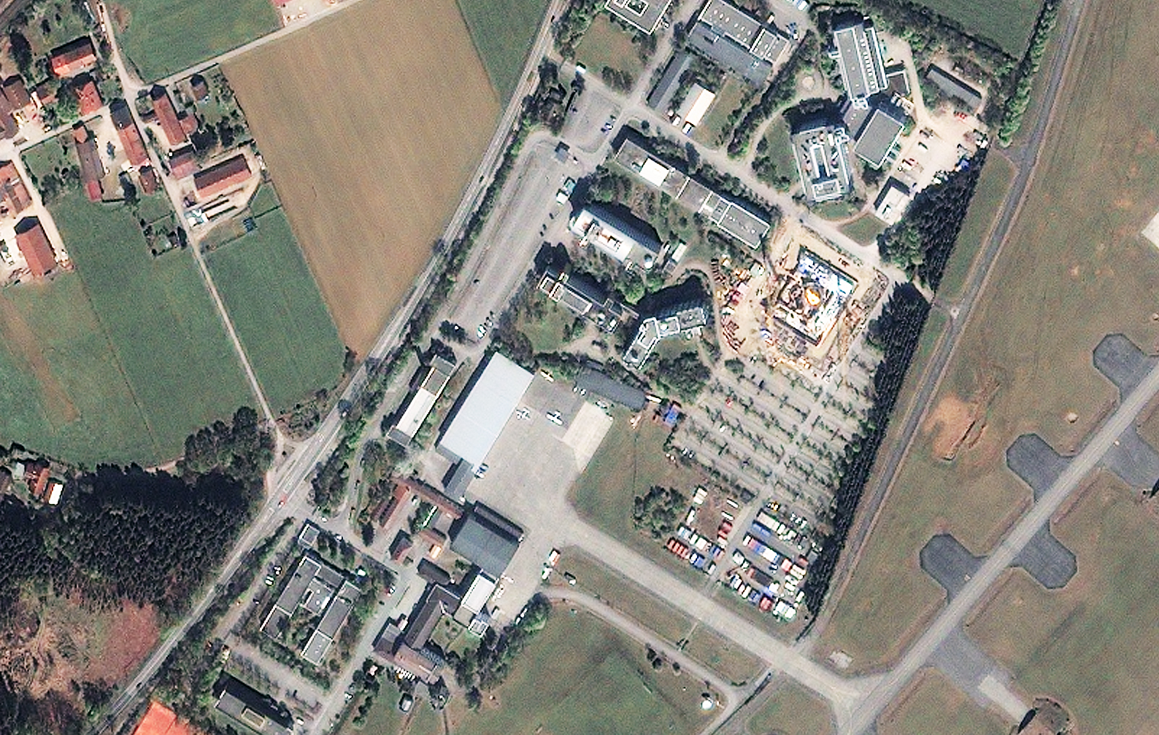

Slide 10
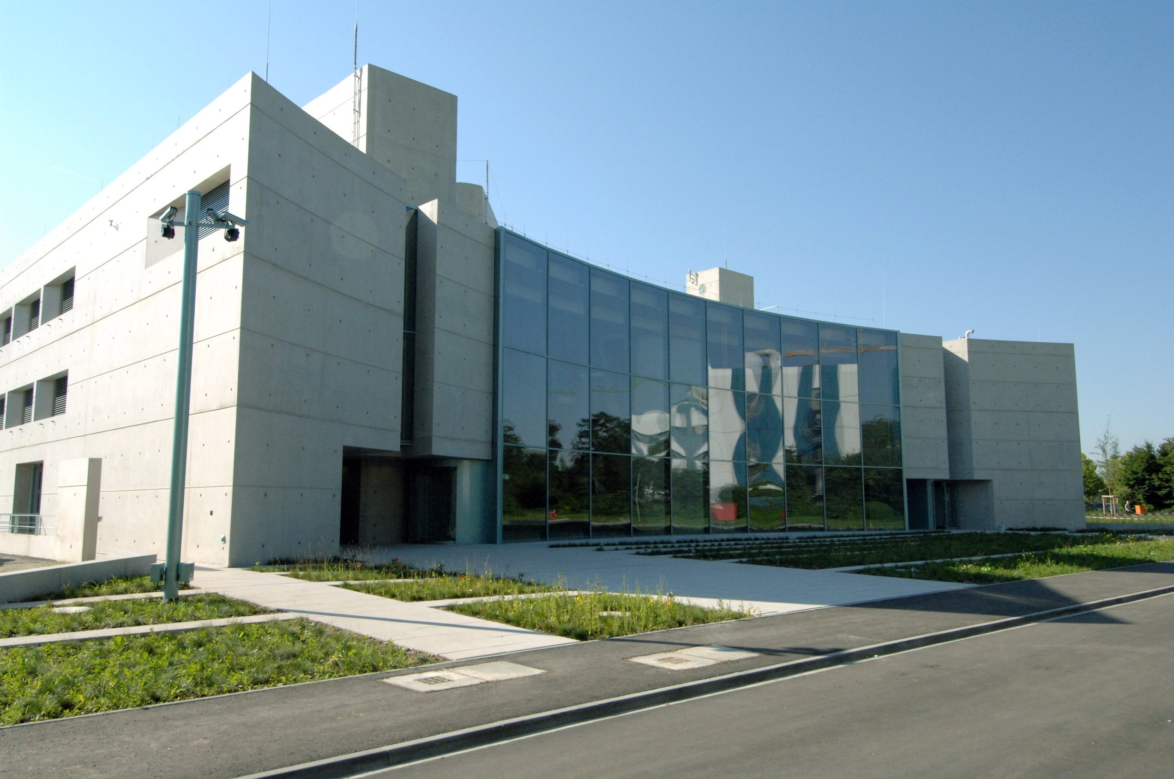
GCC

Slide 11
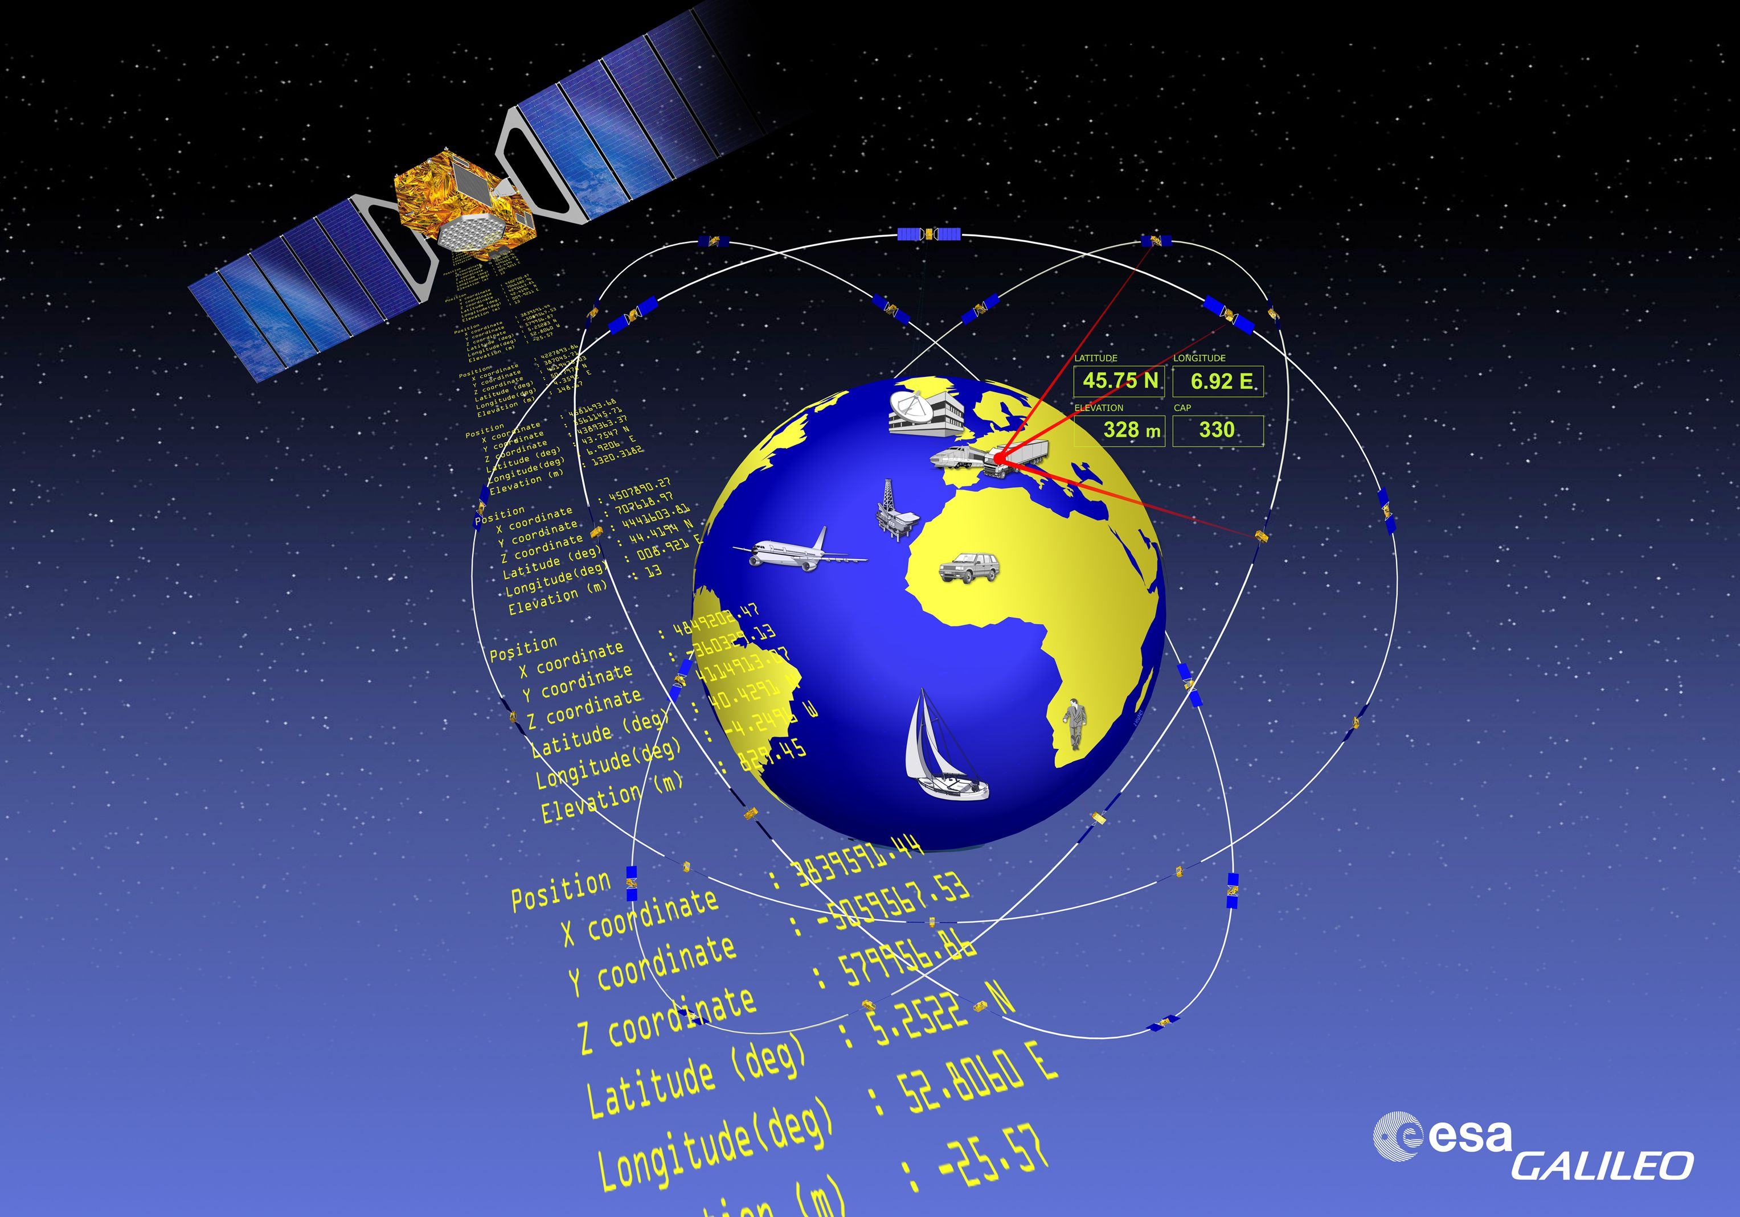
GALILEO

Slide 12
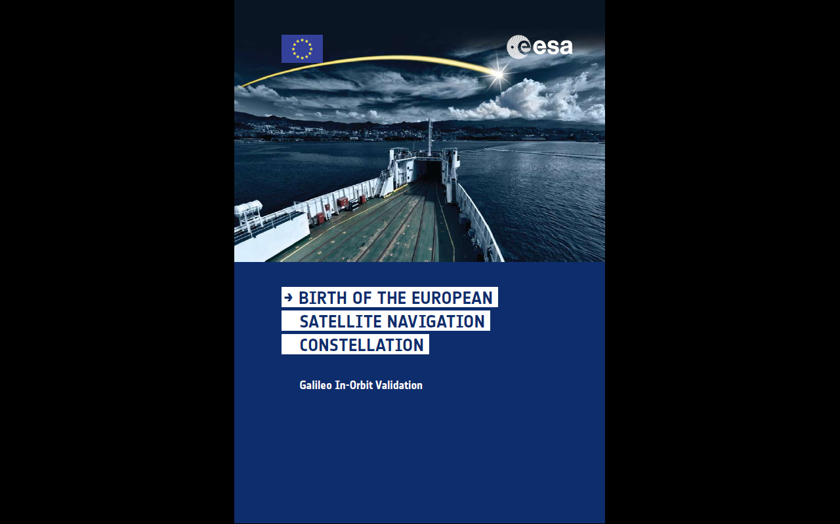

Slide 13
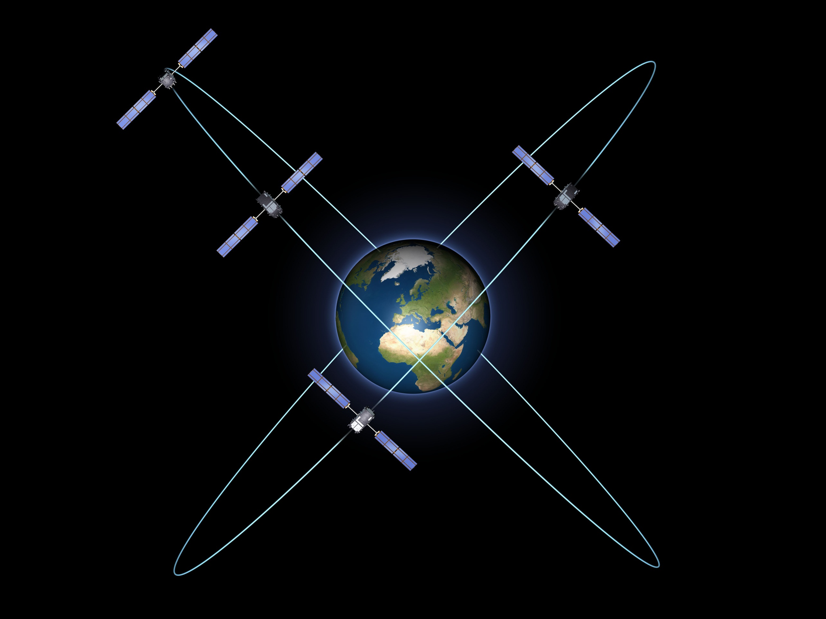
GALILEO
IOV

Slide 14
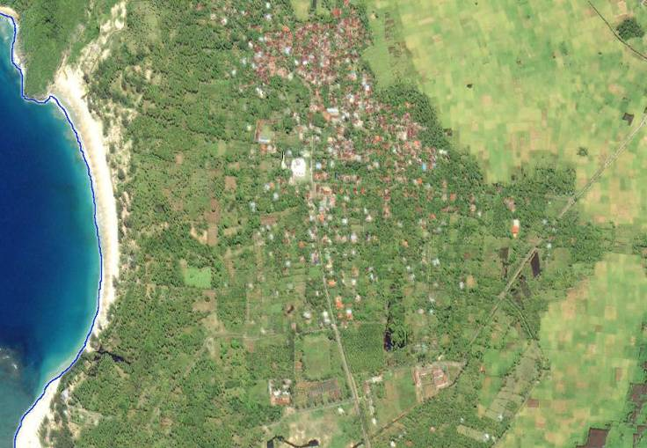
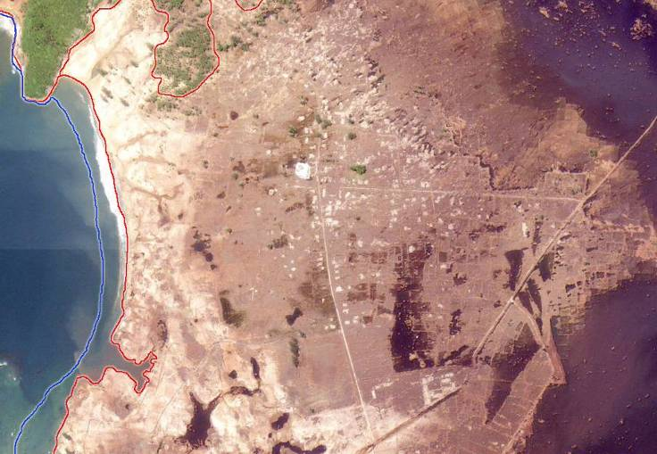
Indonesia/Lho‘Nga - Pre/Post-Disaster mapping
IKONOS, - December 29, 2004
IKONOS, - January 10, 2003

Slide 15
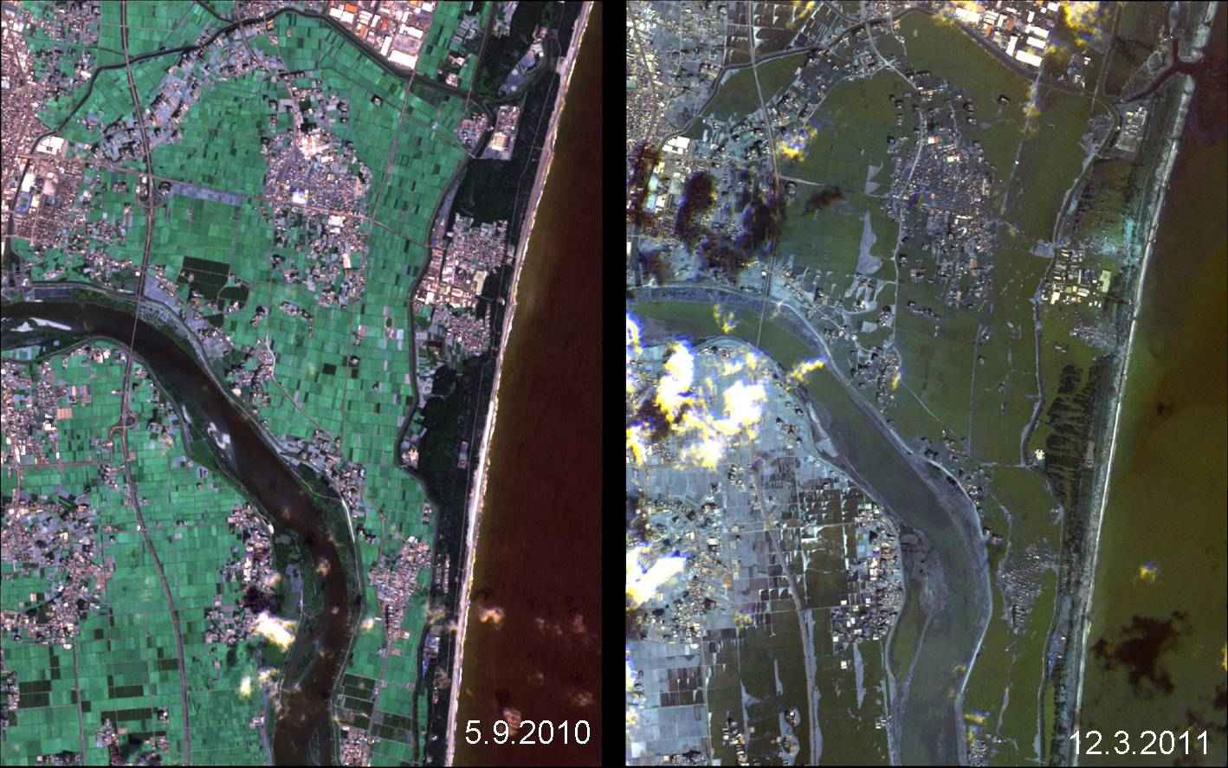

Slide 16
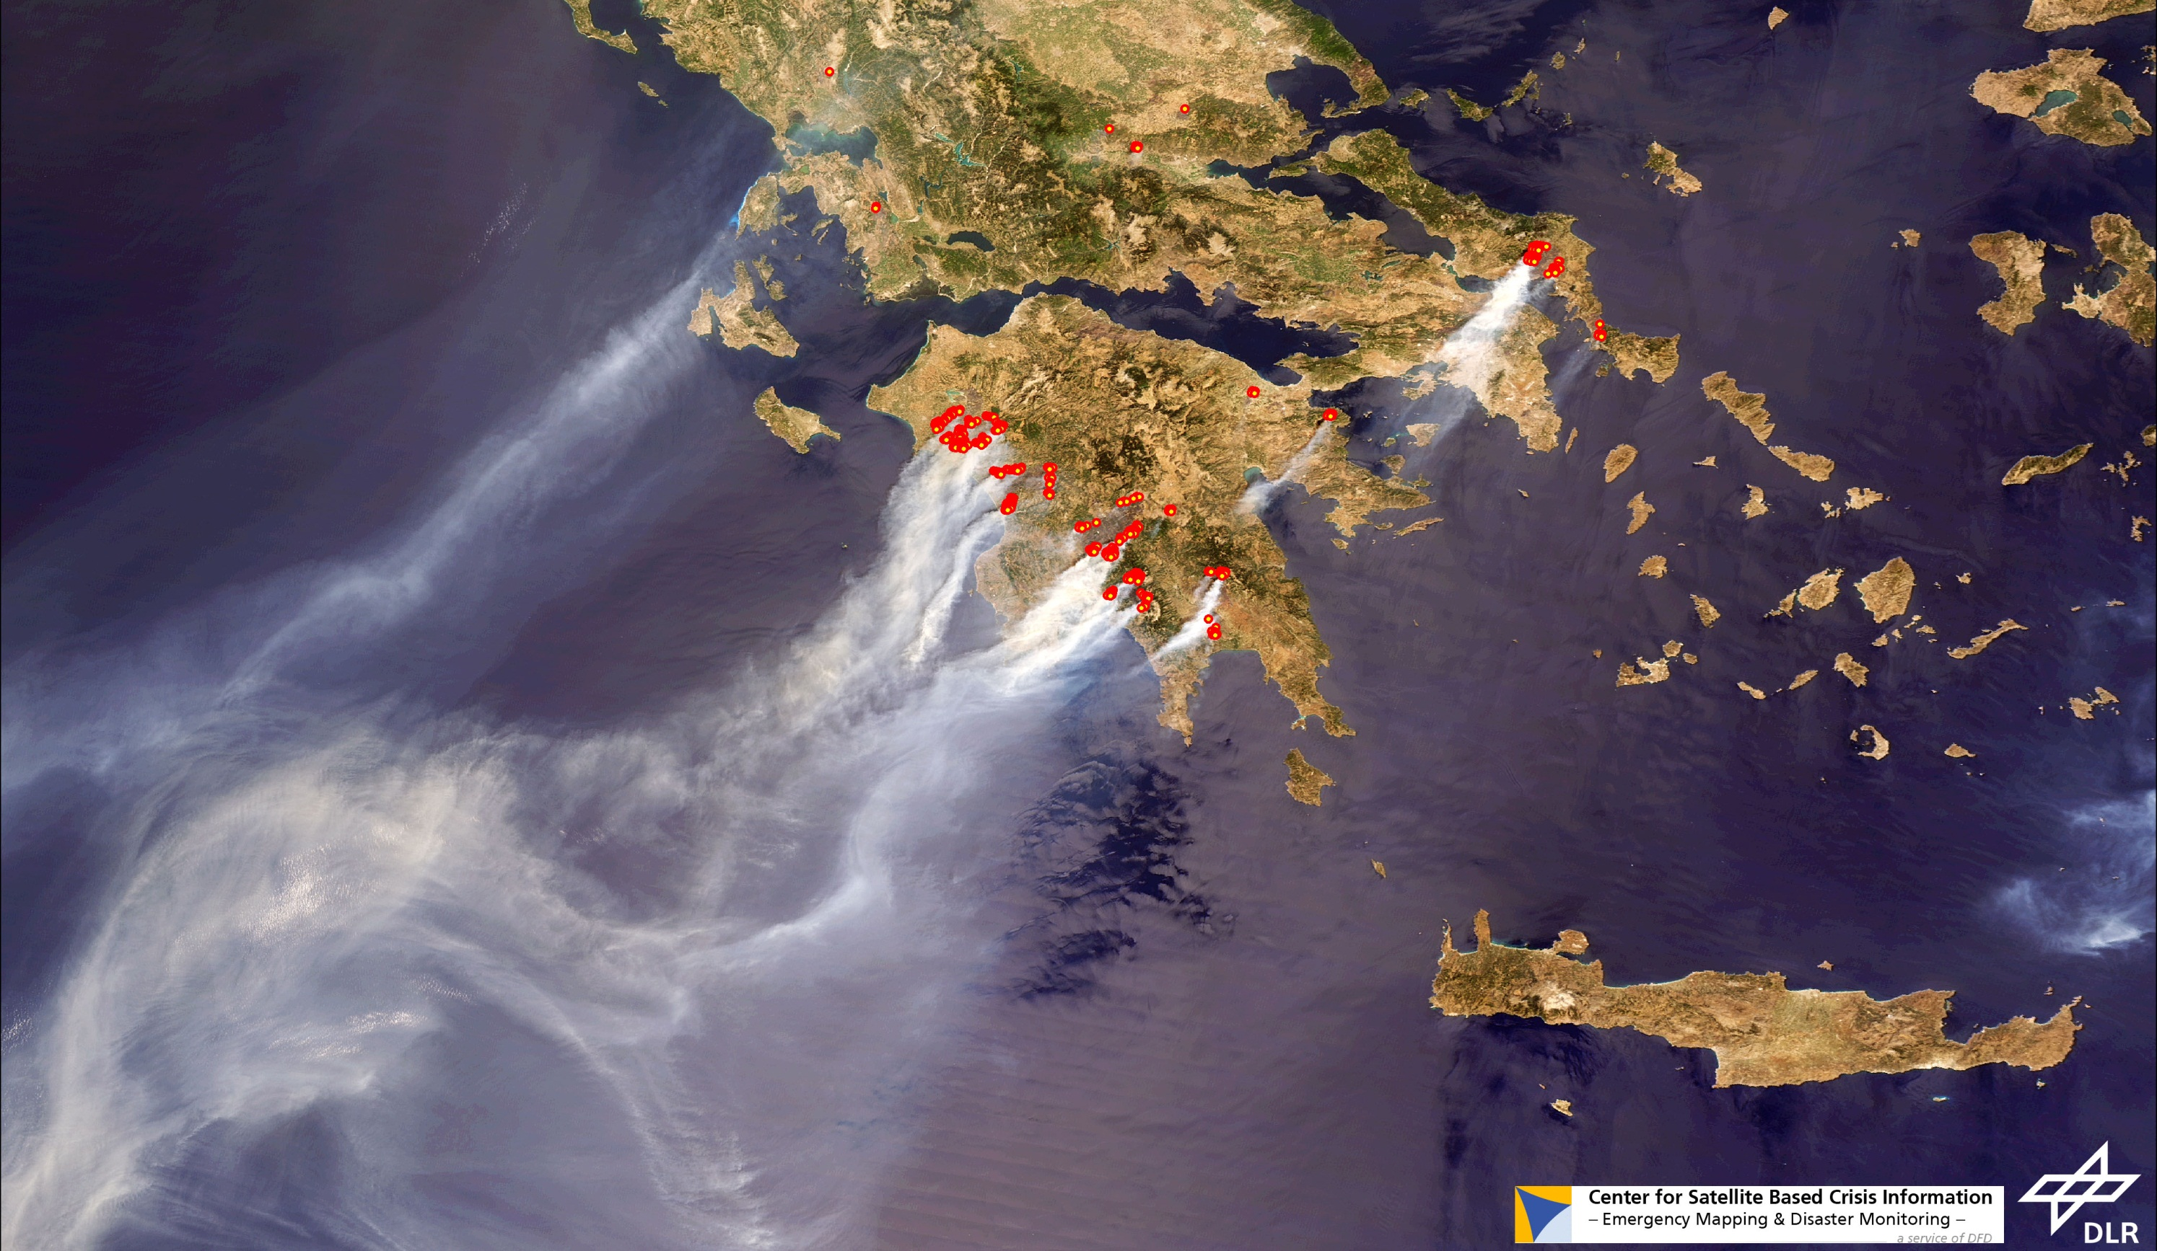
MODIS 26.08.07

Slide 17
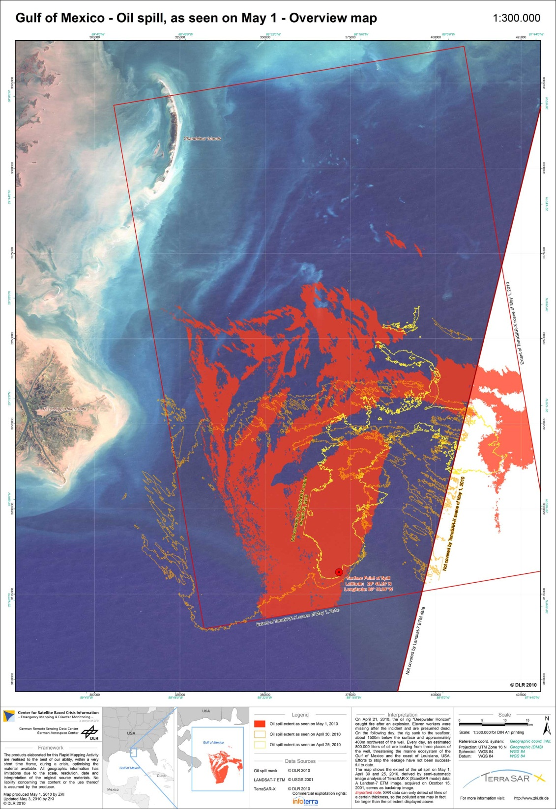


Desaster-Monitoring
Environmental Research
Oil catastrophy “Deepwater Horizon”
Gulf of Mexico
Oil detection: TerraSAR-X (ScanSAR)
Background image: Landsat 7 ETM
1. May 2010
30. April 2010
30. April 2010

Slide 18
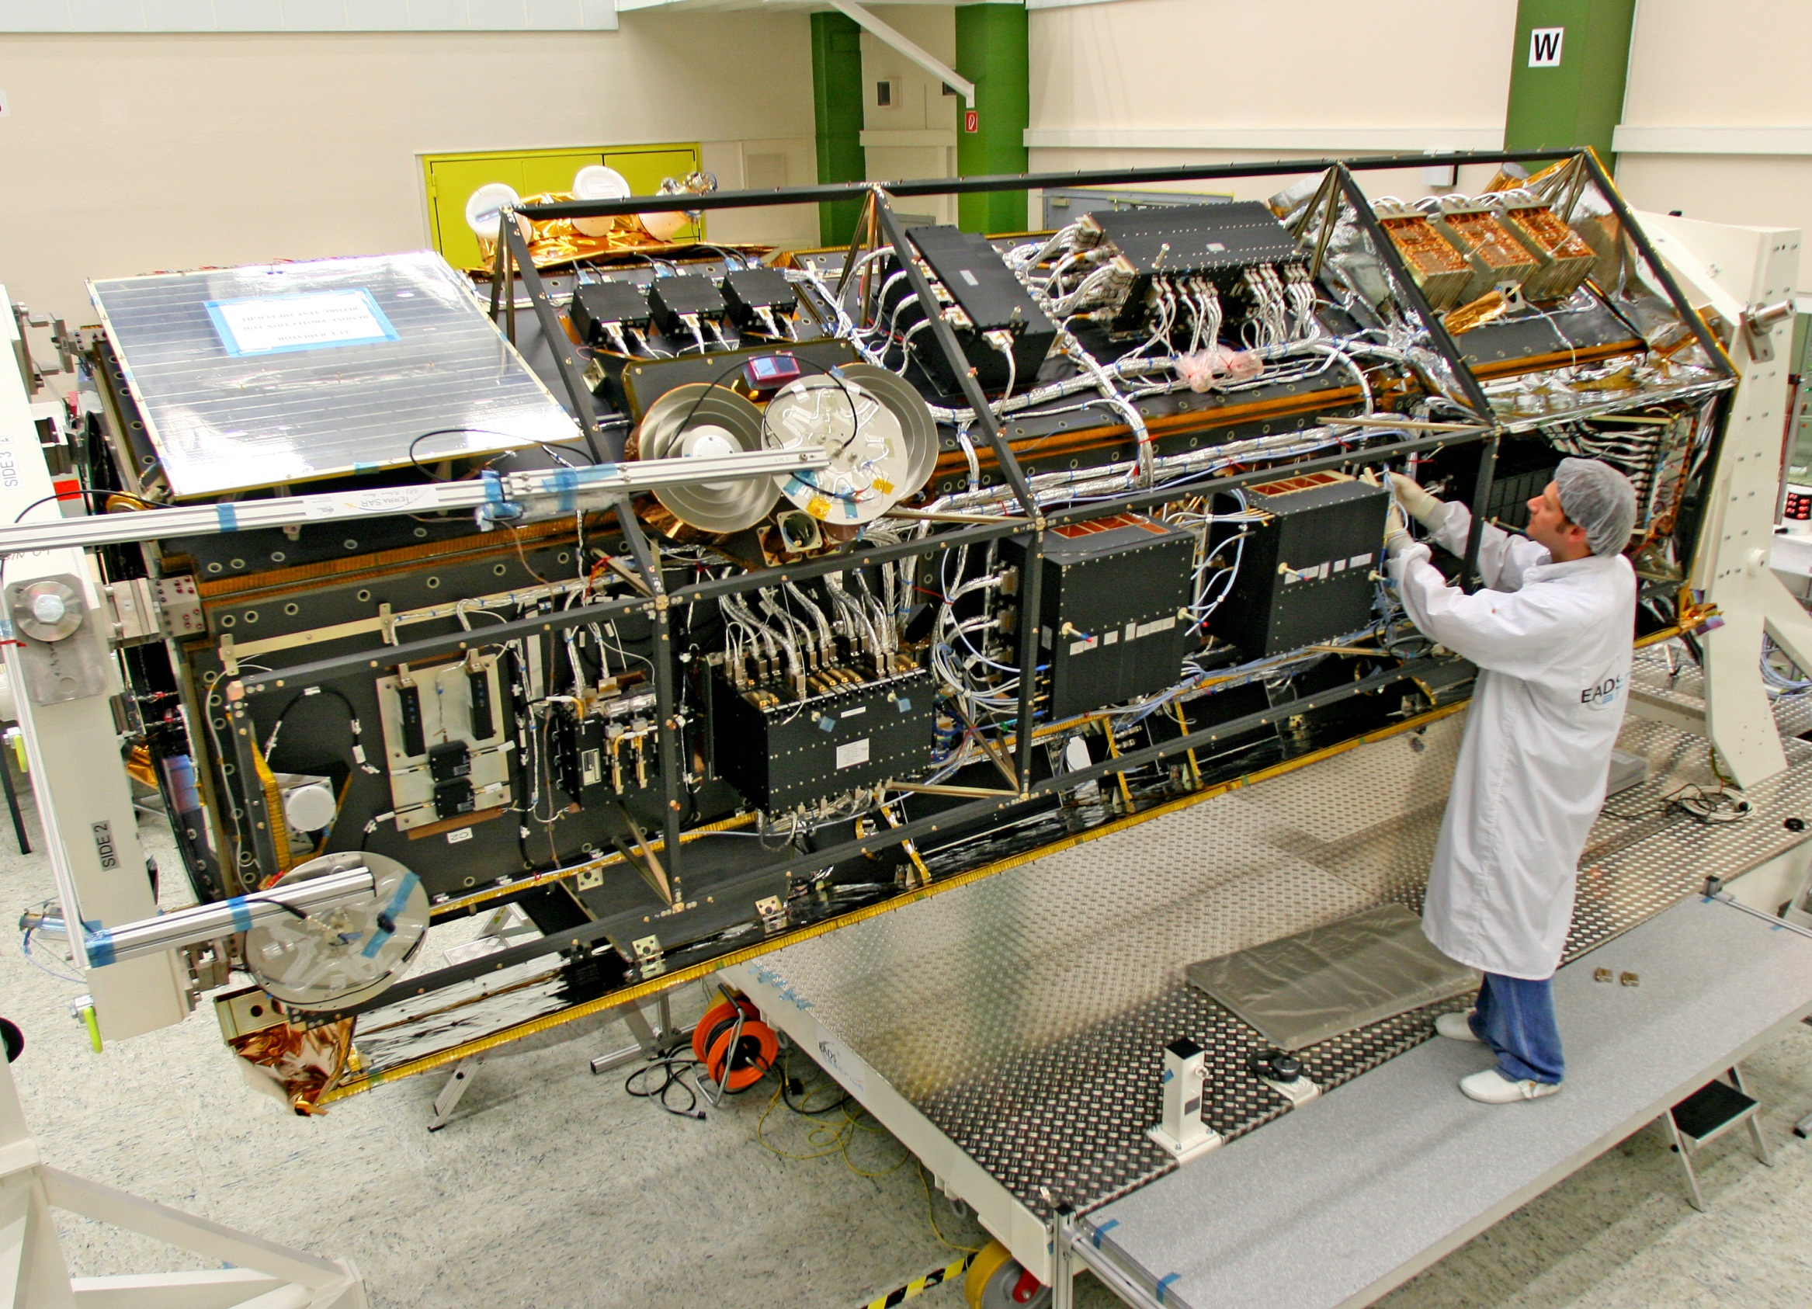

Slide 19
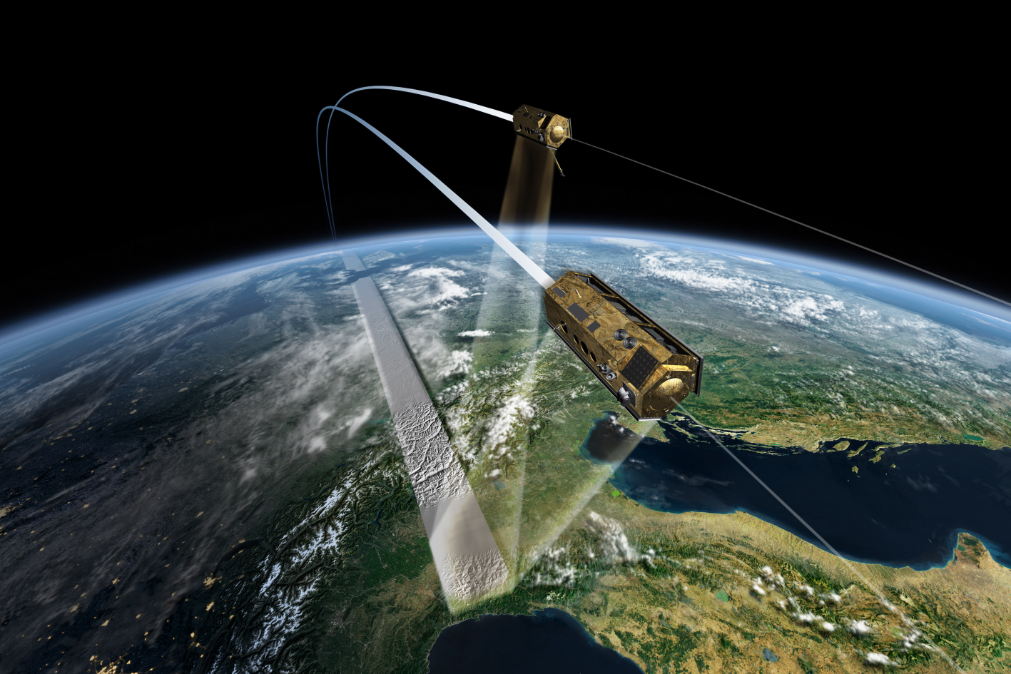
TanDEM-X

Slide 20
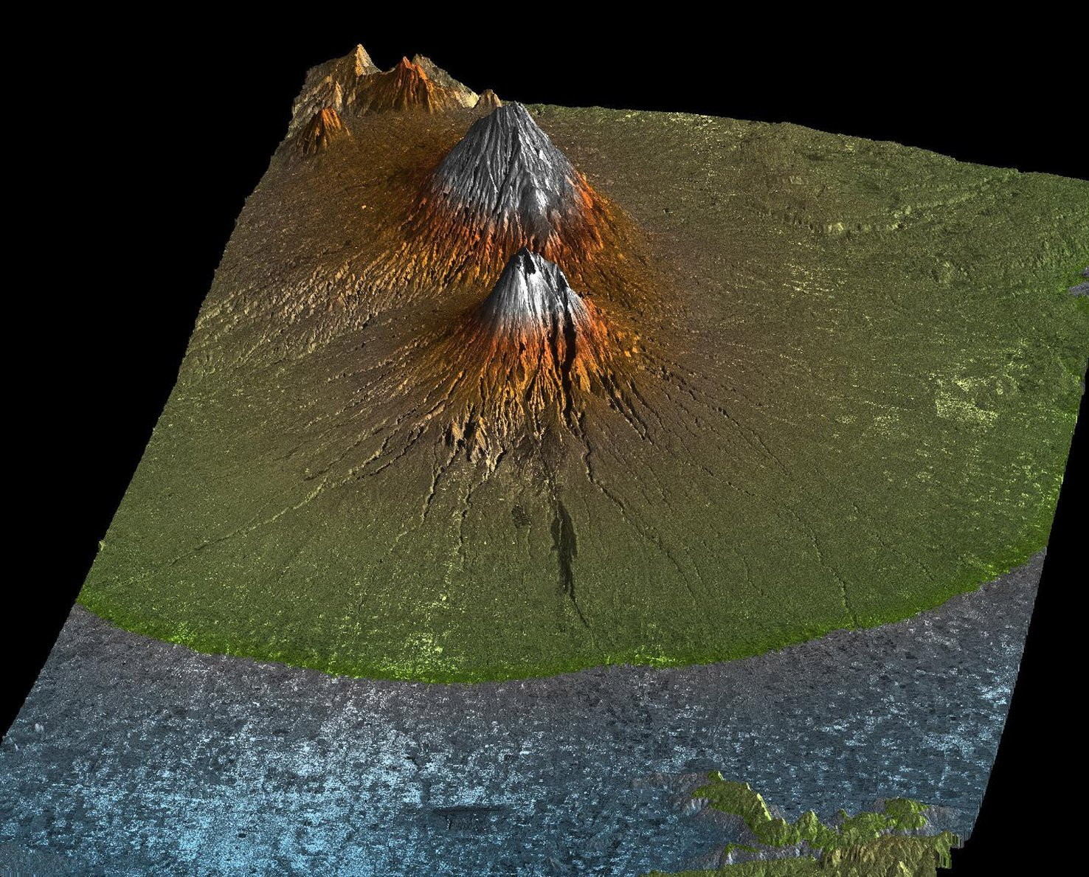

Slide 21
General Outline of the Data Acquisition Plan
2011 2011 2012 2013 2013
6
months
1 year
1 year
6 months
≥ 3 months
t
Commissioning Phase
1 global DEM acquisition with small baselines
+
acquisition of scientific radar data products
1 global DEM acquisition with scaled baselines
+
acquisition of scientific radar data products
additional DEM data takes
for difficult terrain
and filling-in of possible gaps
+
radar data products
radar data products and customized DEMs
with large interferometric baselines

Slide 22
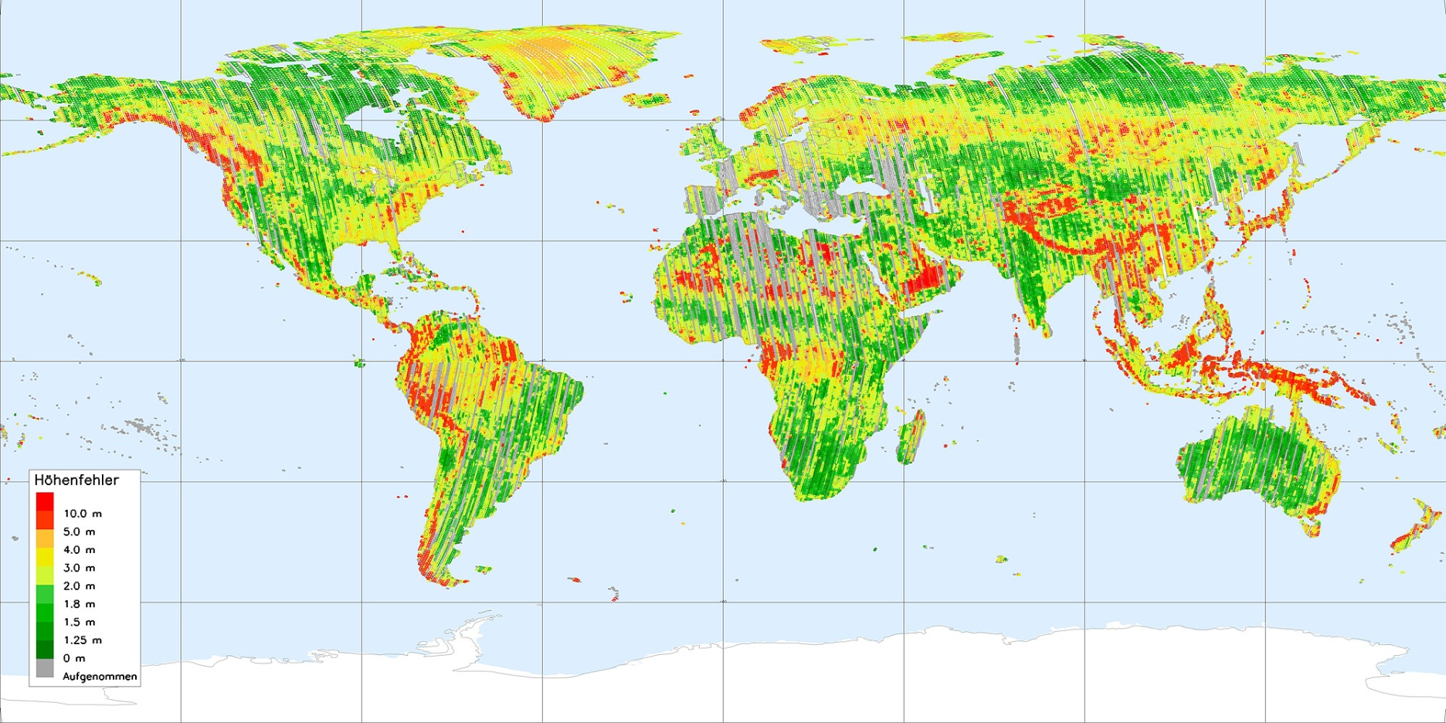
Mission TanDEM-X: Status End 2011

Slide 23
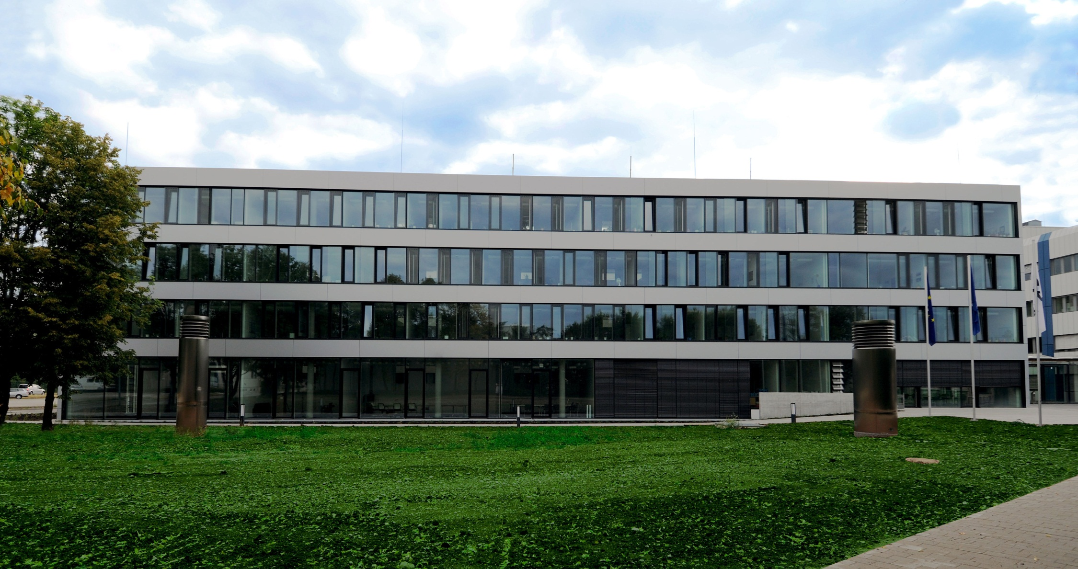
Earth Observation Center EOC – 20.07.2010
1.500.000.000.000.000 Bytes

Slide 24

CONCEPT

Slide 25
Mathematics
Informatics
Natural Sciences
Technology
MINT
Lack of Engineers in Germany in Dec 2011: 80.000

Slide 26



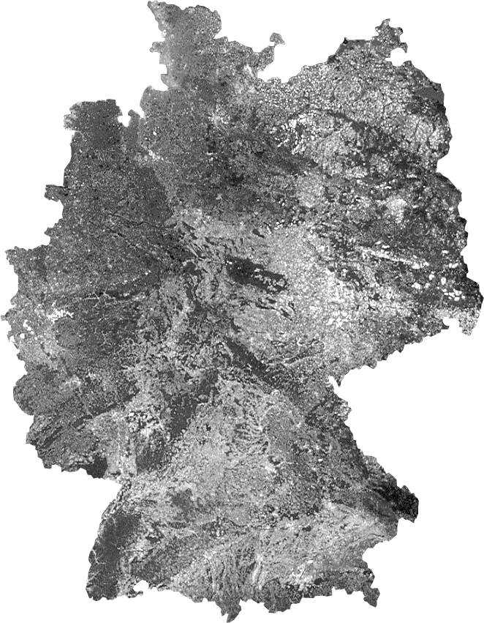

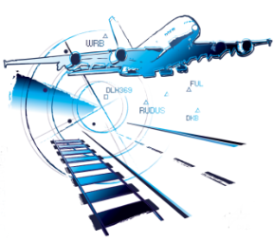
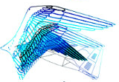
Promoting the Next-Generation Scientists
Stade n
n Hamburg
n Neustrelitz
n Bremen
n Trauen
Berlin- n
● Dortmund
n Braunschweig
n Köln
n Göttingen
n Bonn
n Lampoldshausen
Stuttgart n
Augsburg n
n Oberpfaffenhofen
Weilheim n

Slide 27

IBSE
Inquiry-
Based
Science
Education
Martin
Wagenschein
(ca. 1950)
‚Entdeckendes
Lernen‘

Slide 28
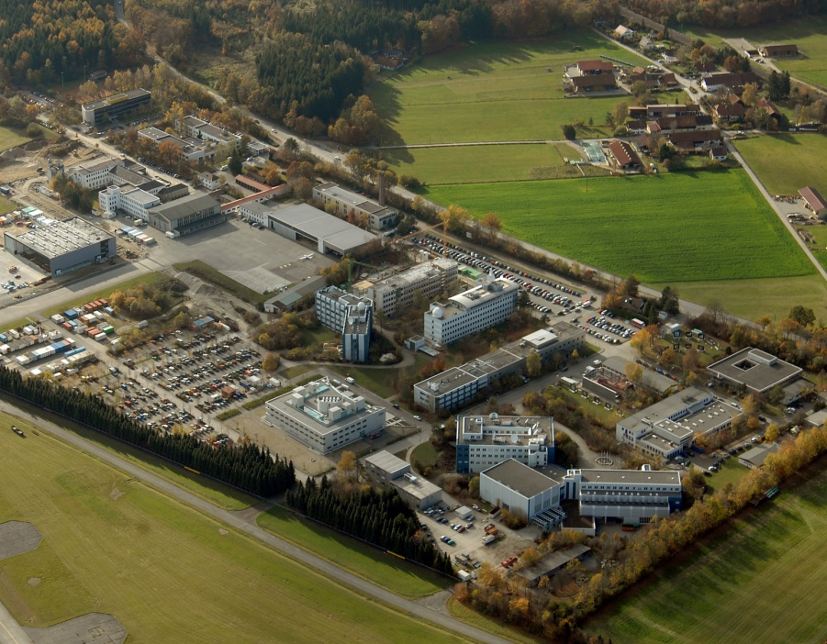
DLR Site
Oberpfaffenhofen
Employees: Approx. 1600
Size of site: 245 000 m²
Research institutes and facilities:
Microwaves and Radar Institute
Institute of Communications and Navigation
Institute of Atmospheric Physics
Remote Sensing Technology Institute
Institute of Robotics and Mechatronics
German Remote Sensing Data Center
Space Operations and Astronaut Training
Galileo Control Center
Flight Experiments

Slide 29
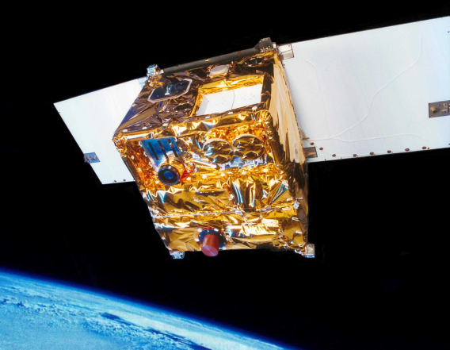
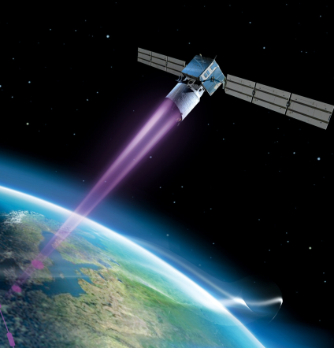

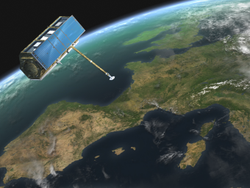
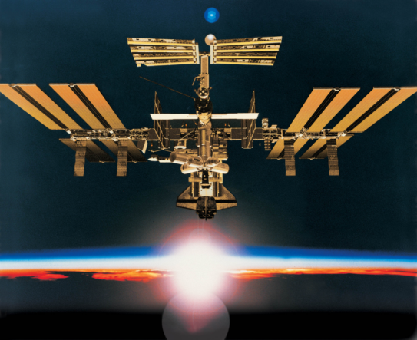
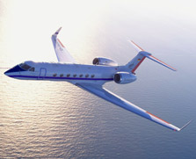
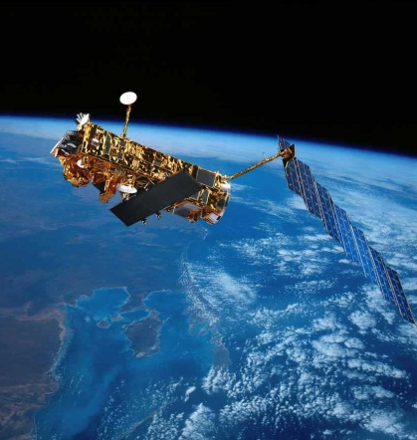
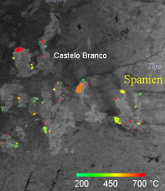
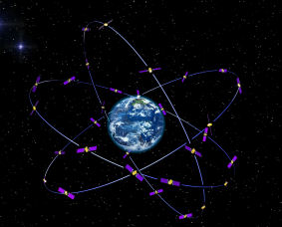
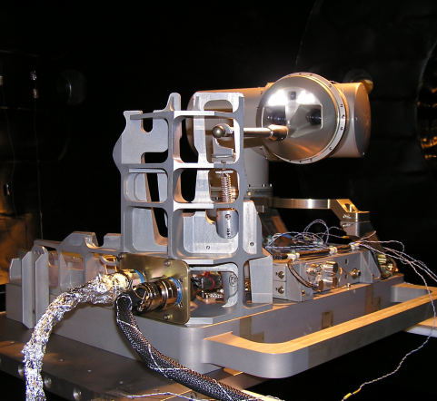
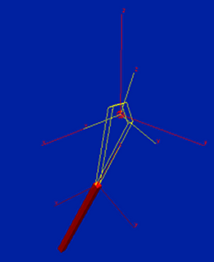

DLR_School_Lab
Oberpfaffenhofen

Slide 30
Experiments
DLR_School_Lab Oberpfaffenhofen
Experiment Institute
Infrared Technology Remote Sensing Technology
Laser Technology Physics of the Atmosphere
Radar Technology Microwave and Radar Technology
Envnmtl. Remote Sensing Remote Sensing Data Center
Weather and Climate Physics of the Atmosphere
Satellite Data Analysis Remote Sensing Data Center
Satellite Navigation Communication and Navigation
Robotics Robotics and Mechatronics
Virtual Mechanics Robotics and Mechatronics
Flight Team Simulator Flighte Operations
Mobile Rocket Basis Space Operations
ASUROnaut Robotics and Mechatronics
Tunnel Boring Machine Technical University Munich

Slide 31
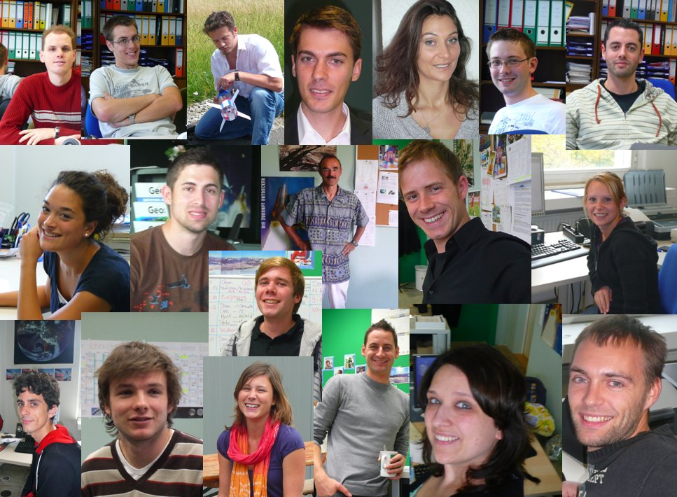
Team 2011

Slide 32
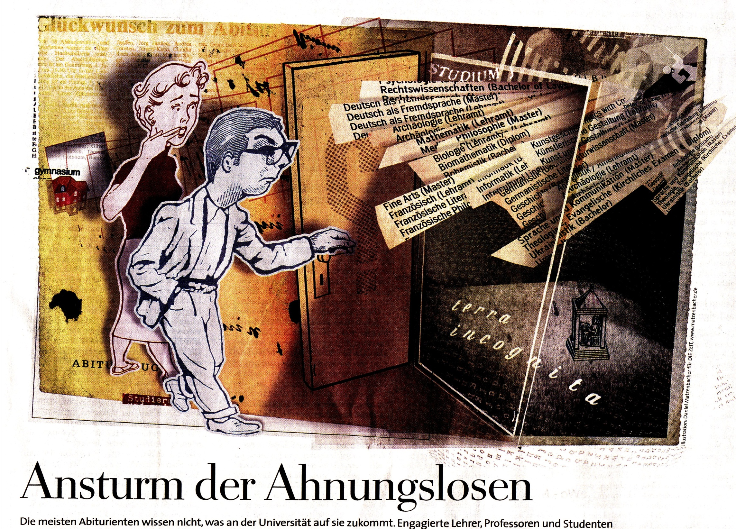
College Adviser

Slide 33
Finnish Students - 05 December, 2011
09:00 – 10:00 Introduction
10:00 – 12:00 Experiment #1
12:00 – 13:00 Lunch Break
13:00 – 15:00 Experiment #2
15:00 – 15:30 German Space Operations Center
15:30 – 16:00 Feedback

Slide 34
Today‘s Experimental Programme
Experiment | Morning | Afternoon | Max. Number
Infrared Technology |  |  | 6
Laser Technology | Julian | Nicola | 6
Robotics |  |  | 4!
Radar Technology |  |  | 6
Satellite Navigation |  |  | 6
Optical Environmental R.S. |  |  | 6
Weather and Climate |  |  | 9
Satellite Data |  |  | 9
Virtual Mechanics | Ingo | Ingo | 9
Flight Team Simulator |  |  | 4!
Mobile Rocket Basis | Ulli |  | 6
Tunnel Boring Machine |  | Thomas | 4!

