Slide 1
Remote Sensing
Experiments

Slide 2
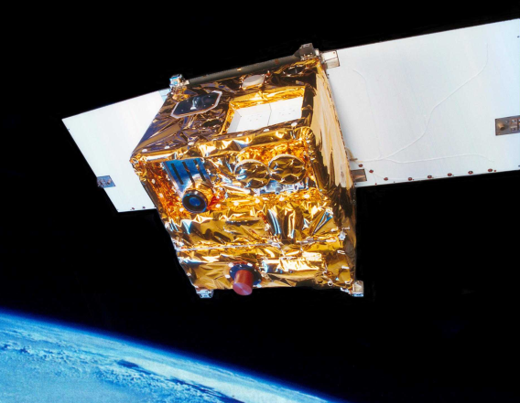
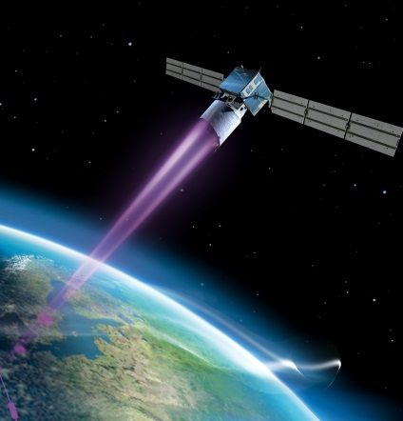
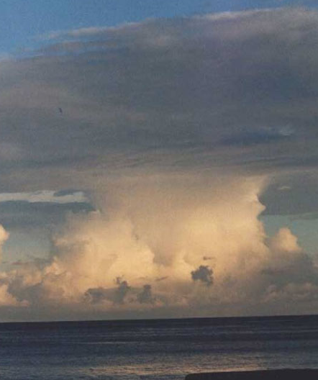
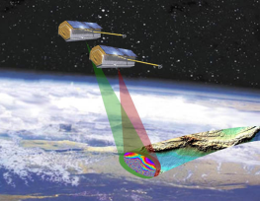
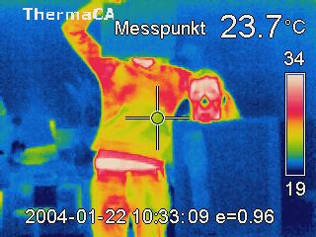
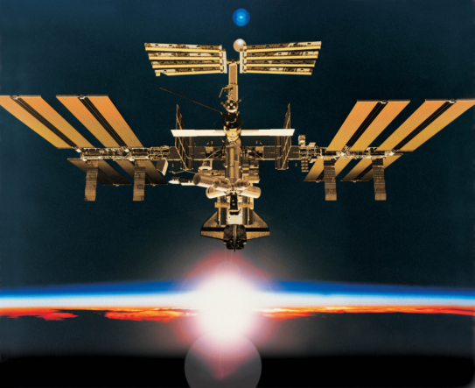
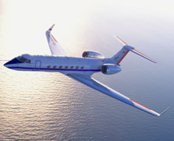
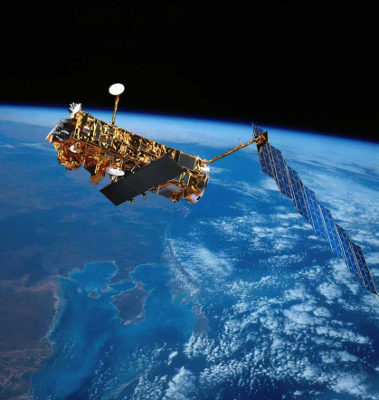
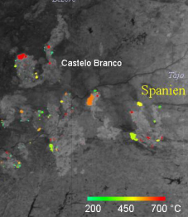
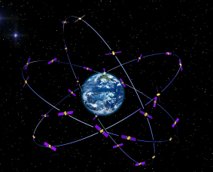
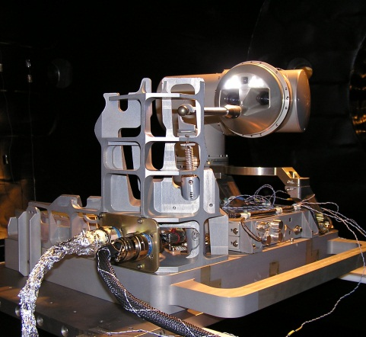
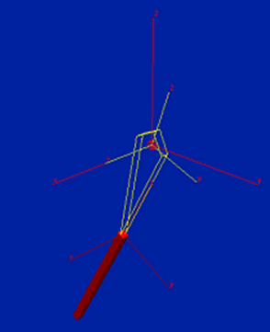
MF
PA
HR
DLR_School_Lab
Oberpfaffenhofen
Infrared
Technology
RB
FB
DFD
KN
RM

Slide 3
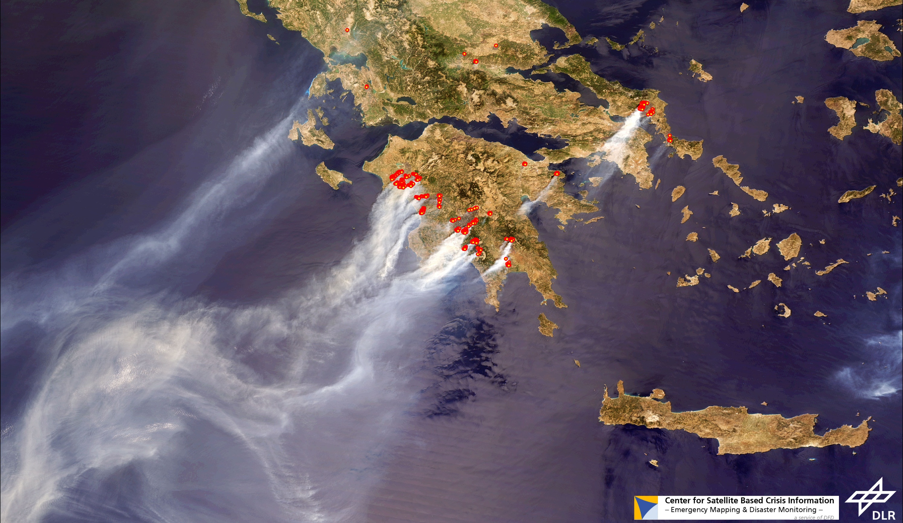
MODIS 26.08.07

Slide 4
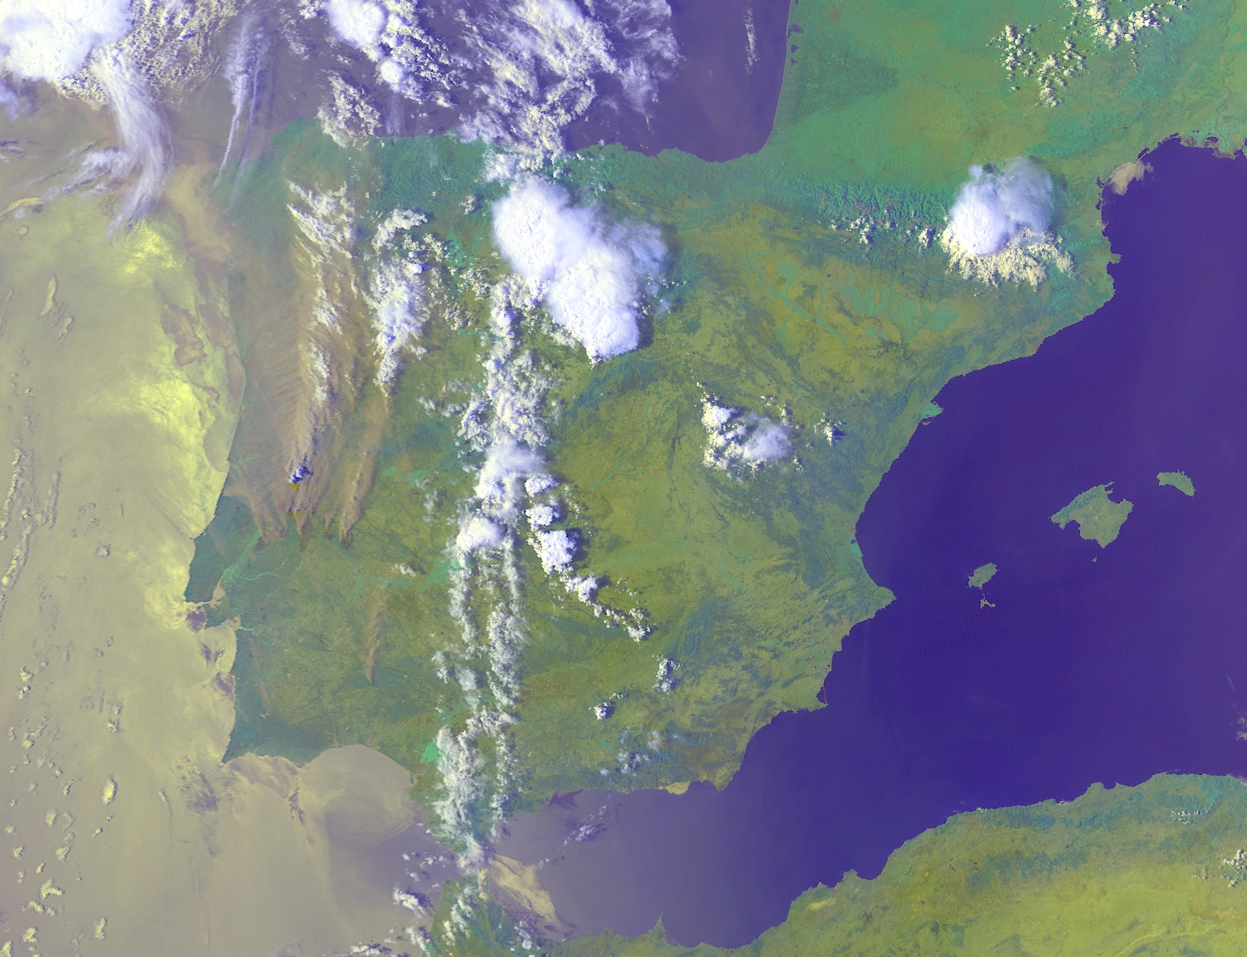
NOAA – AVHRR, 3. August 2003 16:07 UTC

Slide 5
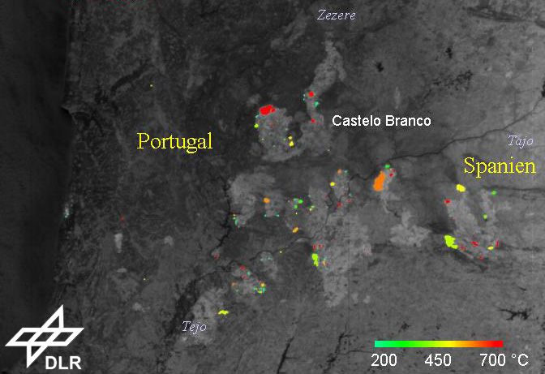
BIRD, August 4, 2003 12:03 UTC

Slide 6
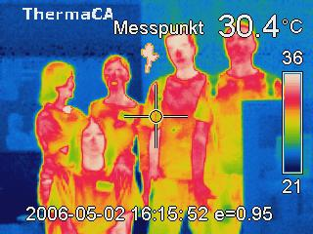
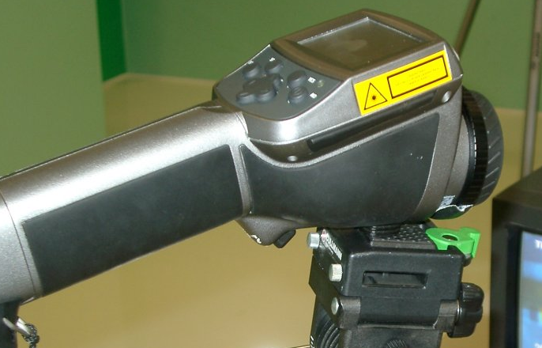

Slide 7
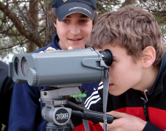
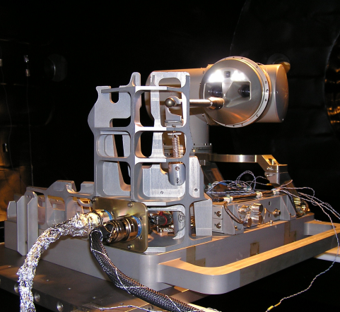
MF
PA
HR
DLR_School_Lab
Oberpfaffenhofen
Laser
Technology
RB
FB
DFD
KN
RM

Slide 8
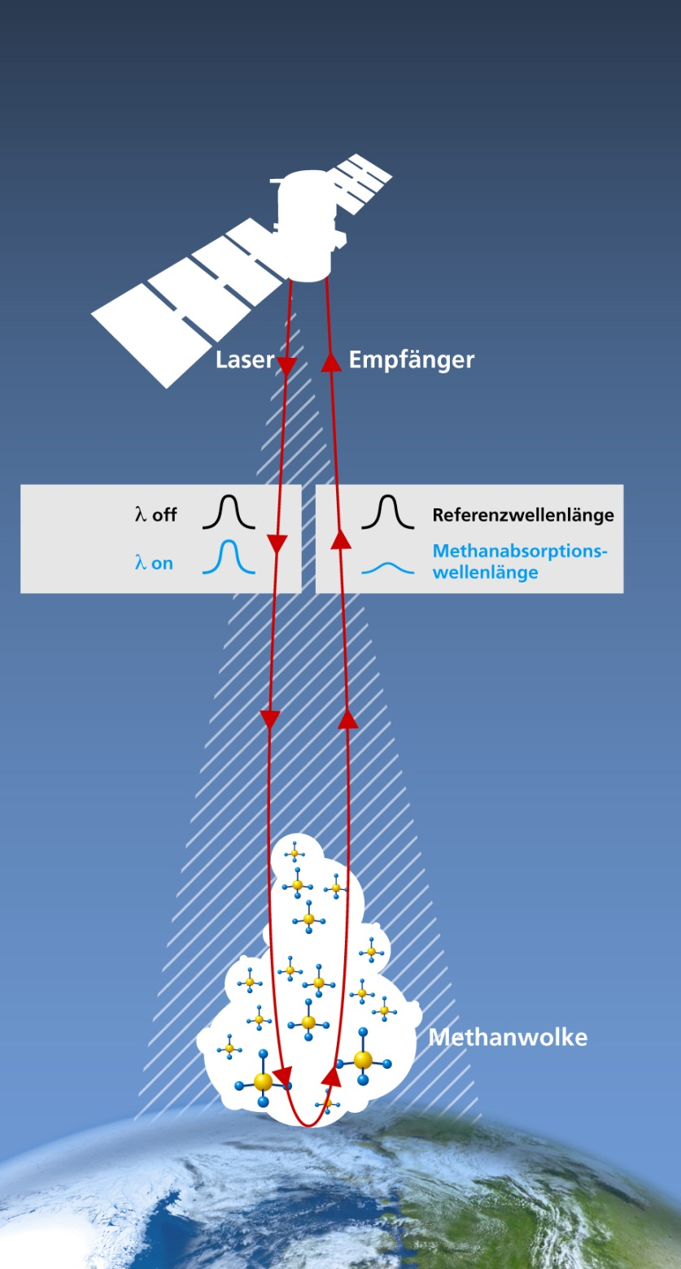
MERLIN
Methane
Remote
Sensing
Lidar
Mission

Slide 11
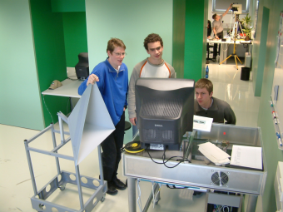
MF
PA
HR
DLR_School_Lab
Oberpfaffenhofen
RB
FB
Radar
Technology
DFD
KN
RM

Slide 12
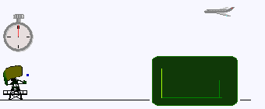
RADAR: „Radio Detection and Ranging“
© Wikipedia
Emission of electromagnetic pulses
Reception of the reflected echo
Radiation penetrates clouds
Independend from daylight

Slide 13
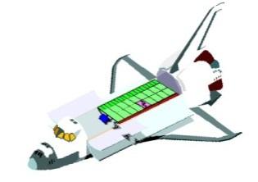
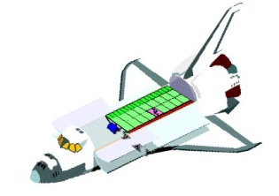
Side-Looking Imaging Geometry
z
Antenna
Azimuth
range
x
Swath
y
Pulsed radar system
Two-dimensional imaging (azimuth x slant range)
Illuminated area

Slide 14
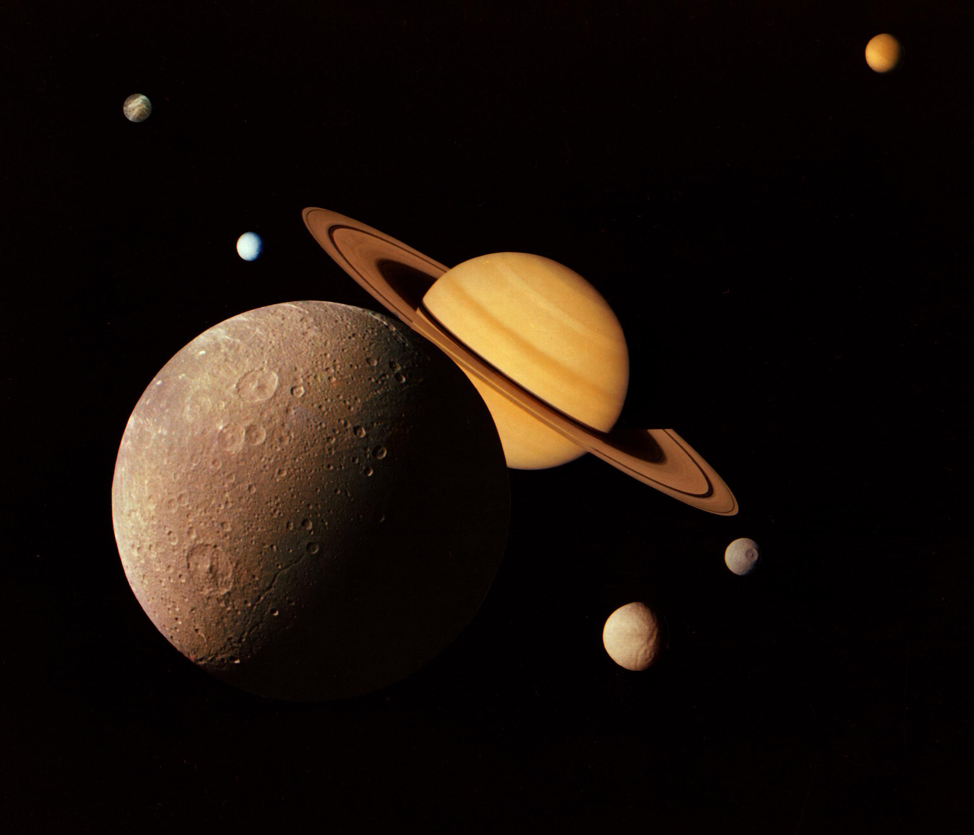
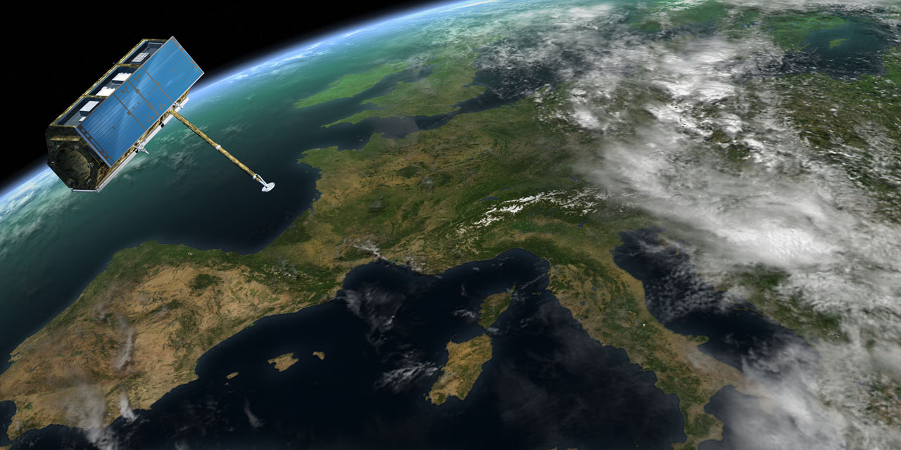
TerraSAR-X
Bilder: DLR, NASA
Notes:
Ergänzende Hinweise zur Vertiefung:
Weitere Informationen:
Neben den Internet-Seiten des DLR – www.DLR.de – kann im Web zum Thema Raumfahrt auf vielfältige Weise recherchiert werden. Zu empfehlen sind u.a. die deutschsprachigen Seiten der Europäischen Weltraumorganisation ESA unter http://www.esa.int/esaCP/Germany.html sowie die (englischen) Seiten der NASA unter www.nasa.gov

Slide 15
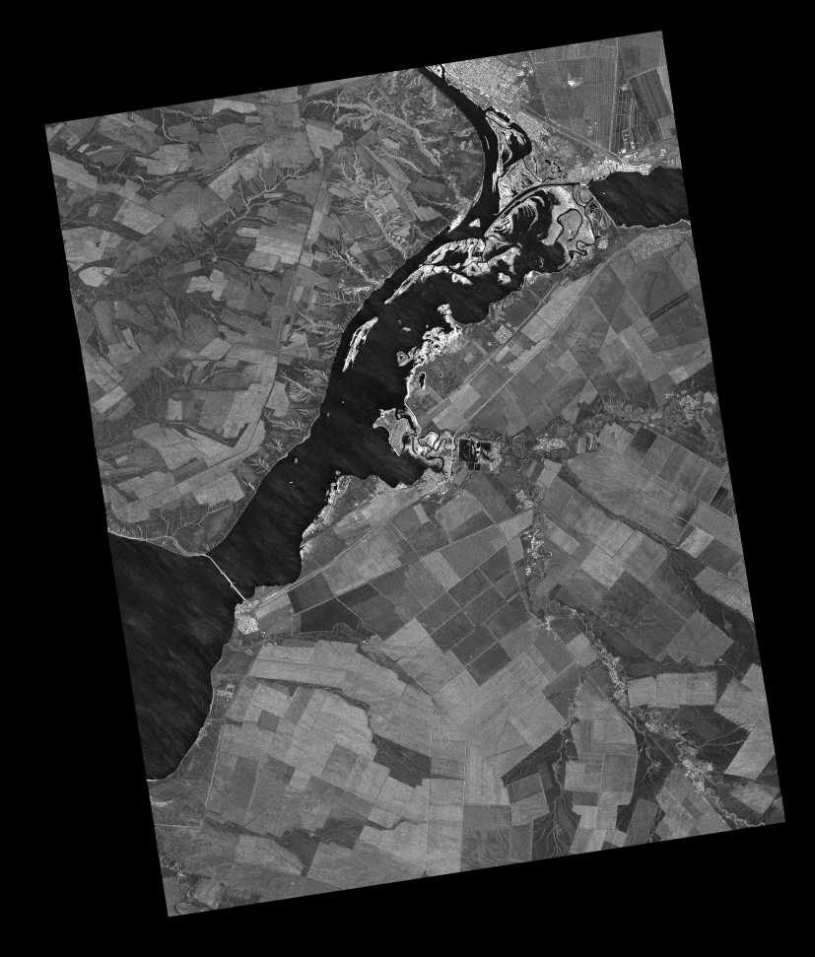
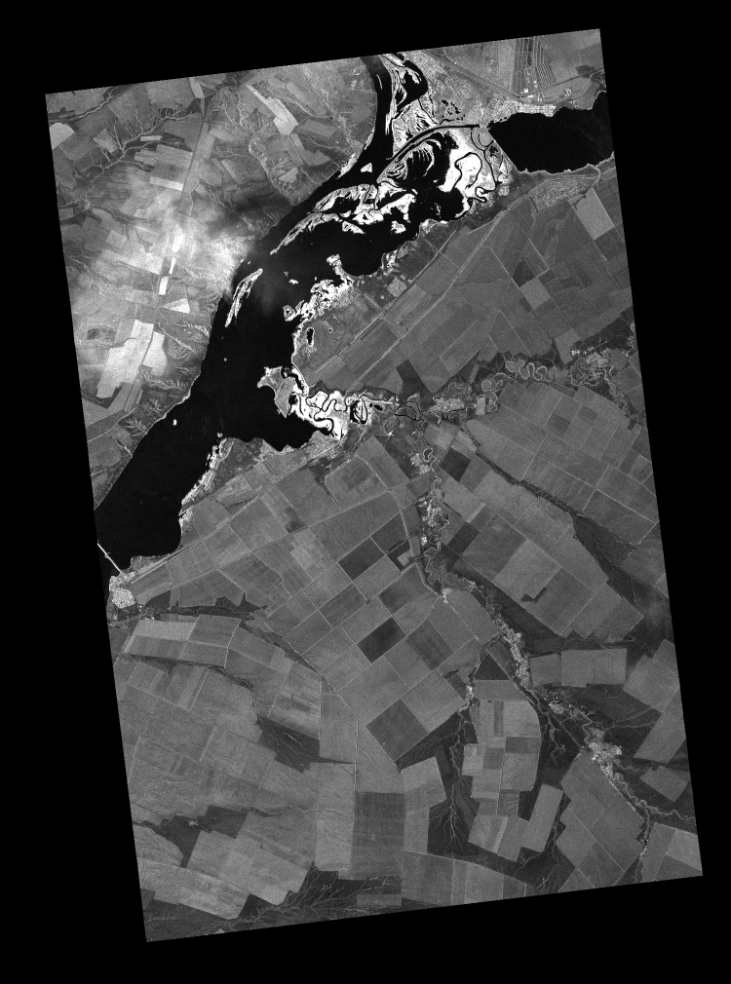
TanDEM-X / TerraSAR-X – First TSX Image 2007 vs. 2010
TSX 2007
TDX 2010

Slide 17
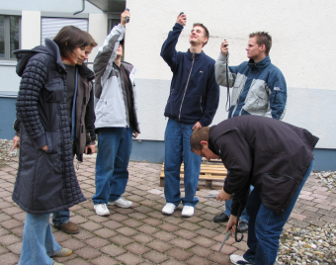
MF
PA
HR
DLR_School_Lab
Oberpfaffenhofen
Environmental
Remote Sensing
RB
FB
DFD
KN
RM

Slide 18
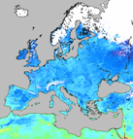
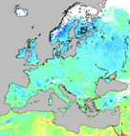
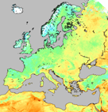
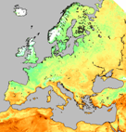
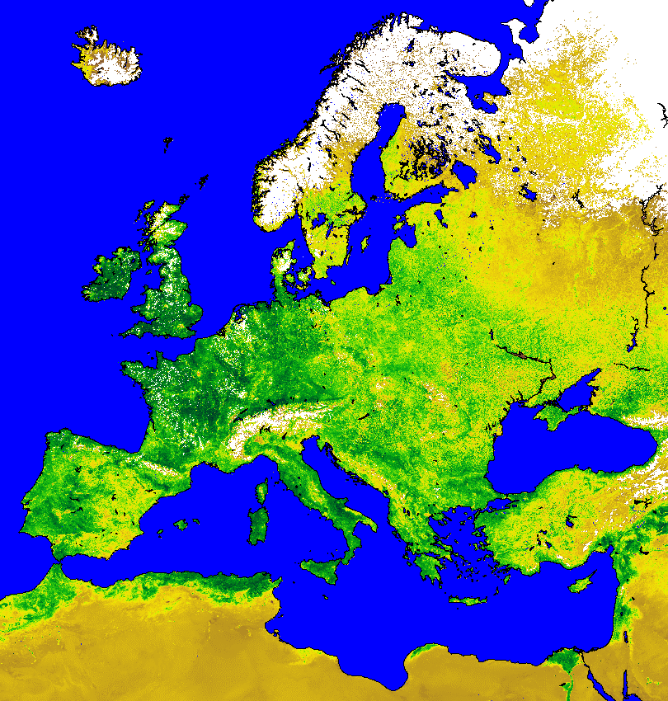
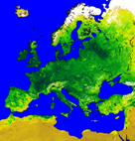
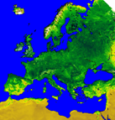
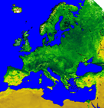
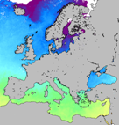
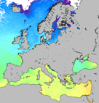
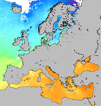
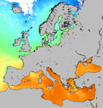
Time Series of Satellite Observations
April
May
June
July
30 Grad C
Land surface temperatures (LST)
-5 Grad C
0.7
Vegetation index (NDVI)
0.0
32 Grad C
Sea surface temperatures (SST)
0 Grad C

Slide 20
Spectral signatures of surfaces
gray: asphalt
yellow: yelllow paint
brown: field geen: meadow blue: blue paint
50
reflectivity / %
0
0
1.0
2.0
wavelength / µm

Slide 21
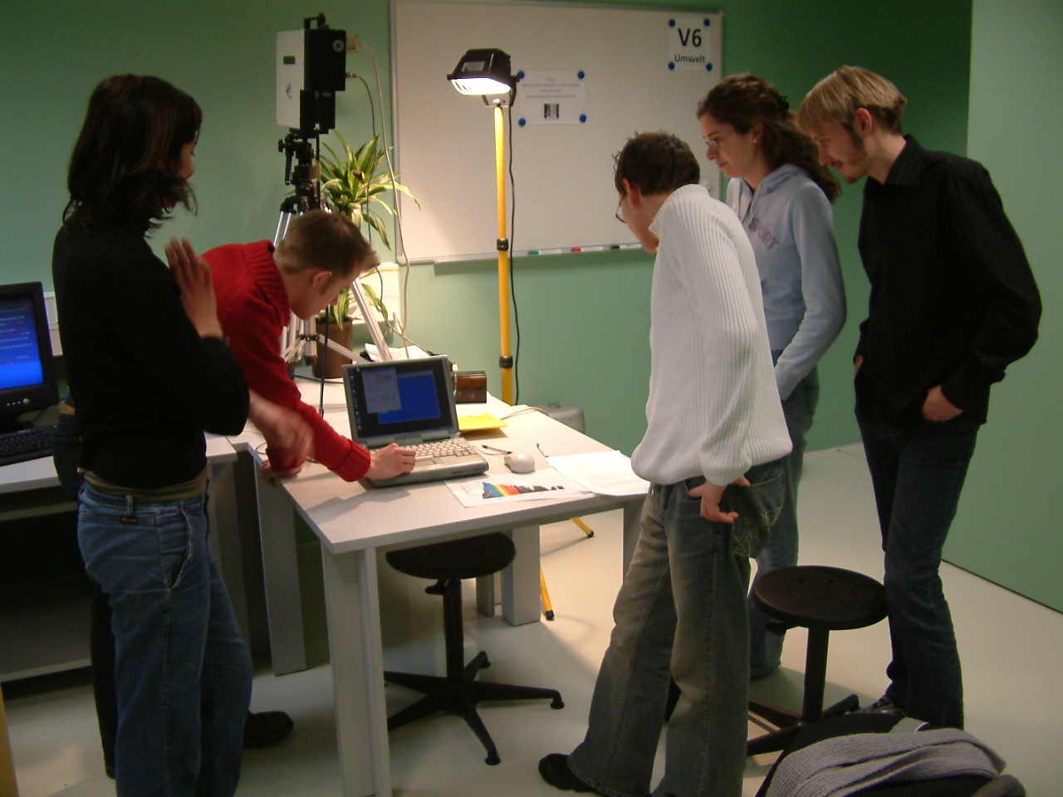

Slide 22
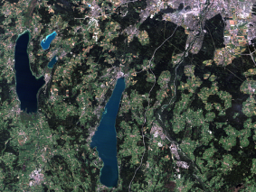
MF
PA
HR
DLR_School_Lab
Oberpfaffenhofen
EO
Data
Analysis
RB
FB
DFD
KN
RM

Slide 23
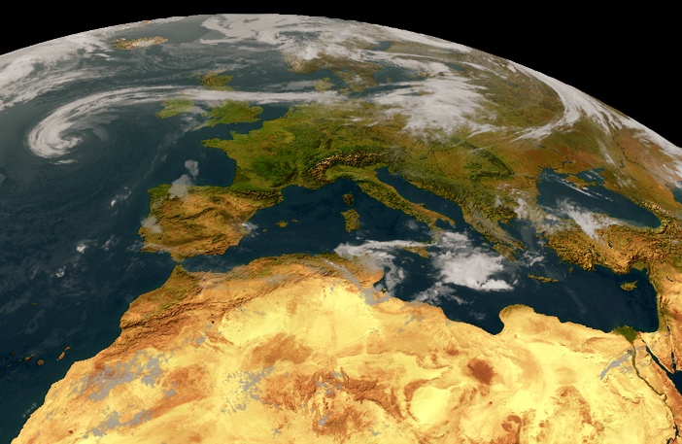
Meteosat-VISSR, ca. 10 x 10 km, alle 30 Minuten

Slide 24
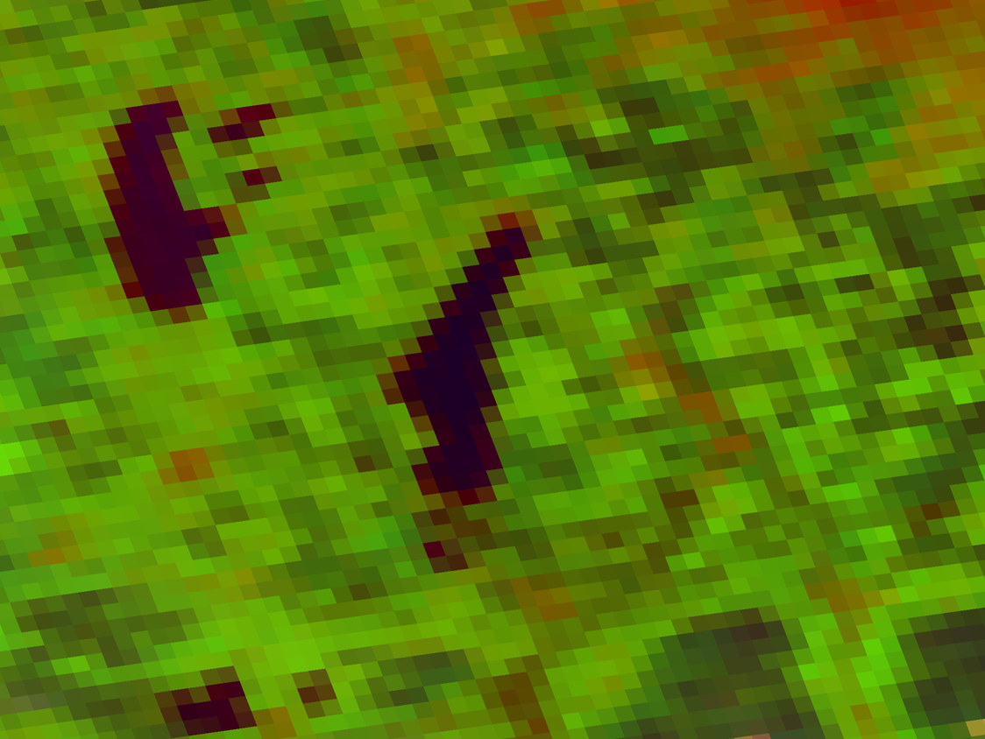

Slide 25
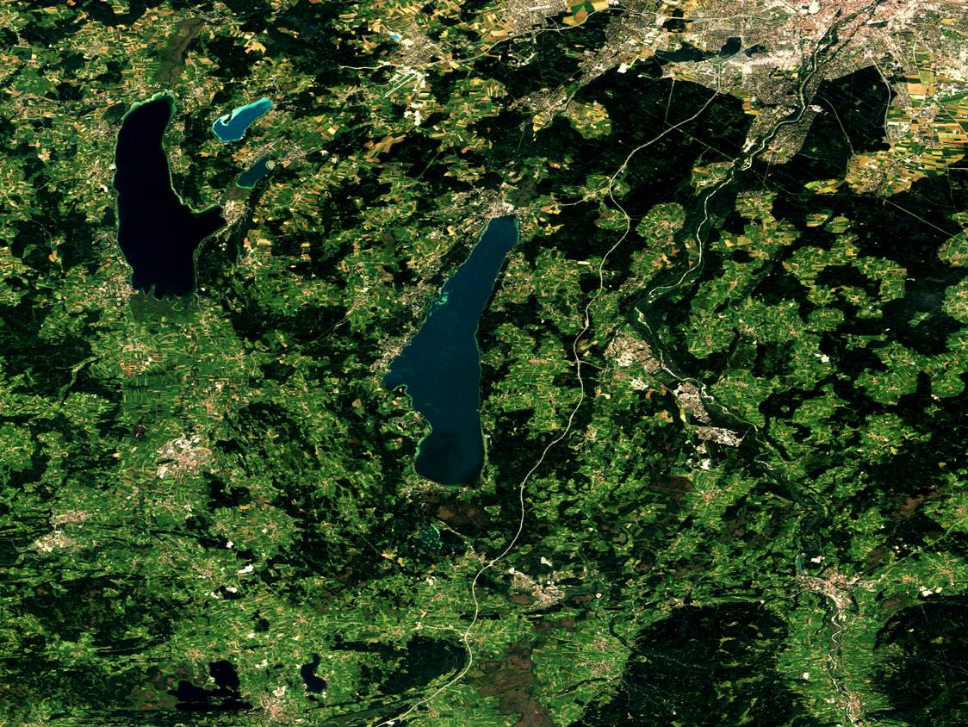

Slide 26
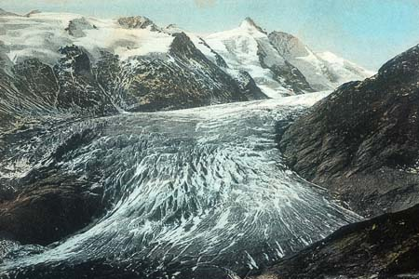
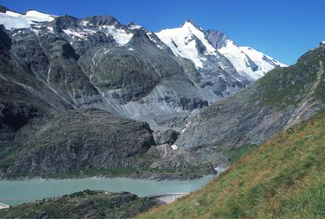
Example: Glacier-Deterioration in the Alps
Location: Pasterzenzunge/Großglockner (3798 m)
around 1900
2000
Gesellschaft für ökologische Forschung, Wolfgang Zängl, http://www.gletscherarchiv.de

Slide 27
Satellite Data: Landsat TM Available at Glovis / USGS
band 1
band 2
band 3
band 4
band 5
band 6
band 7

Slide 28
Ötztaler Alpes, Austria September 1986
Gepatsch reservoir
Gepatschferner
Vernagtferner
Hintereisferner
Landsat TM, RGB 5/4/3

Slide 29
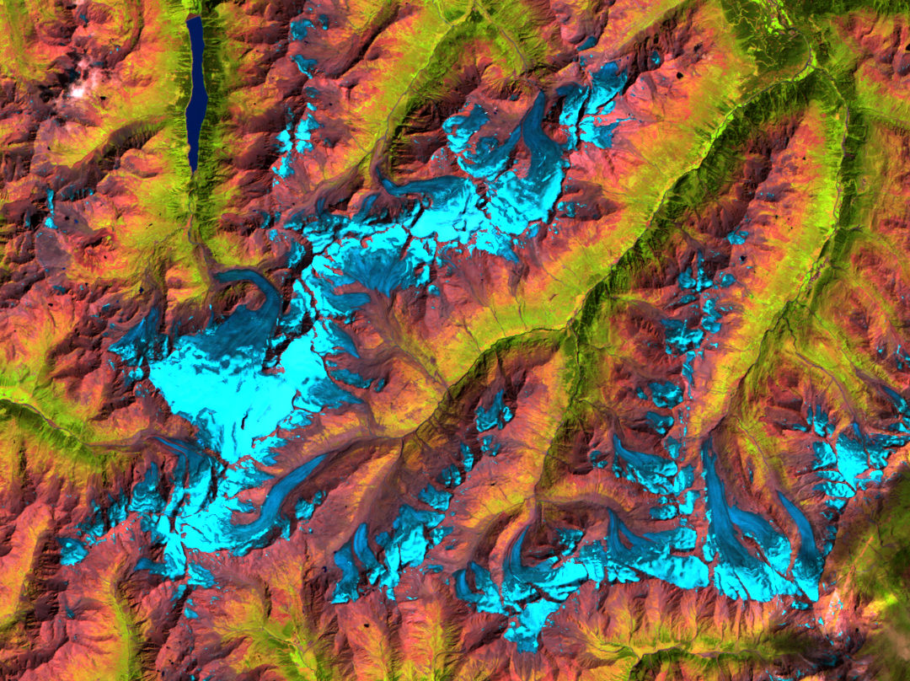
Ötztaler Alpes, Austria September 2003
open ice without snow layer
snow layer
Landsat TM, RGB 5/4/3

Slide 30
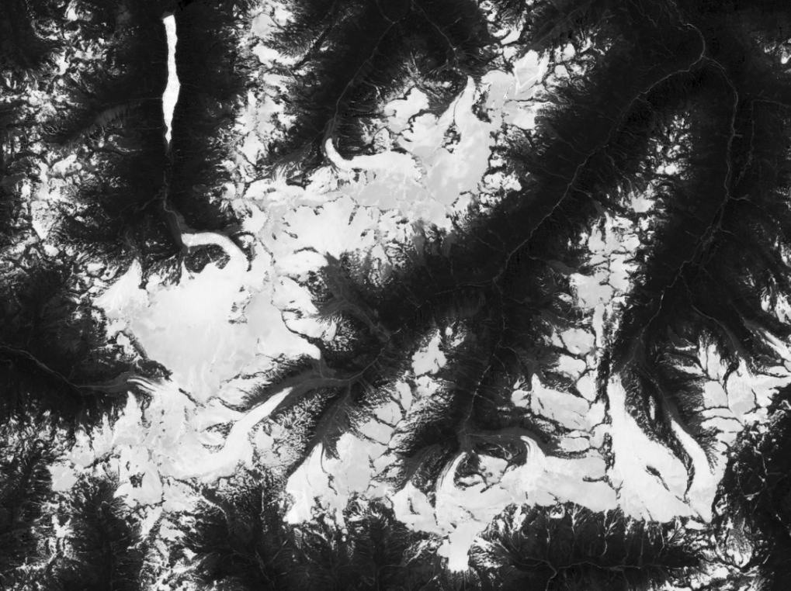
Change Detection Step 1 – Calculating NDSI (Normalized Difference Snow Index)
NDSI = (VIS_{green} – MIR) / (VIS_{green} + MIR)
NDSI_{TM} = (band 2 – band 5) / (band 2 + band 5)
NDSI 1986
NDSI 2003

Slide 31
Change Detection Step 2 – Building a snow & ice mask from NDSI image
maximize contrast
tone mask
Value 0
Value 255
Value 128

Slide 32
Change Detection Step 3 – combining the masks & transparent overlay
subtract masks
color combined mask
transparent overlay

Slide 33
Change Detection Step 5 – export image to Google Earth

Slide 35
Learning laboratories as interest-supporting out-of-school
learning environments for secondary school students
http://eldiss.uni-kiel.de/macau/receive/dissertation_diss_00003669

Slide 36
Creating Awareness from the Beginning…
Secondary School Students
Teachers
Teacher Educators
School Adminstration
Curriculum Makers
Ministeries
International Political Entities (GOs and NGOs)

Slide 37
Covering the Whole Chain
Starting Problem – Motivation
Strategy
Sensor
Data
Tools & Software
Expertise
Didactics

