Slide 1
GEO Capacity Building Resource Facility Portal Andiswa Mlisa GEO Secretariat CEOS WGCapD 5th Annual Meeting Hampton VA, USA 30 March - 1 April 2016

Slide 2
GEOCAB Main Objectives
Provide information that helps decision makers, policy makers, EO professionals and scientists become more familiar with EO applications and opportunities
Make freely accessible through the resource facility
Capacity Building resource: any element (human, organizational, IT-related, methodological, technical, promotion, best practise) of interest that can help the development of knowledge (capacity building) in the field of Earth Observation.
Notes:
the main objectives of the geocab portal is to
Provide informations that helps decision makers, policy makers and more generally earth observation products users to become more familiar with EO applications and opportunies
and also make these informations freely accessible through a web resource facility

Slide 3
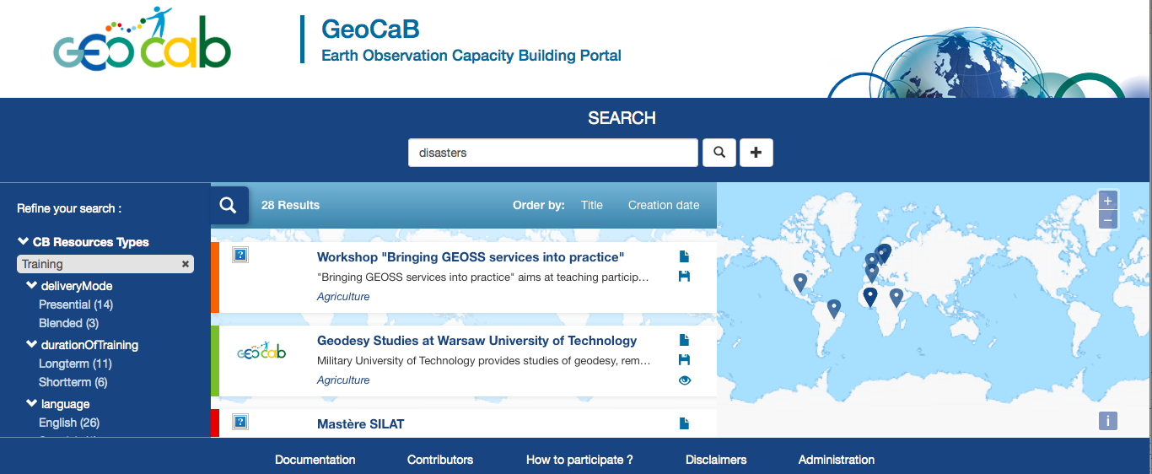
By Type | By SBA
Organizations | Biodiversity
Raw EO Products | Climate
Software | Disaster
Success Stories | Ecosystem
Tutorial | Water
Marketing Tool Kits | Weather
 | Energy
 | Health
 | Agriculture
http://www.geocab.org/
Notes:
There are now 950 resources
Mainly from IASON, EOPOWER and CEOS WGCapD members

Slide 4
GEOCAB Portal Cooperation
Partners have signed MoU for continued maintenance of the Portal
UNIGE, IRD, CRASTE-LF, CNR, AUTH, ITC, HPC
Support from GEO Secretariat and CEOS WGCapD
cooperation concerns the GEO capacity building resource facility (GEOCAB):
Technical hosting of GEOCAB will be provided by IRD;
Coordination for maintenance, operation and quality control of GEOCAB will be provided by IRD
Inputs, updates and checking and validation of inputs by third parties will be provided by all signatories of this Memorandum.

Slide 5
GEOCAB Portal Updates
automatic user registration available : http://www.geocab.org/constellation/#/register
The old user account of geonetcab.mdweb-project.org are always availables.
manage metadata :
new edition tool
new dashboard to manage your metadatas
new dashboard for moderator and administrators to manage the metadata of a user group (e.g. EOPOWER, GEO point of contact group,....)
system of notification to inform administrator and moderator about edition activities (validation and publication of new metadata sheet, for example)

Slide 6
GEOCAB Portal Way Forward
Maintain availability of registered resources
Continue seeking contributions to the portal
Market the available resources in the portal
Track usage and key areas of major interest by users
Improve categorization and search capability of resources
Develop the concept of a Capacity Building System of Systems

Slide 7
AfriGEOSS Symposium
27 – 29 April 2016
Victoria Falls, Zimbabwe
GEO Work Programme Symposium
2-4 May 2016
Geneva, Switzerland
GEO-XIII Plenary
9-10 November
St. Petersburg, Russia
Andiswa Mlisa – amlisa@geosec.org
www.earthobservations.org

