Slide 1
Capacity (and Capability) Building at GA
WGCAPD-5

Slide 2
About GA
National geological survey and national mapping agency.
Six value streams:
  Building Australia’s resources wealth
  Securing Australia’s water resources
  Ensuring community safety
  Managing Australia’s marine jurisdiction
  Providing fundamental geographic information
  Building geoscience capability
Steward of the nation’s geological, geophysical and geographical data and information: get the data used.
Capacity building is led by our Community Safety and Earth Monitoring Division. It is an integrated approach.

Slide 3
Focus activities
DataCube – lowering technical barriers to analysis of satellite remote sensing data at continental and regional scales.
Copernicus Data Hub – enhancing access to Sentinels data in the South East Asia and South Pacific region.
PNG Study – a roadmap for PNG to apply geoscience to support societal development.
APEC EMO – a regional political mandate for application of Earth observation to societal challenges.

Slide 4
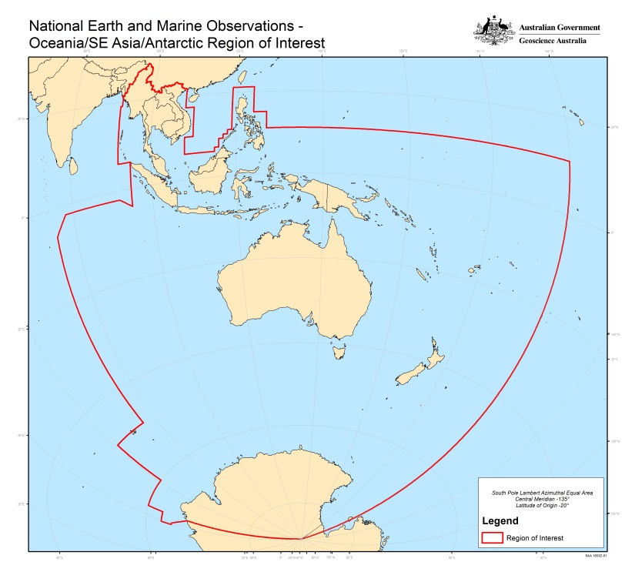





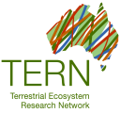








Australia’s Regional Copernicus Data Access/Analysis Hub
An integrated ‘Team Australia’ approach to
Support government information requirements.
Support the broader objective of enhancing access to satellite Earth observation data by research, industry and civil society.
Facilitate collaboration between Australians, Europeans and inhabitants of the South-East Asia-South Pacific region in exploitation of Earth observation data.
Benefits for: Australia, the region, EC/ESA/EUMETSAT, and the global satellite EO community.
All Sentinel Products For
Supporting
Consortium
Partners
Collaborators

Slide 5
Australia’s Regional Copernicus Data Access/Analysis Hub
ESA
IntHub
EUMETCAST
Terrestrial
GEANT/AARNET
Partnerships
(pay-per-use)
Master Repository (NCI)
Delivery for:
Australia
Region
Regional
Portal
(a la ‘SciHub’)
Original Format Data Files
(HSM Storage)
Agreed Standards
Analysis-Ready Data
(Lustre/spinning disk)
Interoperable
Services
(e.g. Thredds)
R&D for:
Research/Academia
Civil Society
Government
Industry
Australia and Region
Cloud and HPC
(Petascale)
Industry Exploitation
Operational Products
Deep National Archives
(Government Systems)

Slide 7
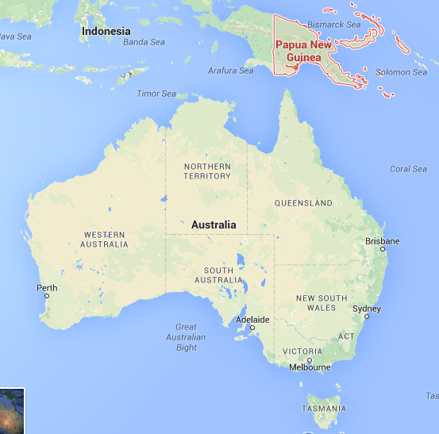
Papua New Guinea
Subsistence economy
Poverty issues
Governance challenges
Major drought
Exposed to disasters
Our closest neighbour

Slide 8

Approach
In support of AusAID
Multi-disciplinary: minerals, natural hazards, land mgmt
In-country engagement, respectful of local capability
Remote sensing as 1 part of the whole
Providing an holistic multi-year roadmap
Focussed on products that will ‘get used’
Emphasis on data infrastructure
Multi-disciplinary training on the ground

Slide 9


APEC Earth and Marine Observation Project (EMO)
Asia-Pacific Economic Cooperation forum.
South-East Asia and South Pacific are hugely exposed to food security, natural disaster and other issues.
EMO is Australian Government-led.
Co-sponsored by USA, Japan, China, Viet Nam and the Philippines.
Seeks to establish a clear political mandate for use of remote sensing to tackle big regional challenges:
Seeks to establish cooperation on: R&D, Data infrastructure, comms, cross-border apps, etc

