Slide 1
Capacity Building Activities at DLR
Committee on Earth Observation Satellites
Dieter Hausamann & Michael Bock
Agenda Item 30
CEOS 7th Working Group for Capacity Building and Data Democracy (WGCapD) Annual Meeting
INPE São José dos Campos, Brazil
6-8th March, 2018

Slide 2
Agency Competencies
Regional, Thematic Areas and Strategies
DLR’s Capacity Building Trainings in Asia
Location | Subject | Year
Bejing, China | Atmospheric Correction Using ATCOR, IEEE GSIS Training Course | 2016
Dongying, China | DELIGHT Information System: User Training | 2014+2015
Dongying, China | DELIGHT System Administrator Training | 2014/15/16
Bejing + Tianjin, China | Land Surface Dynamics, Time Series Processing, Thermal R.S. | 2014+2015
Almaty, Kasachsatn | QGIS Courses | 2015+2016
Urgench, Kasachstan | R.S. Training Courses | 2015+2016
Almaty, Kasachstan | CAWA Summer School | 2014/15/16
Almaty, Kasachstan | Monitoring of Central Asian Water and Land Ressources – from field measurement to spatial analysis | 2016

Slide 3
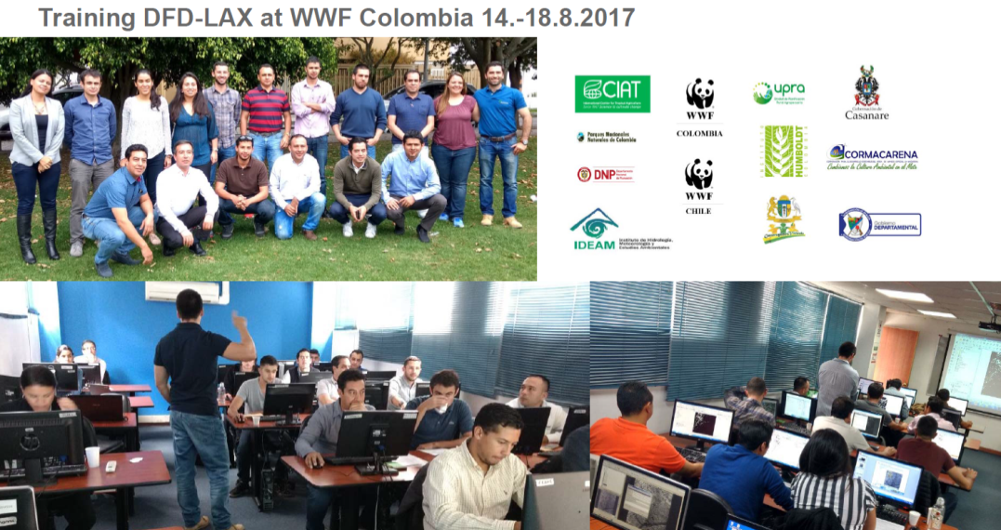
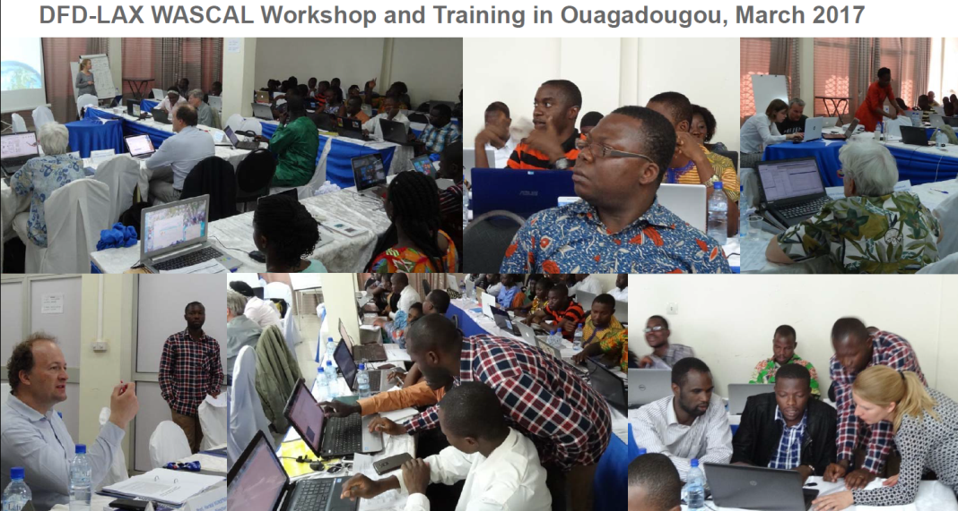
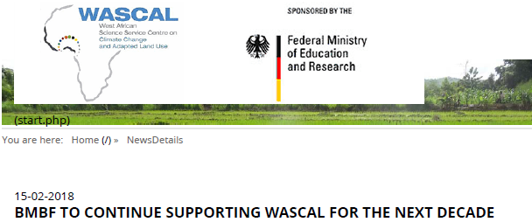
Capacity Building Activities
Activities By Region & Theme
Americas:
DLR/DFD-WWF Remote Sensing Training: Land Use Change – Bogota, Colombia, August 2017
Plans:
SEN4REDD Training Mexiko 2018 (FSU Jena)
DLR-WWF Remote Sensing Training: Land Use Change in Savannahs and Grasslands – Paraguay 2018
Africa:
DLR/DFD-WASCAL Remote Sensing Training: Land Use Change - Ougadougou, Burkina Faso, March 2017
Plans:

Slide 4
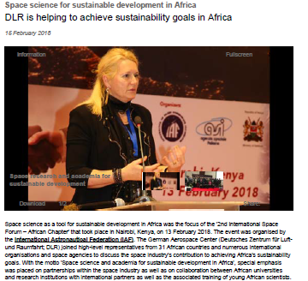
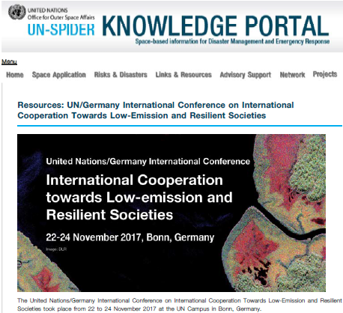
Capacity Building Activities
SDG-Related Activities @ DLR
Copernicus
Geo-Risks in the Andes
Global Urban Footprint
Smart Cities and Spatial Development
Coasts and River Basins
Cooperation DLR-GIZ
Cooperation with Vietnam
Cooperation with Costa Rica
Agroecosystems and Phenology

Slide 5
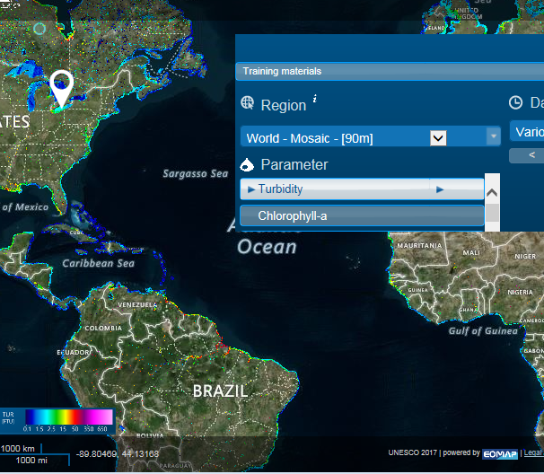
Capacity Building Activities
SDG-Related Activities @ DLR
UNESCO water quality Portal: http://www.worldwaterquality.org/ Free Access to global water data, of the developed by EOMAP (DLR-Startup)
UNSPIDER: un-spider.org
United Nations Platform for Space-based Information for Disaster Management and Emergency Response started in 2006
The German government (BMWi) and DLR support UN-SPIDER and its office in Bonn from the beginning. From 2018 on project DLR supports via the University of Bonn
Earth Observation based information products for drought risk reduction on the national level
The EvIDENz project is lead by ZFL at the University of Bonn. Project partners are UNU-EHS (United Nations University, the Institute for Environment and Human Security) and UN-SPIDER
Support National Wetland Monitoring
in Ruanda

