Slide 1
Regional Initiatives and EO for Sustainable Development (EO4SD)
Gordon Campbell, Stephen Coulson
Science, Applications and Climate Department
Directorate of EO Programmes
ESA

Slide 2
Why do we need Regional Initiatives?
Many of the issues targeted by EO are addressed regionally
Regional development strategies often make no connection to EO
Regional environment and climate issues
Security issues with a Regional dimension
Infrastructure and other developments impacting regionally
Regional collaboration on issues of pan-national interest
Stakeholder organization structured around existing cooperation fora
Common environmental and climate change monitoring and assessment (eg natural capital, ecosystem services)
Data exchange and cooperation agreements (eg maritime data, meteo etc)
Regional Earth Science cooperation fora
But.....these stakeholders often have very little explicit EO expertise/experience
Geographic datasets are usually structured geographically:
National and regional Collaborative Ground Segment Initiatives
Regional consistent (and intercalibrated) earth science data
Regional models and regionally customized EO processing algorithms

Slide 3
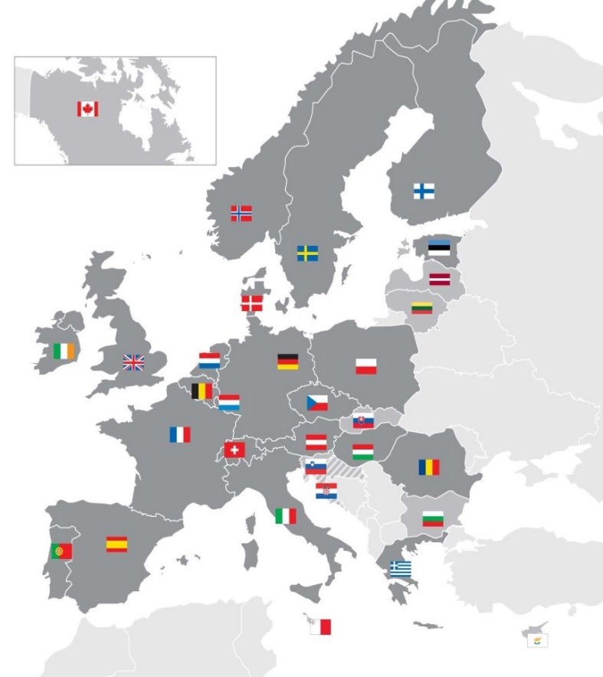
REGIONAL INITIATIVES
Set of coordinated activities: science, public sector, industry growth and infrastructure components;
Focus on regional priorities with high interest for Member States;
Initial regions: Baltic, Black-sea/Danube, Atlantic, Alps, Mediterranean, Mainly driven by interest of Member States;
Two pathfinders started – Atlantic and Black Sea/Danube
Link with existing regional institutions, H2020 activities and initiatives: e.g., Atlantic Ocean Research Alliance, Baltic Earth, BONUS, Black Sea Commission, Danube Delta Commission, etc…

Slide 4
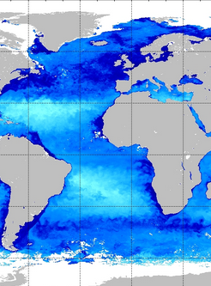
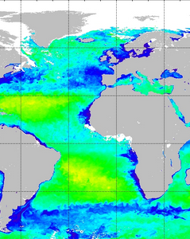
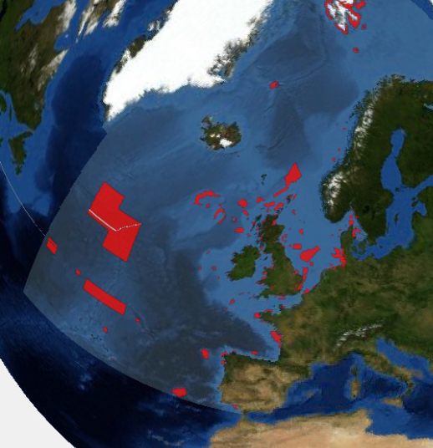
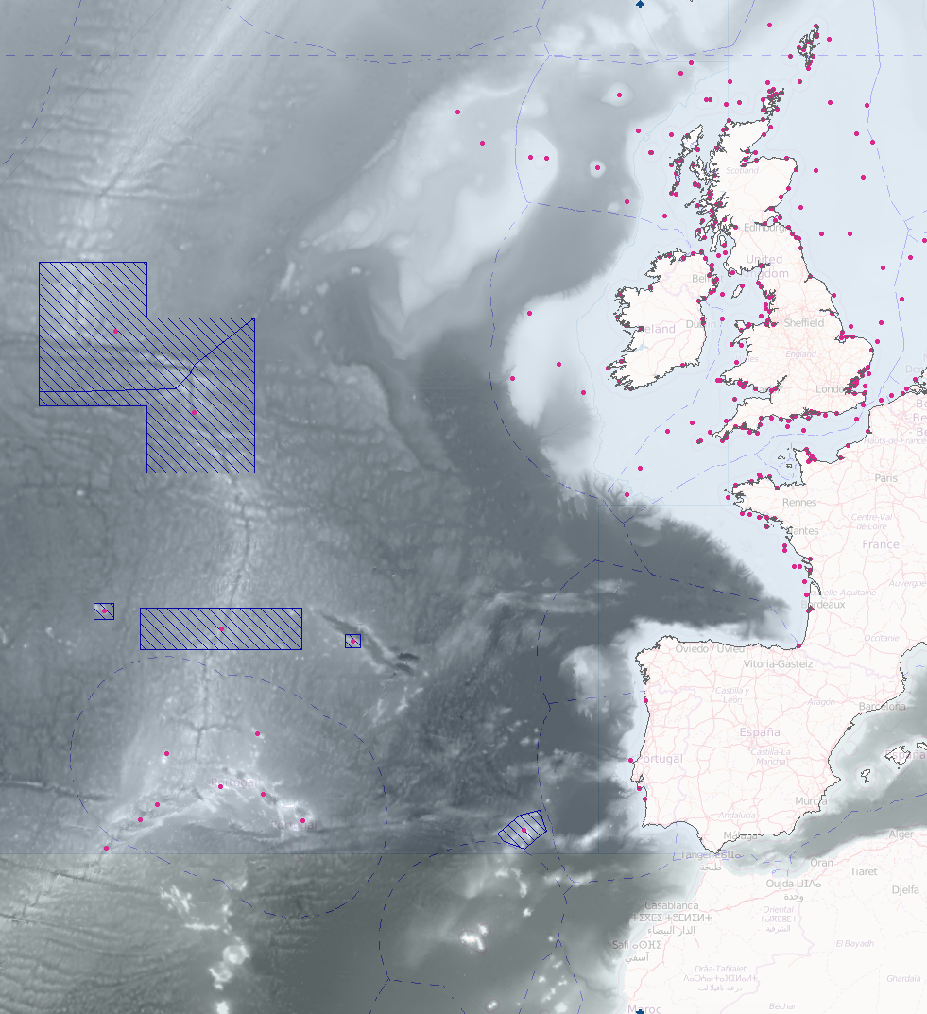
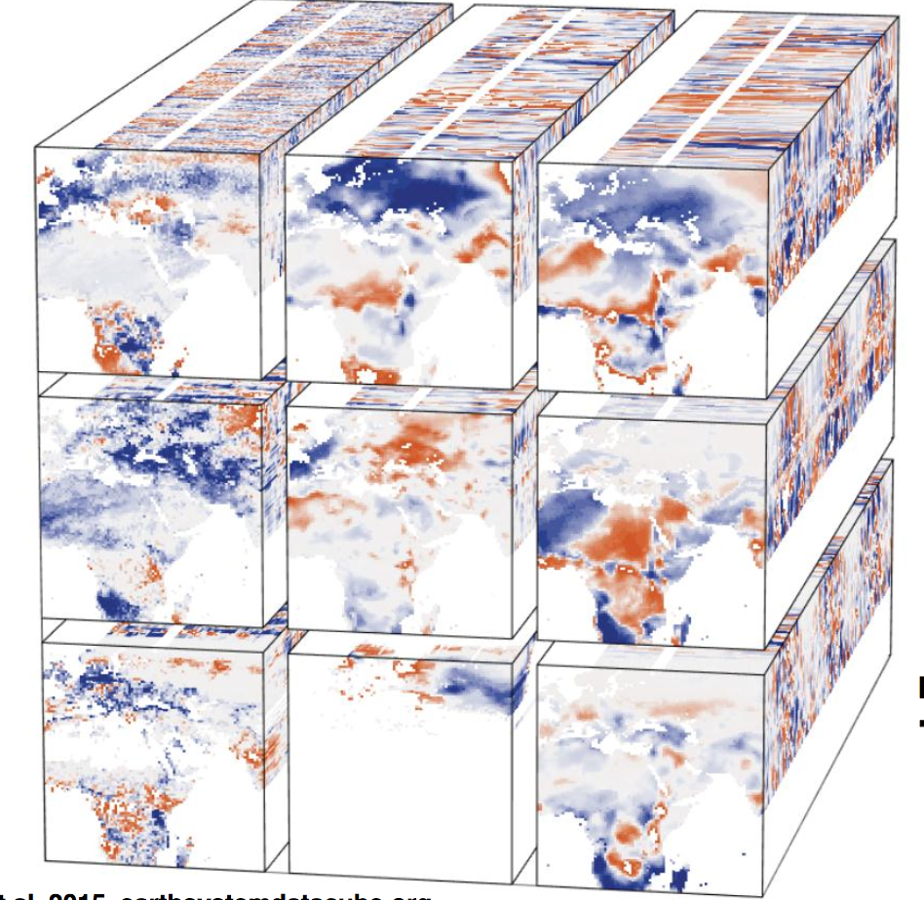
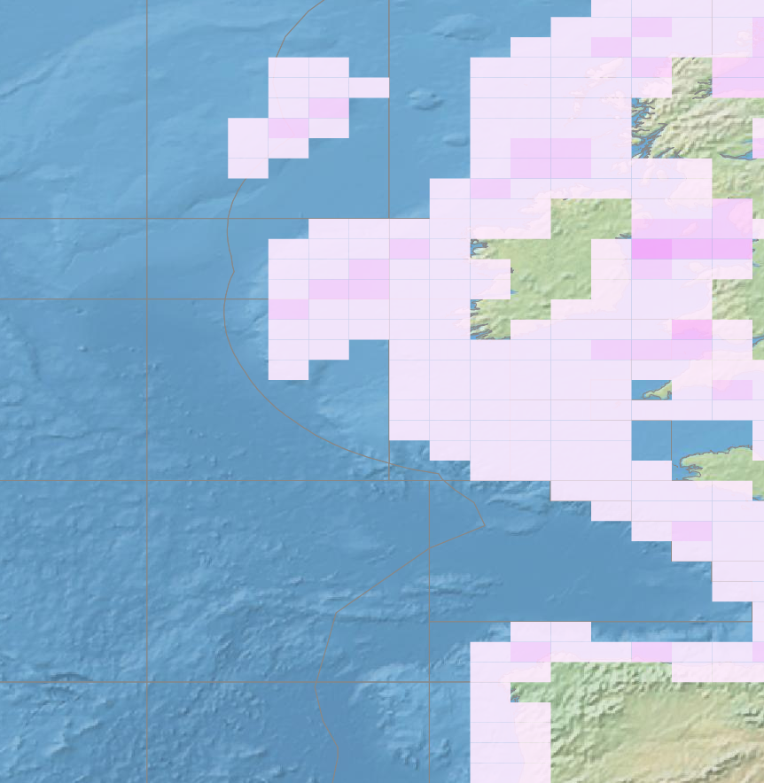
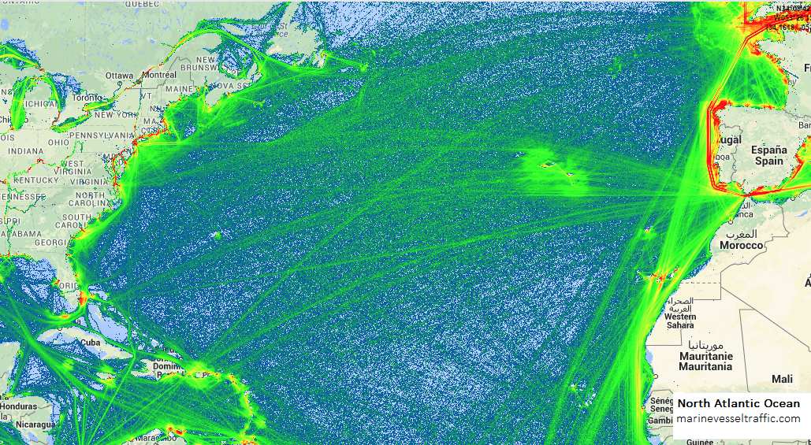
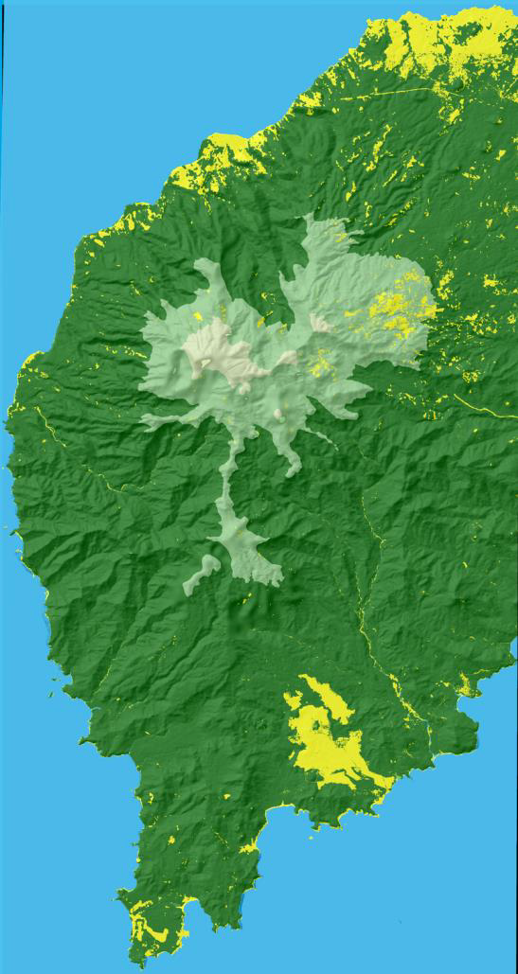
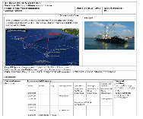
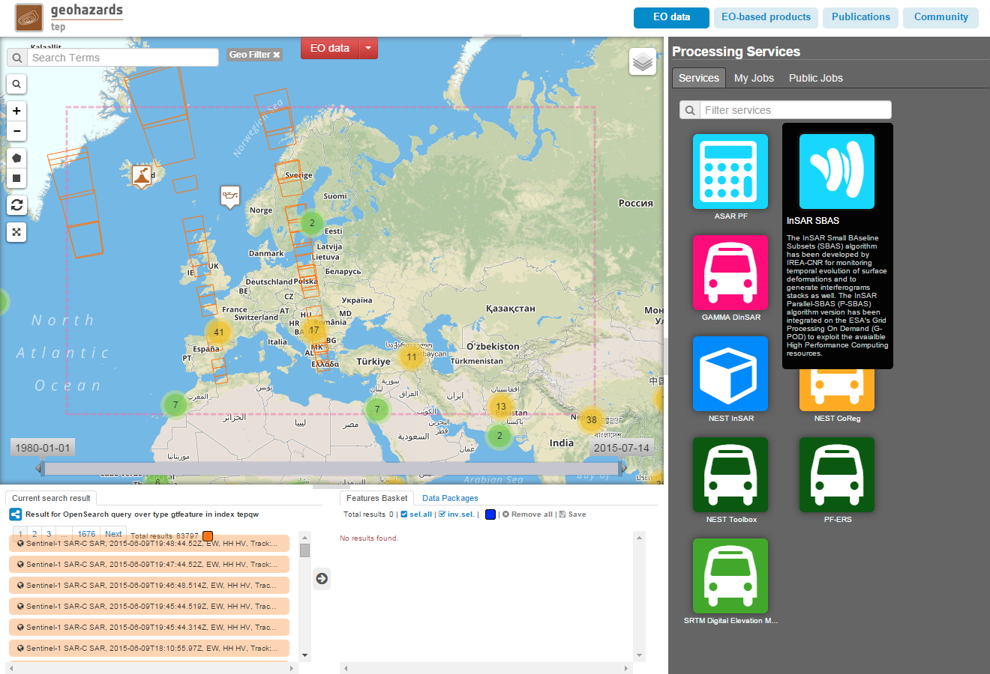
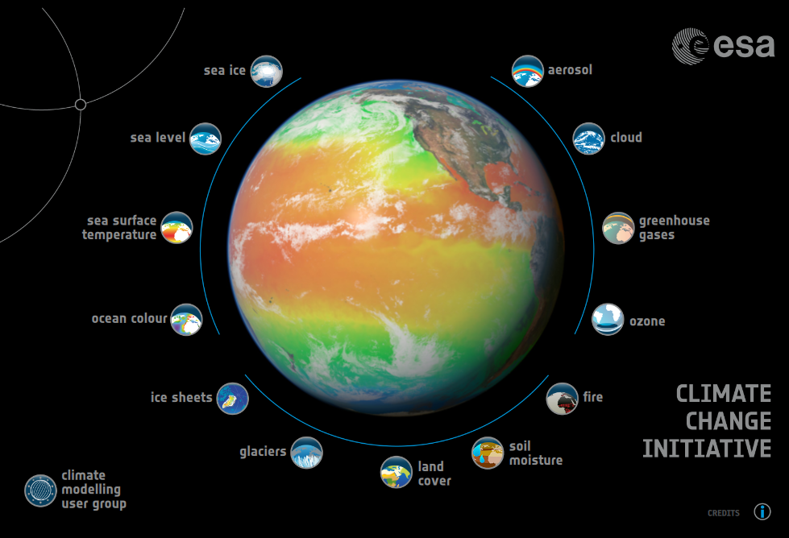
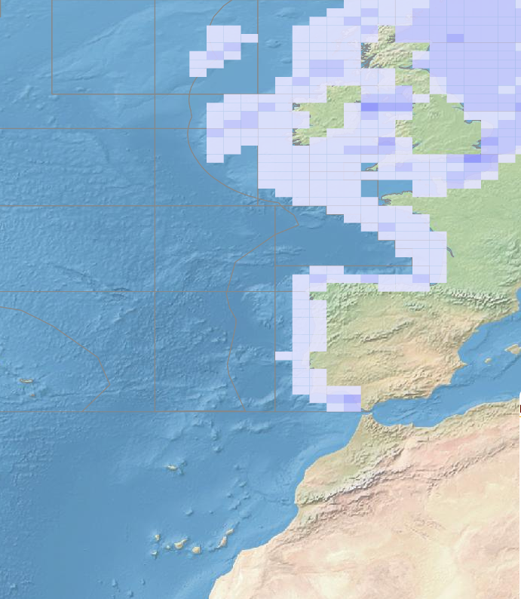
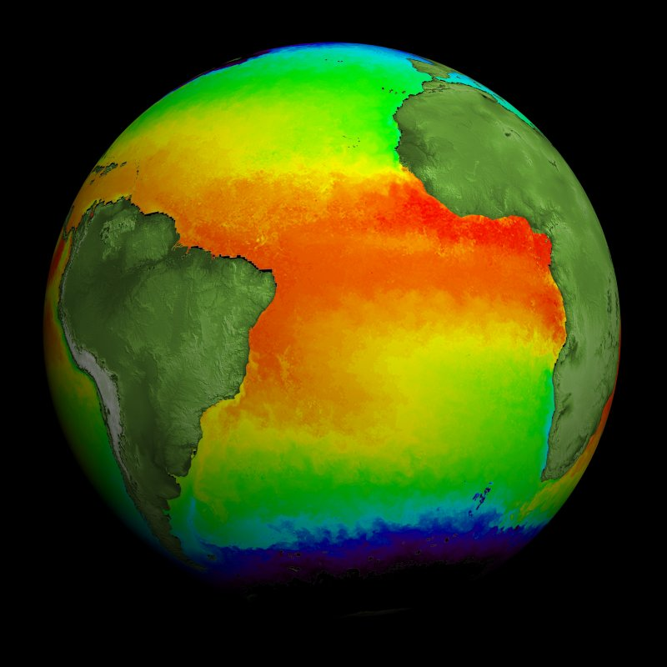
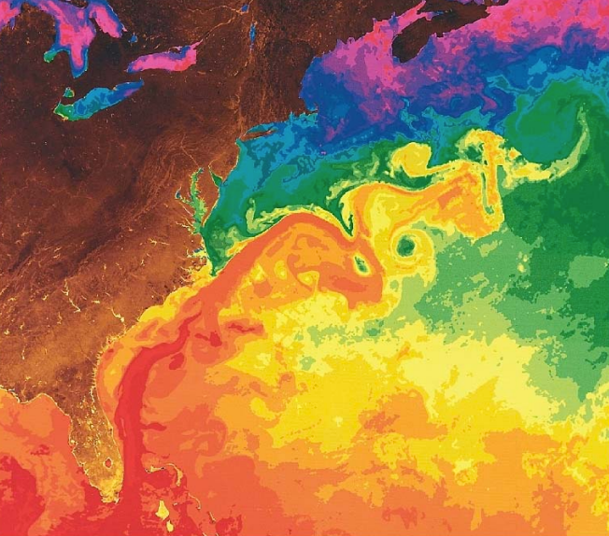
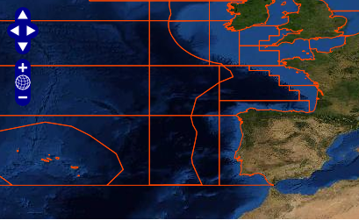
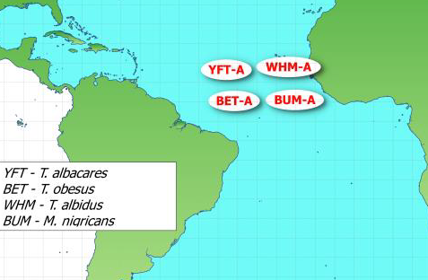
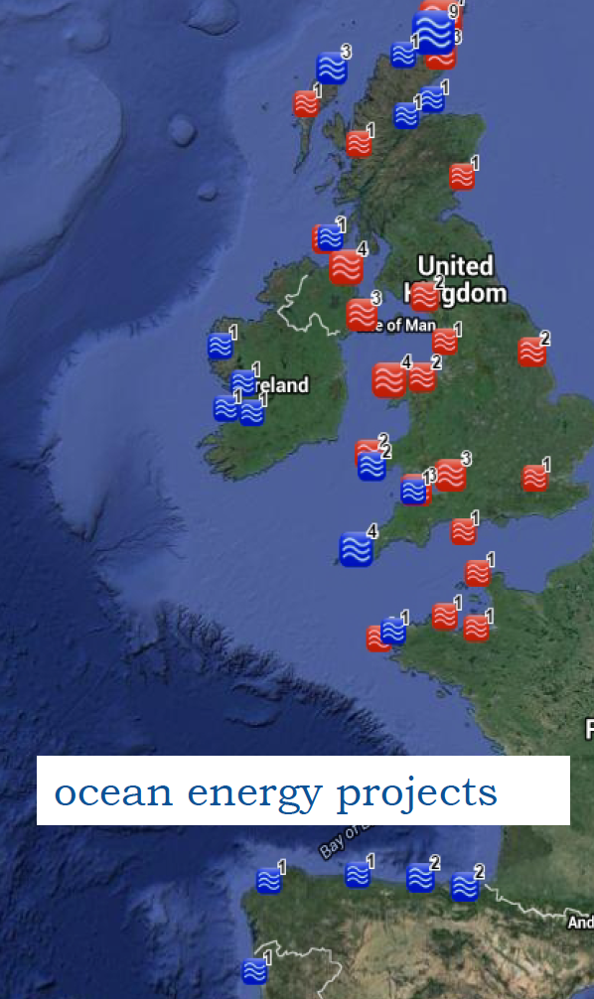
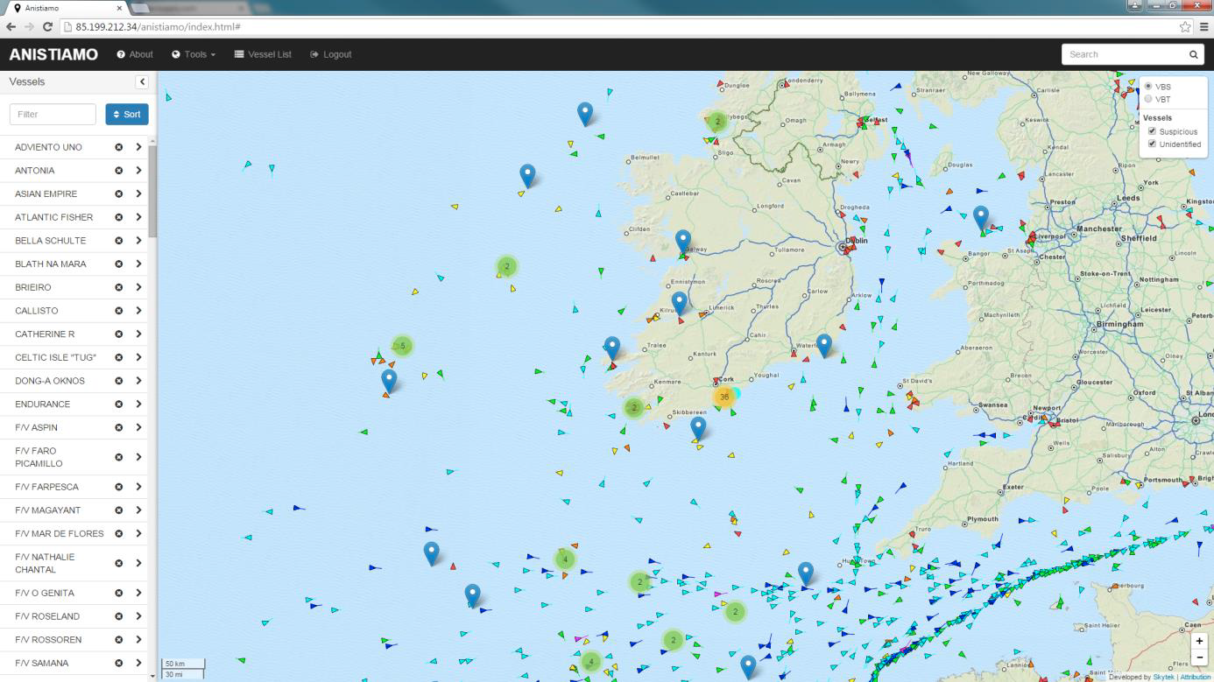
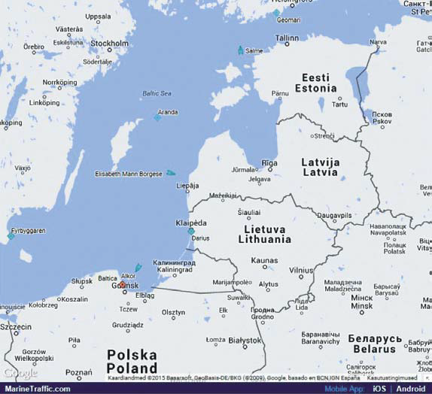
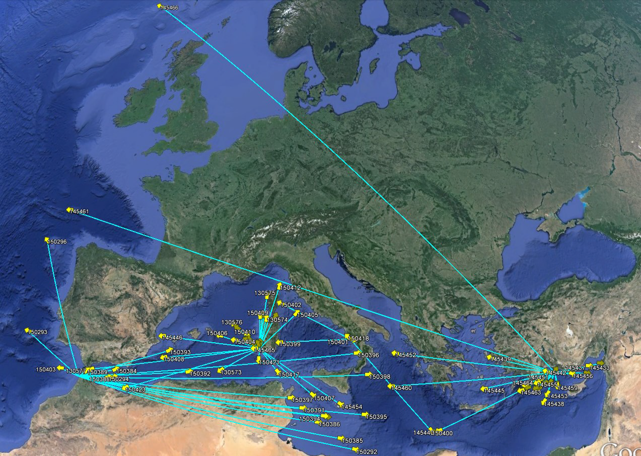
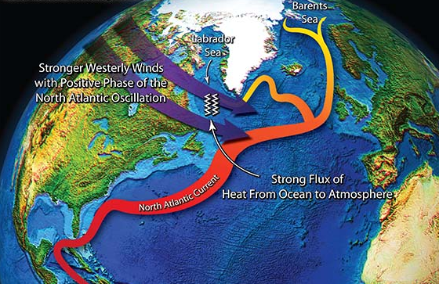
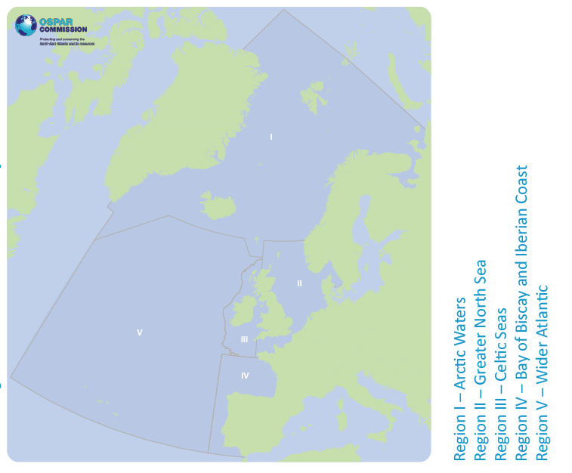
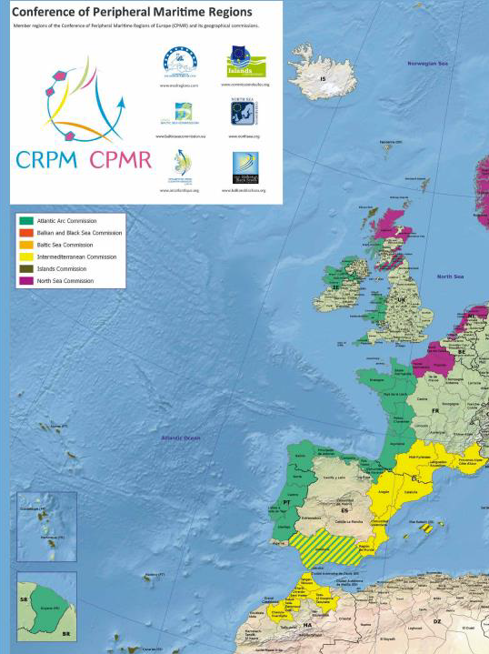
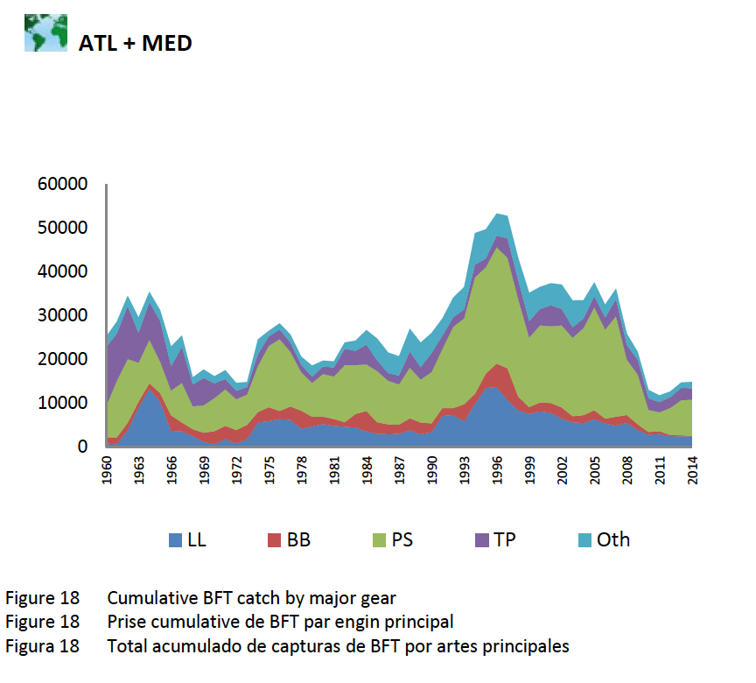
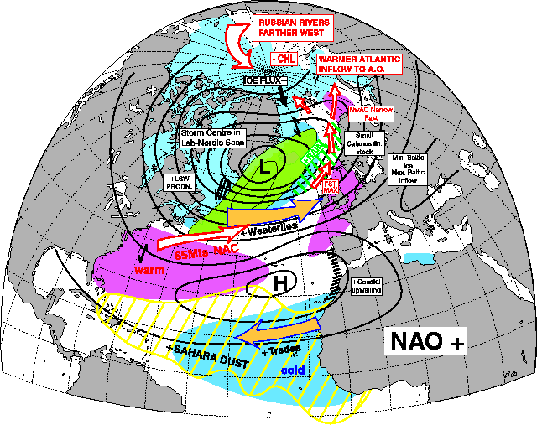
How will a Regional Initiative Operate?
Data access,
management
& processing
Support to
National &
Regional
Reporting
Routine
Monitoring
& Analysis/ Reference Datasets
Communication,
Education and
Citizen Engagement
Support to
Regional
Management
Actions/Plans
Development of
Customized Regional
Applications & Services
Support to
Regional
Earth Science
Research
Support to
Regional
Cooperation
Initiatives

Slide 5
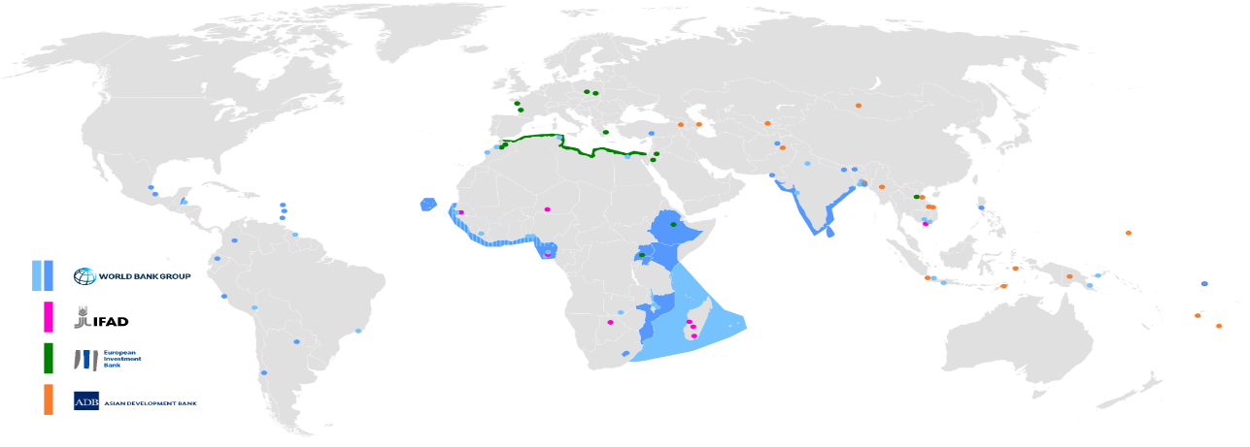
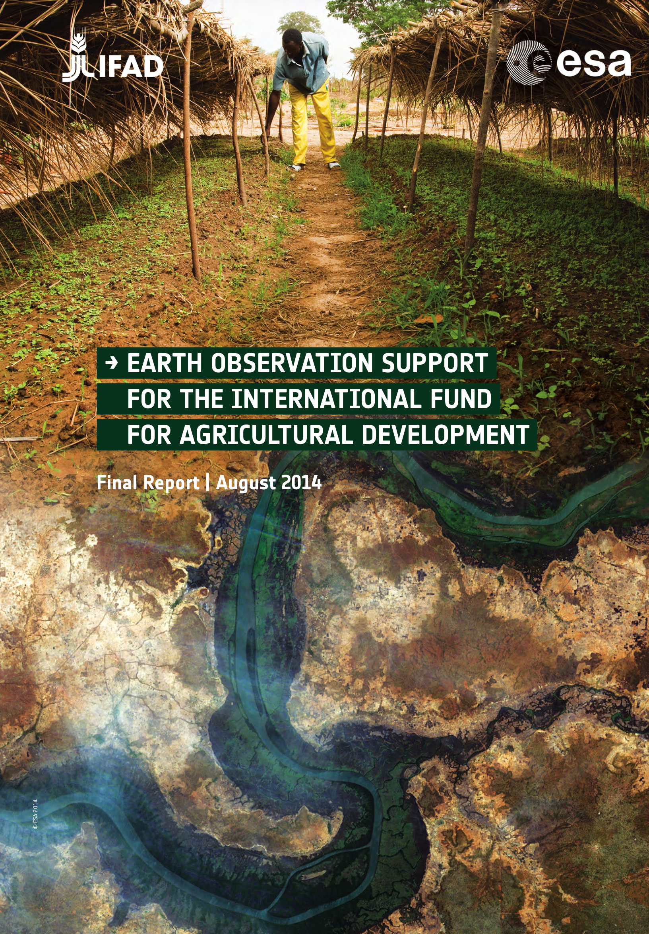
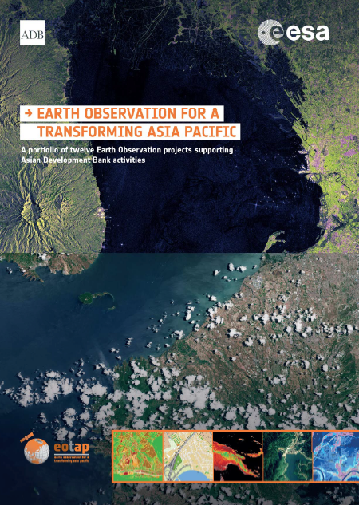
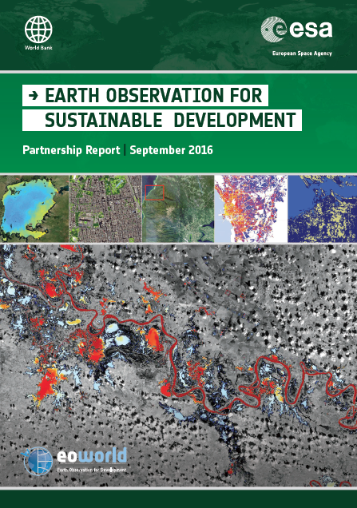
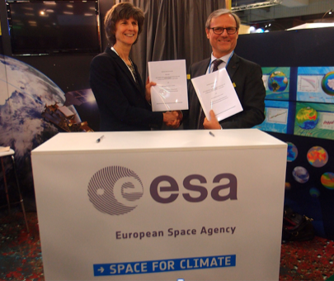
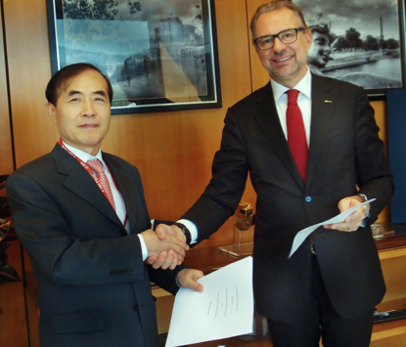
EO for Sustainable Development
65+ small-scale demonstrations of EO-derived environmental information in the implementation of Official Development Assistance (ODA) projects during 2010-15.
ESA - World Bank MoU, Dec 2015
ESA – ADB MoU, Nov 2016
Notes:
This idea is based on active collaboration over the last 5-8 years with the main International Development Banks (World Bank, Asian Development Bank, International Fund for Agricultural Development, etc),
The opportunity is to establish EO-based information as ‘best-practice’ environmental information in the planning, implementation and monitoring of Bank ODA project activities in the developing countries (typically large infrastructure developments),
More than 65 small-scale demonstrations of EO-based environmental information have been carried out in support of actual Bank development projects (the impact and benefits of using EO are documented in the reports on the right of the slide),
This has raised significant interest from the Banks to engage in larger-scale, longer-term activities to transfer EO information into their working practices (MoI 5-year agreements in place, signatures : WB Dec 2015, ADB Nov 2016),
There are also first signs of the Banks using their own resources for integrating EO-based information into their activities (e.g. 2 M US$ action from the Global Environment Facility GEF for Forest mapping in the context of REDD+)

Slide 6
Longer-Term Vision (next ~ 8 years)
Phase 1 (2016-20) : Consolidate Requirements, engage stakeholders (IFIs & Client States) via large-scale regional demonstrations of EO.
Phase 2 (2020-25) : Mainstream & Transfer EO into operational working processes & financing of Development Aid, and as ‘best-practice’ source of environmental information in Environmental Safeguards Systems (ESS) and Monitoring & Evaluation (M&E) methodologies.
Priority thematic areas :
Urban, Agriculture, Water Resources (2017)
Marine & Coastal, Risk Management, Fragile & Conflict States, Climate Resilience & Proofing (2018)
Forest, Ecosystems Services (2019)
Notes:
Fully establishing the use EO in the Bank community and working processes will require a dedicated program of work. There is a very timely opportunity now to position the European EO services sector and take full advantage of the investments already made in Europe. These are the ESA, EU, EUMETSAT and National space missions, together with the ESA and EC activities in the development of EO-based information services over the last decade.
This complete program of work (Phase 1 : Consolidate requirements, Engage Stakeholders, Phase 2 : Mainstream & Transfer EO) was specified in detail (more than 100 pages) to the ESA EO Programme Board (PB-EO paper) in February 2014. Phase 1 activities would require 25 Meuro (for all 10 thematic areas), and Phase-2 is approximately 65 Meuro (i.e 91 Meuro in total). The Phase-2 activities should be carried out with alignment of activities financed by the Banks (these could be capacity-building activities in the developing countries).
Additional subscriptions were made to EOEP-4 at the C-MIN14 to get started on Phase-1 in 3 domains (Urban, Water, Agriculture). The EOEP-5 program has a dedicated element (25 Meuro) to start the Phase-1 work for the remaining 7 thematic areas.
The idea is to go to the C-MIN19 with a proposal for a new element in EarthWatch at 65 Meuro to implement Phase-2 activities. In parallel, ESA (D-EOP) is in contact with OECD in order to explore if such a programme of work could be officially accredited as ‘ODA compliant’. This would allow additional sources of financing in ESA Member States to be used for an ESA programme (i.e. Ministries of Overseas Development/Aid).

