Slide 1
LCLUC Webinars
Committee on Earth Observation Satellites
NASA LCLUC
CEOS WGCapD-8 Annual Meeting
Agenda Item 12
Working Group on
Capacity Building & Data Democracy
Indian Institute of Remote Sensing
Indian Space Research Organisation
Dehradun, India
March 06th – 08th, 2019

Slide 2
Outline
-Introduction to the NASA LCLUC Program
-International and Regional Linkages
-On-going SARI Projects
-Webinars
-Questions Addressed
Webinar topics
Who are you targeting?
What outcomes are you trying to achieve?
What best practices do you follow?
What evidence do you measure to show that capacity is built?
Who are your implementing partners?
What are the potential areas for collaboration and linkages?

Slide 3
NASA Land Cover/Land Use Change
Program
LC/LUC is an interdisciplinary scientific theme within NASA’s Earth Science Division. The ultimate vision of this program is to develop the capability for periodic global inventories of land cover and land use from space, to develop the scientific understanding and models necessary to simulate the processes taking place, and to evaluate the consequences of observed and predicted changes
Characterizing Land Cover
Quantifying LC Change
Drivers of LCLUC
Natural Drivers
Anthropogenic Drivers
Socio-Economic Drivers
Political Drivers
Landscape Modification
Impacts of LCLUC
Carbon Cycle
Surface Hydrology
Atmosphere
Social Systems
Food, Energy, Water
Scenarios of Future Change

Slide 4
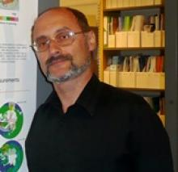
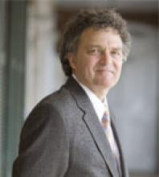
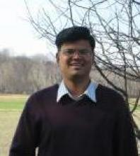
NASA LCLUC Program Management
Dr. Garik Gutman, NASA Head Quarters
-Program Manager
Dr. Chris Justice, Prof. Dept. of Geographical Sciences, Univ. of
Maryland College Park
-Program Scientist
Dr. Krishna Prasad Vadrevu, Remote Sensing Scientist,
NASA Marshall Space Flight Center
-Program Coordinator

Slide 5
Program Context

Slide 6
LCLUC Science Team Meetings
Washington: Spring Blossom
2007: Climate/Carbon
2008: Joint CC&E Focus Area meeting 2009: LCLUC impacts on climate 2010: GLS LCLUC products
2011: 15th Anniversary (review/update) 2011/9: Agriculture (Joint CC&E FA) 2012: Urban
2013: Wetlands
2014: Urban
2015: Early Career Scientists (Joint CC&E FA) 2016: 20th Anniversary/Industrial Forests 2017: Mountains & MuSLI
2018: SARI-1: South Asia & MuSLI
2019: SARI-2: SE Asia & Caucasus
International Regional
2007/9: NEESPI/MAIRS Urumqi, China 2009/1: MAIRS Kohn Kaen,Thailand 2009/9:MAIRS/NEESPI Almaty, Kazakhstan 2010/8: NEESPI Tartu, Estonia
2011/11: MAIRS Hanoi, Vietnam 2013/1: MAIRS Coimbatore, India
2013/11: NEESPI/MAIRS Tashkent, Uzbekistan 2014/10: NEESPI: Sopron, Hungary
2016/1: SARI/MAIRS: Yangon, Burma/Myanmar 2017/7: SARI/MAIRS: Chiang Mai, Thailand 2018/5: SARI: Manila, Philippines
2019/8: SARI – Johor Bahru, Malaysia

Slide 7
LCLUC Program –
NASA Linkages

Slide 8
US External Linkages
USGS
Merge of the newly selected Landsat & MuSLI Science Teams
LCLUC program funded - The Multi-Source Land Imaging (MuSLI) team is focused on developing innovative approaches using multiple sensor data for continental and global products.
USFS
Global Forest Observations Initiative (GFOI)
USAID
SERVIR - LCLUC (meetings + trainings)
PEER (Partnerships for Enhanced Engagement in Research) – LCLUC component

Slide 9
LCLUC Program – International Linkages

Slide 10
INTERNATIONAL REGIONAL INITIATIVES
Northern Eurasia’s Future Initiative (NEFI)
 Since 2000
LeadScientst NEFI
Pasha Groisman, NOAA/UCAR
MAIRS under Future Asia
 Since 2008
-Coordinated with SARI
Lead Scientist MAIRS
Jiaguo Qi, MSU
South/Southeast Asia Research Initiative (SARI)
 Pre-SARI Projects
 LCLUC-2015: South Asia
 LCLUC-2016: Southeast Asia
Lead Scientist SARI
Krishna Vadrevu, NASA MSFC

Slide 11
Pre-SARI LCLUC Studies Over a Period of years

Slide 12
SARI – Need from regional scientists
Jan-10-13th, 2013-Regional Science Meeting, Coimbatore
Total participants =120
US – 18 researchers
Nepal-3; Srilanka-2; Myanmar-1; Afghanistan, Myanmar, Bangladesh-1 each
Pakistan, China invited but could not attend – Visa issues
India – University Researchers, Government, Non-Government, NGO’s

Slide 13
Meeting Summary
NASA The Earth Observer

Slide 14
SARI - Goal
To develop an innovative research, education, and capacity building program involving state-of-the-art remote sensing, natural sciences, engineering and social sciences to enrich LCLUC science in South/Southeast Asia.

Slide 15
SARI Priorities
SARI Focuses on building research collaborations between the US and regional scientists
Meetings/Workshops help in identifying Needs and Priorities for the region (NASA LCLUC calls)
Training events are integral to SARI Events
(eg: 3-day training after the meeting)

Slide 16
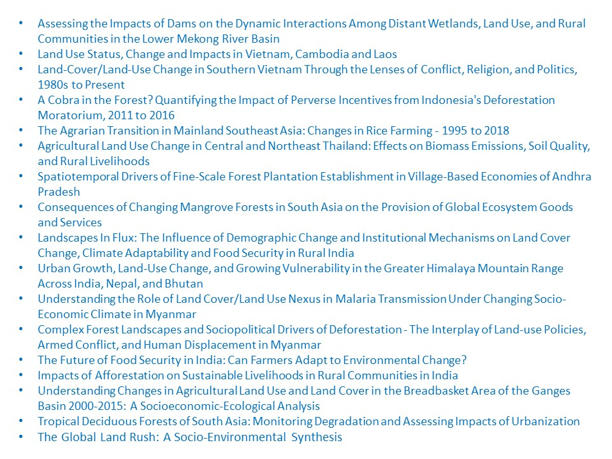
NASA ROSES - ongoing SARI Projects – 2015 - Present

Slide 17
LCLUC – A Global Program
LCLUC is a global program supported through regional partnerships to enhance
Regional scientists’ access to NASA assets
NASA scientists access to national data and facilitate field data collection
LCLUC is a catalyst for regional science initiatives through
Networks by leveraging national/local knowledge and resources and strengthening NASA research projects
Workshops focused on societal priorities and policy-relevant land-use science
LCLUC is a promoter of regional capacity building through
NASA data-use training
International data sharing

Slide 18
Education and Outreach
Webinars
Science meetings
Regional Meetings and Trainings
Special sessions (AGU, EARSeL, Other)
E-Newsletters
LCLUC website and Facebook page

Slide 19
NASA LCLUC Webinars
Since 2014
LCLUC Webinar 2014 - Urban Inter-Disciplinary Studies(IDS)
LCLUC Webinar 2015 – Agriculture, Urban
LCLUC Webinar 2016 - Forests, Water resources, Agriculture
LCLUC Webinar 2017 – Mountain Areas, Multi-Source Land Imaging (MuSLI) Projects and Synthesis
LCLUC Webinar 2018 – South/Southeast Asia Research Initiative
LCLUC Webinar 2019 – South/Southeast Asia Research Initiative

Slide 20
Questions Addressed
What are the Webinar topics?
Who are you targeting?
What outcomes are you trying to achieve?
What best practices do you follow?
What evidence do you measure to show that capacity is built?
Who are your implementing partners?
What are the potential areas for collaboration and linkages?

Slide 21
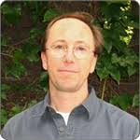
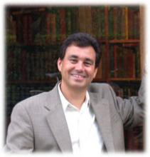
Sample Webinar Topics
Multi-Source Imaging of Seasonal Dynamics in land surface phenology combining Landsat- and Sentinel-2
To generate gap-filled time series of spectral vegetation indices that characterize the entire seasonal cycle of land surface phenology at fixed time steps
Mark Friedl, Boston U
Monitoring and Mapping the Area, Extent and Shifting Geographies of Industrial Forests in the Tropics
Science explaining how to map plantations of Eucalyptus, Rubber, Teak and Pines in tropics
David Skole, Michigan State U
Advancing methods for global crop area estimation
How to employ stratified sampling using MODIS for crop type and very high resolution data to estimate cultivated area
Matt Hansen, Univ. of Maryland College Park.

Slide 22
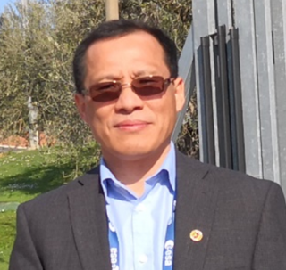
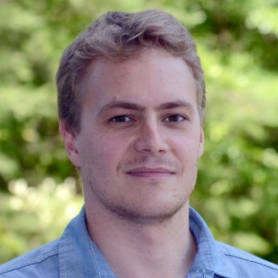
Sample Webinar Topics
Towards Near Daily Monitoring of Inundated Areas of North America. combining Landsat- and Sentinel 1&2
Multi-source fusion of optical and Radar data to map inundated areas, including lakes, streams, wetlands, episodically flooded areas
Multi-source imaging of infrastructure and urban growth using Landsat, Sentinel and SRTM
Continuous Infrastructure Index development algorithm demo
Mapping 25-years of community forestry dynamics in the middle hills of Nepal
Rigorous Terrain Correction approach integrated with Landsat data for deriving forest cover in Nepal using Google Earth Engine - Demo

Slide 23
Who are you targeting?
All interested in the latest LCLUC research
Email sent to the LCLUC Mailing list
Mailing list includes nearly 900-people; however, An average of 200-participants join our Webinars
PI’s, postdocs, grad students, regional researchers, facebook group
Weekly webinars by LCLUC PI’s (lasting for 1-2 months) generally during January/February of every year
Anyone can register for the mailing list

Slide 24
What outcomes are you trying to achieve?
Provide latest updates on the LCLUC research w.r.t. data/tools/science
Improve knowledge and educate people w.r.t. on-going LCLUC in different countries/regions of the world
Provide information on international / regional meetings/training/coordination efforts on-going on the region
PI’s present through WEBEX
1-1.5 hours – Mostly in-depth science research (not training)

Slide 25
What best practices do you follow?
Webinars are done through LCLUC Webex
Pre-presentation dry runs
PI’s are given enough time and asked to go slow and do in-depth presentation
Participants can ask any number of questions – Generally given enough time
Participants can also ask questions through Chat – Moderator reads those questions
Webinars are recorded and posted online
All presentation material posted online

Slide 26
What evidence do you measure to show that capacity is built?
Not through Webinars; LCLUC program does it through hands-on training in different countries
Webinars are mostly to update the participants on the latest on-going research/science in LCLUC studies

Slide 27
Implementing Partners
LCLUC Webinars are solely done by the LCLUC program-funded PI’s
LCLUC program approaches PI’s and ask them to do Webinars

Slide 28
What are the potential areas for collaboration and linkages?
Can include international / WGCapD LCLUC speakers in the Webinars that we organize
LCLUC program considering options to include training modules
Invite WGCapD members to join the LCLUC mailing list
Connect LCLUC mailing list to other WGCapD activities including MOOC’s
Open to the other collaborative options

Slide 29
Thank you for your attention
Questions?

