Slide 1
Technologies, Tools, Methods for capacity building: UK
Committee on Earth Observation Satellites
National Centre for Earth Observation (NCEO)
CEOS WGCapD-8 Annual Meeting
Agenda Item 18
Working Group on
Capacity Building & Data Democracy
Indian Institute of Remote Sensing
Indian Space Research Organisation
Dehradun, India
March 06th – 08th, 2019

Slide 2
UK Capacity building landscape for EO
UK CB activities often project-specific, between international collaborating partners - funded via NERC ODA, Newton Fund programmes, GCRF, UK Space Agency International Partnership Programme, DFID.
Some public-funded bodies have a capacity building emphasis for different audiences, for example:
Satellite Applications Catapult fosters business and public body partnering, including internationally.
National Centre for Earth Observation has regular training courses of a scientific application and technical EO nature aimed at EO postgraduates, Early Career Researchers and new scientific entrants to the field. e.g. international ODA projects on forestry, fires.
Institute for Environmental Analytics fosters late stage research, software applications and training in Big Data aimed at business, public bodies and general public.
The Centre for Environmental Data Analysis supports the computational and data storage aspects of capacity building activities for UK projects and runs workshops/online training.

Slide 3
Best practices and evaluation
Project-specific working fosters a co-design, collaborative approach to solve specific problems, with an emphasis on sustainability, building up expertise in-country.
ODA compliance essential for international capacity building.
Monitoring and evaluation of projects is reported to funders and measured by long-term social impact, e.g. independent monitoring and evaluation of IPP projects.
Collaboration and information-sharing tends to be ad-hoc and based on personal networks between projects/universities, and fostered by umbrella organisations and academic networks.
New drive for join-up for UK partners working in EO projects internationally via meetings and workshops – UK Space Agency, UK Joint GEO/CEOS Office.

Slide 4
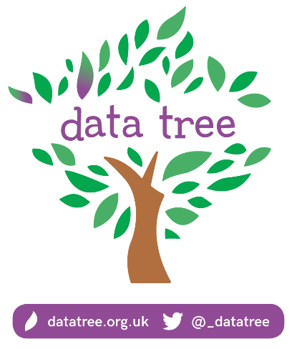
Emerging technologies
DataLabs for collaborative projects, based around Jupyter notebooks with simple access to parallel compute via a browser ‘dashboard’, results publishable to a webpage.
JASMIN infrastructure: provides storage and computational resources for development of services via virtual machines over low bandwidth SSH connections: game-changing for collaborations in Africa e.g. The Pest Risk Information Service (PRISE) project.
MOOCs: UK involvement with ESA and Eumetsat; upcoming online, free courses by IEA: ‘Data Tree’ and ‘Big Data and the Environment’ (starts 25th March 2019). Use quizzes, audio, video content, fully searchable from a dashboard. IEA developing a course with NCEO on using climate data.
Notes:
Data tree is an open online course of 8 modules (15-20hrs) a NERC initiative primarily for the benefit of NERC DTP/CDT cohorts and early career researchers in all aspects of environmental science– three on data management, one on stats, one on data visualization and the final three are on engaging other professionals with your research
Interactive learning and available anytime.
The course is CPD accredited, for those pursuing professional qualifications.
It was developed by the IEA at UoR and Stats4SD who are a social enterprise specializing in stats. There were 40 expert contributors, some appearing on camera.
Online course ‘Big Data and the Environment’ uses current examples to explore the potential benefits of environmental big data for business, research and our daily lives
Week 1: Introduction to big data
Sources of big data, including satellites for looking at the surface of the Earth
Environmental analytics and the link to big data
Computing power, processing and storage for environmental data
Week 2: Data to Discovery
The importance of open data
The challenges of working with data
The skills and knowledge of a data scientist
Week 3: Big and Small Data
Citizen science for climate simulation and ecology
Real-life examples of environmental analytics
The power of visualising data

