Slide 1

Examples of co-design for capacity development
Committee on Earth Observation Satellites
National Centre for Earth Observation (NCEO)
CEOS WGCapD-8 Annual Meeting
Agenda Item 35
Working Group on
Capacity Building & Data Democracy
Indian Institute of Remote Sensing
Indian Space Research Organisation
Dehradun, India
March 06th – 08th, 2019

Slide 2
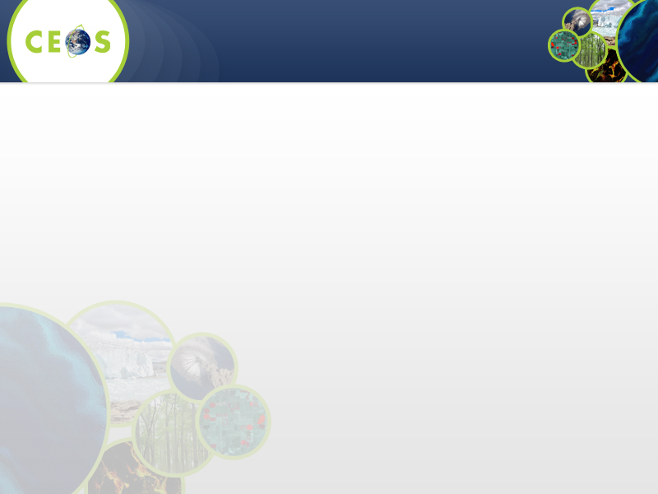
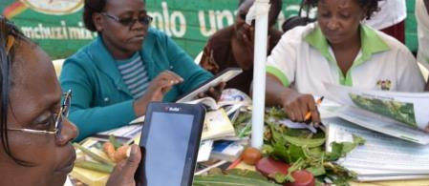
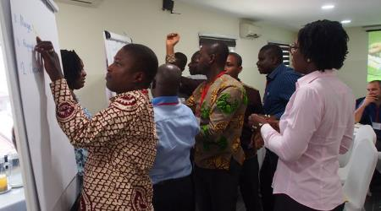
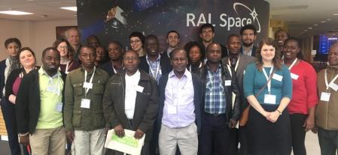

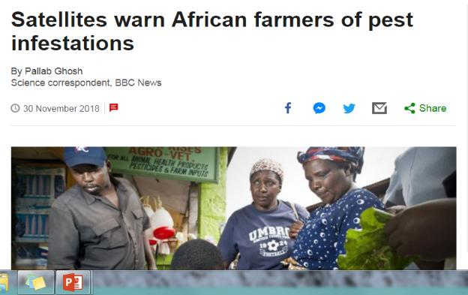
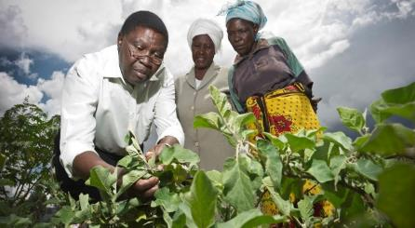
PRISE: Pest Risk Information System
IPP interdisciplinary project: EO-based crop pest risk information system in Ghana, Kenya and Zambia.
Driven by user-requirements for App-based service; match-funding ensures co-design from the start.
Led by Centre for Agriculture and Bioscience International development charity (CABI) (Plantwise)
Brings together local plant health experts, scientists, EO and systems development King’s College London, environmental consultants, data specialists and facilities.
Plantwise has helped 18.3 million farmers, raising average farm incomes & yields ~13%.

Slide 3
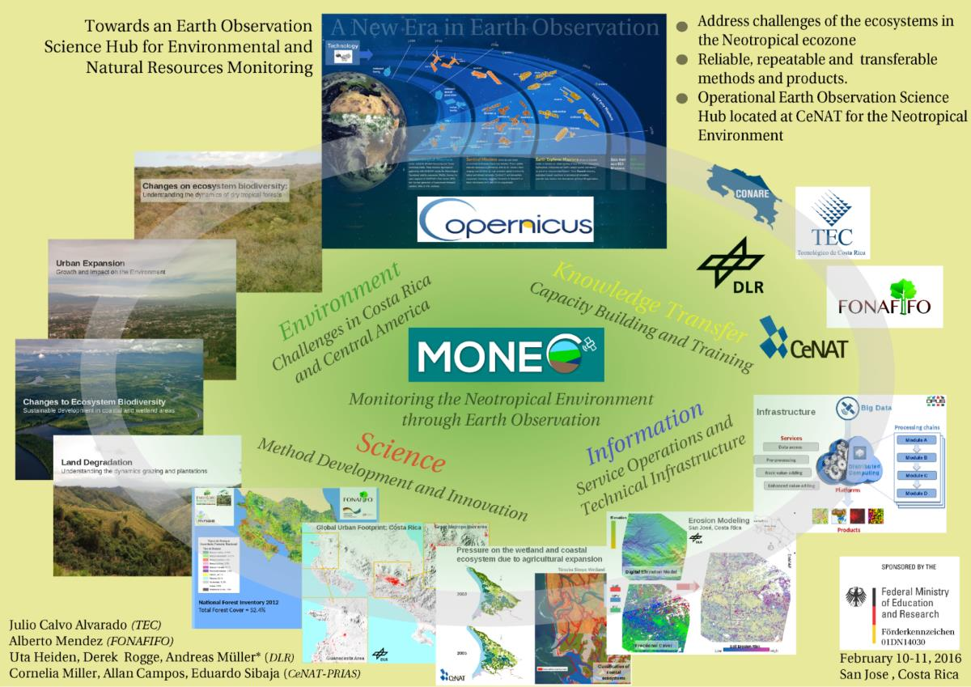
MONEO
Science Hub
Notes:
DLR EOC and Costa Rica’s national technology centre (Centro Nacional de Alta Tecnología, CeNAT) intend close cooperation in the field of earth observation. A corresponding agreement has been signed in March 2016 in Costa Rica in the presence of Germany’s Minister of Education and Research, Dr. Johanna Wanka.
The agreement that has now been concluded is an important step on the way to far reaching cooperation between the remote sensing experts at EOC and CeNAT. The partnership gives the EOC scientists an opportunity to adapt and improve their methodologies for specific local situations using the regional expertise of their Latin American colleagues. In return, earth observation services and monitoring instruments for Costa Rica and Latin America are to be developed locally with the help of DLR. A free-of-charge data stream from Copernicus, the European earth observation programme will be a primary data source.
The high potential for wide-ranging cooperation with Costa Rica was summarized in the the MONEO project (Monitoring the Neotropical Environment through Earth Observation). It has the goal of combining science activities and developments in and with Costa Rica by making use of the European space programme Copernicus, thereby smoothing the way for establishing earth observation services for Latin America and the Caribbean.

Slide 4




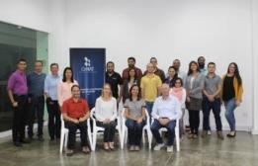
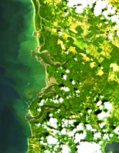
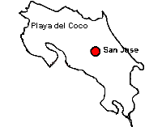

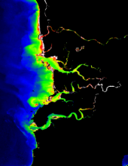
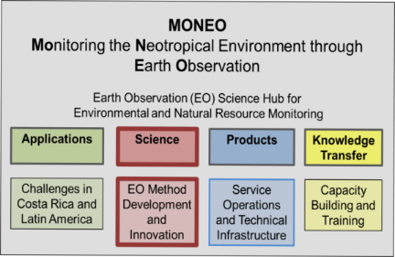
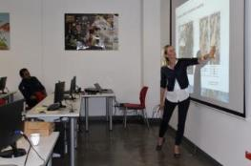
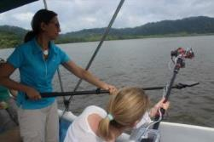
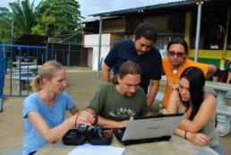
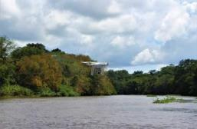
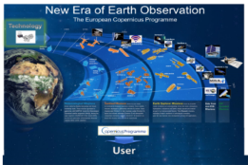
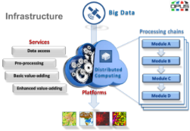

MONEO-WET Project
Collaboration between CENAT-PRIAS and DLR
Data analysis
Processing
Field work
Equipment
Data access
Wetland monitoring
Workshop
Training
Student exchange
November 2018
Nicole Pinnel, Peter Gege, Anna Göritz, Uta Heiden (DLR)
Cornelia Miller, Andrés Contreras, Heileen Arias, Dabiel Flores (CENAT-PRIAS)
Notes:
The project is funded by the BMBF (German Research Ministry) and has been running since Sept 2018 to March 2020.
The partner in Costa Rica is CENAT-PRIAS in San Jose.
In the Moneo-Wet project, the partners in Costa Rica are to be trained and trained in such a way that they can evaluate and monitor the water quality in the Terraba Sierpe Wetland National Park with remote sensing data.
-DLR first training in November 2018 was an introduction to remote sensing of aquatic ecosystems. (Introduction to remote sensing and aquatic ecosystems) and then a software training for the evaluation of field measurements and remote sensing data (LANDSAT, Sentinel) with WASI.
(WASI (Water Color Simulator) is a software developed at DLR by Peter Gege for the evaluation of water data.)

Slide 5

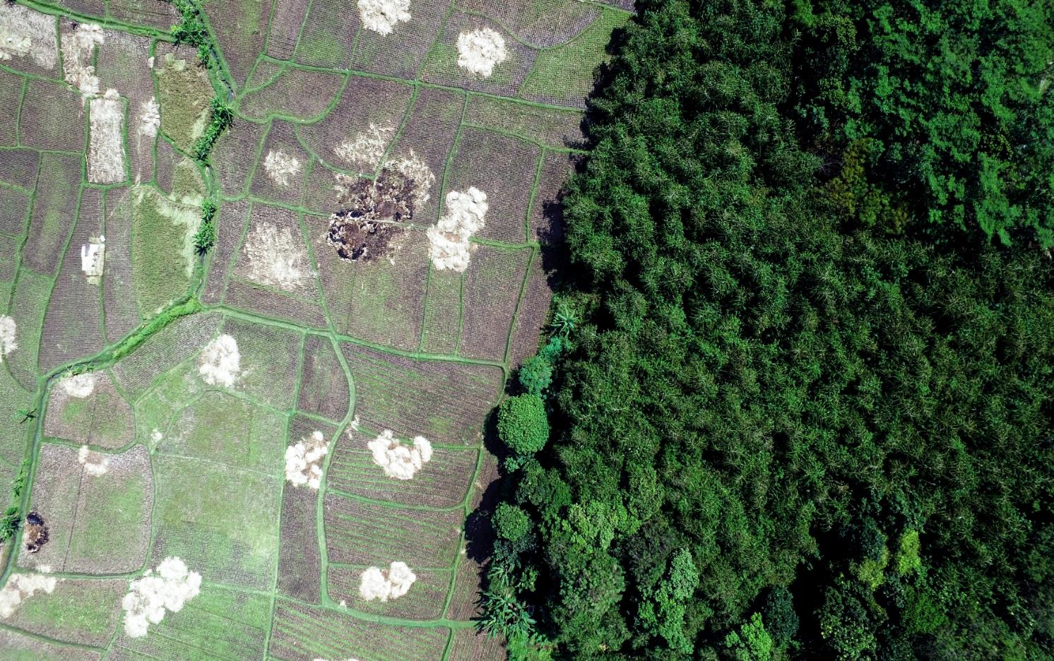
5-year IPP project across 6 countries
Ecometrica collaborating with NCEO, international organisations, forestry agencies and local universities to develop practical, scalable solutions for monitoring forest condition from EO satellites.
IPP projects are based on premise that new innovations / methods must be designed from in-country user requirements; match-funding requirement makes projects collaborative by design from the start.
Training / capacity building sessions for 413 people across all countries:
  SAR workshops and ‘train-the-trainers’, replicated by partners in home institutions;
  Field training on new methods developed for ground data collection (plot size) for calibrating biomass change maps;
  Co-development for modelling potential biomass in different climate / management scenarios for restoration potential;
  One-on-one support with specialists in Colombia (AWS and Datacube scripting); Colombia, Mexico, Indonesia (Python programing).
  Sentinel-2 / PYEO, & machine learning workshops planned for April.
Notes:
Aims to help protect and restore up to 300 million hectares of tropical forests by improving forest monitoring in six partner countries (Indonesia, Brazil, Colombia, Mexico, Ghana and Kenya) through advanced uses of satellite data.
IPP is a five-year, £152 million programme designed to partner UK space expertise with overseas governments and organisations. It is funded from the Department for Business, Energy and Industrial Strategy’s (BEIS) Global Challenges Research Fund (GCRF). GCRF is a £1.5 billion fund which forms part of the UK Government’s Official Development Assistance (ODA) commitment
Project managed by Ecometrica, Forests 2020 brings together some of the UK’s leading experts on forest monitoring at the Universities of Edinburgh and Leicester, and Carbomap.
In each country we are working with national institutions, researchers and NGOs to improve forest monitoring at local, regional and national levels.

Slide 6
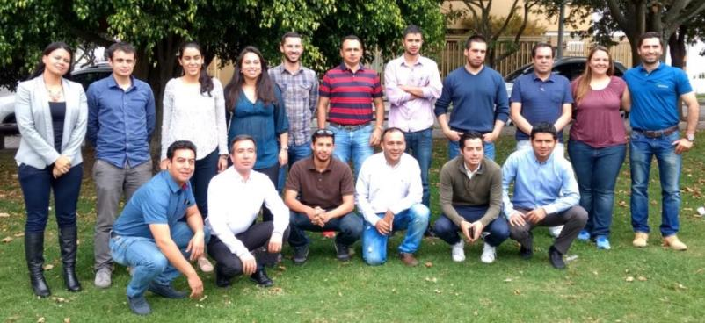
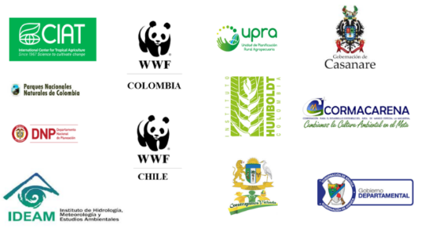
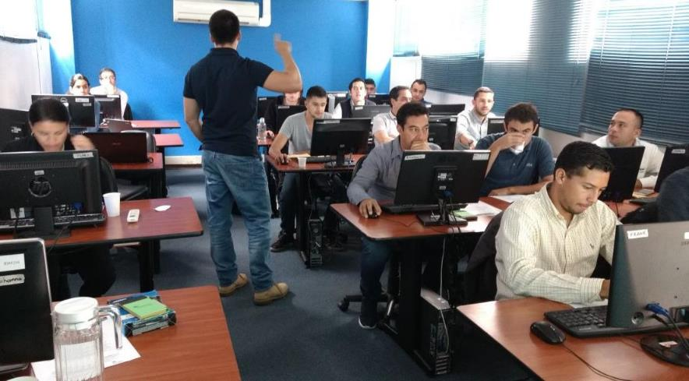
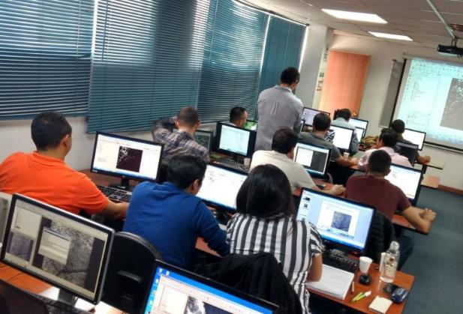
DLR Training in cooperation with WWF, Colombia 14.-18.8.2017 (SULU Project)
- methods for climate smart land use planning, DLR contributes EO Atlas of study region, capacity building activities in Colombia and Paraguay.
Notes:
SULU
2017-2019
The project SULU (Land Use Change in Savannahs and Grasslands. Approaches by Policy Engagement, Land Use Management and Zoning and Best Management Practices) is a three-year project (2017-2019) led by the World Wildlife Fund (WWF) Paraguay in the framework of the International Climate Initiative (IKI) of the Federal Ministry for the Environment, Nature Conservation, Building and Nuclear Safety (BMUB) of Germany. Within SULU methods are developed and improved to achieve a "climate-smart" land use planning that takes into account not only biodiversity and carbon content, but also hydrological dynamics and greenhouse gas conservation potentials. The methods are developed at the local, national and international level through intensive cooperation with stakeholders from politics, business, research and civil society and are supported by "capacity building" for a more sustainable land use planning.
DLR’s contribution to PARLU are earth observation based analyses of land use change, and grassland intensity of the Paraguayan Chaco grassland and savanna systems, the compilation of an Earth Observation Atlas of the study region and capacity building activities in Colombia and Paraguay.

Slide 7

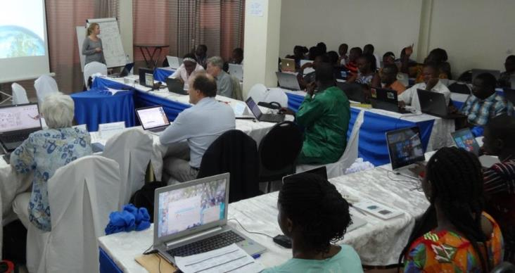
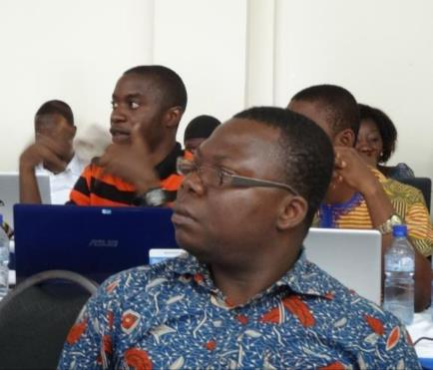
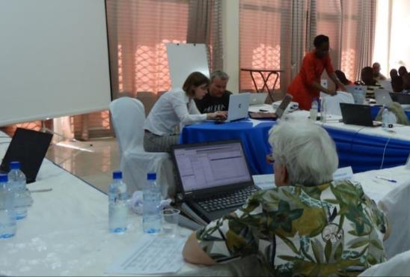
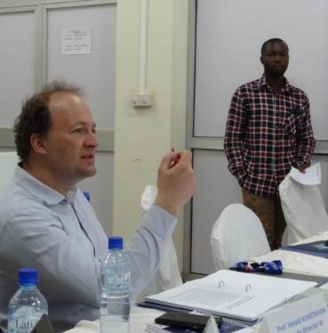
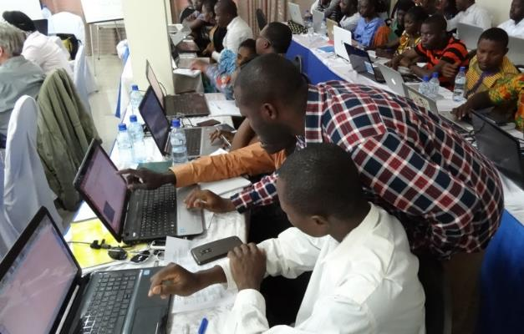
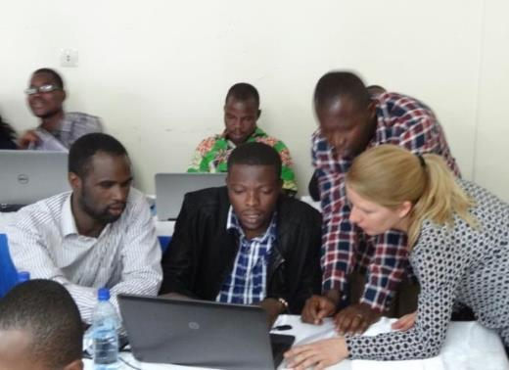
WASCAL Workshop and Training in Ouagadougou, March 2017
funded by
Notes:
WASCAL Trainings
co-design and joint implementation of DLR and African partners
For West African PhD students and scientists in the field of Climate Change and Land Use Adapataion
WASCAL project:
With climate change being one of the most severe challenges to Africa in the 21st century, West Africa is facing an urgent need to develop effective adaptation and mitigation measures.
WASCAL (West African Science Service Centre on Climate Change and Adapted Land Use) is a large-scale research-focused Climate Service Centre designed to help tackle this challenge and thereby enhance the resilience of human and environmental systems to climate change and increased variability. It does so by strengthening the research infrastructure and capacity in West Africa related to climate change and by pooling the expertise of ten West African countries and Germany.
Funded by the German Federal Ministry of Education and Research (BMBF), WASCAL is implemented in a collaborative effort by West African and German partners.
The Competence Centre, a newly established institute in West Africa, carries out research and provides science-based advice to policymakers and stakeholders on climate change impacts, mitigation, and adaptation measures. The Core Research Programme complements the scientific activities of the Competence Center, and is implemented by a network of German and West African research institutes. The Graduate Studies Programme, involving the creation of ten graduate schools in West Africa, contributes to the education of the next generation of African scientists and policy makers in the field of climate change and land management.

Slide 8
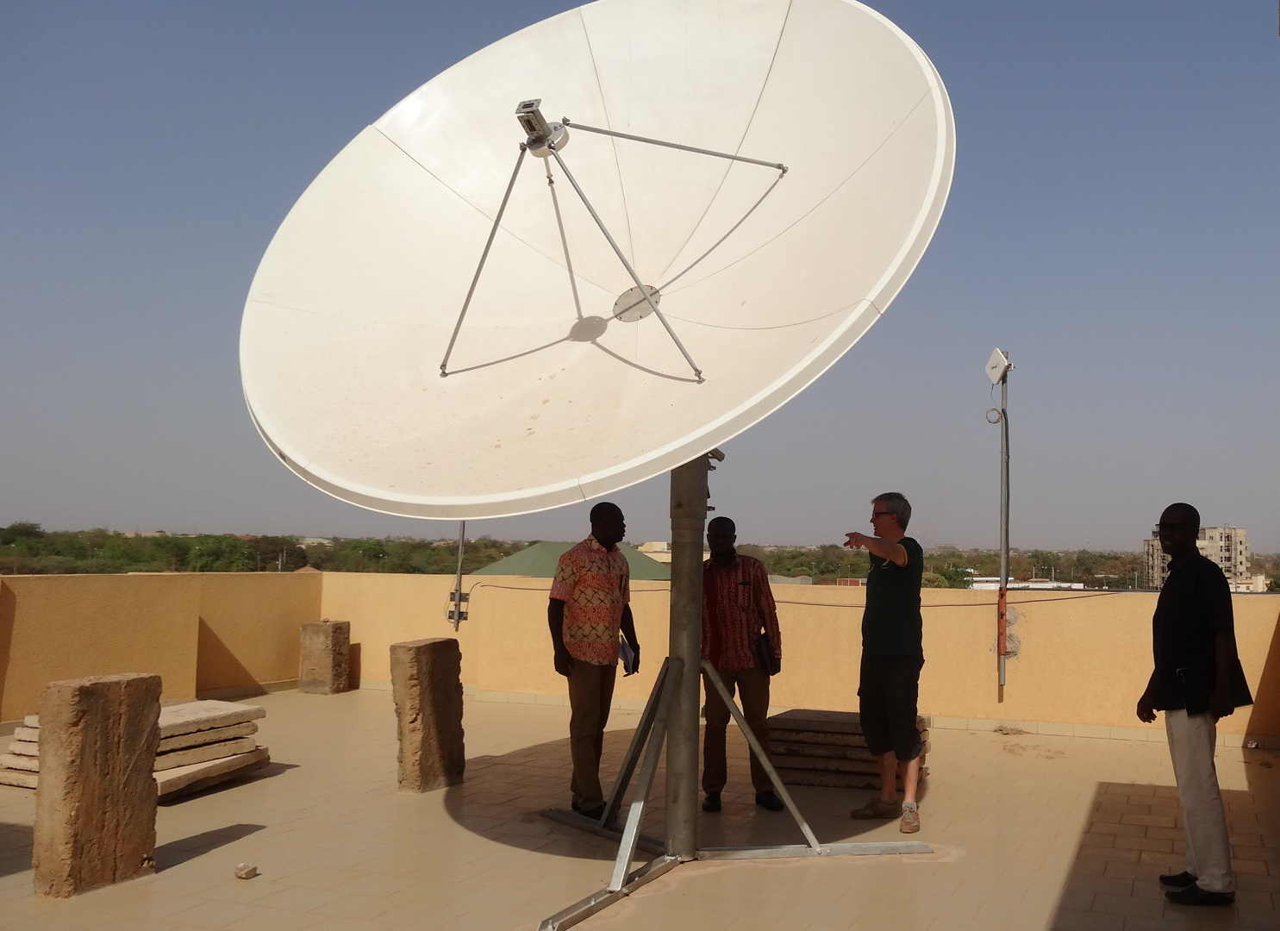
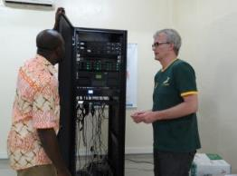
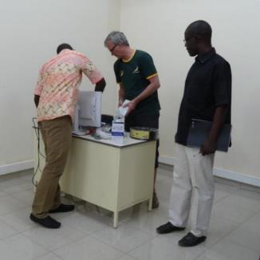
WASCAL EUMETCAST- Antenna, March 2017
Notes:
Establishment of a Eumetcast Antenna at the rooftop of the WASCAL Competence Cenetr building in Ouagadougou, Burkina Faso and introduction into it‘s use.

Slide 9
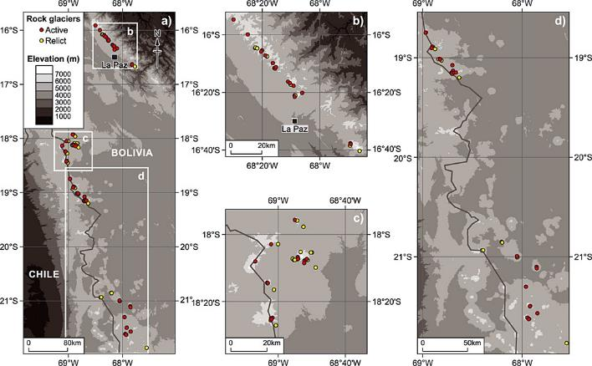
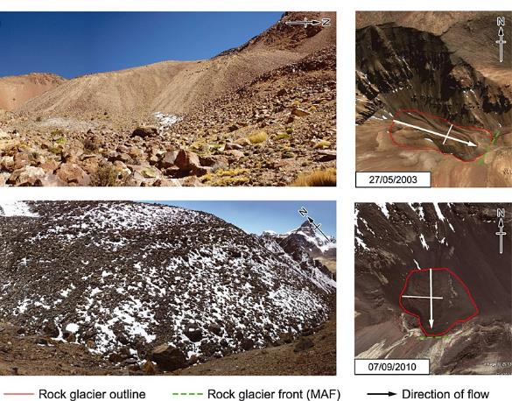
Water supplies in Bolivian Andes: mapping rock glaciers with GEE
University of Exeter researchers working with Bolivian NGO, Agua Sustentable, based in La Paz.
Delivered the first inventory of rock glaciers in Bolivia
Critical for understanding the role of rock glaciers in the hydrological cycle.
Data also used by Oxfam.
Rangecroft, S., Harrison, S., Anderson, K., Magrath, J., Castel, A.P. and Pacheco, P., 2014. A first rock glacier inventory for the Bolivian Andes. Permafrost and Periglacial Processes, 25(4), pp.333-343.
Rangecroft, S., Harrison, S. and Anderson, K., 2015. Rock glaciers as water stores in the Bolivian Andes: an assessment of their hydrological importance. Arctic, antarctic, and alpine research, 47(1), pp.89-98.
Used open source remote sensing data (Google Earth) to map the location, size, height of features and estimate water storage.

Slide 10
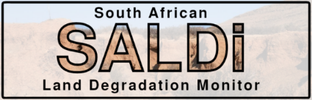





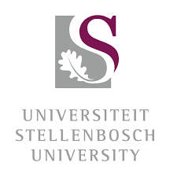



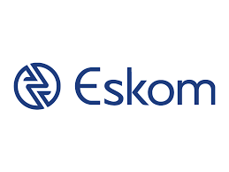

Capacity Building & Scientific Exchange
Annual joint meetings of German and South African partners in South Africa and Europe
Collaborative (field) work in South Africa
Short time scientific missions of South African partner scientists to Germany
Joint summer school activities
Four Trainings of DLR in South Africa on big data processing and satellite earth observation of vegetation characterisics
2019 - 2022
funded by
Notes:
The aim of the South African Land Degradation Monitor (SALDi) is to set up an automated observation system that can accurately identify and monitor land loss through, among other things, soil erosion in South Africa.
SALDI is funded within the BMBF program "SPACES - Science Partnerships for the Assessment of Complex Earth System Processes" aims at the realization of scientific cooperation projects in the region "Southern Africa”. In addition, SPACES should significantly promote the scientific networking of southern Africa with German research institutions. In addition, the promotion of young talent is an integral part of SPACES. In addition to workshops and summer schools, a training and further education component is an integral part of the program

Slide 11
5-year IPP project across 6 countries
Ecometrica collaborating with NCEO, international organisations, forestry agencies and local universities to develop practical, scalable solutions for monitoring forest condition from EO satellites.
IPP projects are based on premise that new innovations / methods must be designed from in-country user requirements; match-funding requirement makes projects collaborative by design from the start.
Training / capacity building sessions for 413 people across all countries:
  SAR workshops and ‘train-the-trainers’, replicated by partners in home institutions;
  Field training on new methods developed for ground data collection (plot size) for calibrating biomass change maps;
  Co-development for modelling potential biomass in different climate / management scenarios for restoration potential;
  One-on-one support with specialists in Colombia (AWS and Datacube scripting); Colombia, Mexico, Indonesia (Python programing).
  Sentinel-2 / PYEO, & machine learning workshops planned for April.
Notes:
Aims to help protect and restore up to 300 million hectares of tropical forests by improving forest monitoring in six partner countries (Indonesia, Brazil, Colombia, Mexico, Ghana and Kenya) through advanced uses of satellite data.
IPP is a five-year, £152 million programme designed to partner UK space expertise with overseas governments and organisations. It is funded from the Department for Business, Energy and Industrial Strategy’s (BEIS) Global Challenges Research Fund (GCRF). GCRF is a £1.5 billion fund which forms part of the UK Government’s Official Development Assistance (ODA) commitment
Project managed by Ecometrica, Forests 2020 brings together some of the UK’s leading experts on forest monitoring at the Universities of Edinburgh and Leicester, and Carbomap.
In each country we are working with national institutions, researchers and NGOs to improve forest monitoring at local, regional and national levels.

Slide 12
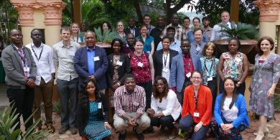
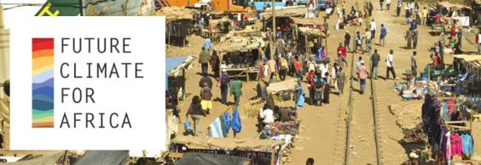
HyCRISTAL – Future Climate for Africa Project – NERC
Driven by East African priorities, HyCRISTAL aims to develop a new understanding of East African climate variability and change, their impacts, and to work with regional decision makers to support effective long-term (5 to 40 year) decision making.
Urban and rural climate mitigation pilot studies in urban WASH, rural livelihoods, water management, tea production, transport and lake levels.
Capacity activities recently: supporting new networks of hydromet stations in urban centres in E Africa to aid modelling of urban flooding, training in data management for publishing open data used to validate satellite data.
Notes:
Availability of water is fundamental for development in the East African region. However, this vital resource is already under stress from land degradation, pollution, and overfishing. Climate change adds to these problems, greatly increasing the vulnerability of the poorest people in the region. HyCRISTAL is developing a new understanding of climate change and its impacts in the region, working with decision-makers to manage water for a more climate-resilient future.
HyCRISTAL focuses on East Africa; a rapidly developing region where, close to the equator, there are two rainy seasons per year, but includes areas which have a single dominant rainy season. The socio-economic focus region is the area of the East African Community states (Burundi, Kenya, Rwanda, Tanzania and Uganda), but the project addresses a wider region including Somalia and Ethiopia. HyCRISTAL is supported by the East African Community and is linked to the World Meterological Office GWEX programme project HyVic.
Driven by East African priorities, the overarching goal of HyCRISTAL is to develop a new understanding of East African climate variability and change, their impacts, and to work with regional decision makers to support effective long-term (5 to 40 year) decision making in the face of a changing climate. In particular, it is designed to understand, quantify and reduce the uncertainty in the regional climate projections; and in collaboration with a range of stakeholders, co-develop climate-change coping options that meet the region’s societal needs in both urban and rural areas through a series of pilot demonstration projects, covering urban WASH, rural livelihoods, water management, tea production, transport and lake levels (see “Pilot Studies’). HyCRISTAL’s overarching goal will be achieved through the following specific objectives:
Quantify the projections of decision-relevant quantities from state-of-the-art climate models, and their uncertainties due to model formulation and due to unknown aerosol-emission and land-use scenarios
Determine the processes most relevant to 5-40 year East African predictions, including the effects of convection-dynamics coupling missing in all Coupled Model Intercomparison Project (CMIP) models, and evaluate their role in models, to quantify the trustworthiness of their projections
Generate cross-level interactions to foster engagement of key stakeholders/decision-makers throughout the research process, to enable appropriate use of water, sanitation and livelihoods planning tools
Improve critical knowledge of water availability as well as current and future risks from high-impact hydrological events based on the new understanding of future climate.
Translate scientific understanding into appropriate water management and livelihood planning tools to enable decision-makers to assess the risk to infrastructure and livelihoods from climate change and to support the development of adaptation strategies.
Evaluate new tools and integrated governance mechanisms in pilots, developing livelihood benefits within targeted urban and rural communities.
Deliver a comprehensive dissemination and knowledge-sharing campaign to share evidence and tools with local decision-makers through to national and regional policy-makers.
University of Leeds (UK)
African Centre for Technology Studies (pan-Africa)
British Geological Survey (UK)
CEH: Centre for Ecology and Hydrology (UK)
Evidence for Development (UK)
Jomo Kenyatta University (Kenya)
Loughborough University (UK)
Met Office (UK)
National Centre for Atmospheric Science (UK)
North Carolina State University (USA)
Practical Action (UK)
Stony Brook University (USA)
Tanzanian Meteorological Agency (Tanzania)
Ugandan National Meteorological Authority (Uganda)
Ugandan Ministry of Water Resources (Uganda)
University of Connecticut (USA)
Makerere University (Uganda)
Maseno University (Kenya)
Walker Institute at the University of Reading (UK)
Africa Climate Exchange at the University of Reading (UK)

Slide 13
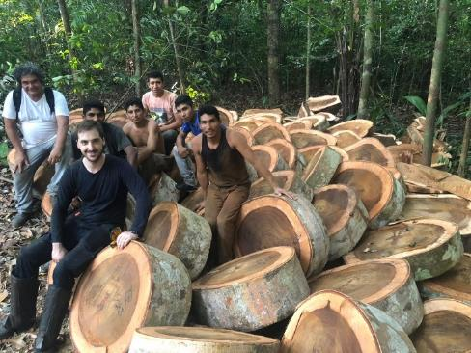
Biomass LiDAR training, Brazil
Project with UCL and Brazilian partners (Museo Goeldi and others) aims to improve tropical biomass estimates.
Expedition to destructively harvest and weigh 4 large tropical trees Caxuianã, Brazil (10/2018).
Measured with terrestrial lidar & compared to EO-based estimates, local partners trained in LiDAR for tree biomass and structure.
Amazingly, it is possible to clearly identify where 3 of the trees were taken down in this series of Sentinel 1 data over 1 month either side of harvesting.

Slide 14







Co-Development as a key part of SERVIR’s Capacity Building Strategy
Nancy Searby, Ph.D.
Capacity Building Program Manager
NASA Applied Sciences Program

Slide 15
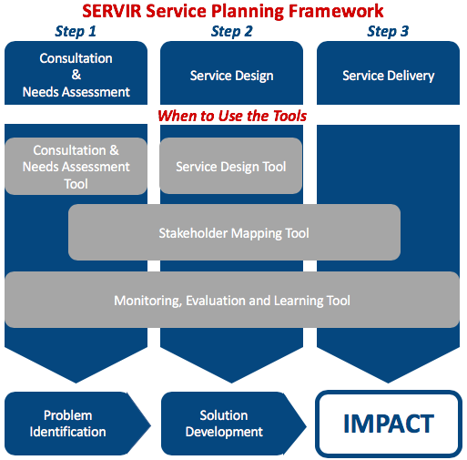
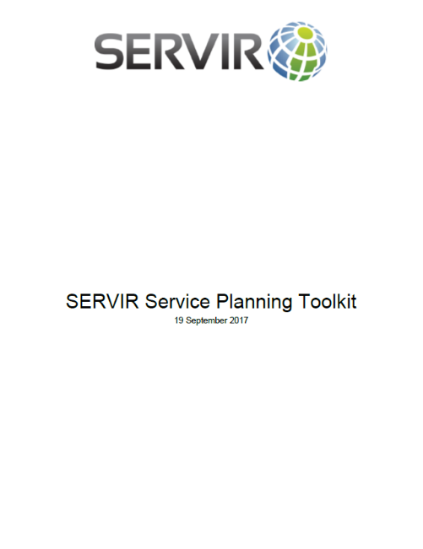
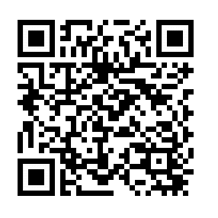
SERVIR Service Planning Framework and Toolkit
The Service Planning Framework concept was introduced into SERVIR in 2016 and underwent a process of refinement, resulting in the development of the Toolkit and integration into service development beginning in late 2017.
bit.ly/2IzkNsL
Notes:
Co-development is a key concept for SERVIR’s Service Planning Framework, which is expressed in the Service Planning Toolkit which was published on www.servirglobal.net in September 2017.

Slide 16
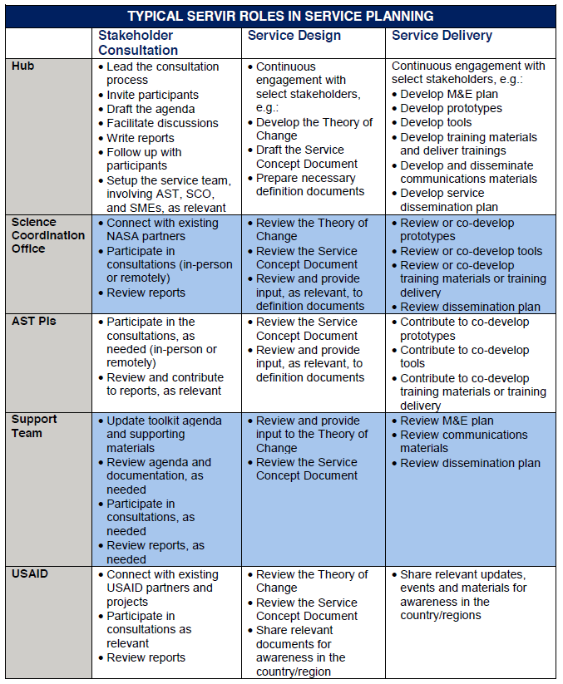
What is co-development and when does it occur?
Co-development:
A means of developing capacity
Alternative to traditional training approach
Part of delivering a service
Longer, iterative process
Multiple ‘sides’ instead of trainer / trainee
Multiple SERVIR services have culminated in ‘code sprints’ where various groups get together to develop a service
Notes:
The key take away is that co-development is an alternative to the traditional “training” approach to capacity building; it acknowledges that capacity is often not built during a single one week workshop.
Via co-development, those who would traditionally be training ‘trainers’ are also learning from those who would traditionally be training ‘recipients.’

Slide 17




Hub status and services
2017
2017
Services:
Drought monitoring
Frost forecasting
Streamflow and flood forecasting
Land cover mapping
Vulnerability assessment
Services:
Crop area estimation
Drought assessments
Land cover mapping, forest monitoring, and biomass estimation
Fire hotspot monitoring
2017
2017
Services:
Dam inundation mapping
Virtual rain and stream gauge
Regional land cover monitoring
Services:
Forest biomass monitoring
Land degradation monitoring
Locust monitoring
Surface water body mapping
Notes:
There are a number of SERVIR services being implemented by each of the hubs, and these services, by and large, are beneficiaries of the co-development process.

Slide 18
SERVIR-West Africa Code Sprint Advances Critical Environmental Services for the Sahel
SERVIR-West Africa consortium members (CILSS-AGRHYMET; Centre for Remote Sensing and Geographic Information Services; and Center for Ecological Monitoring)* convene for a one-week code sprint by the University of San Francisco, led by Spatial Informatics Group (SIG), to produce code for processing Landsat and MODIS data for 3 regional decision making services : charcoal pit monitoring, ephemeral water body monitoring, and desert locust monitoring.
The code sprint advanced SERVIR-West Africa’s capacity in cloud computing using resources such as Google Earth Engine and was modeled after similar sprints for the Lower Mekong, also led by SERVIR-Mekong consortium member, SIG. In addition to SIG, 5 contributors from SERVIR Science Coordination Office, SERVIR Applied Science Team, and University of California, Berkeley also participated.
The new code developed for these cloud-based services improves decision making and reduces the challenges associated with low bandwidth and high Internet costs in West Africa.
In addition to transferring capacity developed for SERVIR-Mekong to SERVIR-West Africa, SERVIR-West Africa consortium members are also transferring this knowledge to their host institutions.
Participants and instructors attend a collaborative code sprint held at University of San Francisco,
Geospatial Analysis Lab, 19-23 March 2018.
Notes:
As a key example of co-development, in March 2018, we were able to bring representatives of 3 SERVIR-West Africa consortium members to San Francisco to work with representatives of the SERVIR SCO and the Spatial Infomatics Group (SIG), South Dakota State University (a SERVIR AST PI), and UC-Berkeley to work together on co-developing 3 services.

Slide 19
Key traits
Long-term projects
Relationships, often with multiple sides, all partners get benefits
Requires a level of partner expertise and commitment (financial, EO etc.)
Clear problem to solve/mandate for the projects
Iterative changes

