Slide 1
Working Group Disasters: Chairs Perspectives and Capacity Building
David Green
NASA, CEOS WGDisasters Chair
CEOS WGDisasters-13,
Virtual, 09 – 13 March 2020
Committee on Earth Observation Satellites

Slide 2
Overview
Introduction
CEOS and GEO: Shared Strategies, Communities and Work plans
Strategic significance of Capacity Building and Sendai Framework
WGDisasters serving CEOS member agencies
Terms of Reference http://ceos.org/wp-content/uploads/2014/09/WGDisasters_ToR_2019_v5.docx
Members
Implementation(Geography, Milestones, Dependencies)
Pilots: Landslides (optical and SAR), GEO/LEO/SAR Floods (CGMS and CEOS)
GEO for Disaster Risk Management (GEO4DRM), Geohazard Supersites and Natural Labs (GSNL), Data Access for Risk Management (GEO-DARMA)
Geohazards Labs (platform and
Demonstrators: Volcanoes, Seismic Hazards
Recovery Observatory: Haiti, Generic
International Disaster Charter
Under consideration: Geodesy4Sendai (Tsunami); Wildfires

Slide 3
WGDisaster ToR (2019)
Main Objectives
Support efforts of DRM authorities in protecting lives and safeguarding property by means of EO and science-based analyses
Foster increased use of EO in support of DRM
Support implementation of Sendai Framework, and contribute to Priority 1 “Understanding Risk”
Raise awareness of politicians, decision-makers, major stakeholders of benefits of EO in all phases of DRM
In pursuit of these objectives, WGDisasters should:
Contribute to the monitoring of the implementation of this Framework
Support the work of international initiatives such as for instance GEO
Strive to increase the awareness of decision-makers of the critical role of EO
Reinforce the need for enhanced satellite EO programs to address DRM

Slide 4
Cross-Cutting Disaster Science Outcomes Imaging and Analysis
InSAR Interferogram – Science
Ridgecrest Earthquake
July 4, 2019
Displacement Map
Puerto Rico EQ
Jan. 2-14, 2020
Damage Proxy Maps
Puerto Rico EQ
Jan. 6, 2020

Slide 5
GEO-DARMA
Latin America Regional Assessment Results
Enhance of capacity building programs and cooperation on disaster risk management and governance.
Capacity building tied to EO data exploitation is a key component of GD.
Geohazards (seismic and volcanoes monitoring, DEMS, flood and landslide response),
Officials and academics
Asia-Pacific Regional Priority
Technical capacity building
Leverage existing activities – Flood Monitoring
Priorities include geospatial indicators of change and coastal/islands
Africa
Information systems for Decision Making

Slide 6
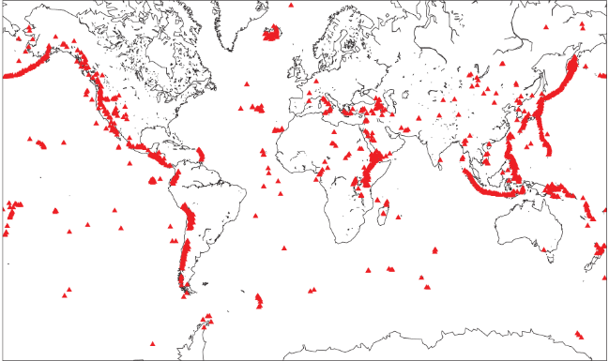
Volcano Pilot
Supporting capacity building initiatives to increase the uptake of satellite imagery in 3 target areas (Americas, Africa, SE Asia)
Multiple independent groups are reaching out to volcano observatories in developing countries to work on capacity building projects
Science engagement to assess hazard, exposure and vulnerability
Contribution to International capacity building workshop (‘Cities on Volcanoes 11’) registrants from Philippines, Indonesia, Chile, Peru, Ecuador, Guatemala, Colombia, Japan, Iceland, Italy, USA, Ethiopia, and Montserrat

Slide 9
Recovery Observatory
Local capacity building in communities and regions at high risk and impacted to analyze and interpret imagery
CB systematically part of international stakeholders activities in a country. •
Existing capacity a requirement for triggering RO, or variety of scenarios and adopt an ad hoc approach ?
Identify local node of expertise; evaluate capacity; make linkages to existing data streams and value adding sources;
Develop ad hoc CB plan; hand-off.
CB critical and requires long-term commitment. RO activity can initialize CB plan and set wheels in motion.
Capacity Building should focus on Recovery monitoring phase rather than early recovery, so is mostly outside scope of RO Demonstrator.

Slide 10
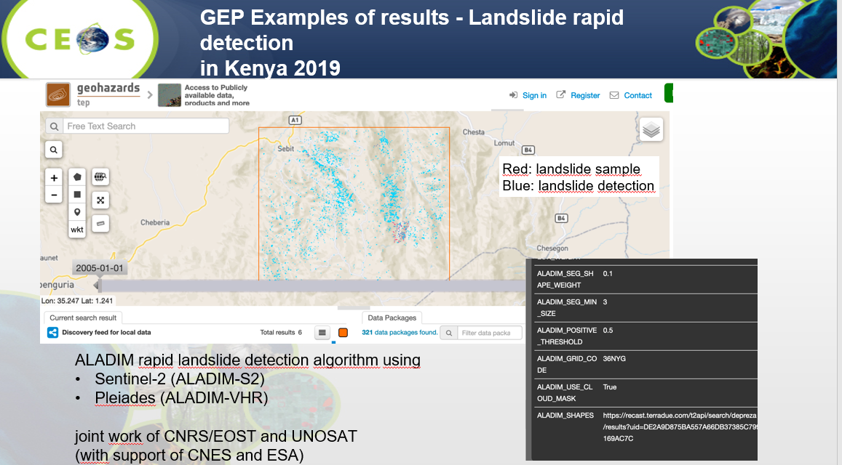
Geohazards Lab Outreach and CB
Demonstrations based on science results and trainings of data processing platforms
GeoHazards Exploitation Platform GEP and related satellite services (TEPs)
Presentations and trainings at international science conferences and other workshops
Materials on CEOS Webpage
Publications and digital libraries
Blogs posts and tweets
MOOCs
Future work on “Network Resources” needs CB

Slide 11
Animate & Communicate Scientific Results

Slide 12
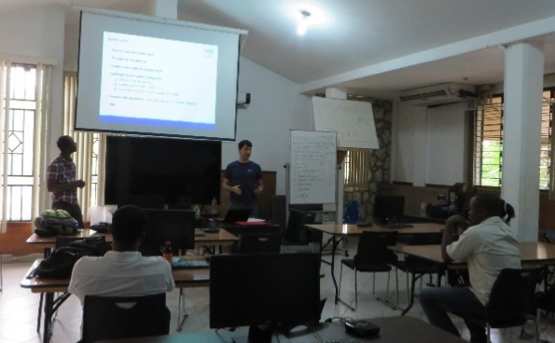
Next Steps
Capacity building Roadmap and strategy papers
Include high level decision makers for policy and governance
Articulate critical linkages and scenarios for further systemic approaches to CB collaboration
Locally-owned EO and products database/catalogues
Propose ideas for future WGD-WGCapD demonstrator(s)
Develop a clear baseline for partner contributions to the future demonstrator(s)
Focus on internships and trainings
Opportunistic meetings and scientific sessions
Specialized CEOS-sponsored workshops and conference sessions
Link with development agencies and civil society organizations

