Slide 1
WGCapD Work in Asia-Oceania
Regional Spotlight: Asia-Oceana
WGCapD
Pham Thi Mai Thy, WGCapD Vice chair
CEOS WGCapD-9 Annual Meeting
Sunnyvale, California
10-12 March 2020

Slide 2
CEOS Working Group on Capacity Building and Data Democracy
Formed in 2011
Pursues a variety of activities based on the four pillars of the Data Democracy Initiative Mission and aims to unify CEOS efforts toward:
Providing wider and easier access to Earth observation data
Increasing the sharing of software tools (open source software & open systems interface)
Increasing data dissemination capabilities and transferring relevant technologies to end users
Providing intensive capacity building, education, and training (including awareness and outreach) to enable end users to gather the information they need and for increasing communication on achieved results
Mission
Increase the capacity of
institutions in less
developed countries for
effective use of Earth
observation data for the
benefit of society and to
achieve sustainable
development.

Slide 3
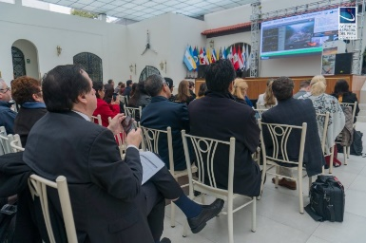
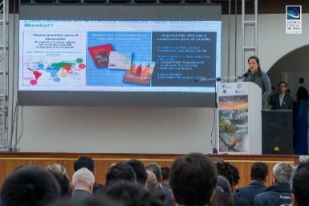
WGCapD activities
Virtual trainings
Organize free E-Learning courses and webinars for participants around the globe
Webinars:
MOOCs:
In-person workshops
Organize free training workshops for participants around the globe
EO Training Workshops
Thematic Training Workshops
Regional Workshops
GEO – AmeriGEO & AfriGEO
Southeast Asia
Awareness Webinars ex. Sustainable Development Goals
Webinar Series ex. Wildfires
SAR trainings
Forest monitoring
Land Cover Land Use Change
Flooding
Echoes in Space: Introduction to Radar Remote Sensing

Slide 4
Resources
CEOS training calendar – https://training.ceos.org/
CEOS WGCapD resources webpage – http://ceos.org/ourwork/workinggroups/wgcapd/resources-2/
Best practices guide for conducting trainings
Training report template
Sample post-training questionnaire
Links for various capacity building portals and web resources
Distribution lists – WGCapD maintains a distribution list that reaches all previous trainees and can be used for sharing appropriate news and opportunities
POCs:
WGCapD Chair
Dr. Nancy Searby (NASA)
nancy.d.searby@nasa.gov
WGCapD Vice Chair
Dr. Pham Thy (VNSC)
ptmthy@vnsc.org.vn

Slide 5
Asia & Oceania
2019 activities
Remote Sensing of Land-Use / Cover change and Climate Impacts in Coastal Zones in Phuket, Thailand (17-19 December, 2019): training addressed issues and showcased the potential of remote sensing and geospatial technologies in coastal monitoring.
Synthetic Aperture Radar Applied in Rice and Forest Monitoring in Hanoi, Vietnam (20-22 February, 2019): training built capacity for Vietnamese remote sensing technical experts in applying SAR data and processing technology support rice monitoring, and forest monitoring.
Future deliverables
Asia GEOGLAM Webinar (Q3 2020) led by ISRO – conducting webinar series on Asia GEOGLAM, SAR Missions, and Disaster Risk Reduction.
In-Person Air Quality Training (Q4 2020) led by NASA & GISTDA – AQ training in Thailand.
In-Person Air Quality Training (Q4 2020) led by VNSC & NASA – AQ training in Vietnam.
Indigenous Peoples-focused Training (Q4 2021) led by NASA & GSA – engage indigenous peoples in a workshop to build their capacity in the use of EO for community needs.

Slide 6
Asia & Oceania
Future deliverables (continued)
In-Person SAR Training (Q3 2020) led by VNSC – SAR training for forest and rice monitoring.
In-Person SAR Training (Q4 2020) led by VNSC – SAR training for subsidence monitoring.
AGEOS Forest Monitoring Capacity Building (Q2 2020) led by CNES – Providing training on use of Sentinel-1 imagery for forest monitoring.
In-Person Regional Training in South Asia (Q4 2020) led by ISRO – one regional training in South Asia on forest biomass monitoring.
AOGEO Contribution (Q4 2020) led by ISRO – coordinate a training in association with AOGEO on a mutually agreed topic (e.g. food security, forest, or land use)
LCLUC Webinar (Q3 2020) led by NASA – provide lectures/training materials relating to Land Use/Cover Change in South/Southeast Asia countries either through Webinars or hands-on training to participants.

