Slide 1
Snapshot of DLR activities in Africa
Regional Spotlight: Africa
Michael Bock, DLR Agency
Ursula Geßner, Sarah Asam. Frank Thonfeld, Andreas Hirner, Igor Klein, Juliane Huth, Claudia Kuenzer,
DLR-DFD (German Remote Sensing Data Center)
CEOS WGCapD-9 Virtual Meeting
10-12 March 2020

Slide 2
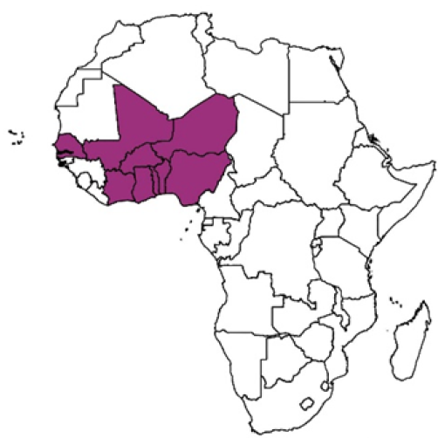
West Africa: WASCAL-DE-Coop
West African Science Service Centre on Climate Change and Adapted Land Use
Main results of WASCAL (2010-2017) were e.g. the establishment of the WASCAL competence center in Ouagadougou (Burkina Faso) and the WASCAL graduate schools (180 PHD, Master )
Objectives of WASCAL-DE-Coop (2019-2021) coordinated DLR EO chair at University Würzburg
Coordination of German Contribution to graduate schools, support of students & networking
Strengthening the technical and methodological skills of young scientists and experts through targeted teaching, training, workshops and excursion offers
Research on human-environment interactions, Agricultural monitoring, etc..
Sustainable provision of the generated data sets through Datacube implementation and HPC access at the WASCAL competence center
Contact: Frank.Thonfeld @ dlr.de

Slide 3
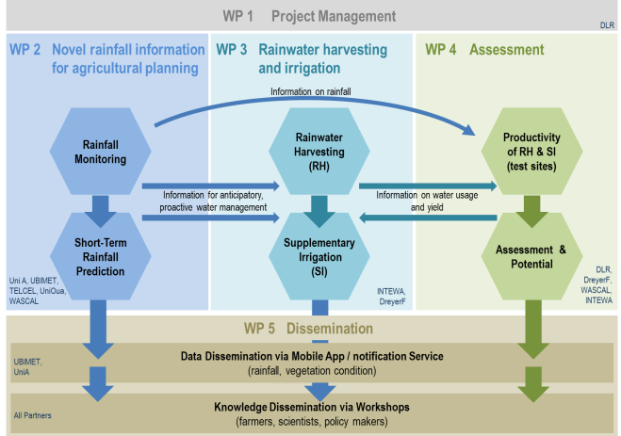
Burkina Faso: AgRain
Project summary: German-Burkina Faso research project AgRain (2019-2022)
Topic: - Improving Rainfall Information and Rainwater Usage for Adapted Agricultural Production under High Climate Variability in Burkina Faso
Partners in Burkina Faso:
West African Science Service Center on Climate Change and Adapted Land Use (WASCAL)
Dreyer Foundation
Université Ouagadougou
Telecel-Faso
ANAM-BF (Agence Nationale de la Météorologie Burkina Faso)
CapD activities planned:
Training on Remote Sensing applications in agriculture
Training on Rainfall prediction
Contact: Igor.Klein @ dlr.de
AgRain Project Concept and Work Packages

Slide 4
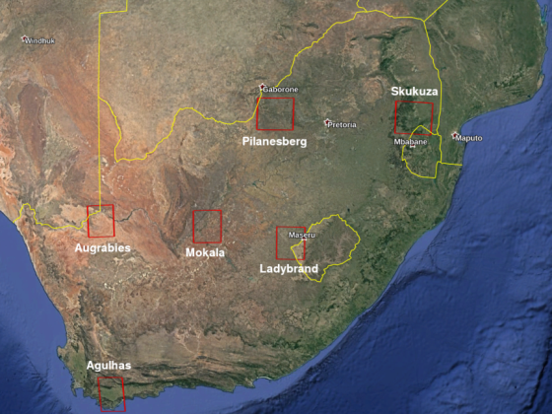
South Africa- SALDi
SALDi South African Land Degradation Monitor (2018 – 2021)
Partners: Universities of Jena, Augsburg, Tübingen; ARC-ISCW, SANParks, US-CGA, SANSA, CSIR, Eskom
Objectives:
Study changes in vegetation and soil conditions
Six study areas to monitor land degradation processes
Capacity Building workshops planned
Outcomes:
Regional framework for identifying and acting on processes causing land degradation
SA company translates research results to communities concerned with the subject
Summer schools will be held over the course of the program
Challenges:
Short term changes regarding commitment in order to cope with unintentional changes
Build on trust and find reliable stakeholders
Contact: Andreas.Hirner @ dlr.de

Slide 5
DLR Agency supported activities
DLR Agency supports the UN-SPIDER’s Bonn Office and the ZFL at the University of Bonn through the project grant “SPEAR” from 2019 – 2024.
Copernicus user uptake in Africa (2020-2022) via technical support in the field of disaster management and disaster risk reduction (mainly capacity building in cooperation with UN-SPIDER, carried out by DLR and ZFL with EC and DLR funding to support technical advisory support provided by UN-SPIDER.
Future cooperative activities envisaged for 2020
Coordination of WgCapD Capacity Building Workshop with UNSPIDER 2020 Regional Network meeting at GEO Plenary in South Africa (Nov 2020)
EO/College SAR Training for Ethiopian Stakeholders in discussion
CoExist (2019-21): Monitoring environmental-related transhumance patterns and assessing the risk for population displacement.
IOM’s activities will be directly supported in this region (Border areas between Chad &Central African Republic) ,approach might be transferred to other countries
Contact: Michael.Bock @ dlr.de / Jens.Danzeglocke @ dlr.de

Slide 6
Success Factors, Lessons Learned
Long Term Sustainability: Consistent long time support to the West African Science Service Centre on Climate Change and Adapted Land Use WASCAL is a key success factor to strengthen the research, teaching, political decision-making ability and competence of the West African countries
Short Term Sustainability: The CEOS WgCapD Summer schools in Zambia , SouthAfrica and Gabon (2015-17) already resulted in important contacts for future cooperation's as:
Project partners (SALDI)
PHD’s through the German Academic Exchange Service (at FSU Jena)
Build up on existing networks: The cooperation with UN-SPIDER eases trusted access to national and regional stakeholders
Collaborations are welcome

