Slide 1

Check if overlap with ESA Edu Office
ESA EO CB and training in Europe
Session 9: Regional highlight EUROPE
ESA
Francesco Sarti, Amalia Castro Gomez
CEOS WGCapD-9 Annual Meeting
Sunnyvale, California
10-12 March 2020

Slide 2
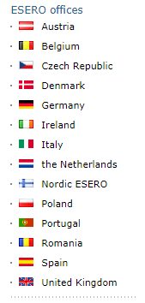


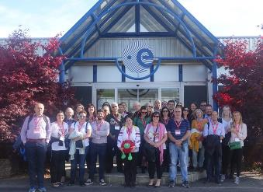
ESA ESERO project (European Space Education Resource Offices in ESA MS) – secondary school level
Target: European students starting from an early age (primary and secondary education)
Goal: using the space context to make the teaching and learning of STEM subjects more attractive
ESERO offers an annual series of national or regional training sessions for both primary and secondary school teachers, offered in collaboration with national partners
Teachers’ workshops; classroom resources; school projects ….

Slide 3


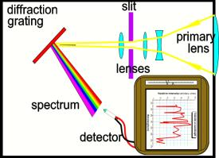
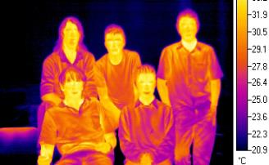
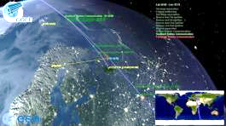
Education in the frame of European cooperation – secondary school level
joint School Lab with ESA, ASI, DLR, UK National Space Academy, INGV, Universities of Milan and Pavia
Living Planet Symposium May 2019, Milan, Italy
  Demonstrating RS to schools using instruments and demos

Slide 4
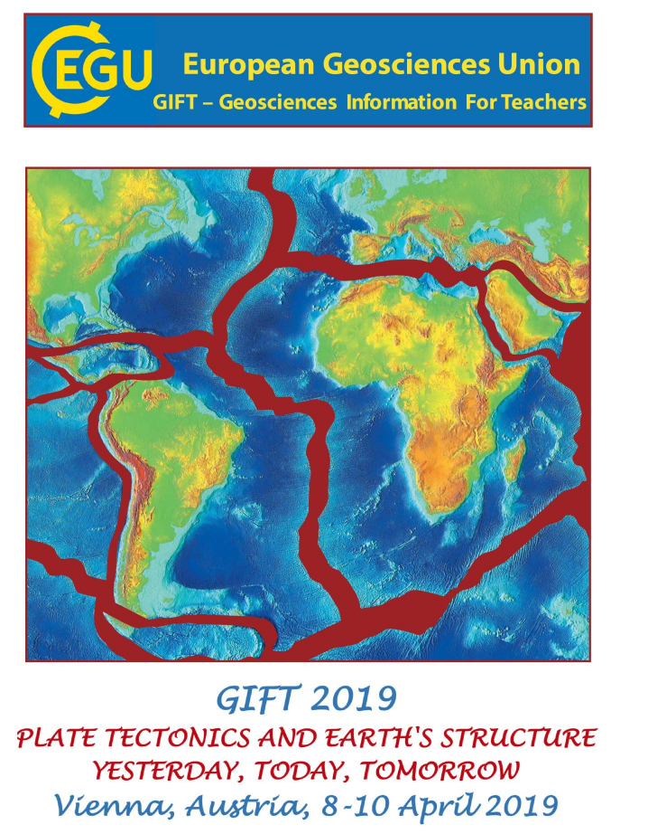

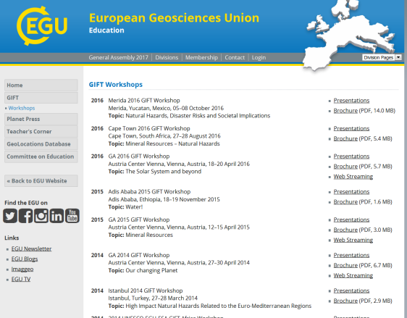
Education in the frame of European Cooperation: EGU/GIFT network (secondary school level )
9-years cooperation with EGU/GIFT (European Geosciences Union GIFT – Geosciences Information for Teachers).
Workshops for Secondary School teachers selected worldwide. Enlarged since 2016 to Africa and South America.

Slide 5
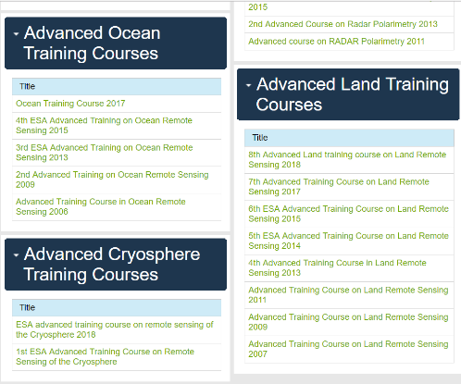
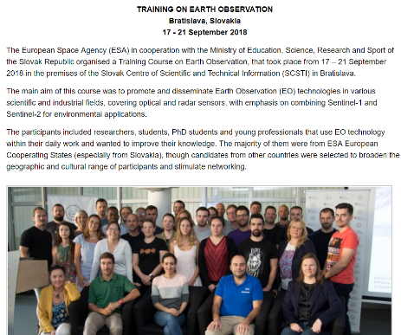
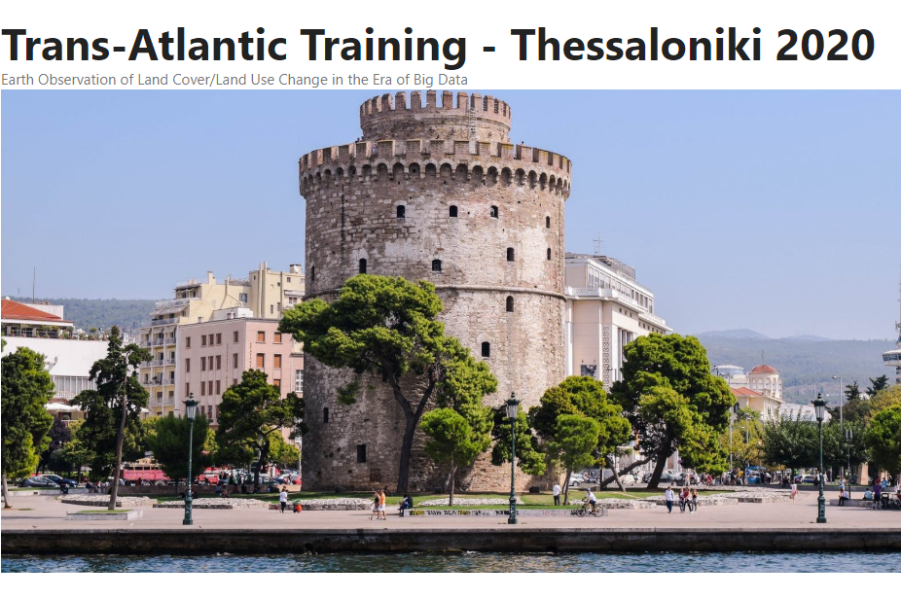
Advanced Training Courses in ESA MS
EO Training courses in Europe (univ and post-univ level)
Training in European Cooperating States
NASA / ESA Trans-Atlantic cooperation in EO Training (TAT courses)

Slide 6

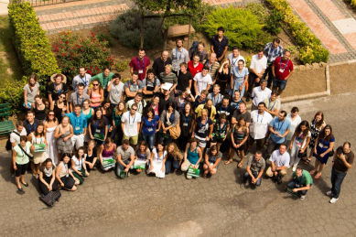

Earth Observation Summer Schools in ESRIN (PhD level)
2020 Summer School ESRIN
50-70 early career scientists
forseen
Usually organized every 2 years, open to students from worldwide, free tuition
Topics :
Global Observing Systems, Earth System Modelling, Data Assimilation, Global Change

Slide 7
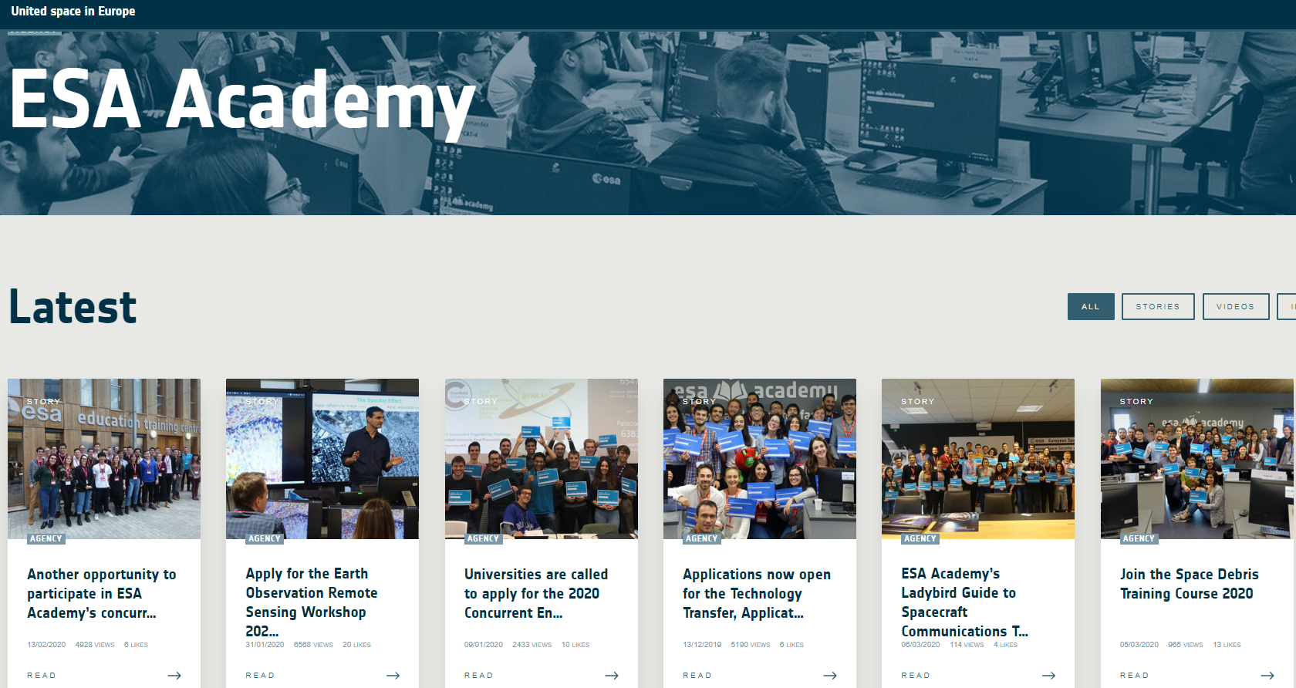
(See dedicated presentation by ESA Education Office)

Slide 8
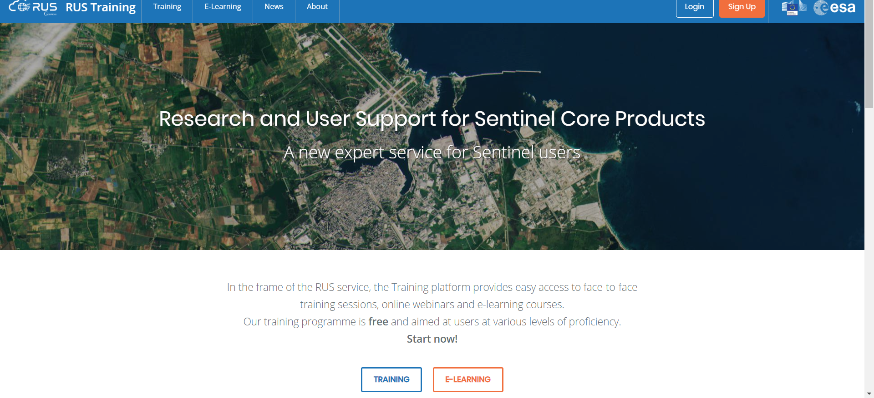
Sentinel Training jointly with the European Commission
Sentinel training with R.U.S. / European Commission (Research and User Support for Sentinel Products / Service operation – with focus on “training the trainers”) - priority: Europe

Slide 9




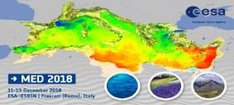

ESA Regional Initiatives
  This element will
  build on the on-going regional consultations and scale up developments initiated under EOEP5 in the Alps, Atlantic, Arctic, Black Sea/Danube and Mediterranean regions
  Embed EO capabilities into on-going and planned regional environmental cooperation and economic development actions
  provide the EO complement to planned H2020 and Horizon Europe regional scientific programmes.
Tender Q4/19
Tender Q4/19
Tender Q4/19

