Slide 1
The ESA Academy Programme
➔ ENHANCING SKILLS, BOOSTING AMBITIONS
Regional Spotlight: Europe
European Space Agency
Joost Vanreusel
CEOS WGCapD-9 Annual Meeting
Sunnyvale, California
10-12 March 2020

Slide 2
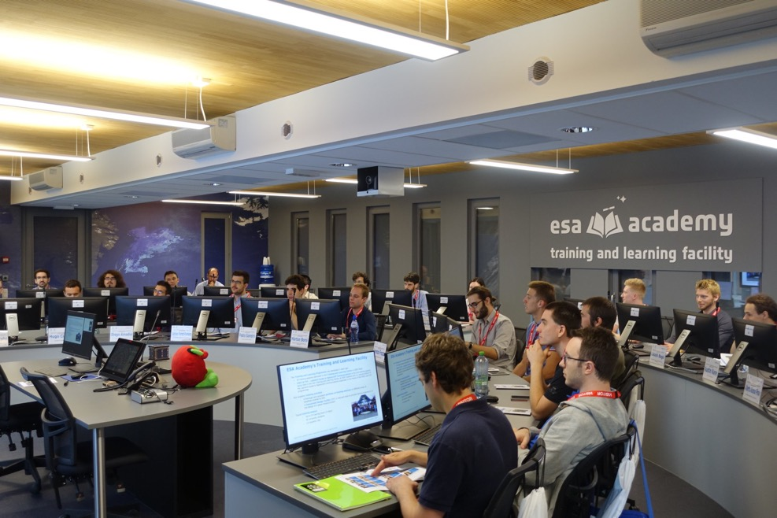
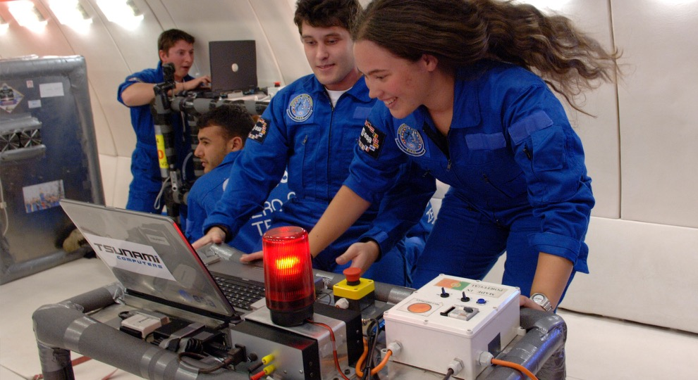
ESA Education
it starts early it never ends
esa academy
STEM
→ ENHANCING SKILLS, BOOSTING AMBITIONS
Notes:
Contributes to the ‘Shared Vision and Goals for the Future of European Space’ calling ESA to act as “an enabler in (among others) stimulating jobs and sustainable growth, providing socio-economic benefits and, inspiring and motivating the next generations”

Slide 3
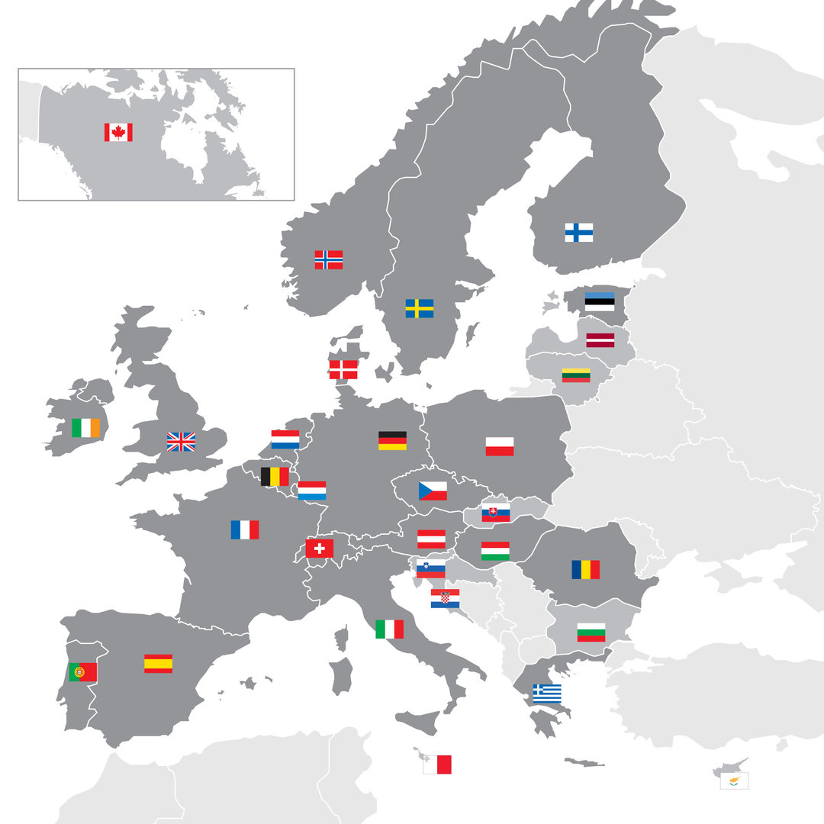
ESA Academy Programme
Opportunities for university students
Eligible for participation are university students from all ESA Member States, Canada and Slovenia.
Objective: offer a transfer of expertise, know-how and standard professional practice in the space activities domain from ESA, Academia or Industry specialists to university students.
In close coordination with European academic institutions and, whenever possible, in partnership with European space industry and other organisations involved in space activities
Training courses: ECTS* credits *Eur. Credit Transfer System for academic qualifications

Slide 4
ESA Academy
Training and Learning Programme
Fly Your Satellite!
ESEO
Fly Your Thesis!
Spin Your Thesis!
Human Edition
Orbit Your Thesis!
REXUS/BEXUS
Satellites
Gravity Related Experiments
Training Sessions
Training Weeks
Spacecraft Operations and Communications
Standardization, Product Assurance Awareness
Mission Design and Analysis
Space Law
Earth Observation
Orbit Your Thesis!
Drop Your Thesis!
Fly Your Satellite!
ESEO
…
Drop Your Thesis!
Experimental Platforms
Fly a Rocket!
Hands-on Programmes
ESA Academy
Spin Your Thesis!
Human Space Physiology
Space Debris
Spin Your Thesis!
Fly Your Thesis!
Conferences & symposia
Educational Facilities
Training and Learning Facility
Concurrent Design Facility
CubeSats Support Facility

Slide 5
Space for Education 2030
“…prepare for jobs
that have not yet been created,
for technologies that have not yet been invented,
to solve problems that have not yet been anticipated”
The future of education and skills, Education 2030, OECD 2018

Slide 6
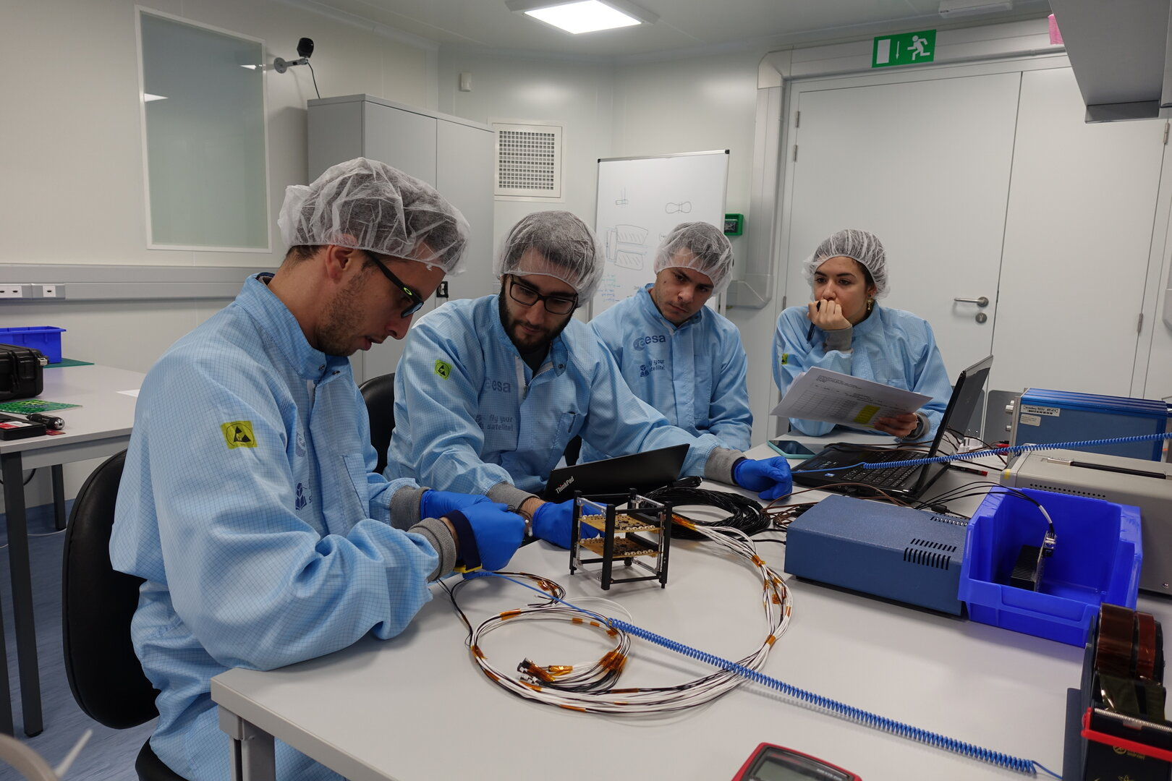
Thank you
www.esa.int/Education/ESA_Academy
Joost.Vanreusel@esa.int

