Slide 1
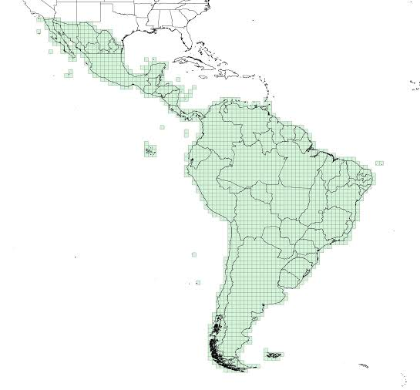
Certificate of Completion
The Committee on Earth Observation Satellites Working Group on Capacity Building & Data Democracy &
the Regional Centre for Space Science and Technology Education for
Latin America and the Caribbean (CRECTEALC)
certify that
Pascal Fetra Rakotomandrindra
successfully completed the
Higher Resolution SRTM Data & Flood Modelling Workshop
including introductory training on the TerraHIDRO & CREST flood modelling tools at
Tonantzintla and Puebla, Mexico
25 – 29 May 2015
_________________________________
Eric Wood, WGCapD Chair
Physical Scientist, United States Geological Survey
_________________________________
Dr. Sergio Camacho Lara, Secretario General, CRECTEALC

