Slide 1
Stake-1 | Link the atmospheric GHG measurement and modelling communities and stakeholders in the national inventory and policy communities (through UNFCCC/SBSTA), to refine requirements. GHG Whitepaper adopts the GCOS (2016) accuracy, resolution and coverage requirements as the baseline requirements for the space-based elements of CO2/CH4 management system. However, these requirements predated the Paris Agreement. Further analysis of these requirements is needed to address this new focus.
Stake-2 | In close cooperation with the WGClimate lead, as the CEOS PoC to UNFCCC, SBSTA, and COP, the Task Team shall support outreach activities during COP and Earth Information Days (EID), increasing awareness and establishing contacts with the national GHG inventory communities. To actively engage its user communities and bridge the gap between satellite products and national statistical GHG inventories, the Task Team will interact with the national inventory community and the modelling communities by: • Seeking an annually exchange with the inventory and modelling communities; • Supporting feedback utilization from user community on product development. A first meeting is envisaged in Q4 / 2019 aside the annual GEIA meeting; • Planning a workshop with modelling community ideally in combination with WMO IG3IS/TRANSCOM (Q2 / 2021), detailed planning for further regular workshops/meetings.
Stake-3 | Coordinate efforts with IMEO to meet expected product requirements
Stake-4 | Coordinate efforts with WMO on G3W to meet expected product requirements
Stake-5 | Seek engagement with other than national level stakeholders, e.g. Covenant of Mayors, landfill owners (possibly IMEO), industry

Slide 2
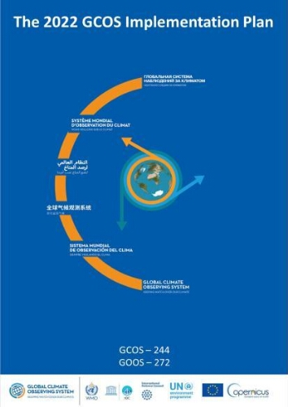
GCOS 244 (2022) Action F5
The overall aim here is to develop an integrated operational global greenhouse gas monitoring infrastructure. The first steps are:
Design and start to implement a comprehensive global set of surface-based observations of CO2, CH4 and N2O concentrations routinely exchanged in near real time suitable for monitoring GHG fluxes.
Design a constellation of operational satellites to provide near-real time global coverage of CO2 and CH4 column observations (and profiles to the extent possible).
Identify a set of global modelling centres that could assimilate surface and satellite-based observations to generate flux estimates.
Improve and coordinate measurements of relevant ECVs at anthropogenic emissions hotspots (large cities, powerplants) to support emission monitoring and the validation of tropospheric measurements by satellites.

Slide 3
Means of assessing progress
Expanded observations of GHGs, ozone and aerosol precursors, aerosols and aerosol profiles near hotspots.
Designs and plans for in situ and satellite observations.
Identification of global monitoring centres that run global Chemistry Transport Models.
Improved satellite retrievals in the presence of varying aerosol loadings in urban and hotspot conditions. Improved uncertainty quantification of GHG retrievals in the presence of aerosols;
Number of emission detection studies using in situ and satellite data near hot spots.

Slide 4
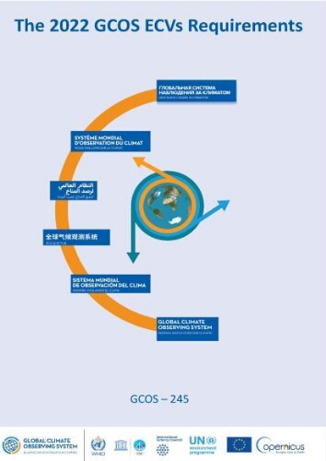
GCOS 245 (2022) Requirements
10.1.5 ECV Product: Total Estimated Fluxes by Coupled Data Assimilation/ Models with Observed Atmospheric Composition – National
10.1.6 ECV Product: Total Estimated Fluxes by Coupled Data Assimilation/ Models with Observed Atmospheric Composition – Continental
10.1.8 ECV Product: High-Resolution Footprint Around Point Sources

Slide 5
https://database.eohandbook.com/ghg/

Slide 6
John’s comments
Stake 1: Known systems that are either in development or becoming operational: COCO2 (Richard Engelen), NASA Earth Information System (Lesley Ott / Kevin Bowman), MARS (MethaneSat).
Stake 2: We should specify modelling / inventory groups we should engage and arrange meetings (e.g. EDGAR, GEIA?)
Stake 3: CEOS representatives have signed up for various IMEO WGs to address their needs
Stake 4: CEOS representatives are part of the Implementation SG to address their needs and coordinate CEOS efforts

