Slide 1
Best Practices for Reporting Satellite Informed Emissions
J Worden (JPL)
Y Meijer (GHG TT)
Agenda Item 2.4
SIT Technical Workshop 2023
18th - 19th October 2023, ESA/ESRIN

Slide 2
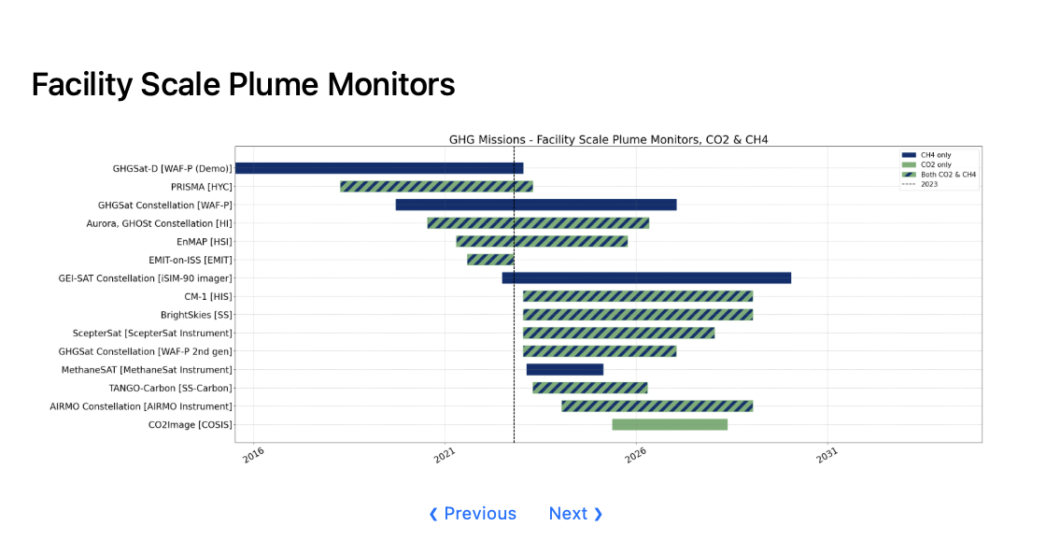
Facility scale emissions from “plume mappers”
10 of these 15 missions are from New Space!
Intellectual Property concerns play a role in transparency of data provenance and processing
(more on this in subsequent slides)
Pre-2023 constellation has measured ~7 Tg/yr of methane relative to ~120 Tg/yr fossil and waste budget --> Unclear how additional measurements increase sampling of methane emissions
Operations: Where are the leaks and can we fix them?(increased methane production, reduces pollution)
Science: What is the role of high emitters (~>100 kg/hr for methane) on the CH₄ and CO₂ budgets ?
Policy: Prioritize which emissions to remediate for climate action (e.g. IMEO is end-user of these data)
Finance: Evaluate a companies stated carbon footprint and its remediation approach (empirical data needed for carbon markets)

Slide 3
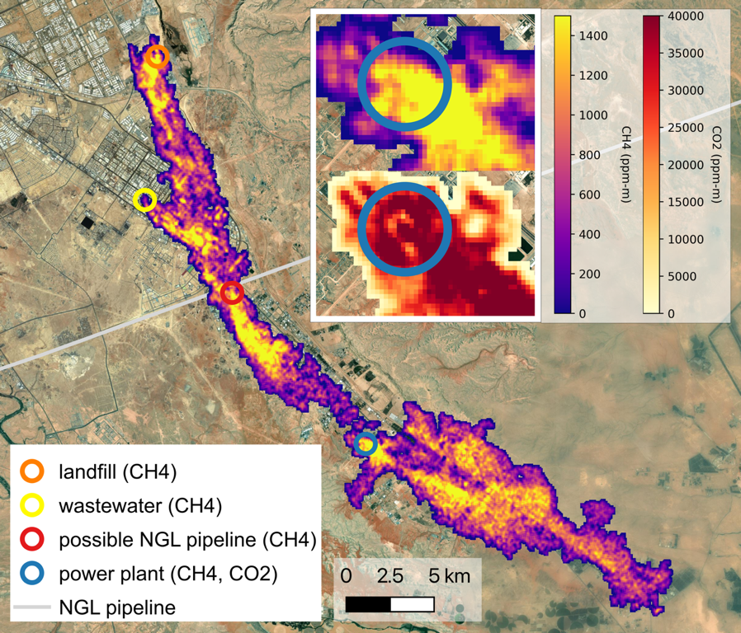
Use Case 2: Facility scale emissions from “plume mappers”
Use of plume-mappers with wide-field mappers such as TROPOMI (“tip and Q”)can prioritize where to observe and remediate emissions
EMIT can resolve CH₄ and CO₂ plumes from multiple sources in Riyadh
(Thorpe et al. Accepted)

Slide 4
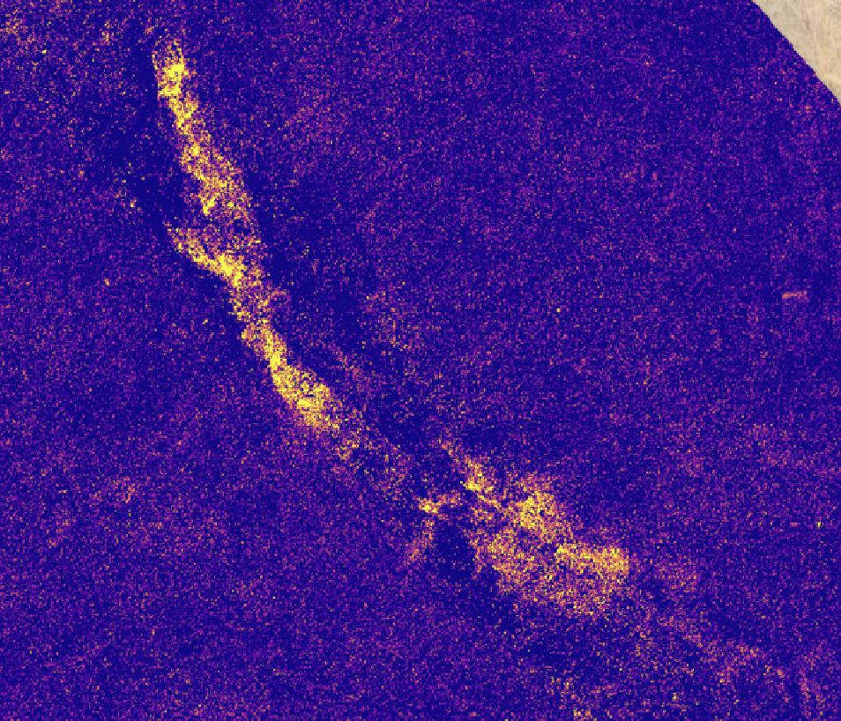
Use Case 2: What are primary uncertainties and how do they affect reporting of emissions
Transport only (chemistry too long lived)
Spectral albedo
”Null Space or smoothing error” this term now appears as a “detection limit”
Human in the middle needed to evaluate location of plume and support processing of plume filling algorithm
EMIT estimated CH₄ concentrations
EMIT estimated CH₄ concentrations after processing
Variations in surface albedo project into estimated methane → this affects how plume is “filled” prior to using algorithm to relate plume shape and concentration to emissions.
A human in the loop for each scene means limited processing of data → Could use ML codes to reduce this burden and increase data rate

Slide 5
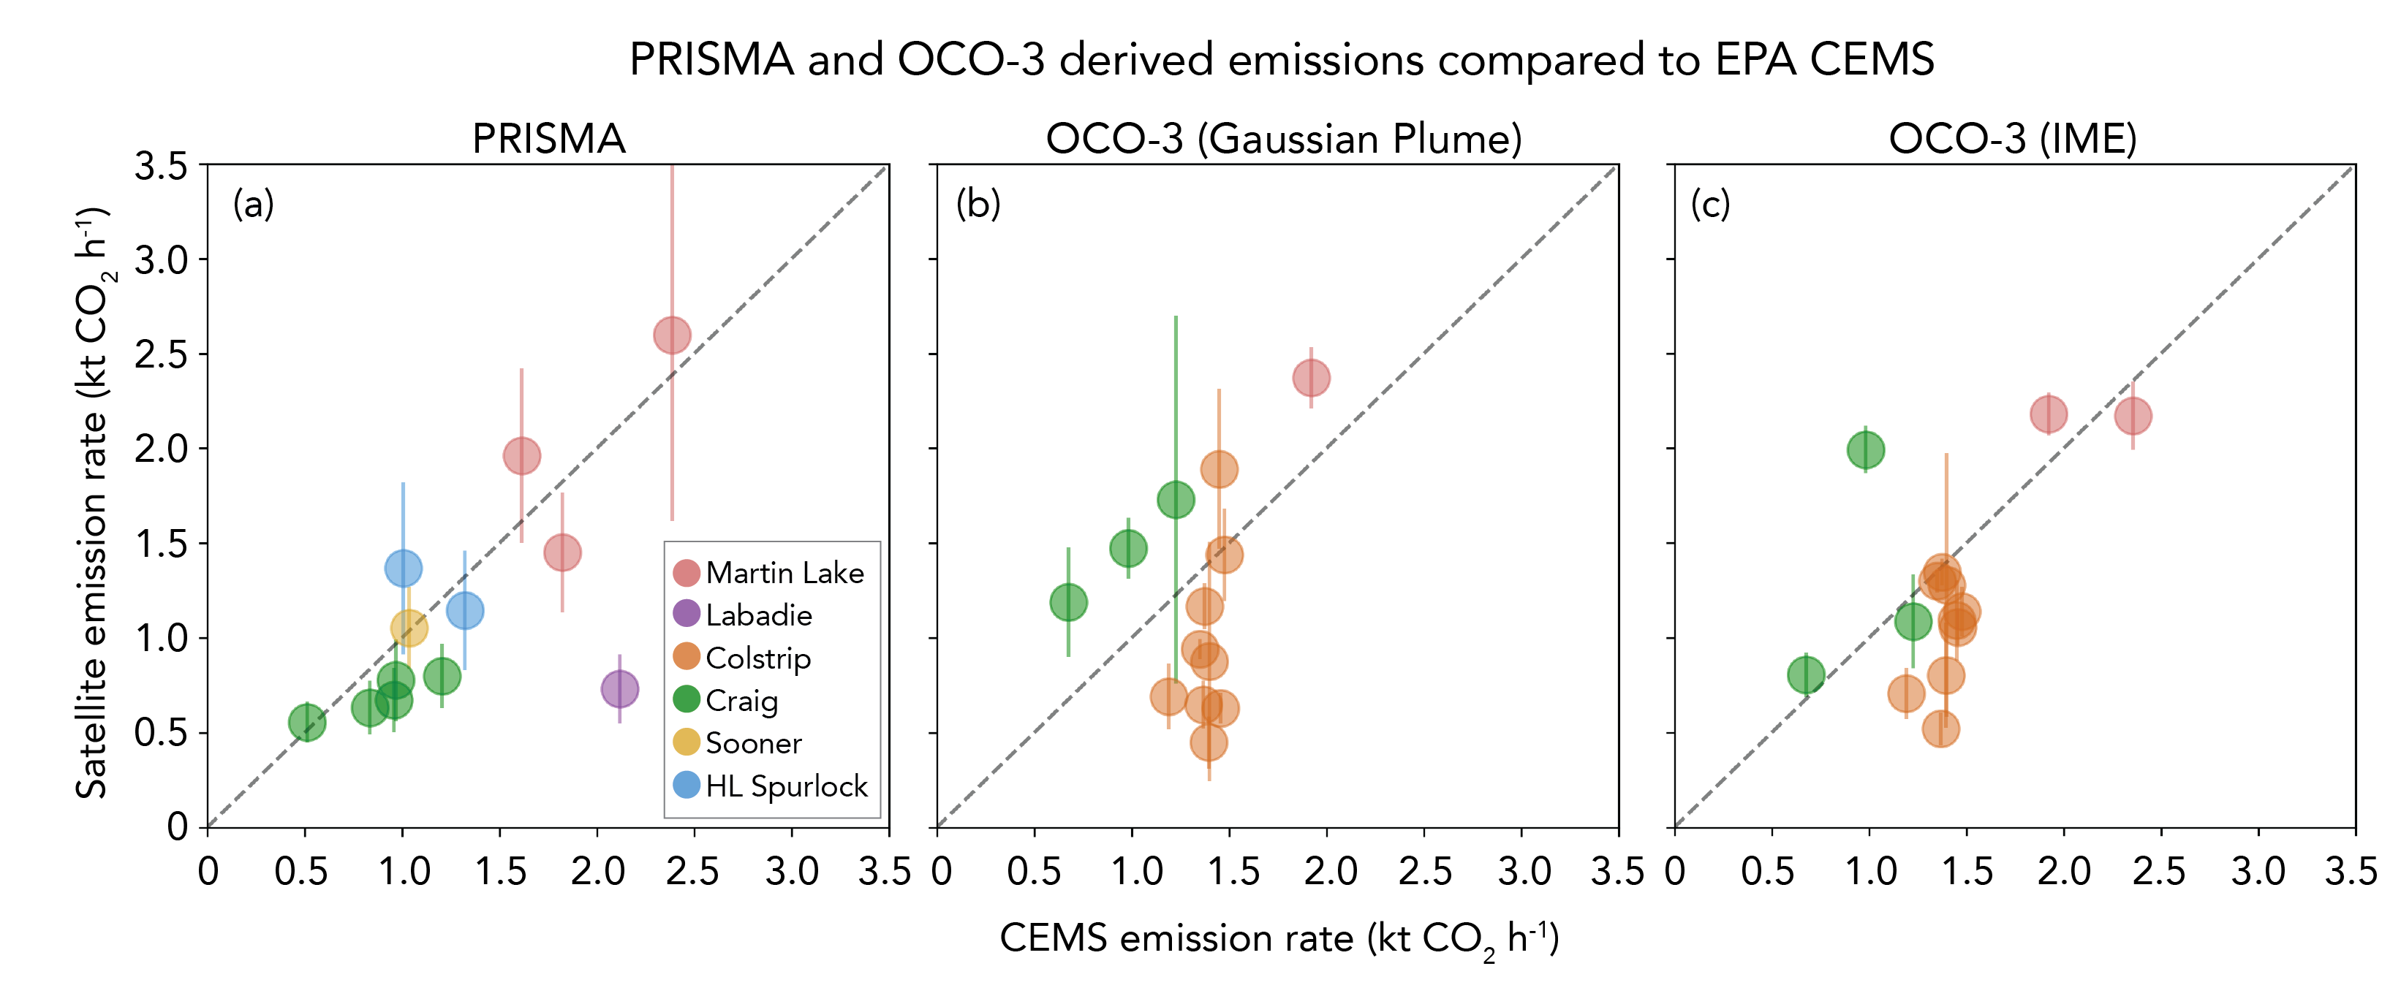
Use Case 2: Validation can be performed for CO2 emissions by comparing against power plants in “Annex 1 countries”
Example of how different instruments as well as knowledge error in wind fields affects reported emissions →
Lots of scatter! But the mean is reasonably well estimated

Slide 6
Use Case 2: Validation of CH4 emissions can be performed using “controlled release” experiments
Figure courtesy of GHGSat

Slide 7
Use Case 2: Other factors affecting how plume mapping based emissions are reported from New Space
Intellectual property concerns mean that provenance of data in different levels of data products (L1 radiances, L2 concentration enhancements, and L4 emissions) are not necessarily traceable
Need to develop evaluation metrics for how well these products are reported and evaluated (in process with ESA / NASA evaluation team)
Public missions (e.g. EMIT, CO2Image) can be used as benchmarks for data products and transparency
May need to move away from “no false positive” for public missions and instead provide gradation of data quality flags
New Space companies can with-hold data if a customer buys it out
New Space companies can be bought

Slide 8
Feedback Welcome!
Meeting recommendations
and possible future directions
(Given issues with intellectual property, person in the middle processing of data, and “no false positive” goal) CEOS should support transparency of New Space data, if they are to be used for science, policy, and financial markets by developing evaluation metrics for reported concentrations and emissions.
Evaluation of how well the product is reported and description of each products provenance (implementing ATBD’s, traceability from L4 through L1, evaluation of reported product against actual) can be baselined against (operational) products from public missions (e.g. EMIT, and upcoming CO2Image and TANGO). Note that ongoing work with IMEO and a joint ESA/NASA working groups are supporting these efforts.
Support development of machine learning codes to reduce “person in the middle” need for evaluating plume concentrations and increasing density of emissions reported by public missions.
Should CEOS support control release validation of these emissions? Or is current support from UNEP / IMEO sufficient?

