Slide 1
Space Agency Response to GCOS IP 2022
– GHG TT –

Slide 2
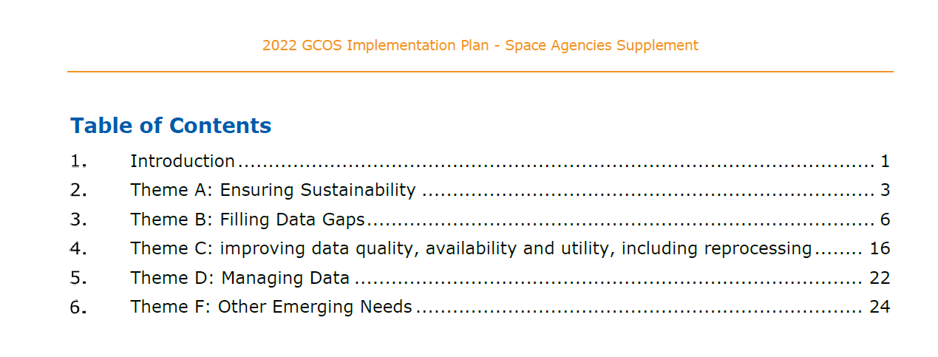
The 2022 GCOS Implementation Plan Space Agencies Supplement

Slide 3
B3.1 Improve diurnal sampling of observations and coverage of GHGs, precursor aerosols, and solar-induced fluorescence (SIF) to improve estimation of emissions and vegetation carbon update
We expect a significant increase in GHG observations on both global and local (facility) scale. Within the CEOS AC-VC, specifically concerning GHGs, this growing constellation will be closely monitored on an annual basis to ensure that measurements are supported by calibration/validation/evaluation efforts and to ensure that measurement gaps are being addressed. For example, recent studies and the general recognition in the community underlines the added value of aerosol, precursor gasses and SIF alongside with GHG observations. These capabilities will be encouraged for future missions and are already planned for inclusion in upcoming missions. GCOS has to clarify the specific product requirements of the precursor aerosols, to ensure they are implemented in an optimal manner, as aerosol is and will continue to be a priority in the future. An operational chain is foreseen with MetOp-SG and also the aerosol instrument on Copernicus CO2M Mission.
The current generation of GHG satellites, such as GOSAT-1/-2, Sentinel-5 Precursor, and OCO-2, have overpass times in the early afternoon . This overpass is optimized for mixing of planetary boundary layer conditions, but may be compromised for expected increase in cloud cover and other local conditions impacting morning overpass retrievals. Morning overpass retrievals could provide unique information regarding CO2 uptake and CH4 release, and also provide diurnal differences in concentrations, enabling the use of divergence flux techniques and process-based inferences. Sentinel-5 and CO2M Missions are scheduled for morning flights. While it is possible to plan missions in GEO, HEO, and MEO orbits, each comes with its drawbacks and significantly different performance compared to LEO satellites. Active Missions usually fly in a dusk-dawn orbit and hence do not offer nighttime operations. For CH4, the MERLIN mission is planned for launch later in the 2020s. Further improving the diurnal sampling will prove to be a challenging task. It is essential to collaborate with GCOS to clarify the exact objectives and use-cases for enhanced diurnal sampling, specifically for the CO2 and CH4 observations on global and local scale .

Slide 4
F2.2 GHG at high latitudes with a focus on the permafrost regions in wintertime
Specifically for methane, up to half of the emissions emitted in high latitude polar ecosystems take place during the autumn and spring ‘shoulder’ seasons. In general, the carbon cycle is expected to be significantly slowed down in wintertime and it will be more difficult to observe changes from satellites even without considering observational limitations.
The darker seasons are times of year when the sun-sensor geometry is suboptimal or inadequate for passive greenhouse gas retrievals to be made within uncertainty requirements for atmospheric inversions. Current and future satellites have the capability to measure in so-called glint mode. This mode is beneficial over snow-covered regions and would extend the coverage into the shoulder seasons. For example, the Copernicus CO2M Mission will be composed of at least two satellites in a constellation and they will fly in an 11:30 LTDN, which improves high latitude coverage and glint observations are performed over snow-covered areas to further improve retrievals over higher latitudes. Due to cloud coverage in Autumn, the main improvements are observed in early Spring. The specific capability to measure in the Polar night is offered by lidar, but this technology has not yet been widely used for GHG observations, is expensive and is expected to remain limited. The upcoming MERLIN mission will be the first to provide this capability.
The main focus of this activity is on methane and less on carbon dioxide. Further, the main gap is perceived in the shoulder seasons. Nevertheless, wintertime observations are also needed from satellites as ground-based observations are extremely challenging and sparse due to difficulties in field conditions.

Slide 5
F5.2 Design a constellation of operational satellites to provide near-real time global coverage of CO2 and CH4 column observations (and profiles to the extent possible)
CEOS and CGMS have been working towards establishing an integrated operational global GHG monitoring system. The current monitoring system includes OCO-2/3, GOSAT-1/-2, and Sentinel-5 Precursor/TROPOMI already provides good coverage. The near-future system is expected to provide near-real time global coverage by the end of 2026 with the launch of CO2M Mission, Sentinel-5, and GOSAT-GW to provide operational GHG monitoring and services. The tables below show current and planned wide area and facility scale missions that will operationalize the global GHG monitoring.

Slide 6
F5.4 Improve and coordinate measurements of relevant ECVs at anthropogenic emission hotspots (large cities, powerplants) to support emission monitoring and the validation of tropospheric measurements by satellites
This activity specifically focuses on the quality of satellite for urban and local scale emission estimates and probably specifically of CO2 (and not CH4). a) Variation in aerosol loading can have a substantive effect on satellite-based estimates of total column CO2 when these data are used to evaluate natural fluxes, which vary by 0.25 ppm/100 km (Worden et al. AMT 2017. However, gradients of total column CO2 in urban regions and facilities are much larger. Consequently, estimates of CO2 emissions from urban regions and large power plants, such as might be observed by OCO-2, OCO-3, and GOSAT are less affected by aerosol variability; instead the errors are typically related to knowledge uncertainty in the local wind fields (Nassar et al. GRL 2017).. Another study called AEROCARB in the framework of the Copernicus CO2M mission also arrived at the same conclusion. Noteworthy is that the CO2M Mission will be equipped with an aerosol sensor which should allow a correction. For plume mappers of CO2, the impact of aerosol on the retrieval is not well known. This will be part of a general action in CEOS AC-VC to require (more) transparency on products from plume mappers, especially from non-public data sets. NB in general aerosols from cities and hot spots have a size distribution that is affecting shorter wavelengths and to a lesser extent the SWIR wavelengths typically used for GHG observations. b) There is a number of initiatives to set up city networks, which includes a relatively large number of sensors around cities in order to understand in more detail the city emissions. We can investigate whether this includes aerosol sensors to connect them better to satellite retrieved data.

