Slide 1
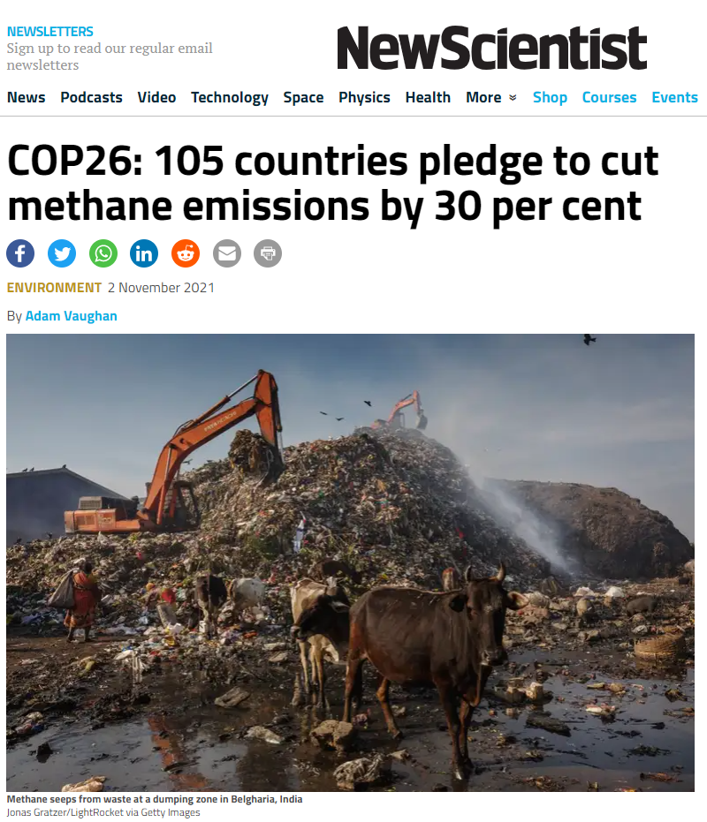
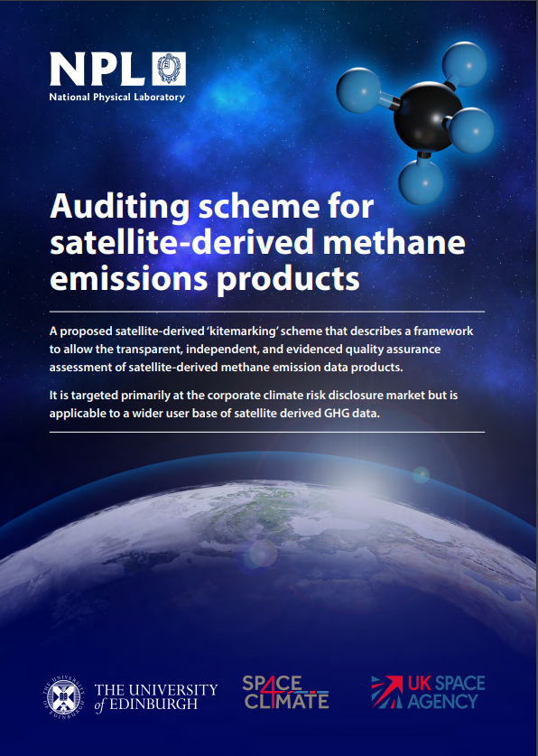
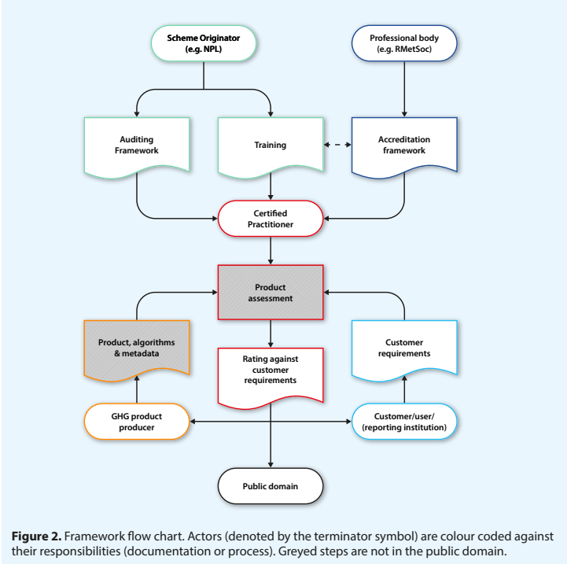
Satellite-derived Methane Product Standards
The need for methane emission data is prescribed to response to government policy enacted to address the climate emergency
To validate national, regional, city and corporate scale emissions reporting
Require a standards framework, applicable across scales, based on transparency, traceability, independence & evidenced QA
UK has drafted a framework so seeking international alignment and consensus
COP28 Space Summit Statement
UK-hosted methane standards workshop in Q1 2024 with recommendations brought to April 2024 CEOS SIT meeting
Implementation developed in 2024-25
International agreement signed in Q3 2025
Paul Green paul.green@npl.co.uk
Paul Palmer pip@ed.ac.uk

