Slide 1
Greenhouse Gas (GHG) Task Team
Sensor Development Updates
Updates to Annex-C

Slide 2
GHG TT – Sensor Tracking
Define and distinguish the combinations of measurement requirements (e.g., precision, accuracy, resolution and coverage) for sensors focusing on (1) Facility scale monitoring, (2) sub-regional to global-scale flux estimates, and (3) operational, thermal IR sounders that measure GHGs in the upper troposphere and above. |  | X | AC-VC | 1.ACTION | ? | ACTION reworded in updated Roadmap [DC] Note, the modified wording turned this from a "Sens" action to a Cal/Val action. I therefore moved that modified requirement down to the cal/val section. I reworded this one to address an emerging need - to define the combination of sensor measurement requirements for facility-scale, national scale and upper tropospheric sensors.
Track implementation and operations of space-based GHG sensors and identify and propose solutions for observational gaps - see extract from Rec#14: The capabilities required to meet the needs of the UNFCCC and the Parties to the Convention are already at the limit of the state-of-the-art for existing, space-based measurement technology. The CEOS and CGMS agencies should therefore continue to pursue complimentary technologies for both sensors (e.g. wide swath passive CO2 and CH4 imagers, active lidar) and mission design (e.g. HEO). These development efforts should be coordinated to keep the Principals updated on additional needs and capabilities that would be useful to consider for future mission opportunities | ? | ? | AC-VC | 3. MONITOR | ANNUALLY | Monitored at annual AC-VC meetings. In addition, we are setting up a CEOS website with overview of missions

Slide 3
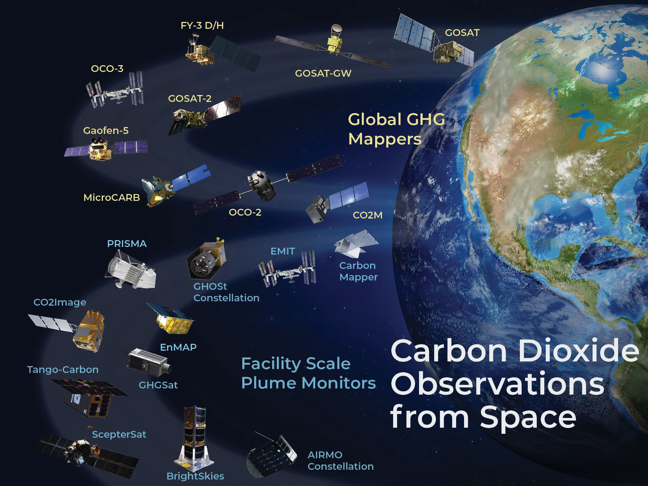
Sensor Tracking
CEOS GHG Missions Portal; centralized overview of GHG Missions in one Portal at ceos.org/ghg
https://database.eohandbook.com/ghg/

Slide 4
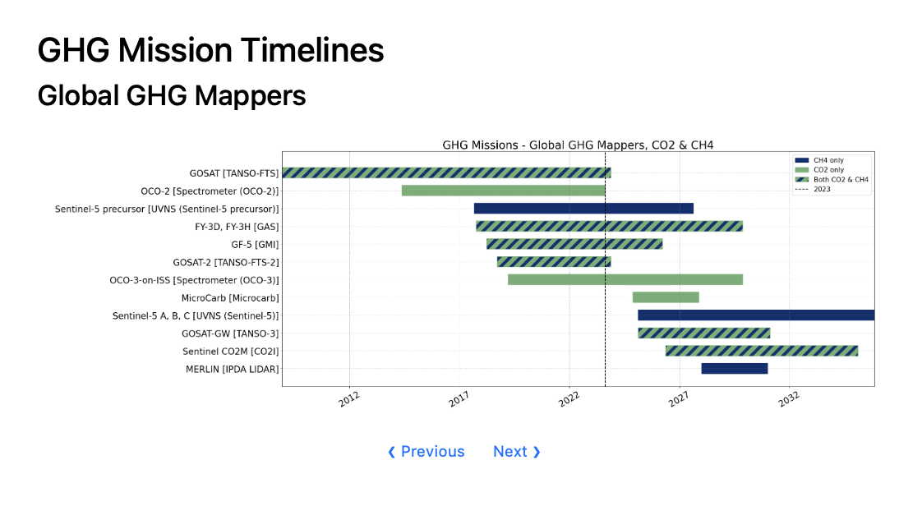
Regional to global emissions from global mappers
What is the distribution and sector of each countries anthropogenic emission?
Do stated emissions reductions affect the global CO₂ or CH₄ growth rate? If emissions reductions do not match expected growth rate change then why and where?
How do natural processes as well as extreme events such as droughts, heat waves, and flooding affect atmospheric CO2, CH4, and their growth rates?

Slide 5
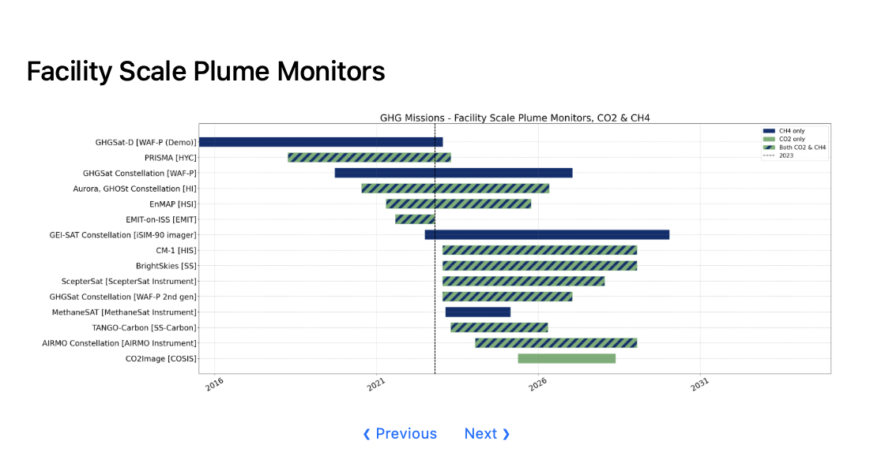
Facility scale emissions from “plume mappers”
10 of these 15 missions are from New Space!
Intellectual Property concerns play a role in transparency of data provenance and processing
Pre-2024 constellation has measured ~15 Tg/yr of methane relative to ~120 Tg/yr fossil and waste budget --> Unclear how additional measurements increase sampling of methane emissions
Operations: Where are the leaks and can we fix them?(increased methane production, reduces pollution)
Science: What is the role of high emitters (~>100 kg/hr for methane) on the CH₄ and CO₂ budgets ?
Policy: Prioritize which emissions to remediate for climate action
Finance: Evaluate a companies stated carbon footprint and its remediation approach (empirical data needed for carbon markets)

Slide 6
Sensor Tracking
Work closely with GCOS to and other partner organizations and stakeholders to refine the requirements for space-based greenhouse gas measurements(Rec#7) | ? | ? | AC-VC | 2. ON GOING | ANNUALLY | Addressed through yearly AC-VC meetings
Coordinate discussion on auxiliary observations enhancing data quality (e.g., aerosol properties for light path correction) - see extract from Rec#15: Ancillary measurements are needed both to improve the accuracy of the XCO2 and XCH4 retrievals (i.e. coincident observations of clouds and aerosols) and to facilitate their interpretation within the context of the anthropogenic and natural carbon cycle (i.e. SIF, NO2 and CO). Here, the proposed atmospheric CO2 and CH4 monitoring system could substantially benefit from the full scope of carbon cycle observations included in the CEOS Carbon Strategy. The CEOS partner agencies should therefore continue to support that strategy | ? | ? | AC-VC | 3. MONITOR | ANNUALLY | (jw) will include discussion of this nature at next ACVC meeting and IWGGMS (jw) need to facilitate studies enabling joint use of trace gas measurements for 1) improving XCH4 / XCO2 accuracy and 2) CO2/CH4 emissions and attribution
These items largely addressed by annual AC-VC meetings
How to break through the XCO2/XCH4 accuracy barrier (0.8 ppm / 15 ppb)?
What measurements are needed to attribute observed fluxes to natural and anthropogenic sources?

Slide 7
Sensor Tracking
Define critical measurement gaps with respect to quantifying fossil emissions and response of natural fluxes to climate change and disturbance | ? | ? | AC-VC | 1.ACTION | Medio 2024 | NEW
Constellation is arguably focused on quantifying anthropogenic emissions at facility and urban/regional scale
Exception → MethaneSat will quantify area sources such as livestock emissions
Can we define the requirements to quantify carbon / climate feedbacks? This would help support identification of measurement gap
Quantify CO2 and CH4 natural fluxes (~0.2 ppm/100km for land and ocean?)
Quantify CO2 and CH4 fluxes from extreme events (fires, drought, floods) → likely need increased sampling with higher resolution pixels

Slide 8
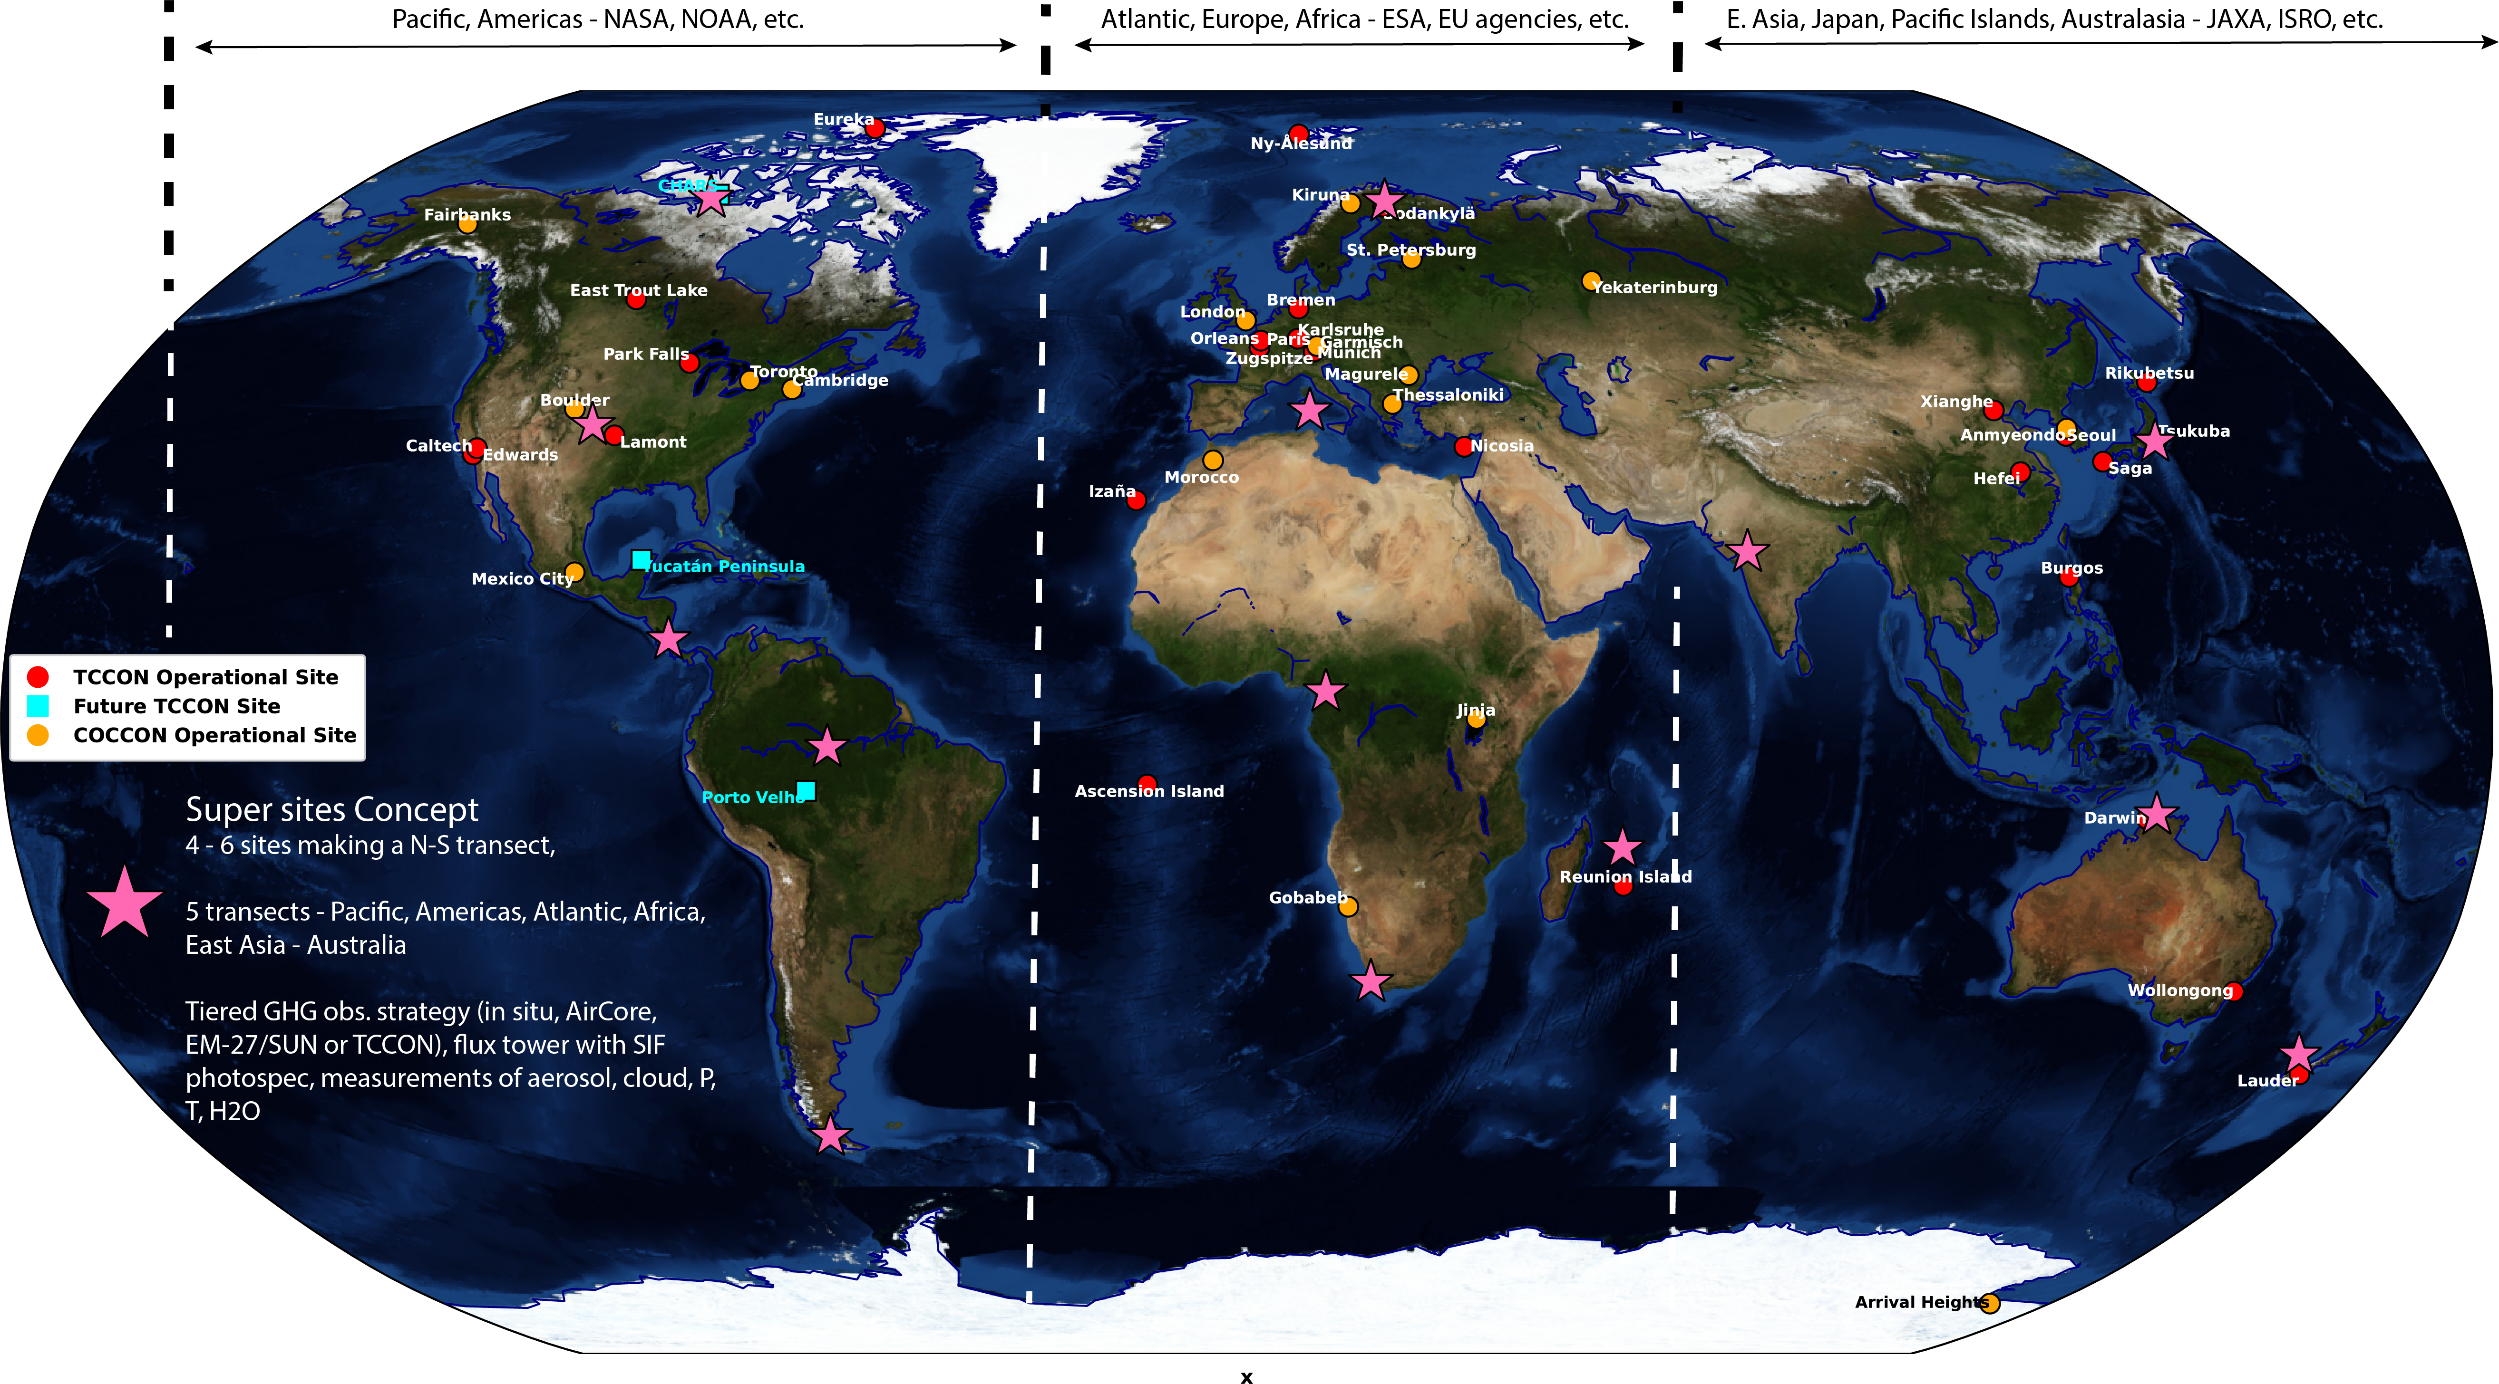
Immediate needs to improve current and future sensors:
Improved cal/val sites for wide field observations
Super Sites with ancillary (aerosol, GHG profiles) observations needed to test L2 algorithms

Slide 9
Immediate needs to improve current and future sensors: facility scale missions
Improved Cal/Val to for facility scale sensor characterization, especially probability of detection across range of viewing conditions
Define best practices for facility scale measurements to improve consistency and accuracy of emissions for use in policy / science
Courtesy Annmarie Eldering

