Slide 1
SIT Chair Prospectus
2024-25
Osamu Ochiai
GHG TT
11th March 2024

Slide 2
Introduction
JAXA takes on Chairmanship of the CEOS Strategic Implementation Team (SIT) since last CEOS Plenary for a 2-year term
SIT “..provides strategic guidance on the direction, progress, and status of implementation activities in relation to the established priorities, commitments, and partnerships of the CEOS organization”.
NASA to serve as SIT Vice-Chair during this term and to take on SIT Chair in late 2025
JAXA Team has been consulting broadly across the organisation to set outcomes and milestones that are significant and reflect societal needs and CEOS agency priorities (and therefore resources)

Slide 3
SIT 2024-25 approach
Focused: a few priorities reflecting major thrusts across civil EO programmes and priority needs, consistent with past CEOS outcomes
  Tangible and achievable outcomes with enduring benefit
Ensuring continuity: for existing SIT and CEOS WP activities
  Reflecting resource availability
  Stressing CEOS agency participation
Consistent with the original vision for SIT:
  Principals in SIT meetings address significant challenges via coordination and observing system harmonisation across space agencies
Effective use of the different meetings:
  SIT: Significant debate and decision - for Principals
  TW: Working Teams reporting, interaction, and prep for Plenary
  All meetings cannot accommodate reporting of all CEOS business
  Ensure effective intersection between CEOS management and WP contributors

Slide 4
SIT 2024-25 headlines
JAXA SIT Chair Priorities
  Climate Policy Impact – addressing obstacles and opportunities for CEOS agency data, particularly AFOLU/Biomass map datasets, to have maximum impact in the key climate policy processes such as the Global Stocktake of the Paris Agreement
GHG observations from space - addressing coordination for data continuity challenges ahead and developing good practices so that operators of all kinds may contribute to societal needs
Supporting existing & emerging CEOS business
Escalating, elevating and expediting the CEOS WP activities underway and planned in which CEOS agencies are investing

Slide 5
Climate Policy Impact
Addressing opportunities for EO data impact on climate policies
  Significance of AFOLU datasets to understand sink and source of GHG from the land surface which is the primary domains of human and natural activities
  Progress AFOLU Roadmap implementation
  Important dataset harmonization studies offer insights and new opportunities
National Case Studies on EO data impact
  Space based AFOLU datasets (e.g., Biomass map) for potential GHG inventory reporting in Asian countries
  Asia focus of SilvaCarbon: working dataset for reporting and more
Responding to GST1 outcomes and reinforcement of UNFCCC engagement
  EO-related support arising from 1st Global Stocktake
  Propose to launch a coordinated effort targeting EO data role in the next update of the IPCC Task Force on Inventories Good Practice Guidance (circa GST2 in 5 years)
  Highly insecure interface for CEOS (and GEO, WMO) to UNFCCC SEC and COP process to explore mechanisms for improvement
Other policy engagement
  Updated Space Agency Response to GCOS IP (Plenary 2024)
  Alternate angles (eg Covenant of Mayors)

Slide 6
GHG Observations from space
Observation continuity
  Multiple delays, cancellations or program reductions of concern
  New GHG mission portal (with ESA MIM team) to aid coordination
GHG Roadmap Implementation
      Implementation of the GHG Roadmap including CO2 emission from mega cities.
Good Practices for GHG Emission Estimates from Space
  Diverse data contributors to goals like IMEO MARS - CEOS can help optimise contributions of smaller missions
  Best Practices document including methods for evaluating commercial products through engagement with IMEO, WMO+
  Case studies to monitor Methane from rice field
Active engagement with policy entities – UNEP IMEO and WMO GGGW
  IMEO Roadmap with CEOS inputs
  Active engagement in WMO GGGW discussion
  Support to Global Methane Pledge

Slide 7
Existing & Emerging Business
Support for current CEOS WP tasks & deliverables
  Including GEO contributions and interfaces
  SDGs, ARD etc
Expedite emerging business as required
  CEOS Aquatic Carbon Roadmap
  Biodiversity Initiative of 2024 CEOS Chair
  COAST VC
Review and reinforcement of the VC construct
  Updated VC timelines and comms materials
  Continuity challenges for thematic observations

Slide 8

































Meet the team
JAXA SIT Chair team
Key Climate Impact colleagues
Key GHG Observation colleagues
Hirabayashi | osamu |  | Mariko | ko | Kamei | Uenuma | Sato |  |  | MS | LR | RS

Slide 9
SIT-39 in Tokyo – Week at a Glance

Slide 10
SIT-39 in Tokyo – Climate Policy Impact
Climate Policy Impact Session
Take stock of the Earth observation community’s interface and impact on the climate policy process – notably the United Nations Framework Convention on Climate Change (UNFCCC) and Global Stocktake (GST). This includes a report from the Institute for Global Environmental Strategies (IGES) on the first GST in 2023 (GST1).
Debate the way forward, new approaches, and new opportunities – including improved coordination across Earth observation frameworks, between CEOS and the World Meteorological Organization (WMO), between research and operational agencies, and more.
Consider specific strategies aimed at the GST2 timeframe (2028) to provide focus and mobilisation of community efforts. Agree on whether the CEOS GST Strategy (2021) actions need to be updated accordingly.
Hear plans for in-country demonstrators to support the uptake of satellite Earth observation datasets for national inventories and reporting.

Slide 11
SIT-39 in Tokyo – Climate Policy Impact

Slide 12
SIT-39 in Tokyo – GHG Observation
Greenhouse Gas Observation Session
Hear the latest on the WMO Global Greenhouse Gas Watch (G3W) initiative, its Implementation Plan, and debate the opportunities for CEOS to collaborate, including updates to the CEOS GHG Roadmap.
Agree on changes needed to the CEOS GHG Roadmap (2020) in 2024 and the associated actions for its updating.
Take stock of CEOS Agency changes in GHG observation continuity and the outlook for data supply and product generation through to the GST2 timeframe (2028).
Review and discuss various activities underway to document best practices and standards for measurement of GHGs from space and seek to establish consensus on any necessary coordination and the ultimate goals for CEOS.
Discuss the way forward for the CEOS relationship with the International Methane Emissions Observatory (IMEO), while also acknowledging the national policy dimension

Slide 13
SIT-39 in Tokyo – GHG Session Detail

Slide 14
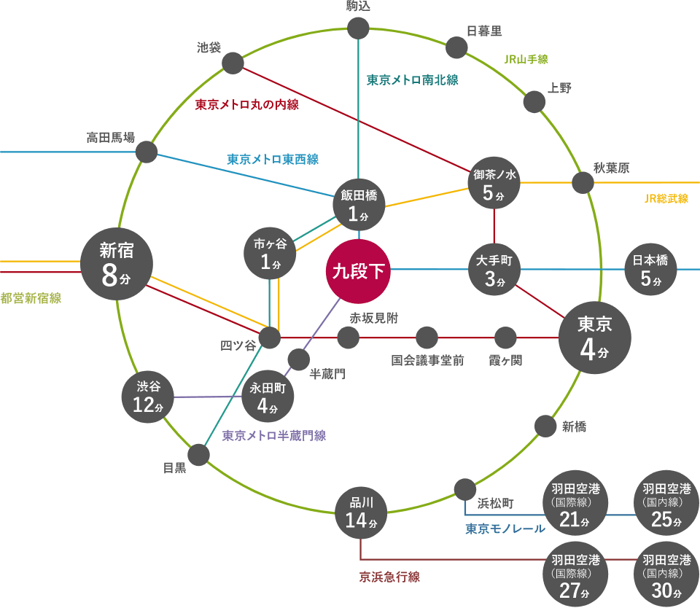


2024 meetings
SIT-39
  9th April 2024: Side Meeting
  10th – 11th April 2024: Plenary Meeting
  Venue: Kudan-Kaikan Terrace
  Conference & Banquet
  (Address: 1-6-5, Kudan Minami,
  Chiyoda-ku,Tokyo 102-0074)
Tokyo Metro and Railway
Kudanshita St.
Tokyo St.
(4 min)
SIT-TW 2024
  Week of 16th September 2024
  Sydney, Australia
  Thanks to GA/CSIRO for hosting!
Haneda/Tokyo
Airport
(27min)

