Slide 1
WGClimate Work Plan
Wenying Su, NASA
WGClimate Chair
Agenda Item 1.2

Slide 2
Deliverables Closed in 2025
CMRS-24-03: Restructure ECV Inventory architecture and processes for population, review, gap analysis
See Agenda item 3.2
Completed November 2025
CMRS-23-04: Provide Agency Response to GCOP IP
Delivered to SIT-40, April 2025
CMRS-24-07: Document GST1 lessons learned
Delivered to SIT-40, April 2025

Slide 3
Ongoing Deliverables
CMRS-25-01: Expanding the utility of the CDR Inventory
Due: 2026 Q2
See agenda item 3.3
Supporting recommendation from GST Strategy
CMRS-24-01: Update and align WGClimate website instances (CEOS, CGMS, climatemonitoring.info)
Due: 2026 Q2
WGClimate will progress over coming months
CMRS-25-03: Support for GCOS ECV rationalisation process
Due: 2026 Q2
See GCOS Joint Meeting agenda
CMRS-25-04: Gap Analysis for ABG, Soil Moisture and Sea Level data records
Due: 2027 Q4 🡪 propose to close this action, and focus on variables that are of interests to GCOS/WCRP
CMRS-24-04: Conduct consultation to converge on definition for Climate Data Records (CDRs) and its variants
Due: 2026 Q4
See agenda item 3.4

Slide 4
New Deliverables
Update the Space Agency Response to the 2022 GCOS Implementation Plan
Due: Q2 2026
Lead agency: all
Regional satellite data experts for national inventory compilers
Due: Q4 2026
Lead agencies: ECMWF, European Commission, ESA
Mapping EO products to Adaptation Indicators
Due: Q4 2026
Lead agencies: European Commission, EUMETSAT
Supporting recommendation from GST Strategy
Guidance for EO data for resilience and adaptation efforts
Due: Q4 2027
No lead agency/ies yet identified
Supporting recommendation from GST Strategy

Slide 5
Recurrent WGClimate Tasks
Maintenance and population of CDR Inventory
Identified in the ‘CEOS Services’ chapter of the CEOS Work Plan
Coordination of the annual CEOS-CGMS Statement to UNFCCC SBSTA
Coordination of themes and inputs for UNFCCC Earth Information Day

Slide 6
CEOS Work Plan
Deadline for initial inputs was last Friday
Chance for final edits and new deliverables this week

Slide 7
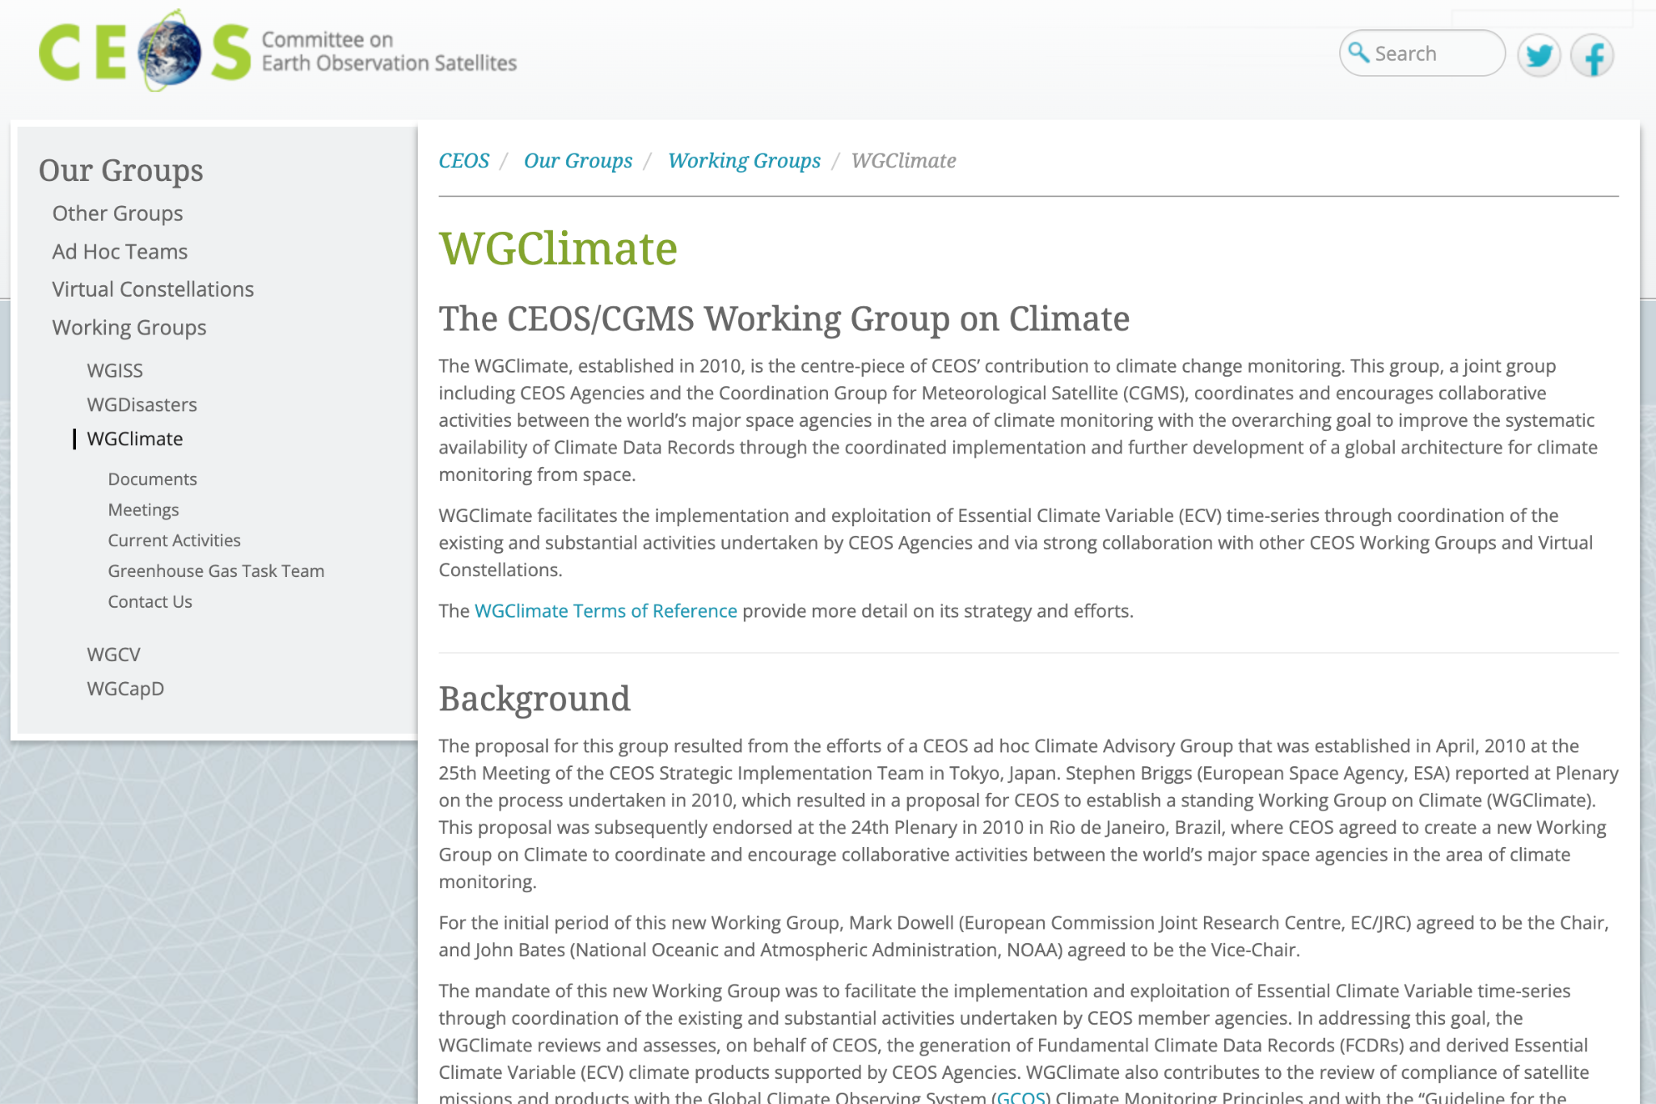
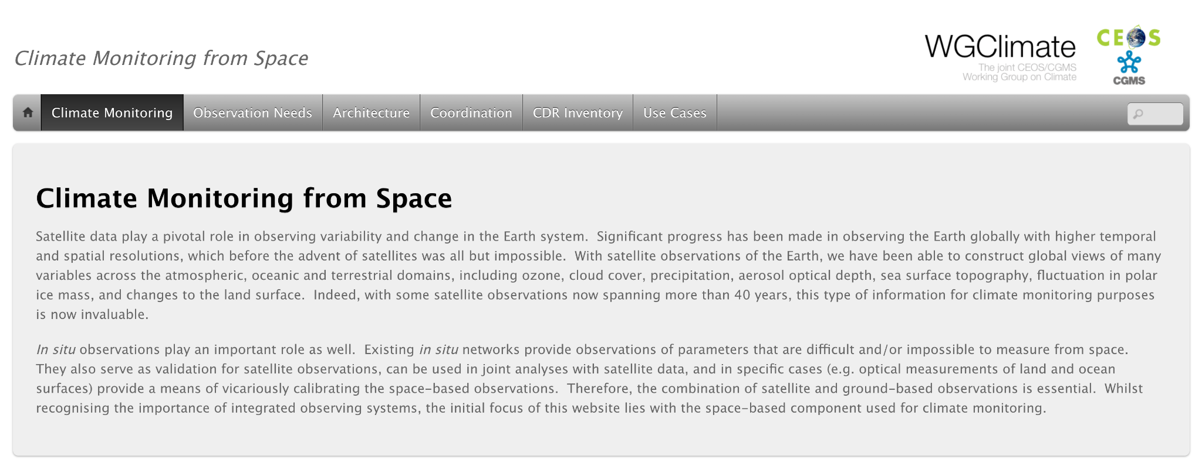
WGClimate Webpage Updates
Current status:
CEOS Website WGClimate page -> basic background information, documents, meetings, contact details, GHG-TT subpage and outdated ‘current activities’
Needs update
CGMS Website WGClimate page -> basic background info -> links to CEOS page 👍
climatemonitoring.info -> has information about the architecture, hosts CDR Inventory & Use Cases

Slide 8
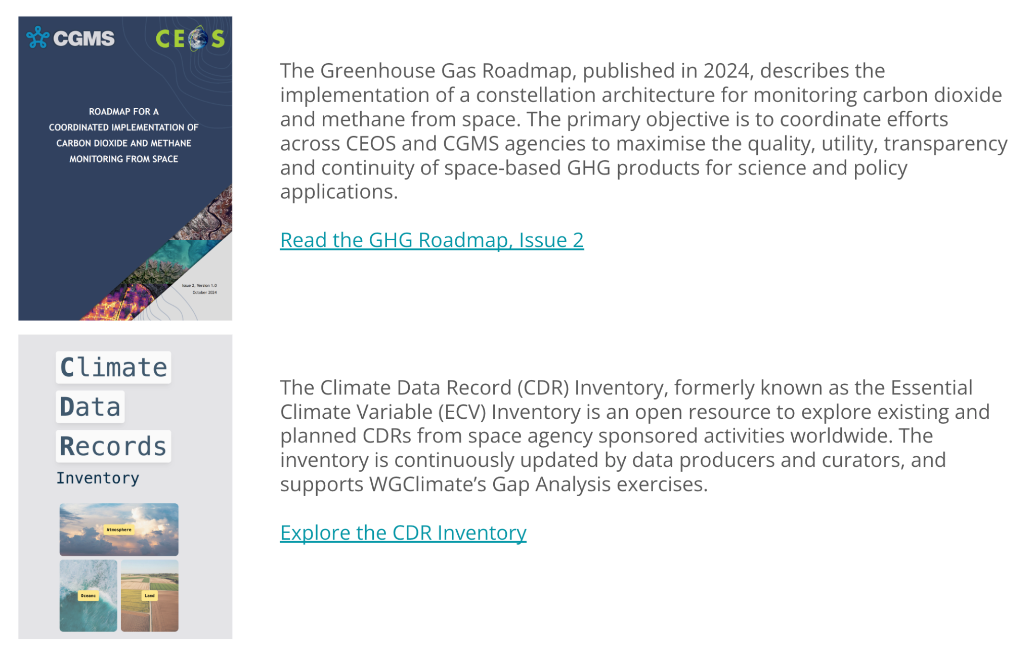
WGClimate Webpage Updates
Proposal:
Update CEOS WGClimate Page:
Short background/overview
List of resources and links
CDR Inventory
Use Cases
GHG Roadmap
Architecture
Latest Space Agency Statement to the SBSTA
Latest Space Agency Response to GCOS IP
Latest Gap Analysis & Coordinated Action Plan
Move detailed background & history of the WG to subpage
Does climatemonitoring.info also need to be updated?
Perhaps just one background/overview page, then highlighting CDR Inventory & Use Cases more?
WGClimate Activities
.
.
.

