Slide 1
GHG Roadmap and Activities
Yasjka Meijer, ESA
GHG Task Team Lead
Agenda Item 1.3

Slide 2

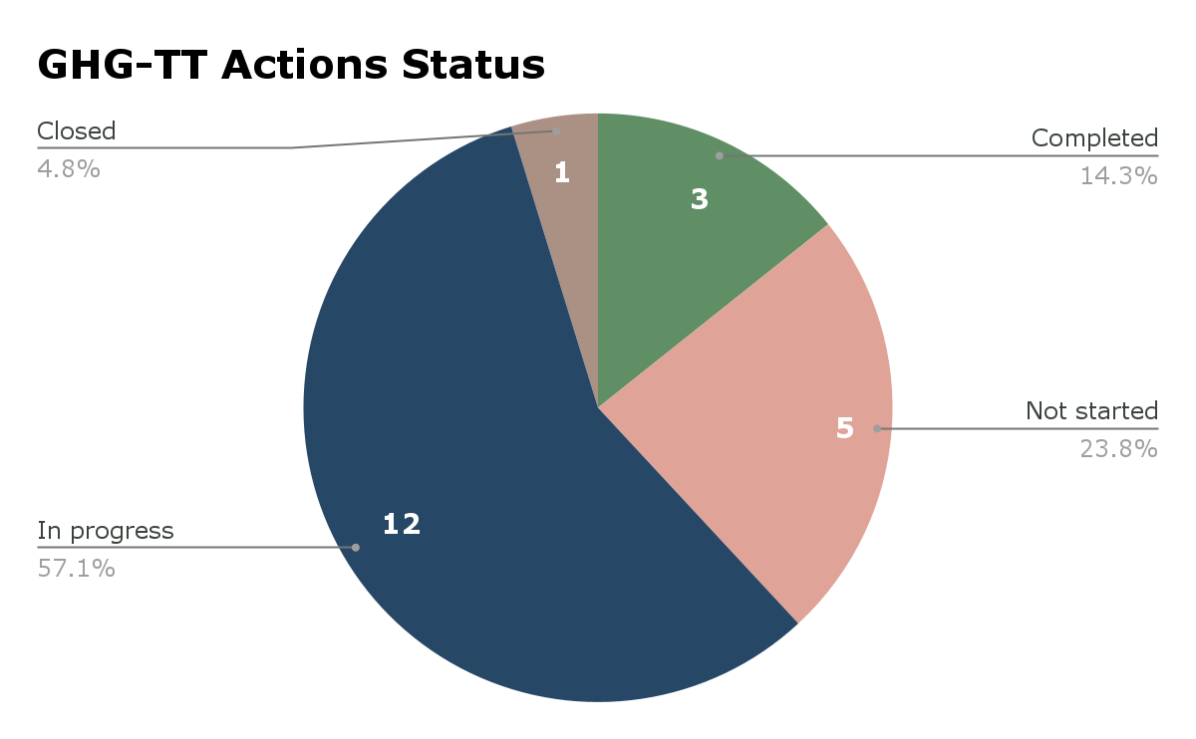
Greenhouse Gas Roadmap Issue 2
Endorsed at CEOS Plenary 2024
Supplemented by Annex C Actions:
  21 near-term actions identified covering
  8 thematic areas described in next slides

Slide 3
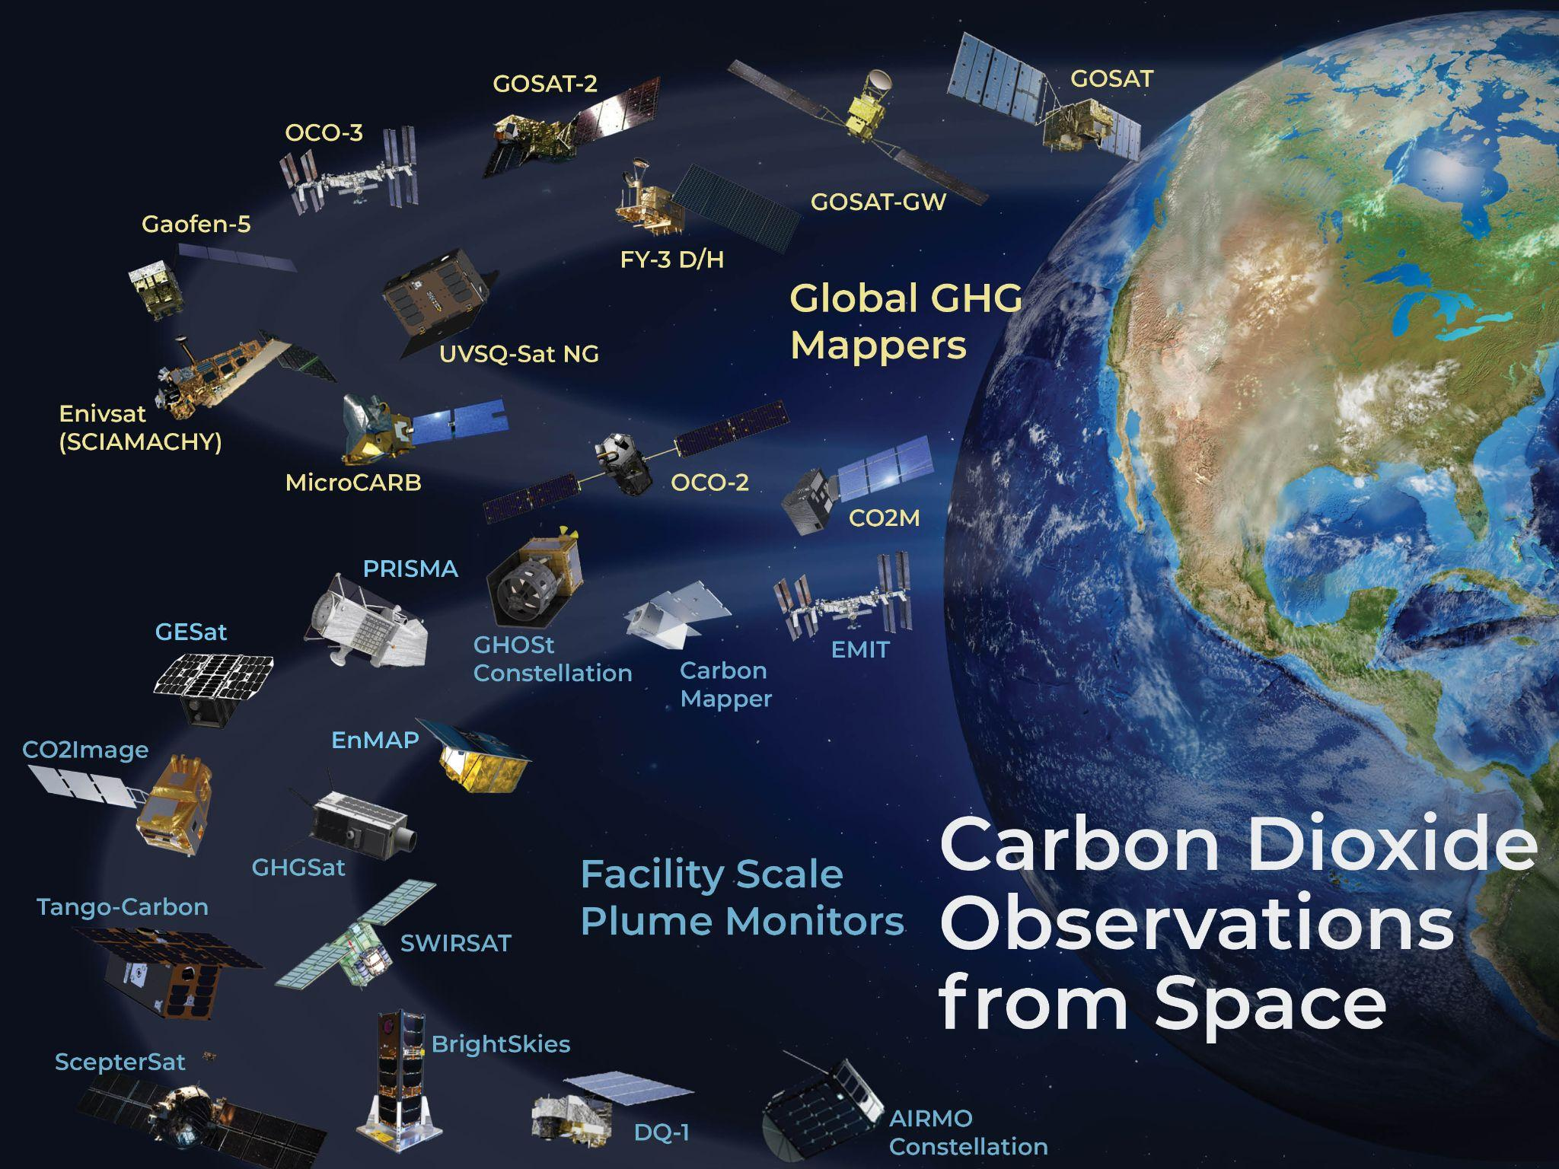

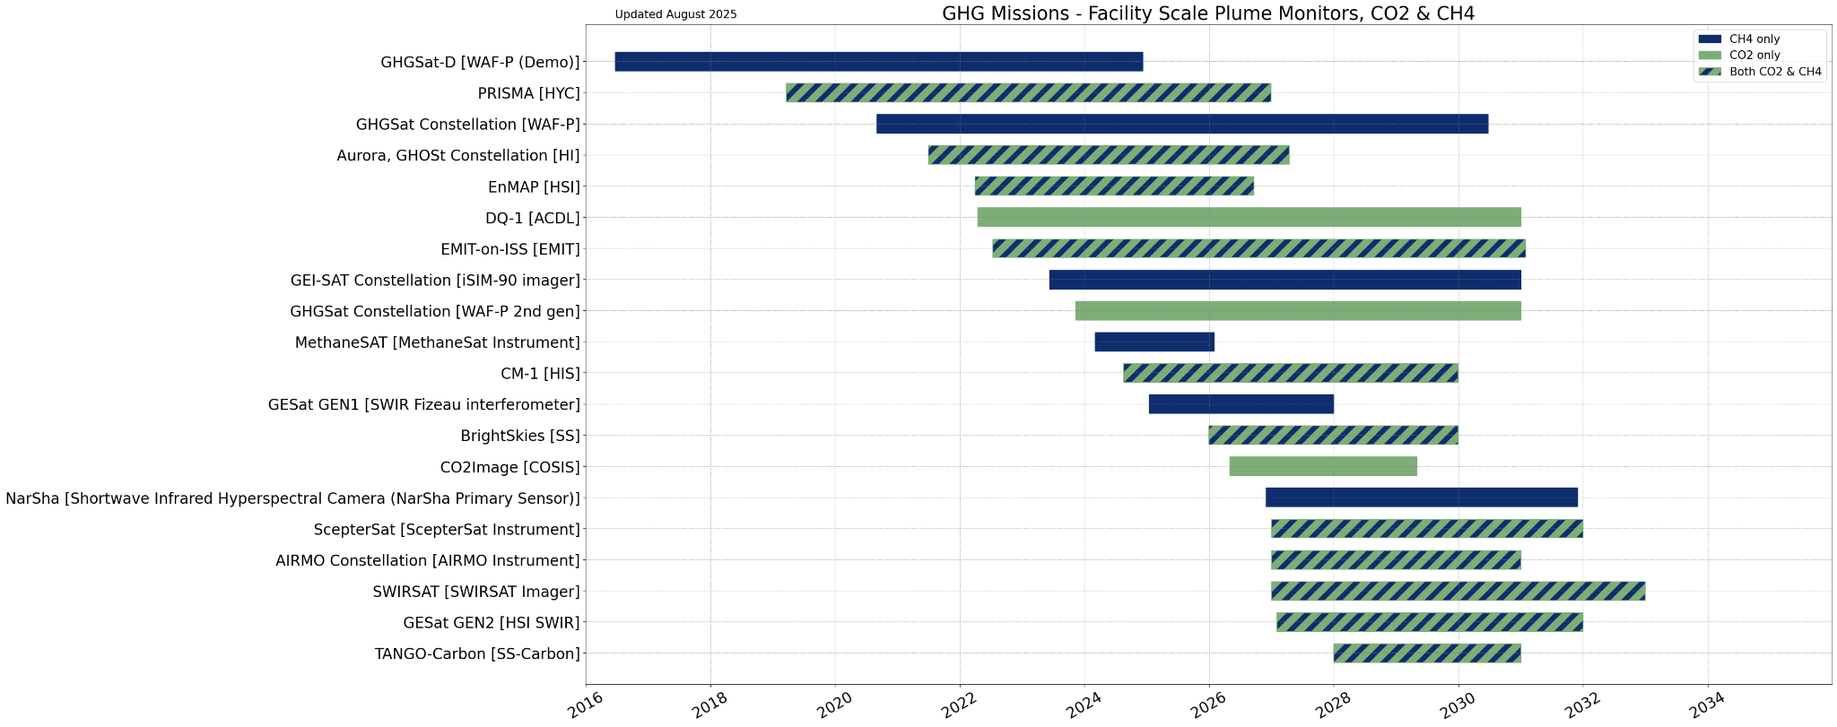
GHG Mission Portal
Updated portal, see ceos.org/ghg
(public and non-public)
Allows exploring GHG missions, explore building constellations, detailed mission info, timelines, and case studies

Slide 4
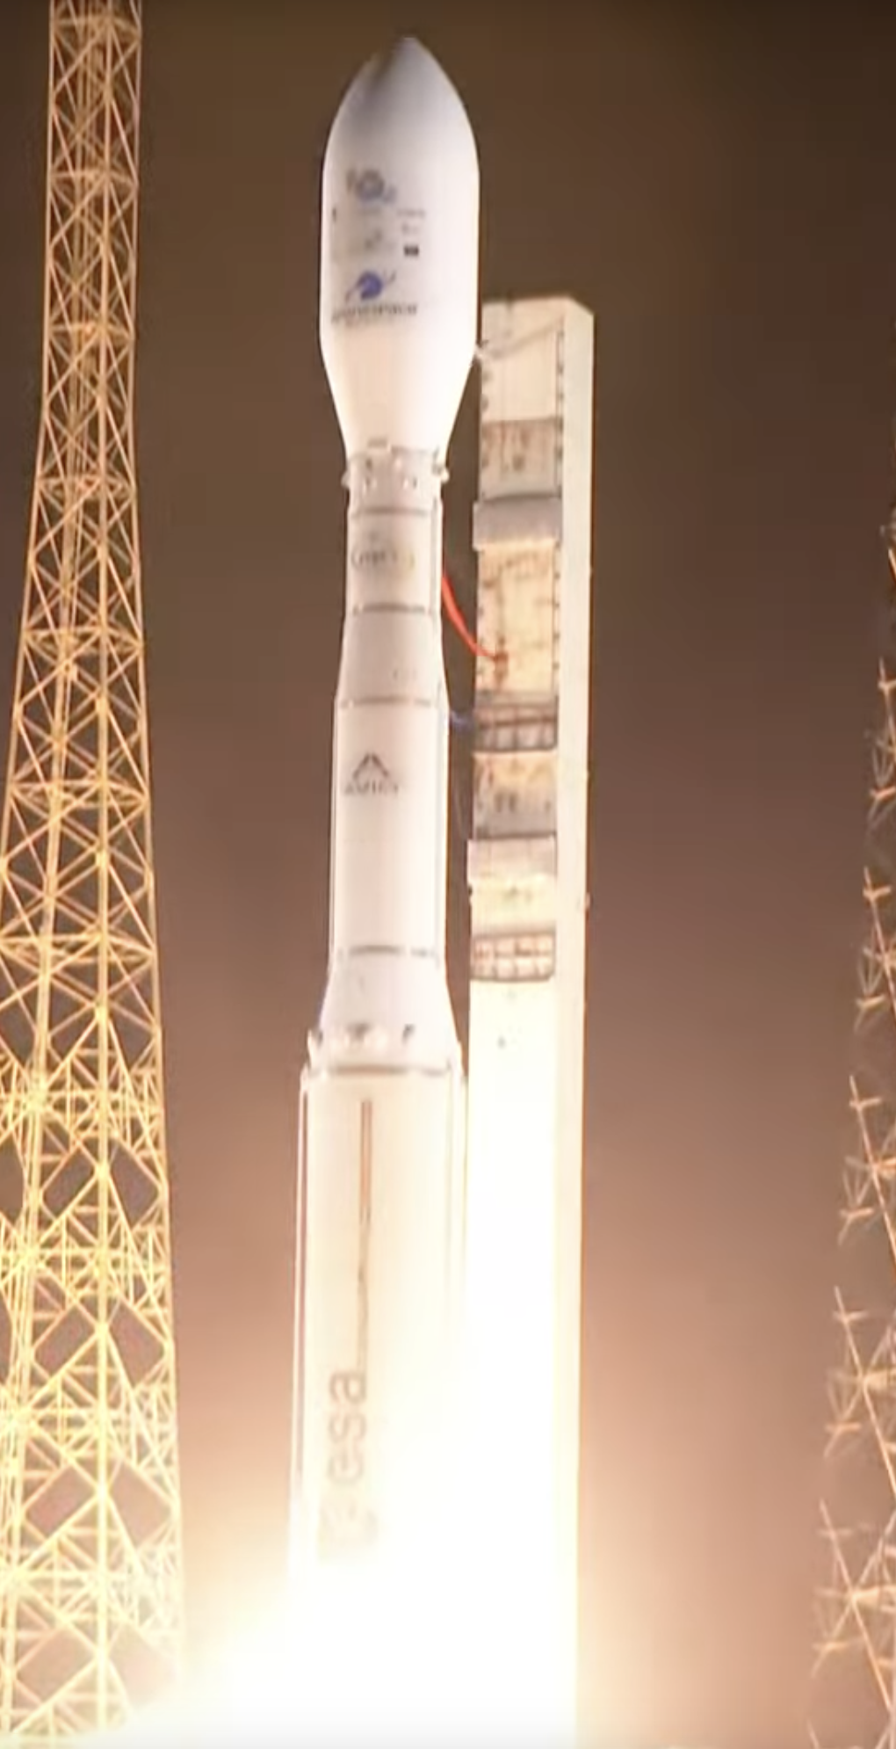
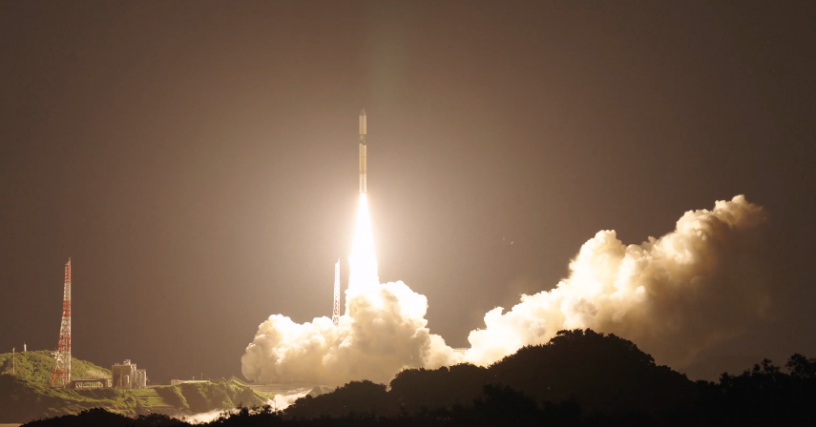
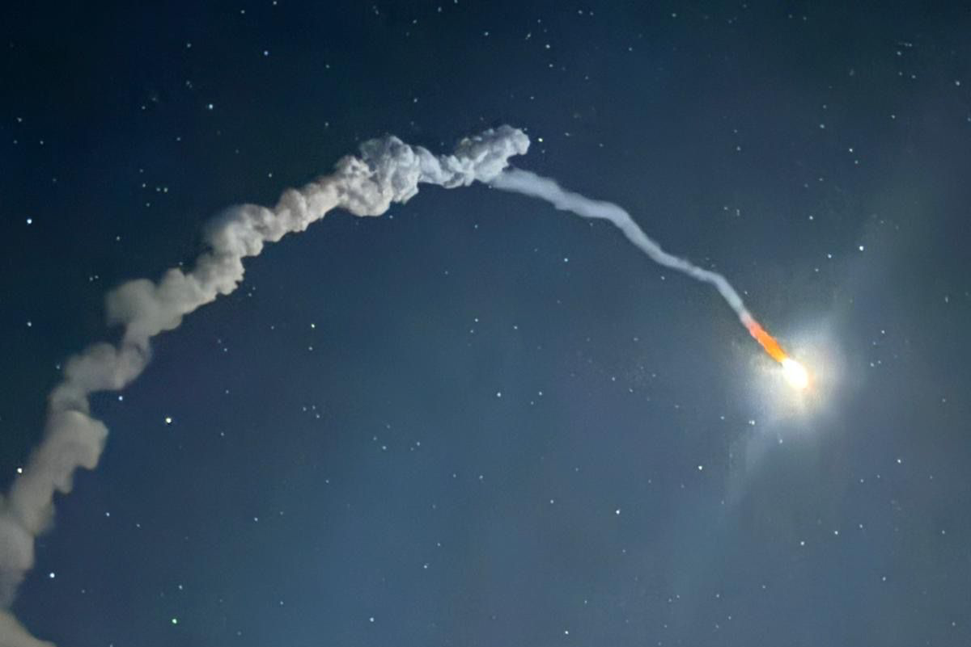
Greenhouse Gas Missions
International constellation is EXPANDING in 2025
Successful launch of:
GOSAT-GW on 29 June
MicroCarb on 26 July
Sentinel-5 on 12 August
(on MetOp-SG-A1)
Overview on GHG Mission Portal

Slide 5
Arctic Observing Mission - AOM
AOM will address a measurement gap with focus on high latitude Arctic
Support letter had been provided endorsed & signed by CEOS & CGMS

Slide 6
Sensor Development and
Constellation Architectures
Lead: TBC as John Worden (NASA/JPL) retired, co-lead Hiroshi Tanimoto
Sensor Characterization to Meet Stakeholder Requirements
Track Instrument type and mission timeline
Track & evaluate other measurements of tracers of carbon cycle
Identify Measurement Gaps
Tracked via AC-VC, annual IWGGMS & GCOS

Slide 7
Calibration and Level 1 Products
Lead: Hiroshi Suto (JAXA)
Railroad Valley Campaign 2025:
  Split in two campaigns
  GOSAT-GW will join the Fall campaign
  Sentinel-5 and MicroCarb also invited
CMA is also performing regular campaigns in Gobi Desert
Vicarious calibration portal has been updated

Slide 8
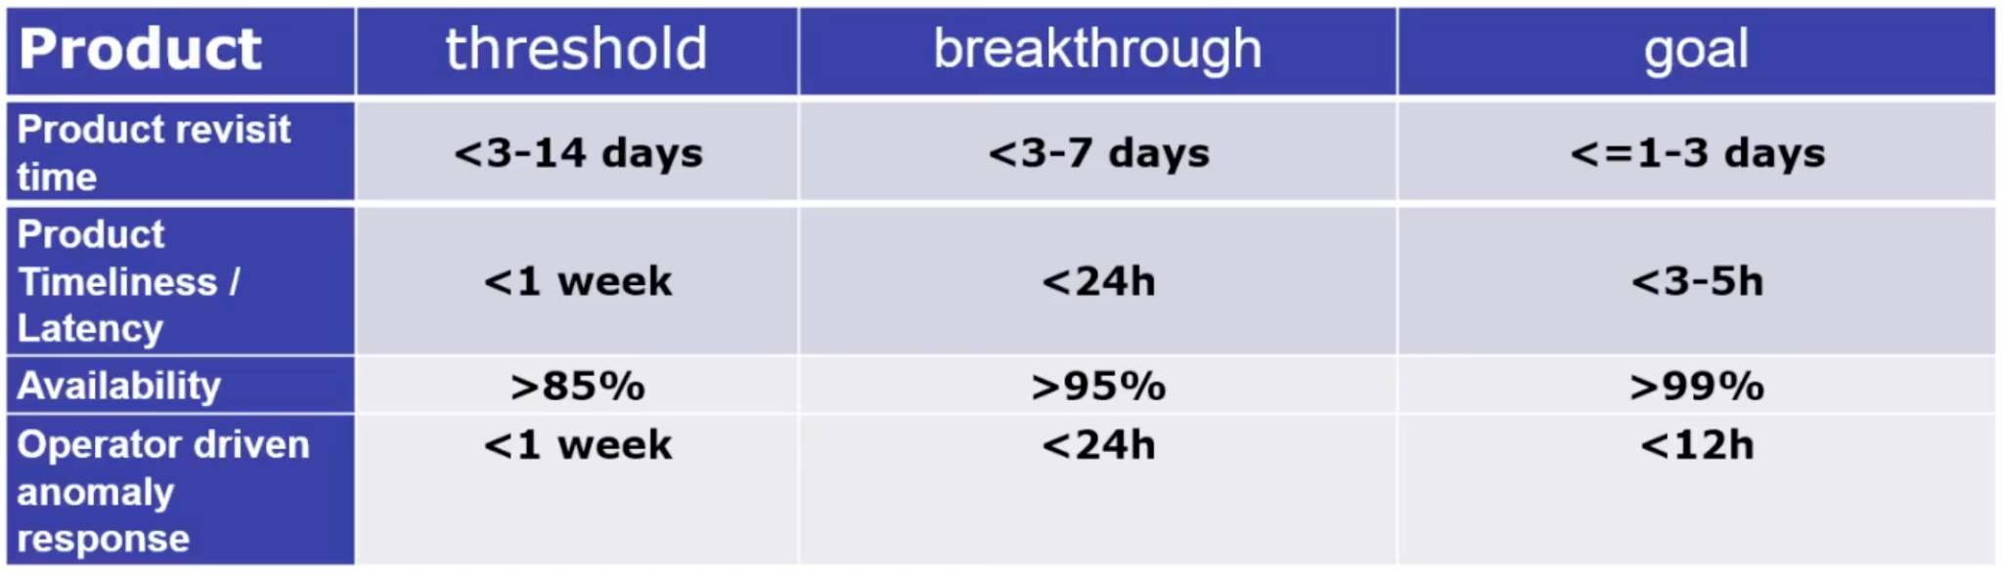
Level 2 Products and Validation
Leads: Ruediger Lang (EUMETSAT), Dave Crisp
Algorithms for Intercomparison: Aerosol scattering
Track L2 Validation Capabilities, Evolving Needs and Gaps
Discussing the L2 product requirements for a system like G3W:
DRAFT

Slide 9
Flux Inversion Modelling and Validation
Leads: Kevin Bowman (NASA/JPL), Frederic Chevallier (LSCE)
G3W Applications:
  Capabilities currently do not meet stringent latency requirements of G3W
UNFCCC National Reporting
Coordinating with AFOLU & Aquatic Carbon Teams on this topic
Notes:
INV-01: The OCO-2 V11 MIP is underway with international participation. This activity still represents the best practice to date for the exploitation of satellite assets to infer global fluxes. These include protocols for data delivery and a robust validation approach against independent observations. However, this activity does not meet the stringent latency requirements of G3W (the last time I checked). It is important for other CEOS members to develop analogous MIPs, especially for GOSAT-GW and MicroCarb—followed by CO2M. The continued operation of OCO-2 and OCO-3 is uncertain given US executive priorities. This increases the urgency of their initiation.
INV-02: One of the emerging activities within OCO-2 V11 MIP is the calculation of uncertainties and spatial correlations of the top-down inversions. The idea is to be able to calculate the error correlation of the flux estimates between, say, France and Germany. This activity is also working to reproduce the stocktake results from Bryne et al with the updated fluxes, which will include years up to 2024.

Slide 10
System Development
Lead: Richard Engelen (ECMWF)
Activities with G3W now slowly restarting again
Capacity sharing between regional GHG Centres
(e.g. Copernicus, Japan, US)

Slide 11

Methane Common Practices
Lead: Paul Green (NPL)
First document completed!
Enables working with New Space
Controlled release experiments form
an important fundament
Details in item 4.2

Slide 12
Fostering Stakeholder Engagement
Lead: Mark Dowell (EC-JRC)
GST Parties - 'BYO Inventory Compiler'
  Harwell meeting 2025 was a success and aim is to repeat in other regions
GCP & RECCAP →→ agenda item 8.2
IMEO →→ agenda item 8.3
  SIT Chair and GHG TT engaged with ASI and DLR
  to facilitate access for IMEO to PRISMA and EnMAP
IG3IS & G3W →→ agenda items 8.5 & 8.6 (Oksana)
  G3W implementation continues and is integrated in existing WMO infrastructure

Slide 13
2025 & 2026 meetings
Joint meeting with WGClimate
CEOS meetings: SIT-40, AC-VC, SIT-TW, Plenary
CGMS meetings: WG-II, CGMS-53 Plenary, WG-III
Arigatō JAXA for supporting the GHG Monitoring efforts during their SIT chair term
CGMS-54 and SIT in April 2026
Continue in coming years will be a challenge….

Slide 14
Time for questions
and discussion
THANKS!

