Slide 1
WGClimate-24 & GHG-TT-6
CEO Report
Lefteris Mamais, CEOS Exec Officer
Agenda item 1.4

Slide 2
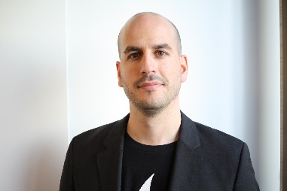

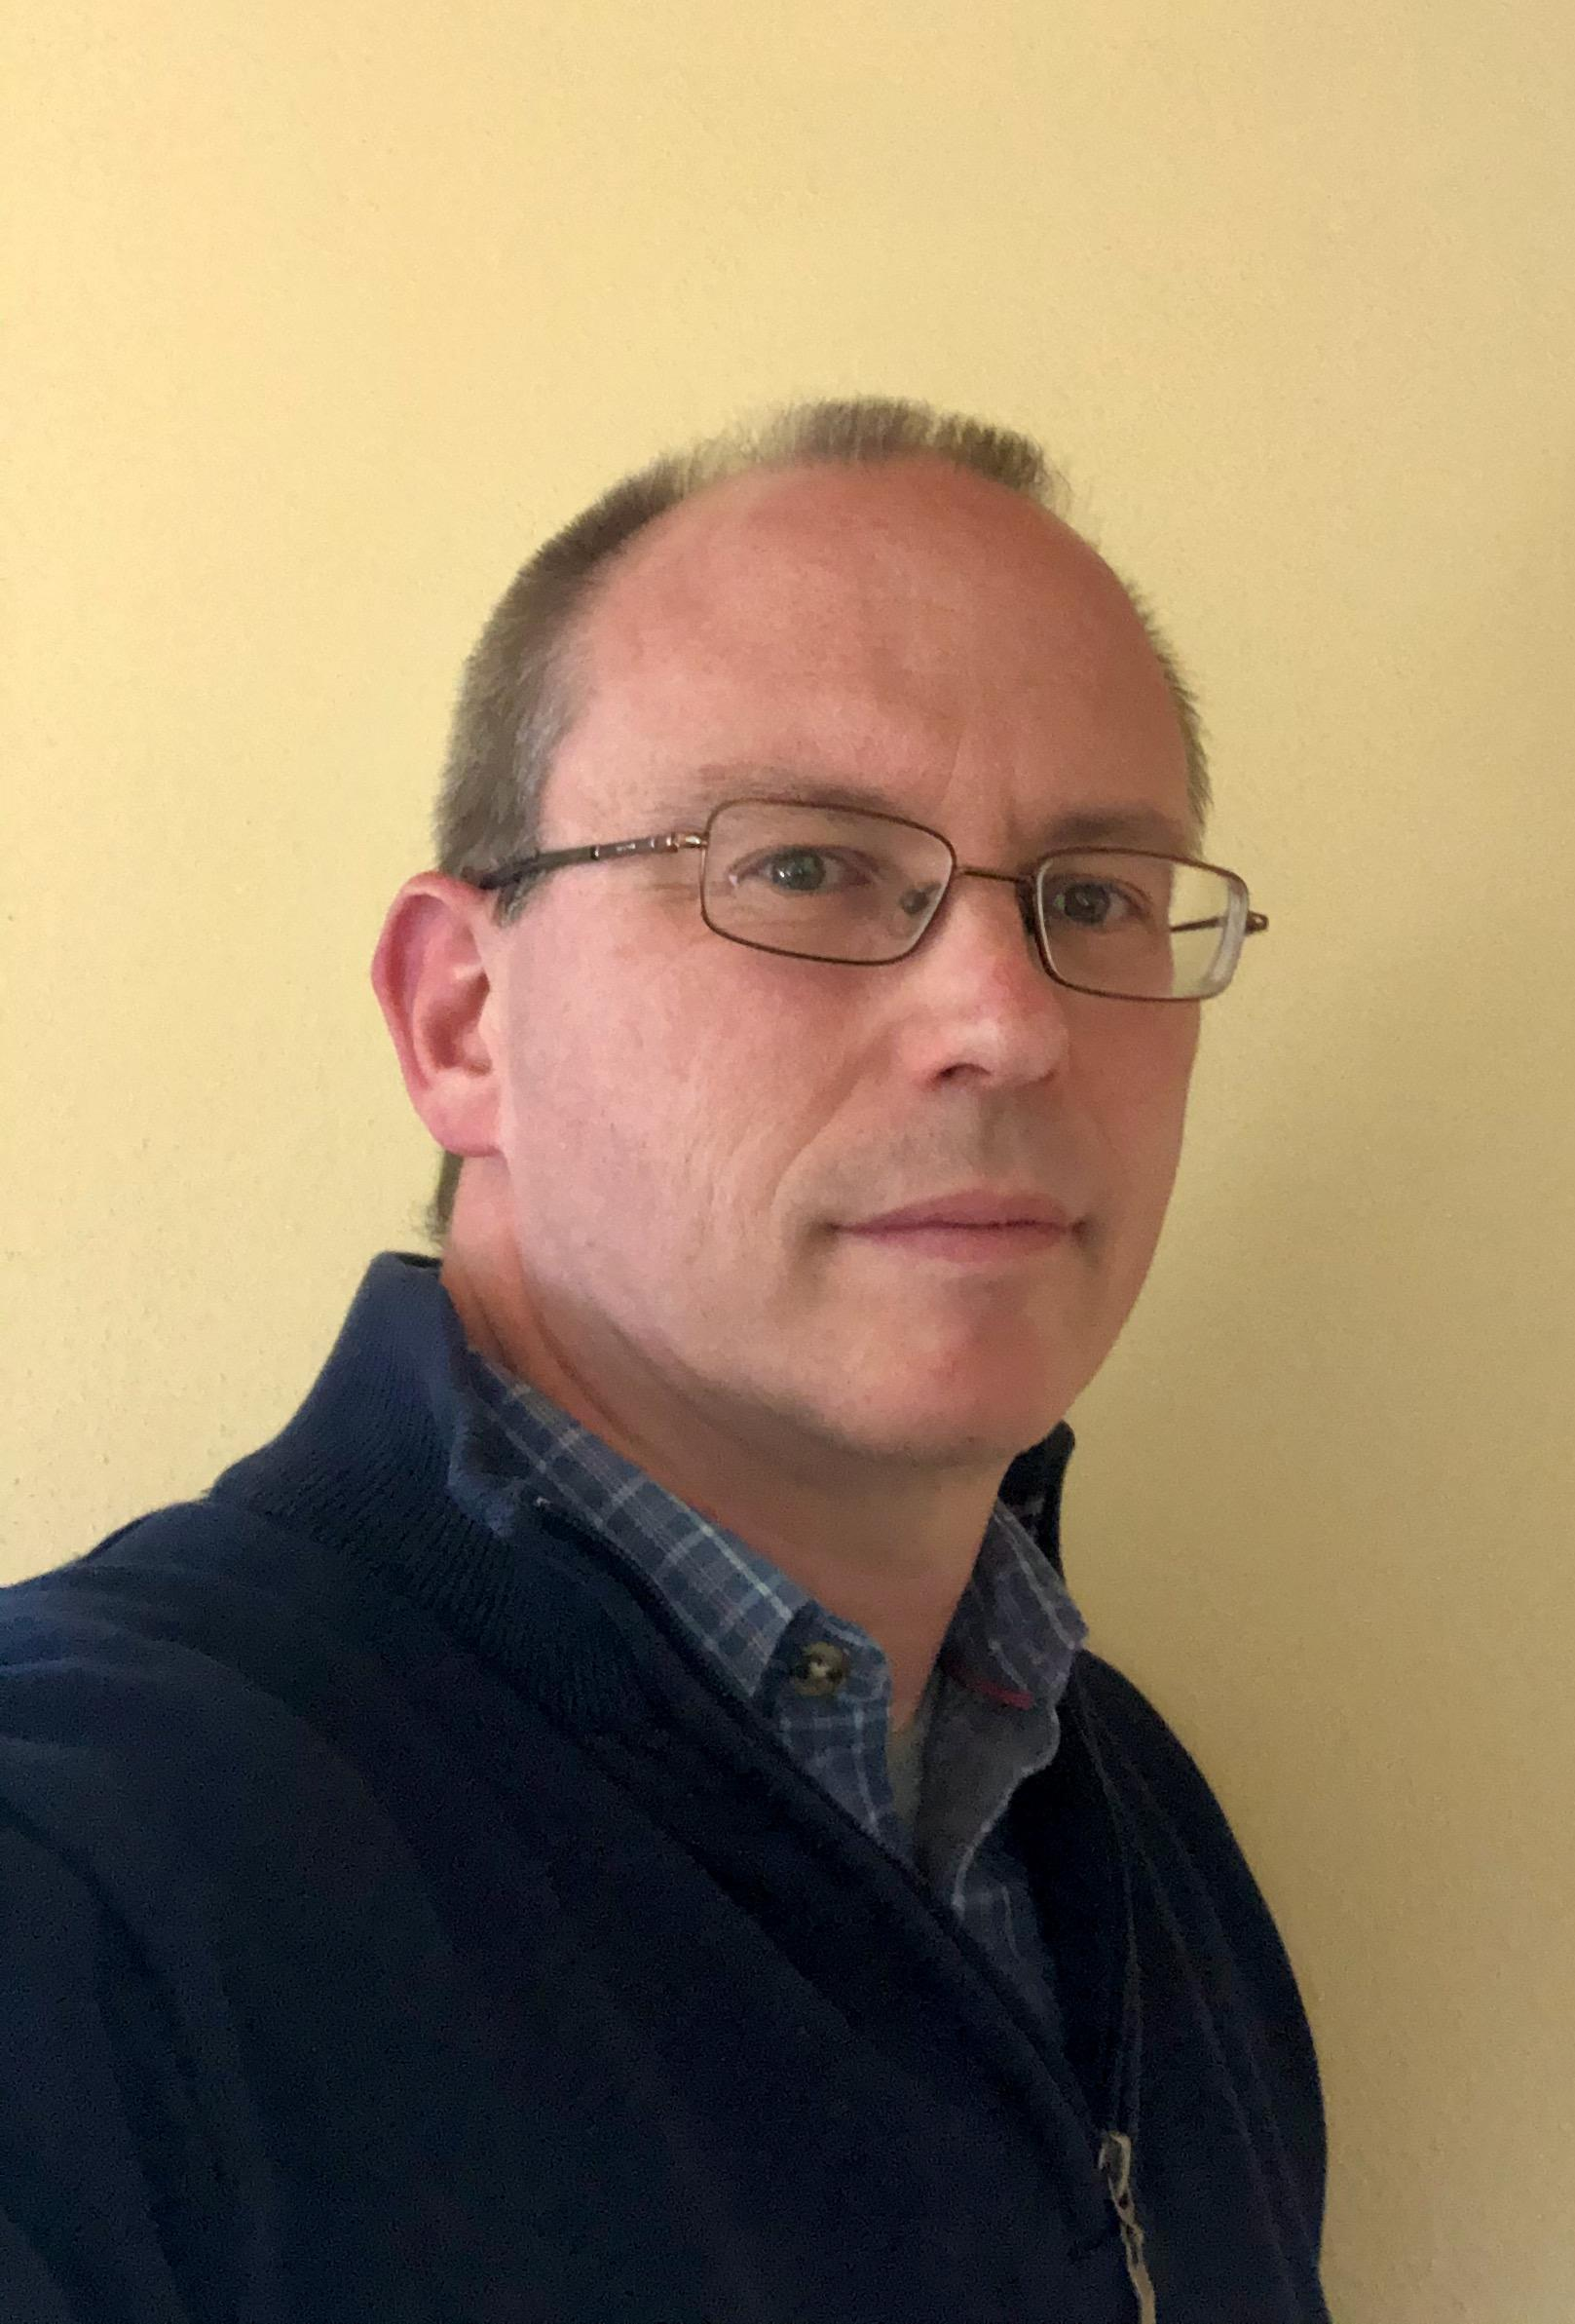
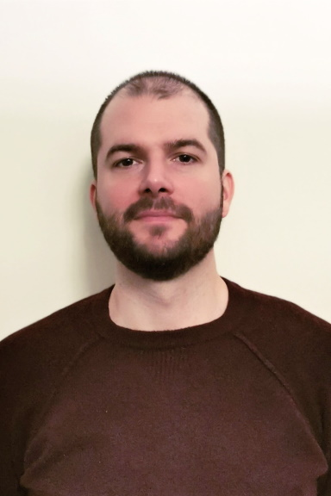
CEO Team
Lef Mamais – CEOS Exec Officer
Julia Caufape
CEO at Evenflow, 15+ years in the sector
Overall leadership of executive office
Liaison with CEOS Chair, CEOS SIT Chair, GEO
2 years as Deputy CEOS Executive Officer
Analyst at Evenflow – heavily involved in EuroGEO
Exec Office Support
Work plan and deliverables monitoring
Phil Harwood – Deputy
Branimir Radun
Senior Consultant at Evenflow + 20 years in the sector
“Deputy”
Support with VCs and WGs
Senior Consultant at Evenflow + 10 years in the sector
Support with VCs and WGs
All members are part of the Strategy Consulting Practice of Evenflow led by Lef and have been working together on complex projects and prominent clients for several years now
If needed, Evenflow can tap further inside its team (20+ FTEs) to bring in additional support or skills (e.g. around communications)

Slide 3
CEO Role
Work Plan Coordination
  Continuous engagement with CEOS community to get inputs
  Development of the Work Plan document
  Maintenance of Deliverable Tracker
Liaison with CEOS WGs, VCs, task teams
  Routine interactions with all parts of CEOS to identify areas with cross-fertilisation or synergy potential
Representation and external liaison
  GEO: PB (principal) and ExCom (alternate) representation
  Provide guidance to external stakeholders and help them prepare their application to CEOS
  Coordinate response to external requests (e.g. from UN bodies)
Maintenance
  Event tracker, mailing lists, CEOS contacts, CEOS governance documents
Ad hoc requests
  Specific actions agreed at SEC or during key events | SDG Coordination Group facilitation

Slide 4


Oct – Nov
Plenary 2025
Nov – Jan
Feb
Mar
SIT 2026
Clean-up & preparation
Timeline presentation
Input collection & iteration
Drafting
Finalisation & review
Endorsement
Review deliverable tracker vs last work plan (content, contacts, missing items)
Assess gaps, issues, and next steps
07/01
Official request sent for updates (deadline: 06/02)
Develop first full draft
02/03
Send Work Plan to CEOS Principals (deadline: 25/03)
01/04
Send final version to everyone
Confirm contact points for input collection
Cross-reference, consolidate all inputs
Official endorsement at SIT
Confirmation of receipt & commitment to deadline
Confirmation of receipt & commitment to deadline
Liaise with WG/VC/group chairs to validate data
10/02
Send first full draft to CEOS Members
(deadline: 24/02)
Going forward…
Maintain continuous interaction with groups to keep the deliverables tracker up to date.
15/01
Reminder#1
09/03
Reminder#1
Cross-check minutes or meeting outputs where needed
10/02
SIT Chair to do a parallel holistic overview
(deadline: 24/02)
21/01
Reminder#2
16/03
Reminder#2
28/01
Reminder#3
30/03
Incorporate feedback, make final edits, prepare final version
05/02
Compile received inputs

Slide 5
CEOS Work Plan - overview
Harmonisation within the current WP update cycle
  Sections 3.1, 3.2 and 3.3 shall be merged into the new 3.1 “Observations for Climate Research and Services”
  Incorporation into 3.1 of other relevant entries to avoid repetitions (e.g. reference to Statement for UNFCCC/SBSTA)
Incorporation of relevant inputs from GST recommendations
Update of deliverables
Big thanks for providing input last week!

Slide 6
CEOS WP - Deliverables
Number | Title | Completion Date
CMRS-25-01 | Expanding the utility of the CDR Inventory | 2026 Q2
CMRS-24-01 | Update and align WGClimate website instances (CEOS, CGMS, climatemonitoring.info) | 2026 Q2
CMRS-25-03 | Support for GCOS ECV rationalisation process | 2026 Q2
CMRS-24-04 | Conduct consultation to converge on definition for Climate Data Records (CDRs) and its variants | 2026 Q4
CMRS-26-01 | Update the Space Agency Response to the 2022 GCOS Implementation Plan | 2026 Q2
CMRS-26-02 | Regional satellite data experts for national inventory compilers | 2026 Q4
CMRS-26-03 | Mapping EO products to Adaptation Indicators | 2026 Q4
CMRS-26-04 | Guidance for EO data for resilience and adaptation efforts | 2027 Q4

Slide 7
CEOS WP - Deliverables
Number | Title | Completion Date
 | Stimulate uptake of the controlled release database | Q3 2026
 | Promotion and Development of the GHG Calibration Portal | Q4 2026
 | Best Practices for Facility Scale Methane measurements | Q4 2026
 | IMEO Use Cases | Q4 2026
 | Data supply for IMEO | Q4 2026
 | Adoption of methane common practices by IMEO MARS | Q4 2026
 | GHG Cal/Val Supersites | Q4 2026
 | Common Practices for Area Flux Methane measurements | Q2 2027
 | Space-based data requirements for G3W | Q2 2027
 | National Greenhouse Gas Inventory Compiler regional workshop - Asia | Q2 2027
 | Monthly top-down flux budgets | Q4 2027
 | Evaluation and validation strategies for GHG concentrations | Q4 2027

Slide 8
CEOS WP - Deliverables
Number | Title | Completion Date
 | Tip-and-cue system for methane observations | Q4 2027
 | Best Practices for Area Flux Methane measurements | Q2 2028
 | High resolution GHG inversions | Q4 2028
 | Multi-scale GHG integration methods | Q4 2028
 | Common Practices for Facility Scale Carbon Dioxide measurements | Q4 2028

Slide 9
CEOS WP - Deliverables
Number | Title | Completion Date
CARB-20-05 | Support and encourage space data uptake in GFOI countries | Q4 2027
CARB-19-03 | CEOS Contribution to the Early Warning Module for GFOI | Q2 2028
 | Alignment of space-based biomass products with user needs in a consistent manner from CEOS agencies | Q4 2028
 | Biomass satellite capabilities guide and promotion of space-based forest biomass measurements for GFOI countries | Q4 2027
 | CEOS AFOLU Portal | Q4 2026
 | Refinement of the CEOS AFOLU Roadmap actions | Q4 2026
 | Exploratory groundwork for a CEOS-ARD specification for Lidar | Q4 2027
 | GST2 prototype products and guidance | Q4 2027
 | CEOS contribution to GEO-TREES | Q4 2028

Slide 10
CEOS Work Plan – open questions
Harmonisation
  3 in 1 – CEO can help with “connectivity” between subsections
  Deliverable naming convention
GST recommendations incorporation – expected to be finalized after this meeting (any inputs from VCs expected?)
Ensuring final updates of deliverables (dates, potential new deliverables after this meeting)
Next important deadline: 24/02

Slide 11
Thank you!
Feel free to reach out to:
lefteris@evenflow.eu and ceos_exec_support@evenflowconsulting.com

