Slide 1
From ERA5 to ERA6
Hans Hersbach,
Bill Bell, Mikael Kaandorp, Paul Poli, Dinand Schepers, Cornel Soci, Adrian Simmons, Liam Steele, Paul Berrisford, Alison Cobb, Cornelia Strube, Raluca Radu, Philip Browne, Patrick Laloyaux, Marco Matricardi, Christoph Herbert, Tim Stockdale, Kristian Mogensen, Hao Zuo, Eric Boissesson, Adrien Oyono Owono, Roberto Ribas, Carlo Buontempo, Tony McNally, Martin Suttie, Patricia de Rosnay, Thomas Wilhelmsson, Mirco Valentini, Patrick Gillies, Iain Miller, Paul Dando, Mark Rodwell, Sarah Keeley, Stephanie Johnson, Andrew Dawson,
... and many others…

Slide 2
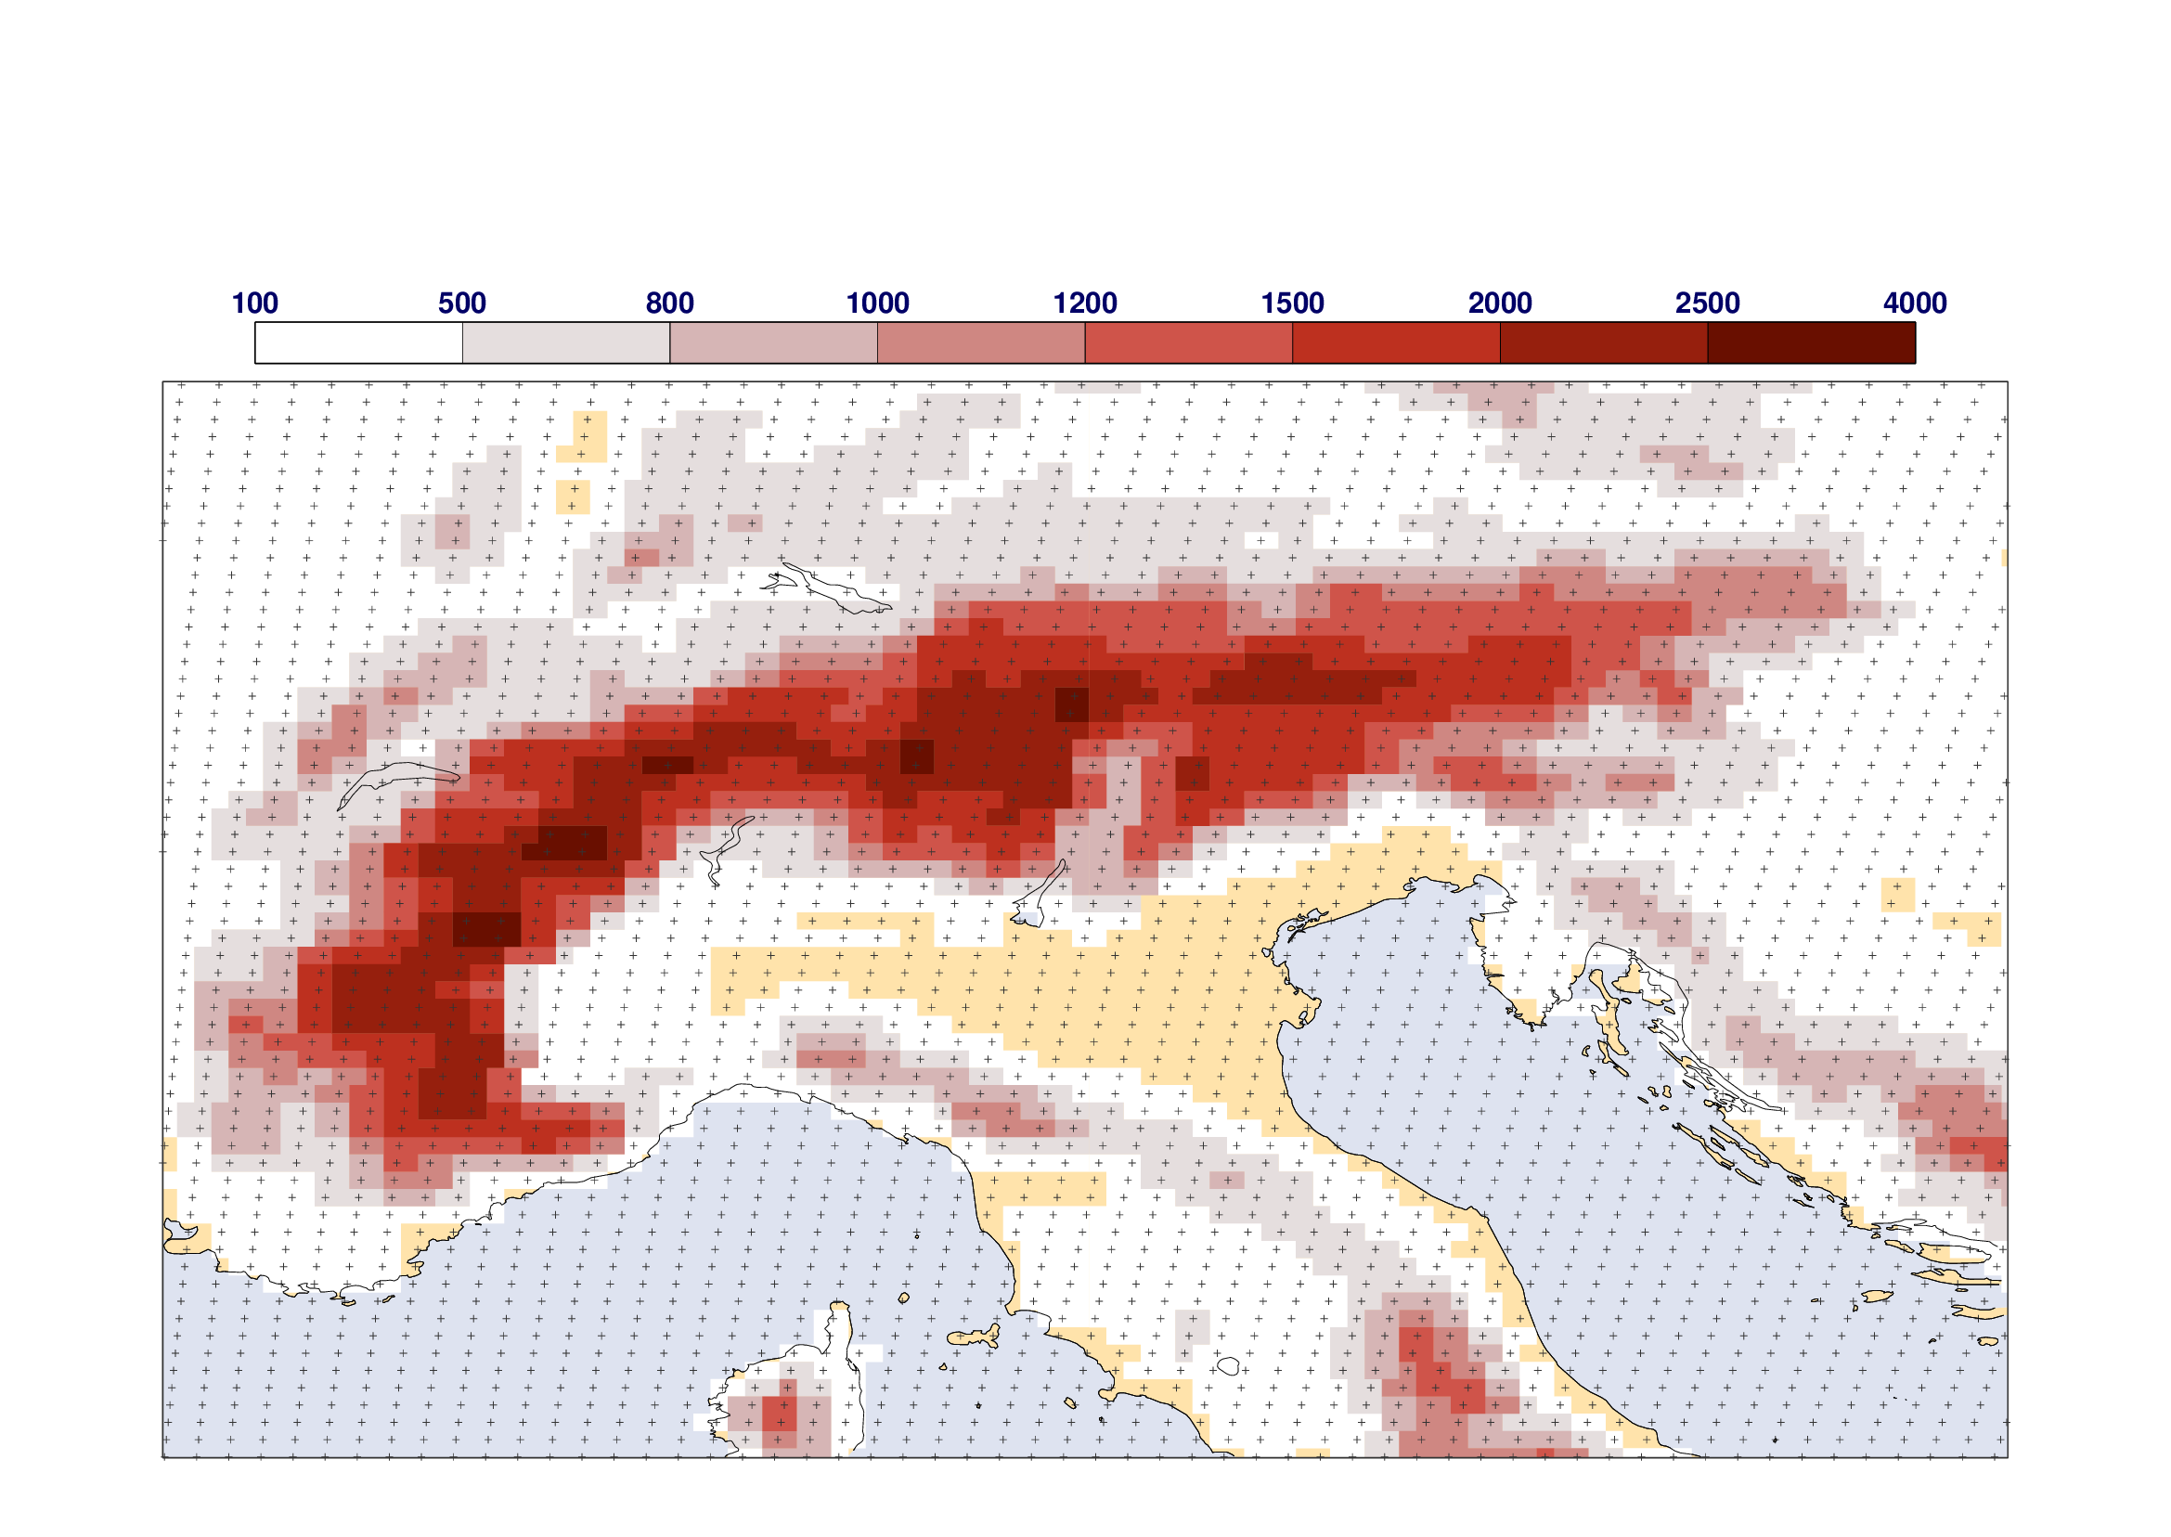
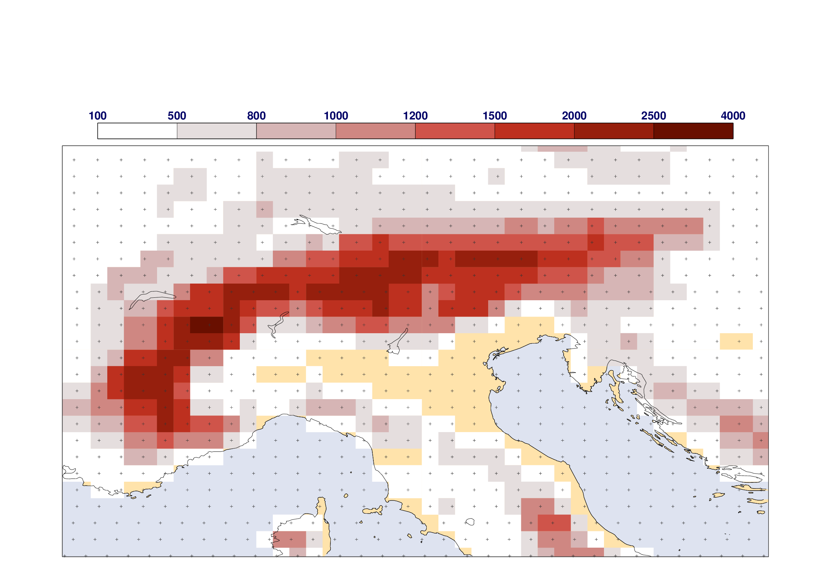
Overview
Status and user base of ERA5
Where ERA5 sits in the C3S climate dataset portfolio
Towards ERA6 ⬅ user requirements
What ERA6 gets from 8 years additional R&D
The benefit from more and better observations
Some results for ERA6 prototypes
Status ERA6, summary/outlook
ERA6 14km (TCo799)
Horizontal grid
ERA5 31km (Tl 639)

Slide 3
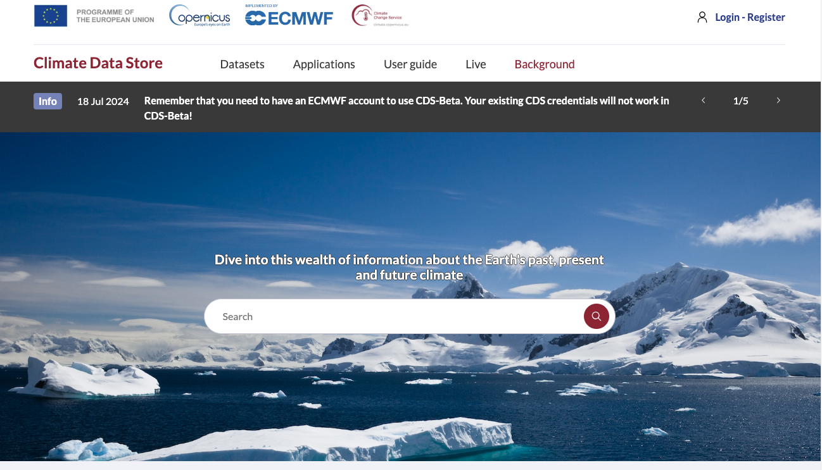
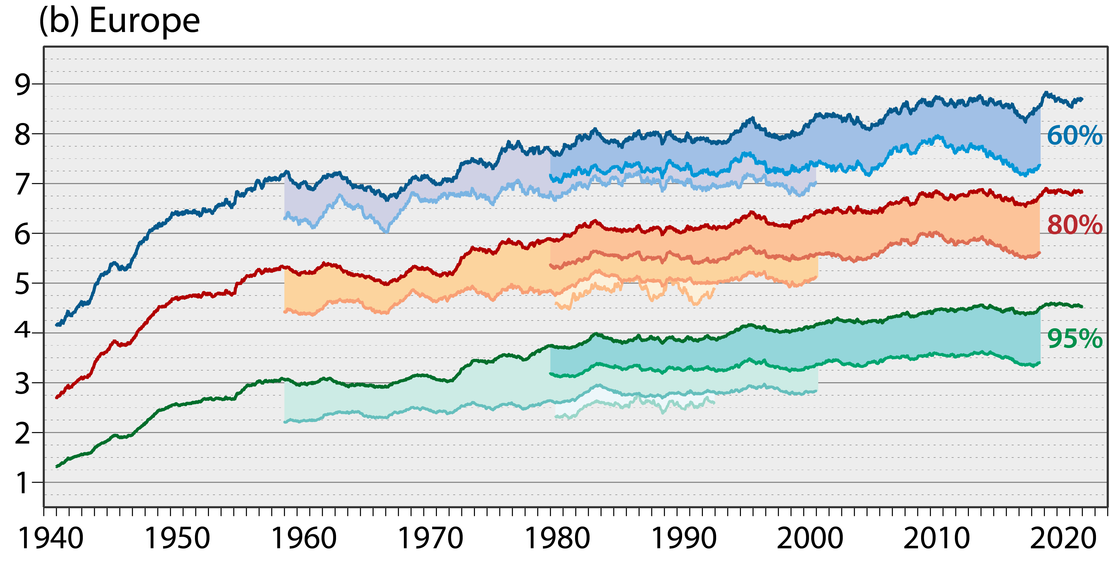
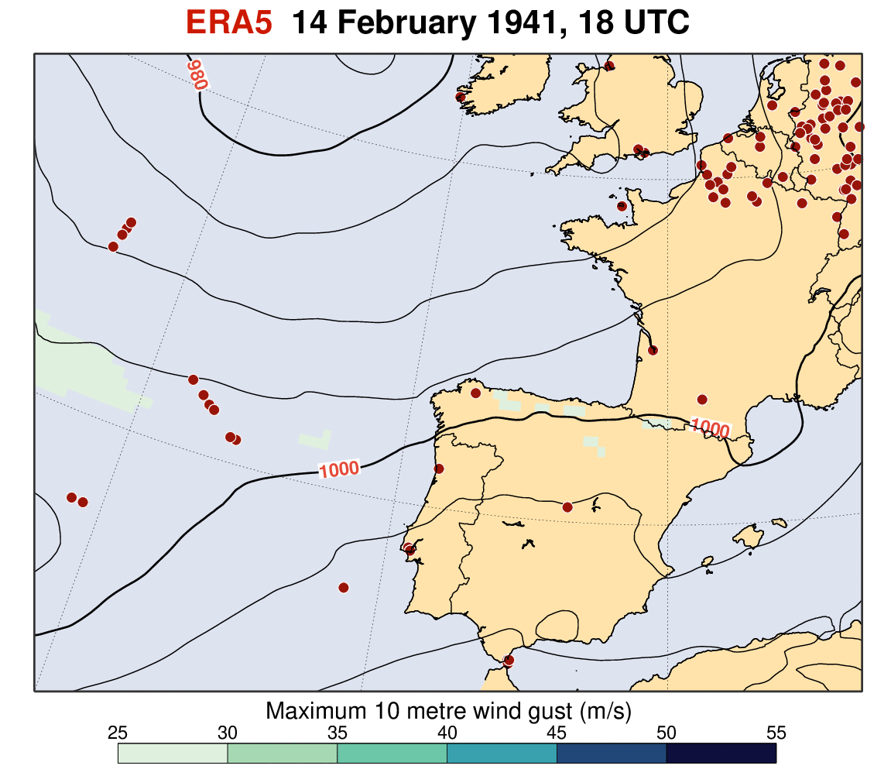
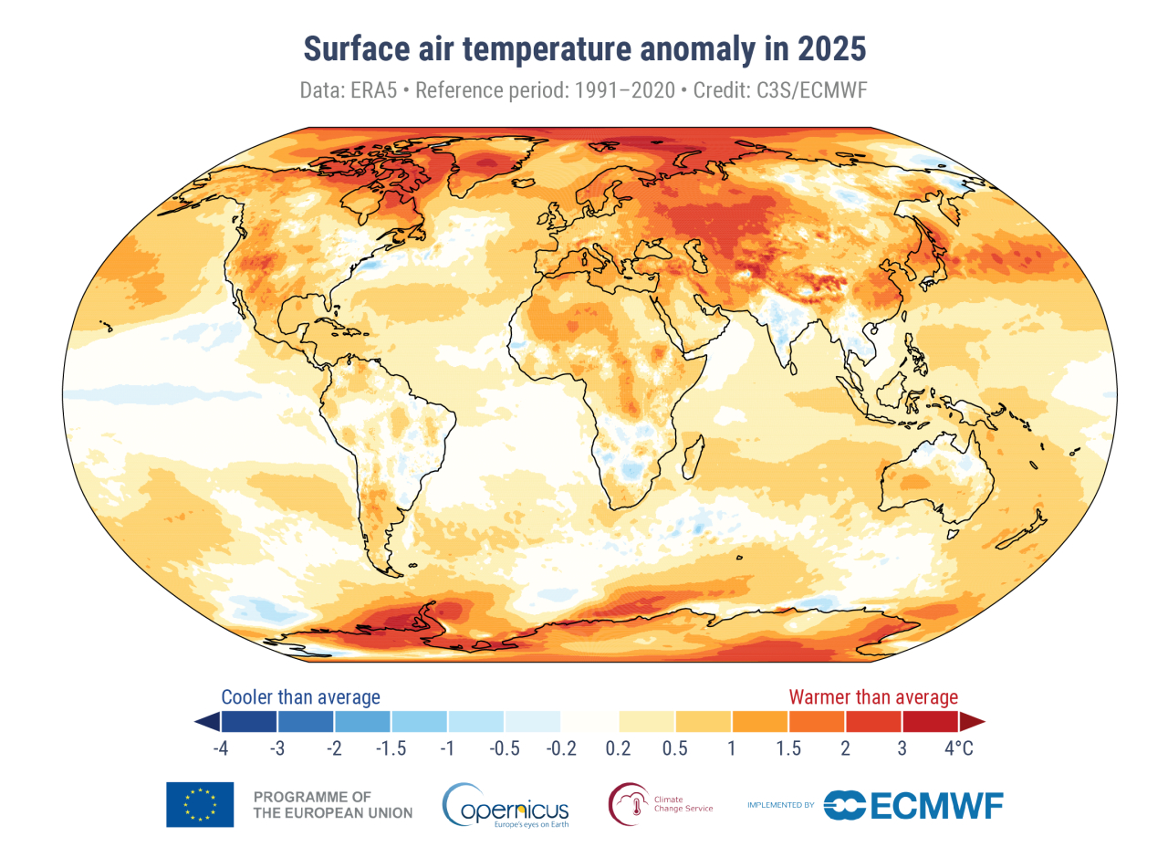

ERA5: Global reanalysis, 31km, hourly from 1940 to 5 days behind time, operationally
ERA5 was built on the shoulders of other ECMWF reanalyses
ERA5 has over 200,000 users providing petabytes of climate data
> 25,000 citations, estimated economic value ~ 1 billion euros
Soci et al., QJRMS 2024
.. to historical extreme cases ..
Skill of 10-day forecasts initialized from ERA against ERA at verification time
.. and leading training set for data-driven
weather forecasting and much more ...
From accurate timely climate monitoring, ..

Slide 4
Overview
Status and user base of ERA5
Where ERA5 sits in the C3S climate dataset portfolio
Towards ERA6 ⬅ user requirements
What ERA6 gets from 8 years additional R&D
The benefit from more and better observations
Some results for ERA6 prototypes
Status ERA6, conclusions
ERA6 14km (TCo799)
Horizontal grid
ERA5 31km (Tl 639)

Slide 5
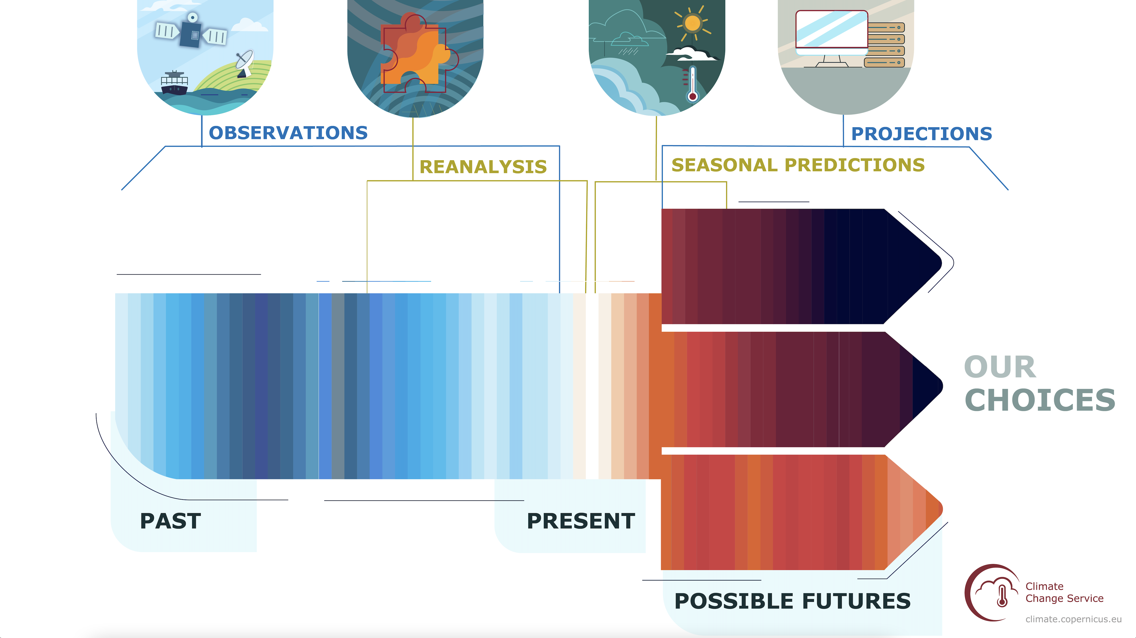
C3S and the Climate Data Store: CDS
ECMWF operates the Copernicus Climate Change Service (C3S) and Copernicus
Atmosphere Monitoring Service (CAMS) on behalf of the European Commission.
The CDS is a ‘one-stop-shop’ for quality-assured climate data; over 300,000 registered users

Slide 6
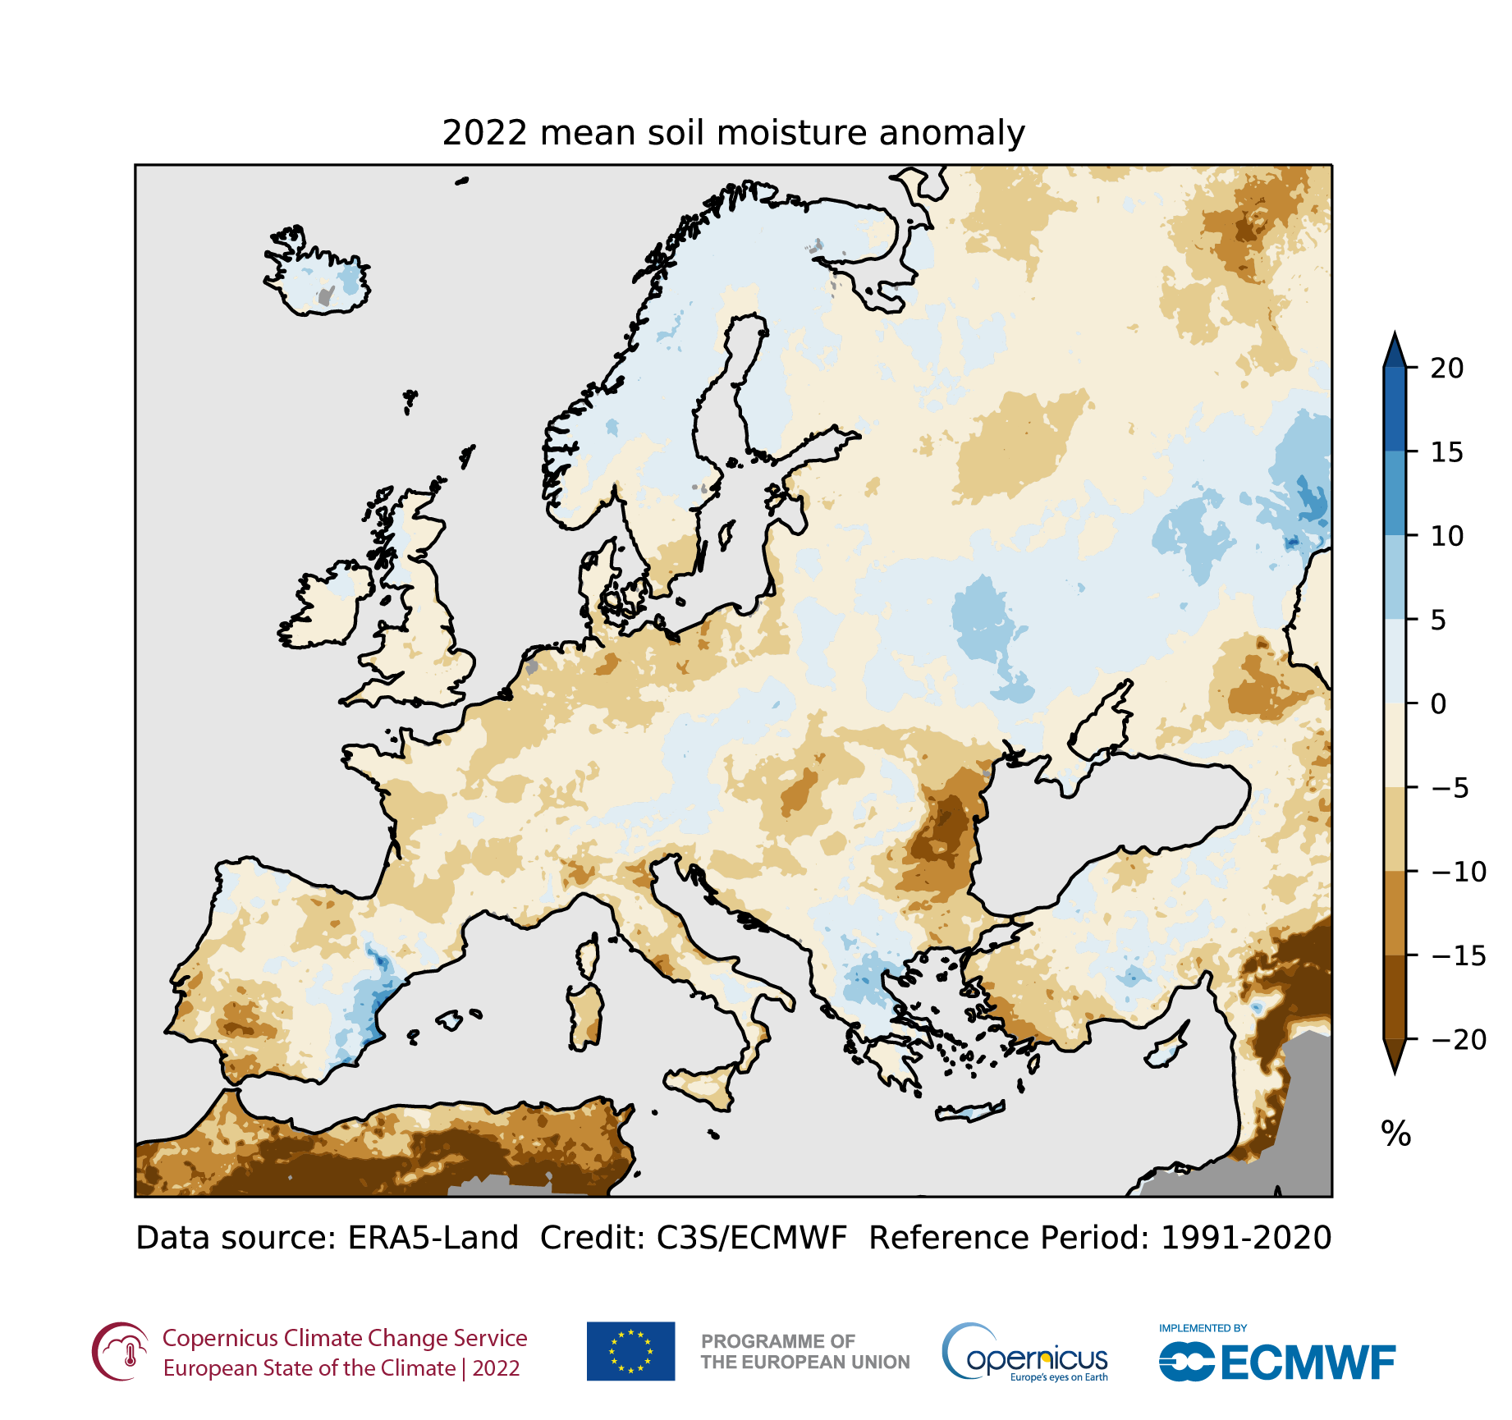
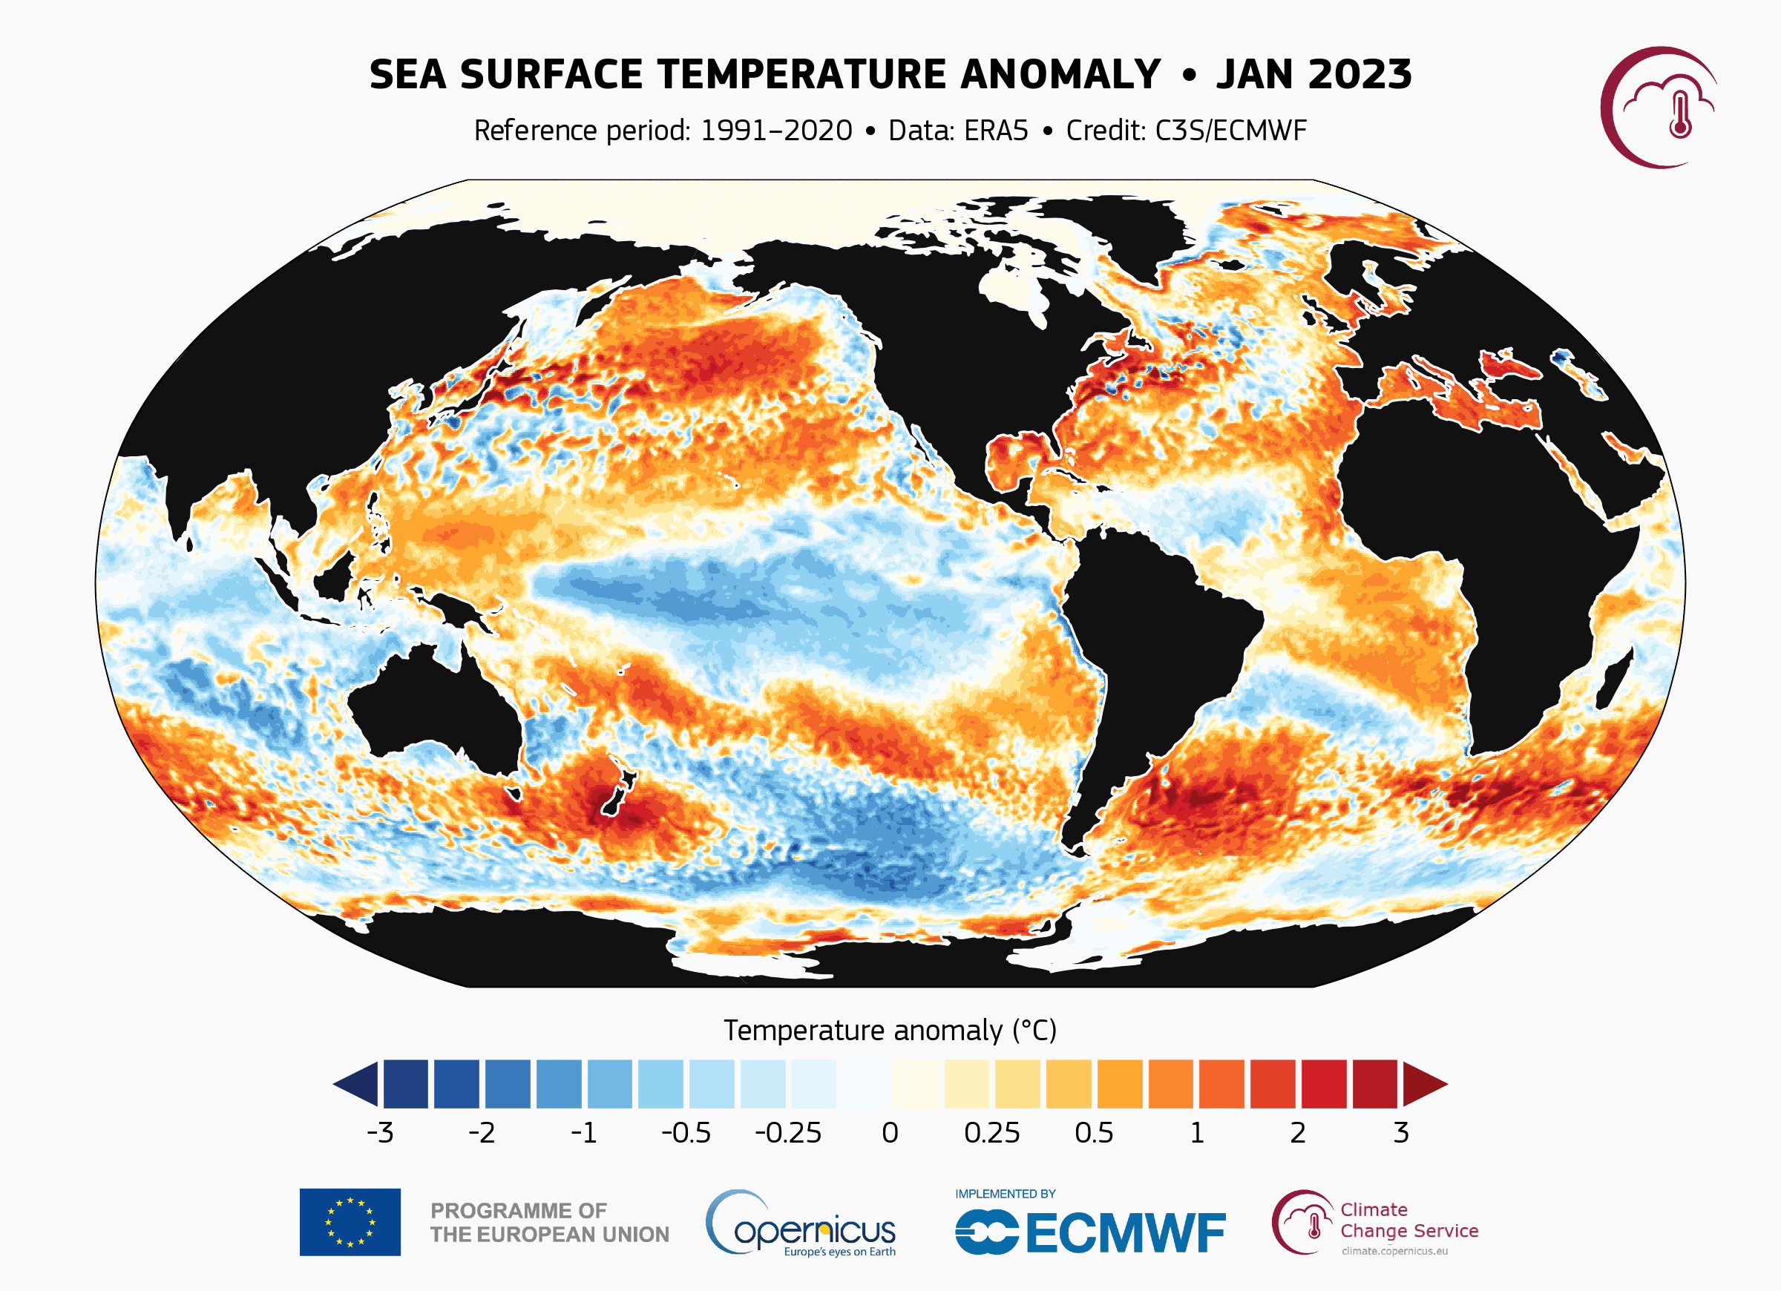
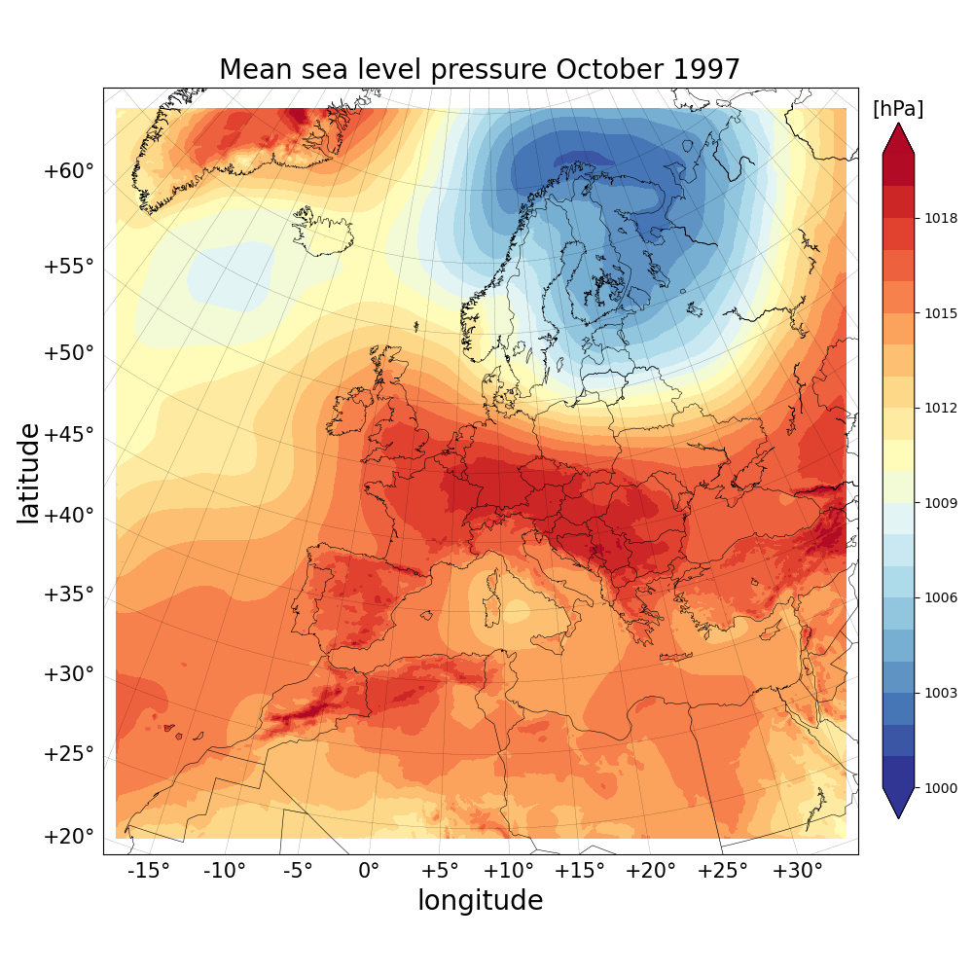
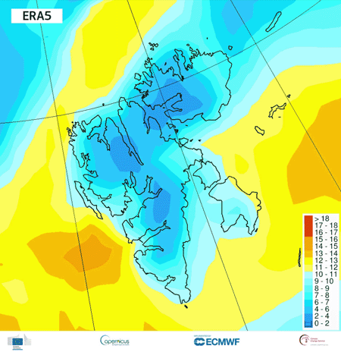
Overview of C3S reanalysis products
ERA5
ERA5-Land
Many derived datasets
AgERA5
ERA5-HEAT
WFDE5
…
CARRA
CARRA2
CERRA

Slide 7
Overview
Status and user base of ERA5
Where ERA5 sits in the C3S climate dataset portfolio
Towards ERA6 ⬅ user requirements
What ERA6 gets from 8 years additional R&D
The benefit from more and better observations
Some results for ERA6 prototypes
Status ERA6, summary/status
ERA6 14km (TCo799)
Horizontal grid
ERA5 31km (Tl 639)

Slide 8
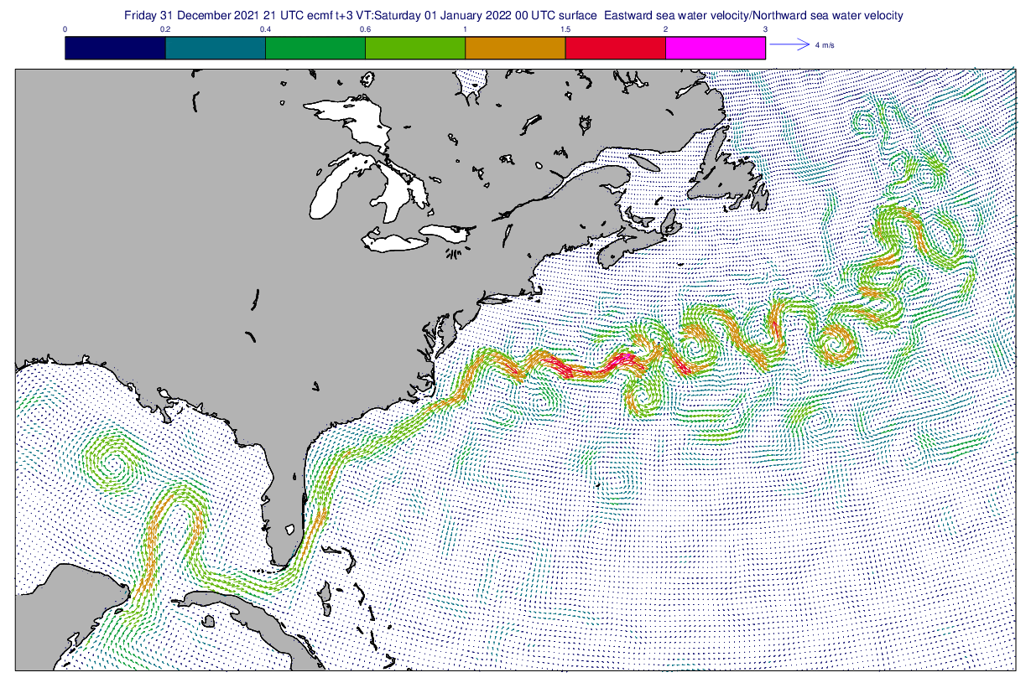
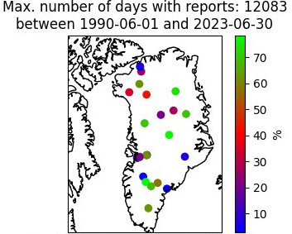
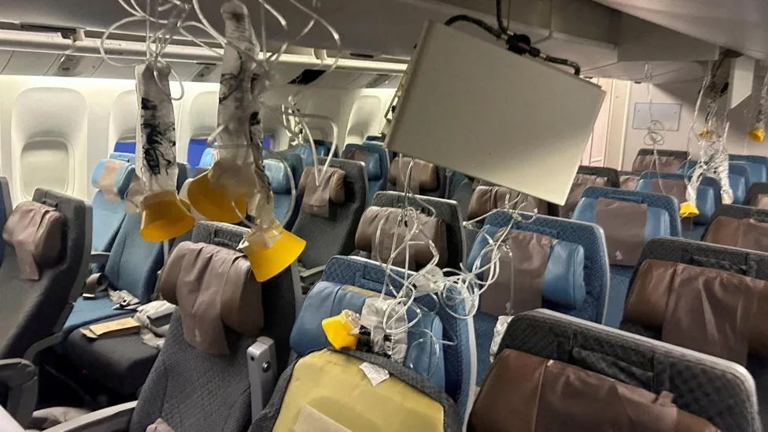
ERA6 will benefit from an additional 8 years of R&D at ECMWF & improved compute capacity
Configuration: 75 years of reanalysis, to be maintained close to real time once completed, based on IFS Cy49r2
Higher horizontal resolution of 14km (TCo799) for all components (ERA5 31km for atmosphere, 40km for waves)
Uncertainty estimate at 28km (TCo399) from 11-member ensemble (63km for ERA5)
Science :
8 years of additional R&D at ECMWF
Ocean model (NEMO4) fully coupled in DA trajectories
Handle stratospheric biases, better forcing for large lakes, better initialization soil moisture
Resolve several other ERA5 known issues
Geological Survey of Denmark
Ingest the best observations:
Satellite+ in-situ reprocessing and data rescue
Together with EUMETSAT, SPASCIA, Maynooth University + partners
Products: based on user requirements
3D+2D ocean parameters
Height levels for the lowest part of the atmosphere
Hourly, for extended list of (new) parameters, e.g., Rh2m, clear-air turbulence (CAT)
Daily in addition to monthly precalculated statistics
GRIB2
8
Source:Reuters, from www.bbc.co.uk

Slide 9
Overview
Status and user base of ERA5
Where ERA5 sits in the C3S climate dataset portfolio
Towards ERA6 ⬅ user requirements
What ERA6 gets from 8 years additional R&D
The benefit from more and better observations
Some results for ERA6 prototypes
Status ERA6, conclusions
ERA6 14km (TCo799)
Horizontal grid
ERA5 31km (Tl 639)

Slide 10
‘ What do we get from ERA6 ? ’
Integrated Forecasting System (IFS) upgrades since ERA5
45r1
Data assimilation
Weakly coupled sea-ice/atm assimilation
Improved RH increment calculation
WC model error forcing every timestep
Observations
Non-surface sensitive IR chs on over land
MW all-sky obs over coasts
RTTOV-11 → RTTOV-12
Constrained VarBC for AMSU-A/ATMS
Improved R for radiosondes
Account for drift in radiosondes
Improved bias correction for conv. obs
Jason-3 & Sentinel-3A altimeters
Model
Coupling of 3D ocean and atmosphere.
Improved warm-rain numerics
Improved CH₄ oxidation
Improved super-cooled water in convection
Improved TL/AD in convection
Improved soil conductivity & soil-ice dependency
49r1
Data assimilation
RTTOV 13.2
Improved T2m assimilation
VarQC & stratospheric balance
Land surface assimilation changes
Hourly altimeter wave assimilation
Soft recentering of EDA
Observations
Scene dependent R for CrIS
Reduced thinning for SEVIRI Geo rads
All-sky & all-surface in sea-ice areas
All-sky AMSU-A window channels
F-18 SSMIS 19, 22 & 91 GHz
Improved thinning & superobbing for MWH
MWS superob resolution 80km → 40km
Improved surface emissivity (SURFEM)
Optimisation of hyperspectral IR
GNSS-RO ceiling 50km → 60km
Improved anchoring from RO
Model
Wave model / land convection package
Land surface model updates
SPPT→ SPP
Improved physics and numerics
43R1
Data assimilation
SST perturbations in EDA update
TL399 EDA B variances tuned
WC-4DVar above 40hPa
Improved SYNOP Assimilation
ORAS5
Observations
Slant path RT for radiances
Tuned R for IASI & CrIS
Change in O₃ anchor channels
CrIS: 77→ 117 channels
Revised aerosol detection for IR
Model
CAMS O₃ climatology
Improved marine boundary layer
Improved surface coupling for T2m
Assim. snowfall from NEXRAD
46r1
Data assimilation
Continuous DA: 3→4 outer loops
Weakly coupled DA for SST in tropics
Improved spatial interpolation of model to obs
RTTOV12 → RTTOV12.1
Observations
SMOS NN soil moisture product
F-17 SSMIS 150 GHz, GMI 166GHz
land-sea mask in FOV for MWIs
Inter-channel R for ATMS & Geo WV chs
Slant path for Geo rads & and ↑ zenith ang.
Consistency of aerosol detection for IR
Model
Improved convection scheme
LW scattering in radiation scheme
2D → 3D aerosol climatology
Better scaling of dry-mas flux
Improvements to TL/AD of S-L departure point
Fix instability of T2m diagnostic
Wave model improvements
47r3
Data Assimilation
New RT coeffs for IR
Improved AMV height assignment
Representativeness in R for Aeolus
WC-4DVar on in EDA
Observations
All-sky AMSU-A
Model
B-L turbulence, shallow conv. & sub-grid cloud
Improved convection
Improved simplified moist phys. TL/AD
Improved cloud overlap
Cubic interpolation of cloud/precip in S-L
Improved interp. Of cloud/precip in Rad scheme
Improved visibility calculation in fog/rain/snow
Revised gustiness
Improved calculation of peak wave period
43r3
Data assimilation
Improved humidity B
Revised wavelet filtering of B
Observations
Saphir & GMI humidity sounding
118 GHz channels from MWHS-2
Harmonised MWS over land & si
Screen HCN affected IR channels
Improved QC of RO and sonde data
Model
Improved Rad scheme (LW RT)
New aerosol climatology
Improved super-cooled H₂O in conv
Improved visibility calculation
47r1
Data Assimilation
WC-4DVar: new estimate of Q
WC-4DVar above 100hPa
Revised B for T_{skin} for sink variable
Same tstep for final outer/inner loop
Observations
Inter-channel R for NOAA-20 ATMS
Improved aerosol detection for IR
Improved RO operator
Model
Surface albedo changes
CMIP6 TSI & GHG
Quintic interpol. for S-L advection
Improved drag coefficient for high winds
Improved convection scheme
Improved TL physics
48r1
Data assimilation
Increased inner loop resolution
OOPS
Observations
Reduced thinning for ASCAT L2
Optimisation of hyperspectral IR
RTTOV-12 → RTTOV-13
ATMS (snow, Lambertian, slant-path)
Improved surface sensitive All-Sky
More MWI over land
Model
Improved energy and water conservation
Multi-level snow scheme
49r2
Data assimilation & Observations
Outer-loop coupling updates
1D-OI → SEKF: soil and snow temp analysis
Orbital bias correction for AMSU-A and ATMS
VarBC for surface pressure
Time varying CO₂ for IR assimilation
Model
Time varying solar forcing
O₃(t) for HLO
Revised aerosol
Revised wave model bathymetry
Non-orographic GW drag changes
Reduced vertical diffusion in stable conditions
https://confluence.ecmwf.int/display/FCST/Changes+to+the+forecasting+system
+ analogous technical developments, incl. HPC upgrade

Slide 11
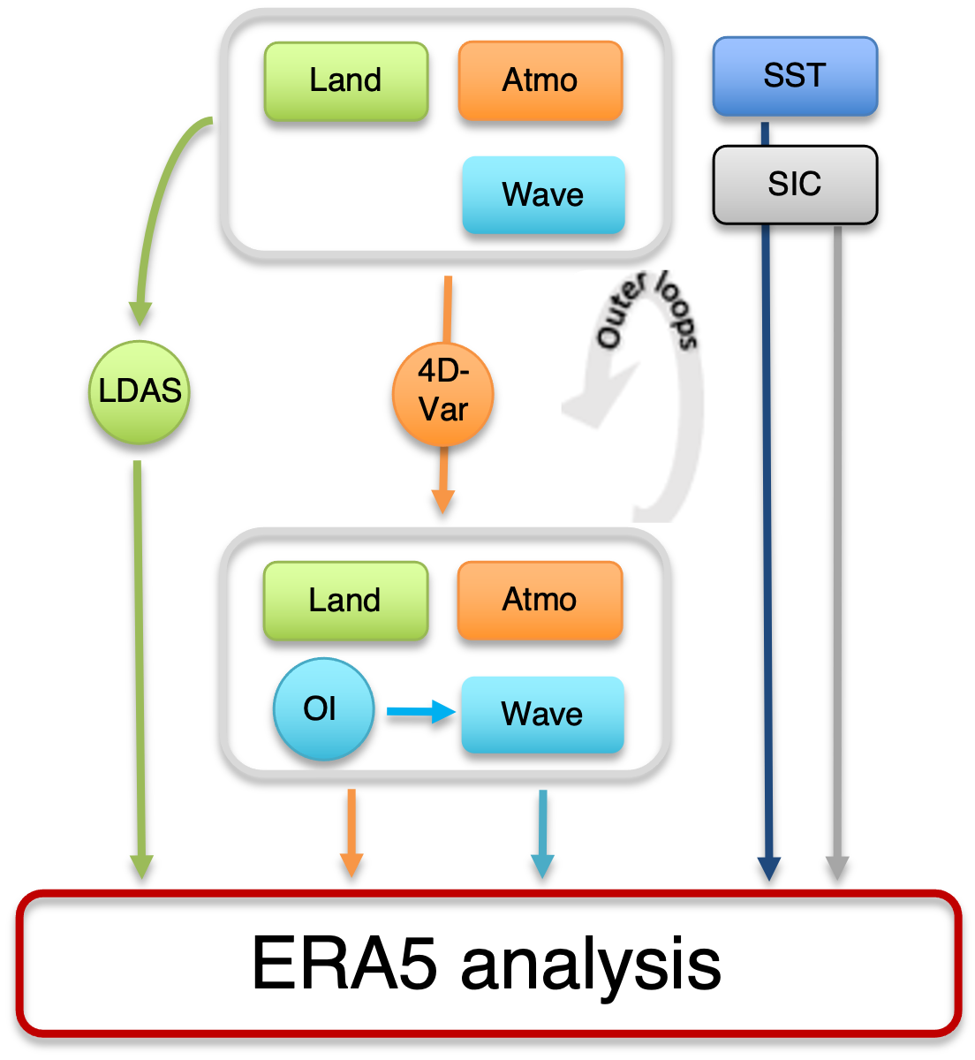
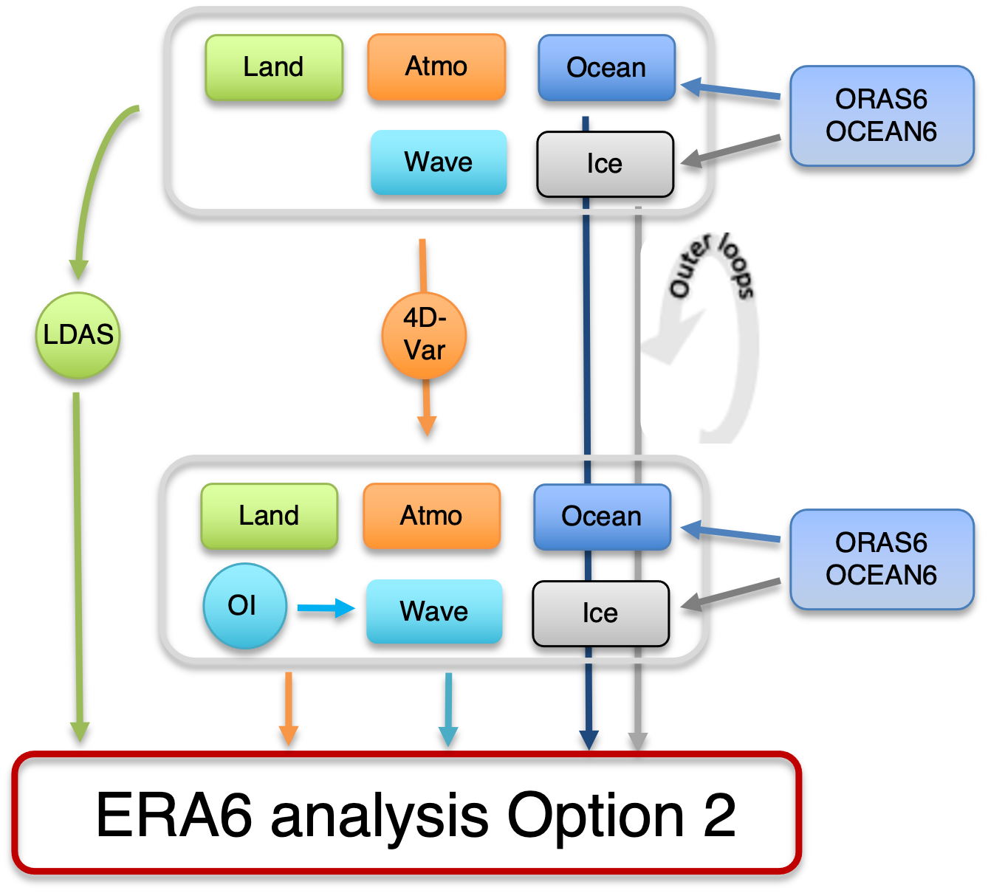
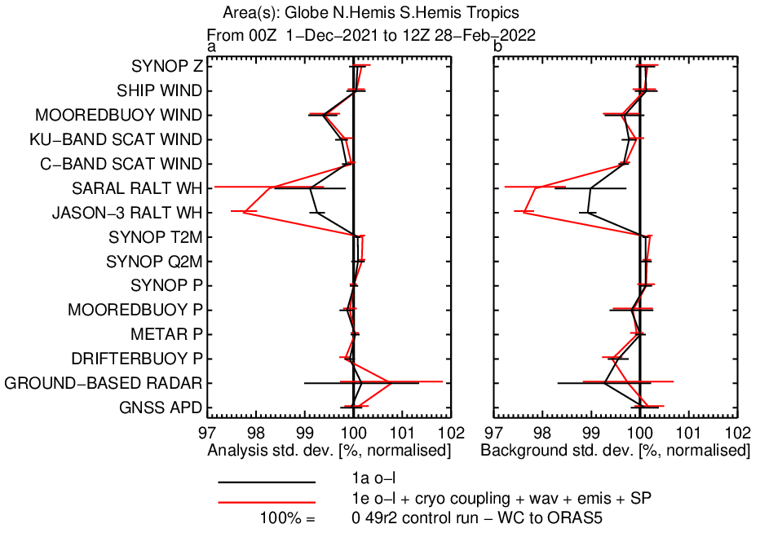
The ERA6 model is coupled with the ocean; but it gets the ocean initial state from ORAS6
Time in DA Window
Time in DA Window
New!
Positive impact where you expect it
near the surface, improved ocean wave forecasts (account for ocean currents)
better fit to near ocean surface observations (scatt wind and alt Hs)
SST/SIC evolving hourly rather than daily in ERA5, ocean currents

Slide 12
Overview
Status and user base of ERA5
Where ERA5 sits in the C3S climate dataset portfolio
Towards ERA6 ⬅ user requirements
What ERA6 gets from 8 years additional R&D
The benefit from more and better observations
Some results for ERA6 prototypes
Status ERA6, summary/outlook
ERA6 14km (TCo799)
Horizontal grid
ERA5 31km (Tl 639)

Slide 13
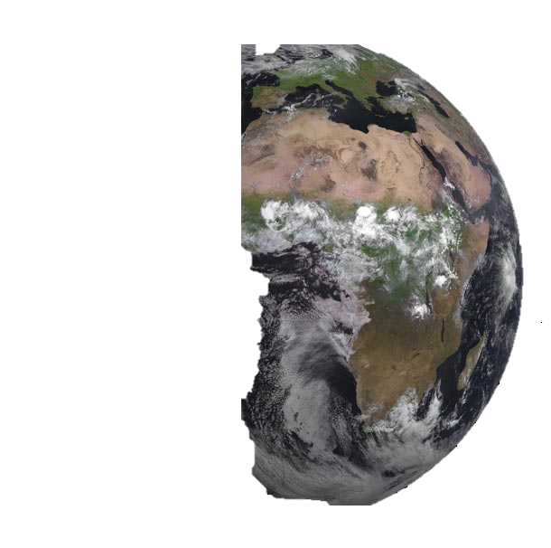
Satellite data rescue for ERA6
EARLY SATELLITE ERA
(pre-1979): NASA Nimbus, early NOAA, DMSP, Meteor
1979
MODERN ERA (1979 onwards)
Operational Satellites
(NOAA, EUMETSAT, DMSP, GMS, FY…)
THIR /N4-7
Infrared imagers
HRIR/N1-3
Preparations for ERA6 include:
Rescue and Assessment of radiance observation from pre-1979 sensors
Aim is to improve the ‘assimilation readiness’ of the data
MRIR /N2-3
AVHRR/POES (but data used via Sea-Surface temperature forcing maps)
PMR/N6
SSU/TIROS_N/NOAA 6-9,11,14
Infrared sounders
SCR/N4-5
HIRS/2-4
HIRS/1/N6
SIRS/N3-4
SI-1/M28-29
IRIS/N3-4
VTPR/NOAA2-5
IMG/ADEOS
SSH/DMSP F1-F4
SMMIS/DMSP F16-19
ITPR/N5
Microwave radiometers
NEMS/N5
MSU/TIROS-N-NOAA6-14
SSM/T-2/DMSP F11-15
Data not yet assimilated in ERA
SCAMS/N6
SSM/T-1/DMSP F4, F7-F15
SMMR/SEASAT-N7
SSM/I/DMSP F8-F15
Original or earlier-reprocessed data version assimilated in ERA5
Atmospheric motion (wind) vectors
MVIRI+SEVIRI
ATS
GMS
SMS-1,2
AVHRR/POES
1979
GOES 1-15
1960 1970 1980 1990 2000
(A. Klonecki & colleagues, Spascia)

Slide 14
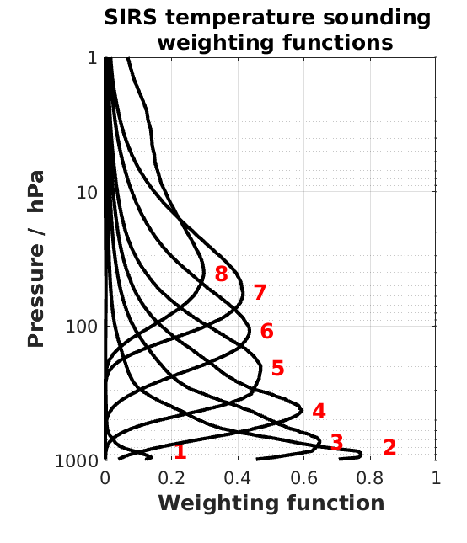
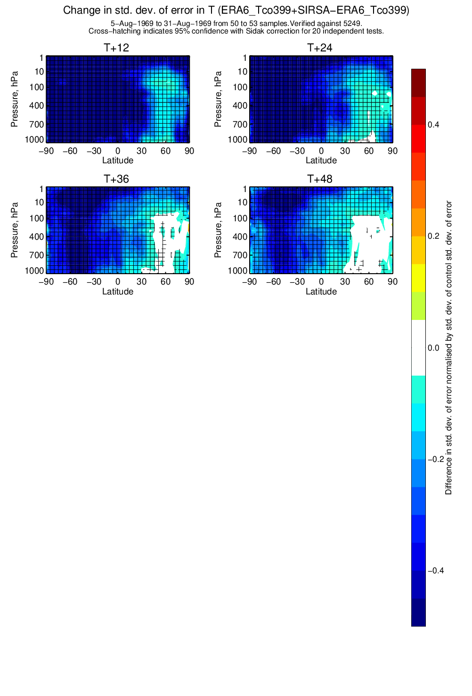

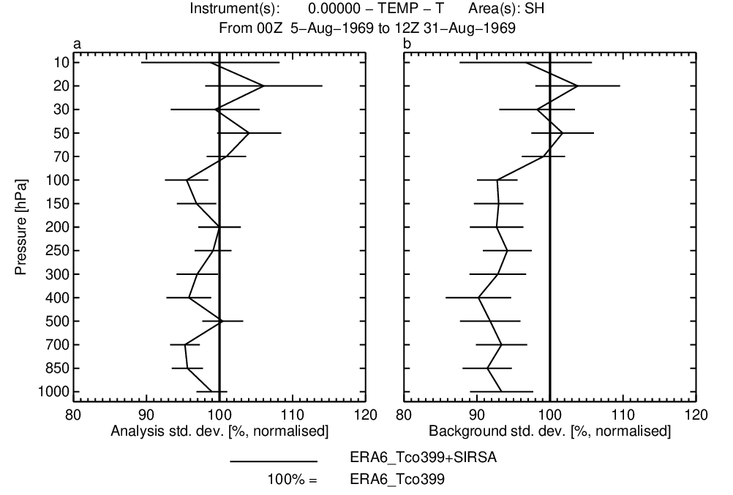
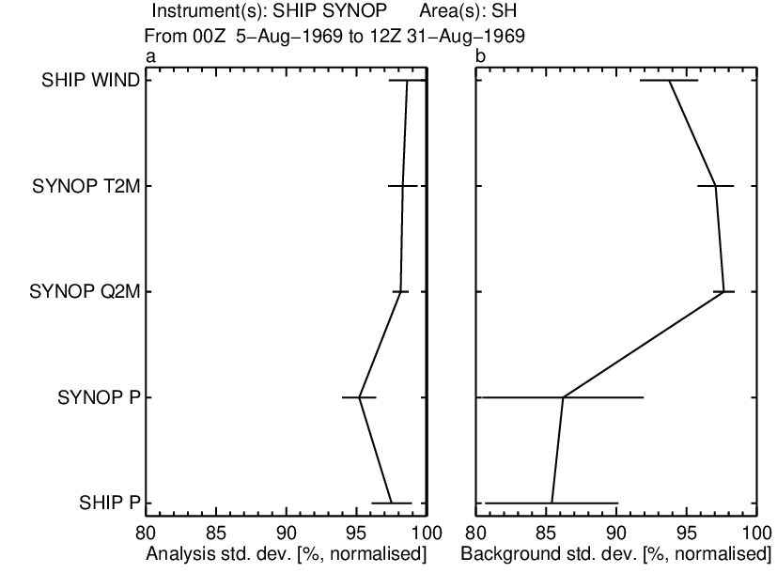
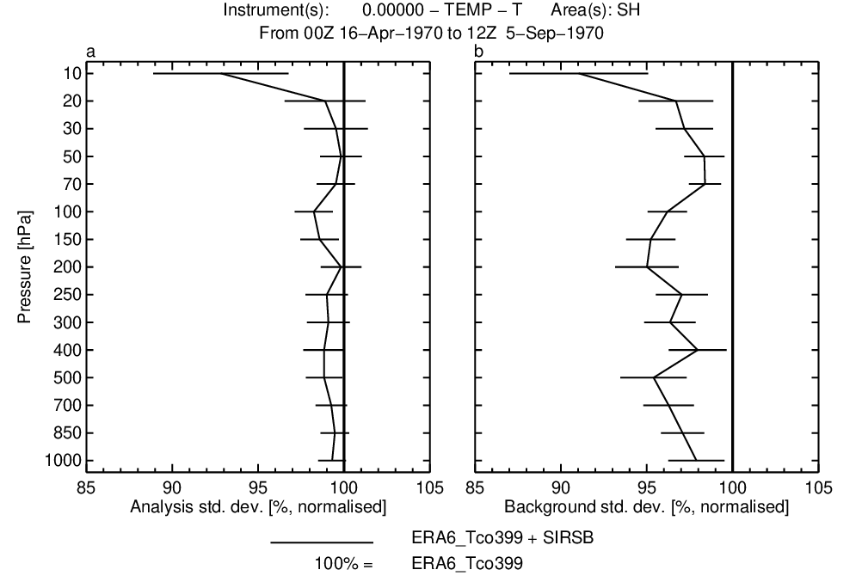
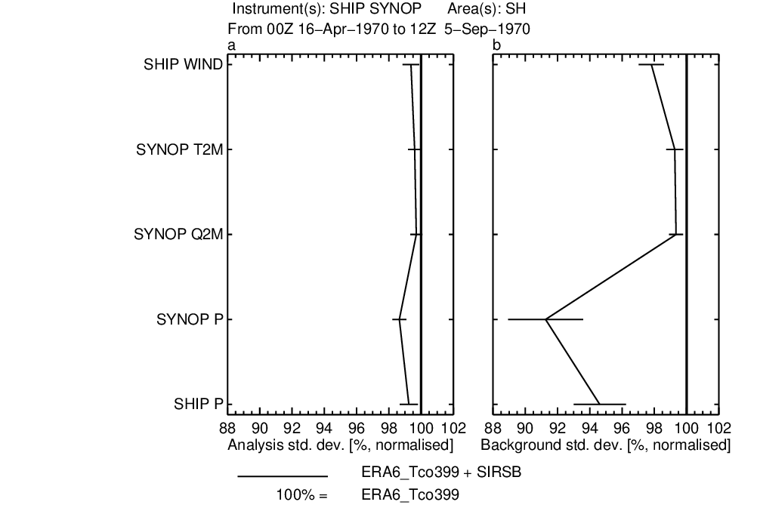
Pre-1979: The impact of assimilating data from the Satellite Infrared Spectrometer (SIRS) in 1969 & 1970 – preliminary experiments
Vertical coverage of
early satellite data
1969 - 1980
PMR/N6
mesosphere
SCR/N4-5
IRIS/N4
VTPR/NOAA2-5
stratosphere
SIRS/N3-4
NEMS/N5
SCAMS/N6
troposphere
ESMR/N5
1960 1965 1970 1975 1980 1985
Temp-T
SFC
VTPR assimilated in ERA5 (& ERA6)
SIRS extends the sounding record back to
April 1969
If SCR can be used
→ continuous sounding observations from 1969
Temp-T
SFC
~8%
~4%
~9%
~14%

Slide 15
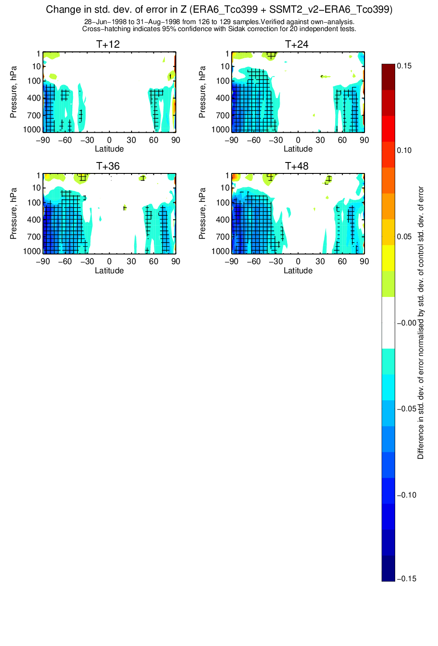
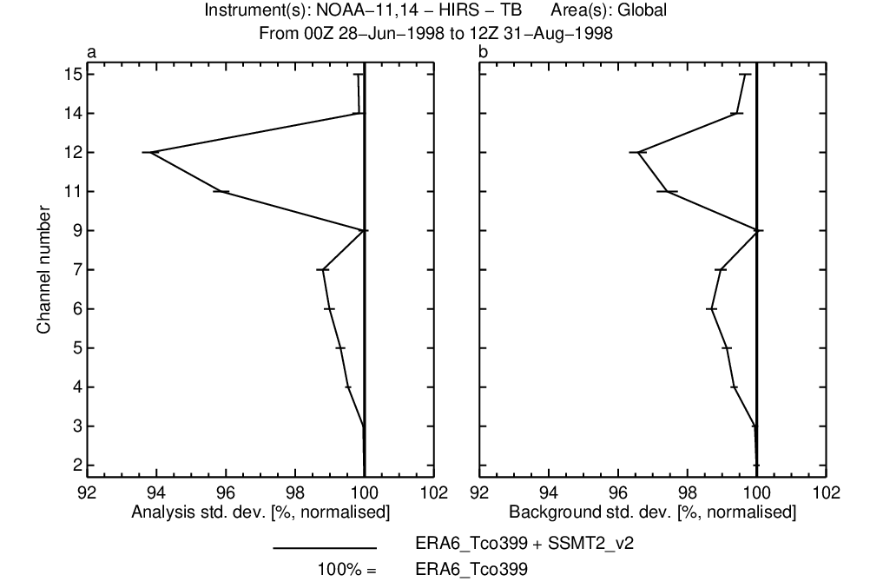
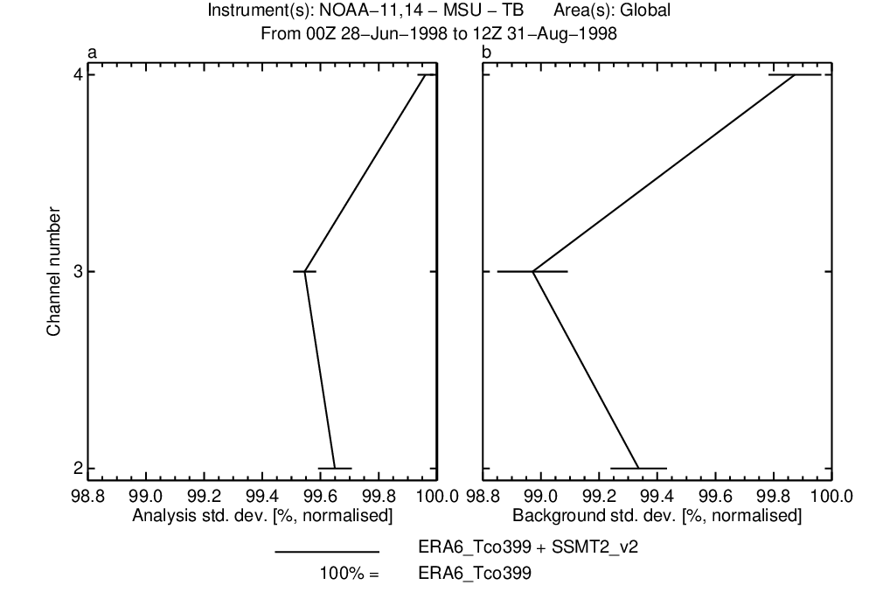
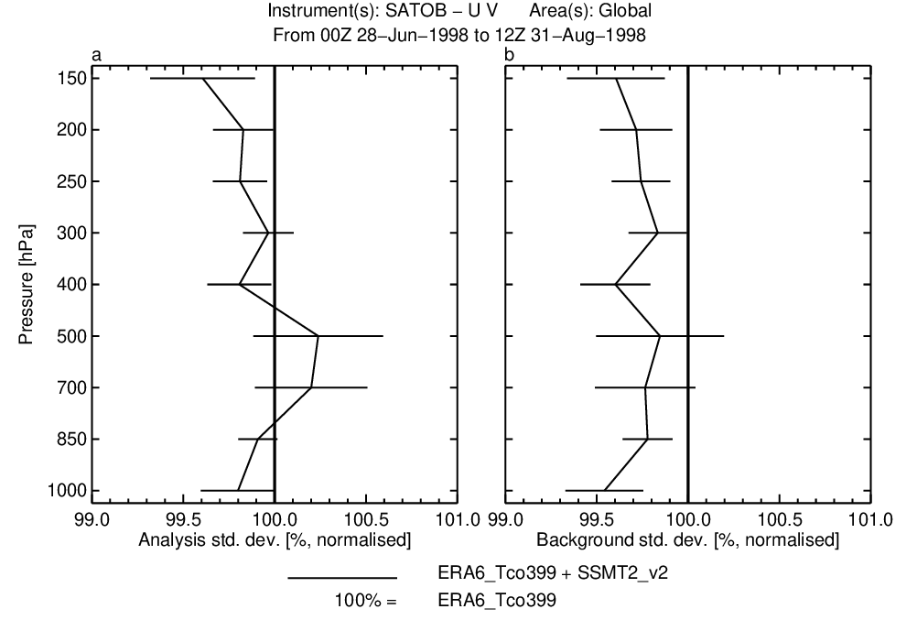
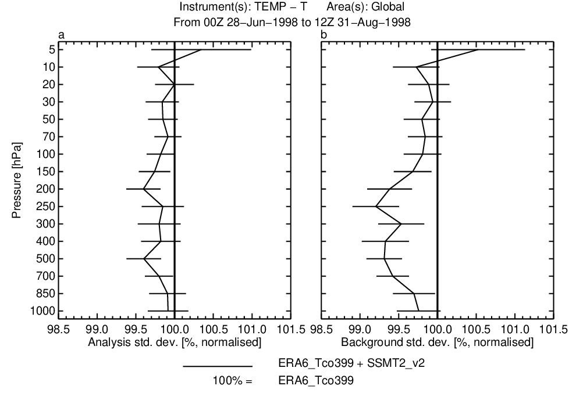
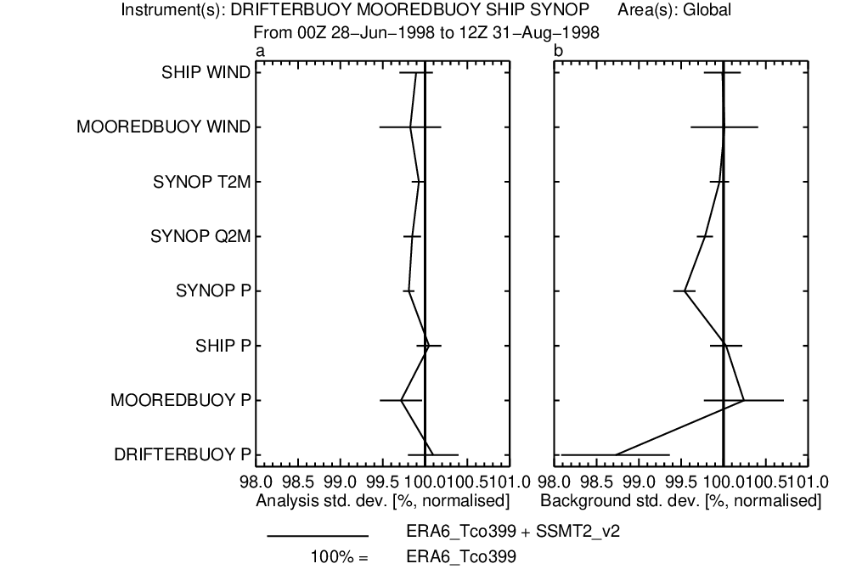
Post-1979: e.g., the SSM/T-2 (a microwave humidity sounder)
Initial tests assimilating F-12 SSM/T-2 data
Background and analysis fits
to independent observations
~3%
1%
HIRS
MSU
ERA5 used AMSU-B 2001 onwards (NOAA-16)
SSM/T-2 : an ‘MHS / AMSU-B – like’ humidity sounder
Data 1994 - 2005 reprocessed by EUMETSAT (4 sats)
ERA5 assimilated AMSU-B data from 2001 (N-16)
  → SSM/T-2 (& NOAA-15 AMSU-B) extends ERA6
Assimilated through all-sky route
Initial (2 month) experiment shown here
0.5 -
1%
sat
winds
temp-T
sfc
1%
In summary:
Substantial benefit from both rescued & reprocessed datasets –
for ERA6 & future generations of ECMWF reanalyses

Slide 16
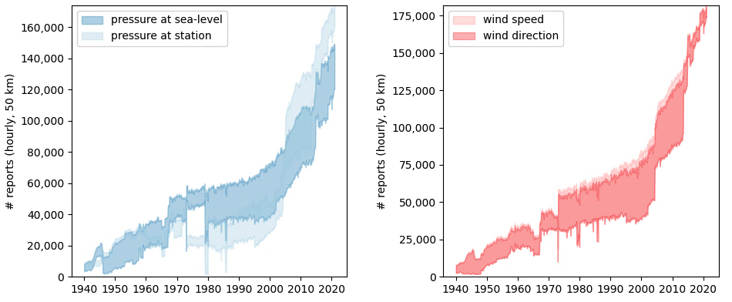
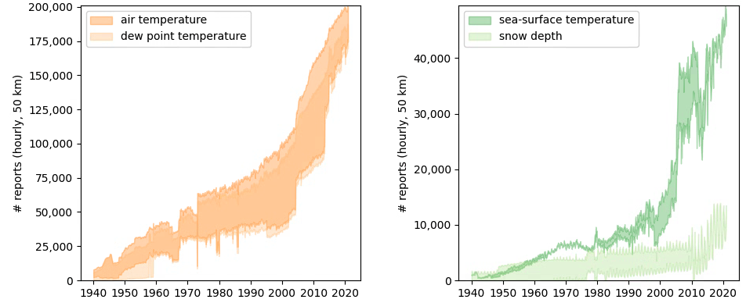
In-situ observations: Additional reports in ERA6, as compared to ERA5
Bottom curves show numbers of reports available to ERA5, at hourly, 50-km equal-area grid resolution.
Top curves show numbers of reports available to ERA6.
Shading shows the additional reports, between +50% to more than doubling, for key variables.
Final counts of data used will only be known after ERA6 is produced!
(Paul Poli)

Slide 17
Overview
Status and user base of ERA5
Where ERA5 sits in the C3S climate dataset portfolio
Towards ERA6 ⬅ user requirements
What ERA6 gets from 8 years additional R&D
The benefit from more and better observations
Some results for ERA6 prototypes
Status ERA6, summary/outlook
ERA6 14km (TCo799)
Horizontal grid
ERA5 31km (Tl 639)

Slide 18
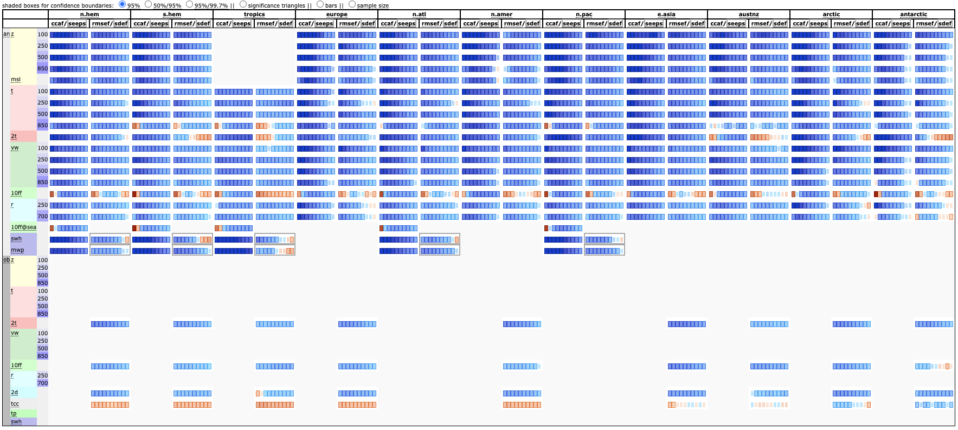
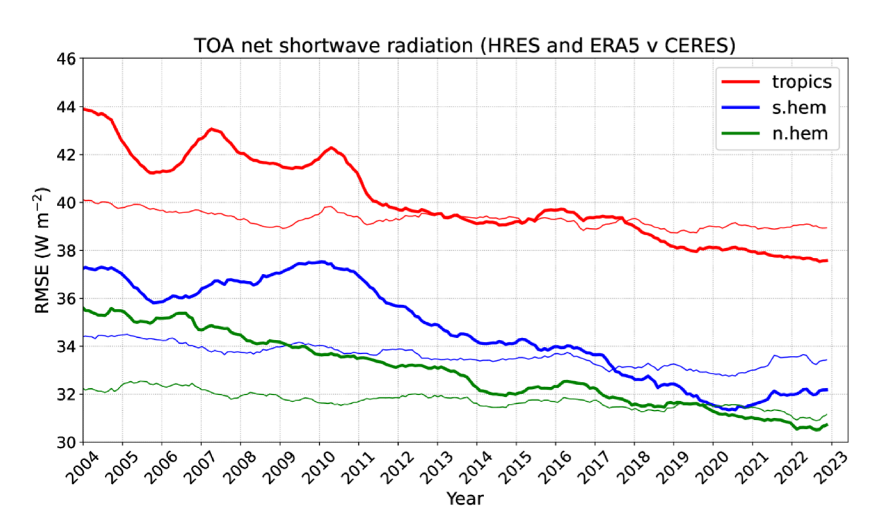
Performance of ERA6 prototype experiments
NH Z500 (Oct 2019 – Jan 2020)
By this metric improvements
from ERA5 to ERA6 are
in-line with those achieved in
previous generations of reanalyses
+12
hrs
anomaly correlation
ERA5
ERA6
Scorecard pilot ERA6 vs ERA5: blue is better
Short-wave radiation was improved (Richard Forbes)

Slide 19
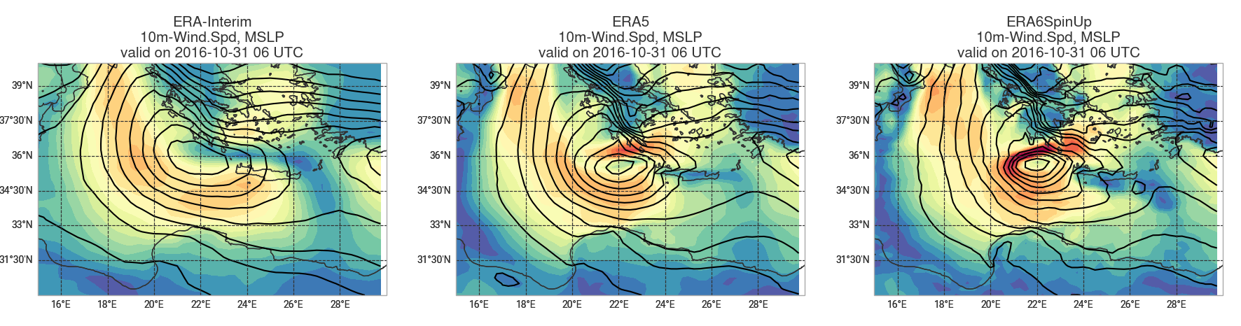
Improvements in extremes, not only pressure, but also wind plus more detail of the stratosphere since ERA5
Paul Poli

Slide 20
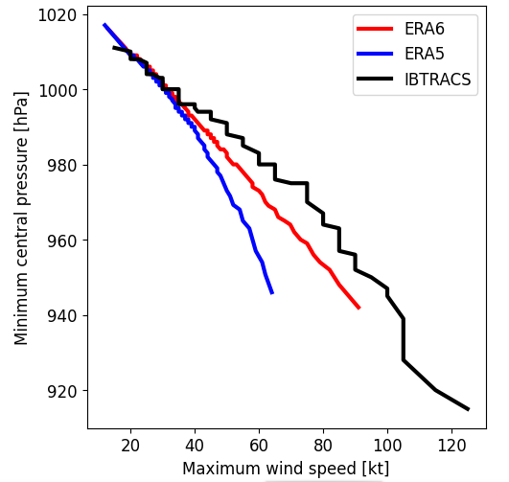
Tropical cyclones
Improvements in the representation of tropical cyclones in an ERA6 prototype of the stratosphere since ERA5
Logarithmic scale of the y axes to highlight differences in the stronger intensity categories.
Verification of 12-month ERA6-like experiment
Michael Maier-Gerber
Forecasted numbers of Cat-1 hurricanes now fit well to observed numbers.
ERA6 captures Cat-2 to Cat-4 hurricanes, which were missing in ERA5.
TC track errors reduced by almost 1 day at lead times larger than 2 days.
Deeper core pressure and higher wind speeds on average
ERA6 features smaller TCs compared to ERA5 (smaller average maximum wind radii)
Pressure-wind relationship is also more consistent with observations, now qualitatively similar to the operational IFS
AI forecast models inherit the deficiencies in ERA5. ERA6 will offer improvements in this regard.
Notes:
Forecasted numbers of Cat-1 hurricanes now fit well to observed numbers.
ERA6 is able to capture Cat-2 to Cat-4 hurricanes, which were missing in ERA5. (Maybe also Cat-5 but there was none observed in that period.)
TC track errors have reduced by almost 1 day at lead times larger than 2 days. This improvement is largely due to a reduced along-track bias, which can also be seen in higher average propagation speed and reduced propagation speed errors.
For intensity, we find deeper core pressure and higher wind speeds on average, along with reduced bias and MAE over the first 5 days.
In terms of structure, ERA6 features smaller TCs compared to ERA5 as can bee seen by smaller average maximum wind radii.
The pressure-wind relationship is also more consistent with observations, and now qualitatively similar to the operational IFS.
In line with the ability of higher mean absolute central pressure tendencies, rapid intensifications of the same magnitude as those observed can now also be detected, but still less often than observed (last slide).

Slide 21
Overview
Status and user base of ERA5
Where ERA5 sits in the C3S climate dataset portfolio
Towards ERA6 ⬅ user requirements
What ERA6 gets from 8 years additional R&D
The benefit from more and better observations
Some results for ERA6 prototypes
Status ERA6, summary/outlook
ERA6 14km (TCo799)
Horizontal grid
ERA5 31km (Tl 639)

Slide 22
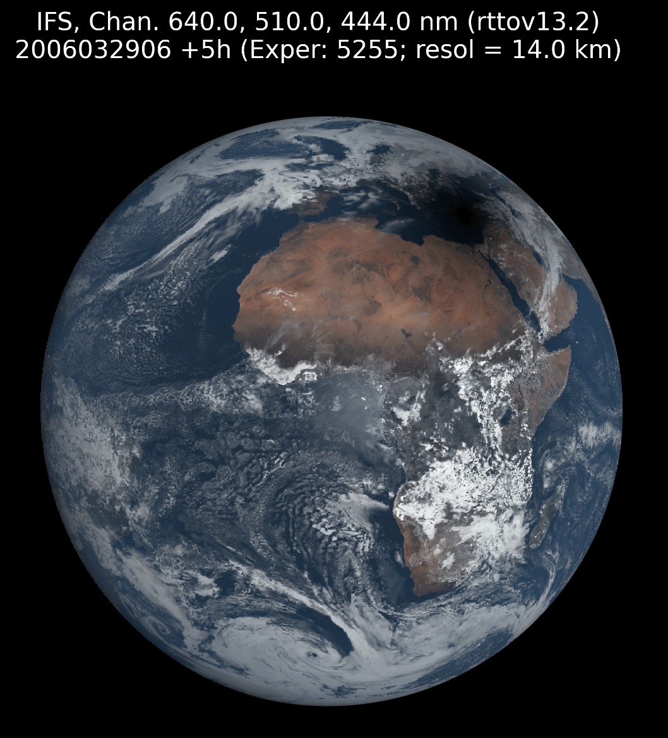
Status ERA6, summary/outlook
ERA6 is coming
production is to about to start
Spin-up years (2006/2016) completed
Expect 2007 onwards public by mid 2027.
ERA5T will be maintained for the time being
Higher resolution 14km
Additional 8 years R&D
Ocean component
Enhanced realism
More and better use of observations
Resolve several ERA5 issues
More products:
Ocean fields, height levels
GRIB2 format
Daily/monthly statistics
What FCI onboard MTG would have seen according to ERA6
in case it would have been in orbit in 2006, courtesy Philippe Lopez

