Slide 1
European Commission
Recent Achievements and Outlook
Hugo Zunker European Commission
Agenda Item 2.1

Slide 2
Copernicus Overview
Copernicus is Earth Observation component of the EU Space Programme aimed at developing European information services based on satellite Earth Observation and in situ data
First operational funding 2012
Copernicus is coordinated and managed by the European Commission
Data acquisition (own satellites, third party data, in-situ)
Information services (4x environmental, emergency mgt., security)
Data access and distribution (towards a ‘Copernicus Data Space’)
User Uptake (at the level of Space programme, of Earth Observation and of the thematic services.)
Copernicus is implemented in partnership with the Member States, ESA, EUMETSAT, ECMWF, EEA, EC JRC, Mercator, EMSA, SatCen, Frontex
Copernicus EU Operational Funding + 3rd countries 2021-2027 > 6 billion €
Copernicus data and infrastructure guaranteed beyond 2030

Slide 3
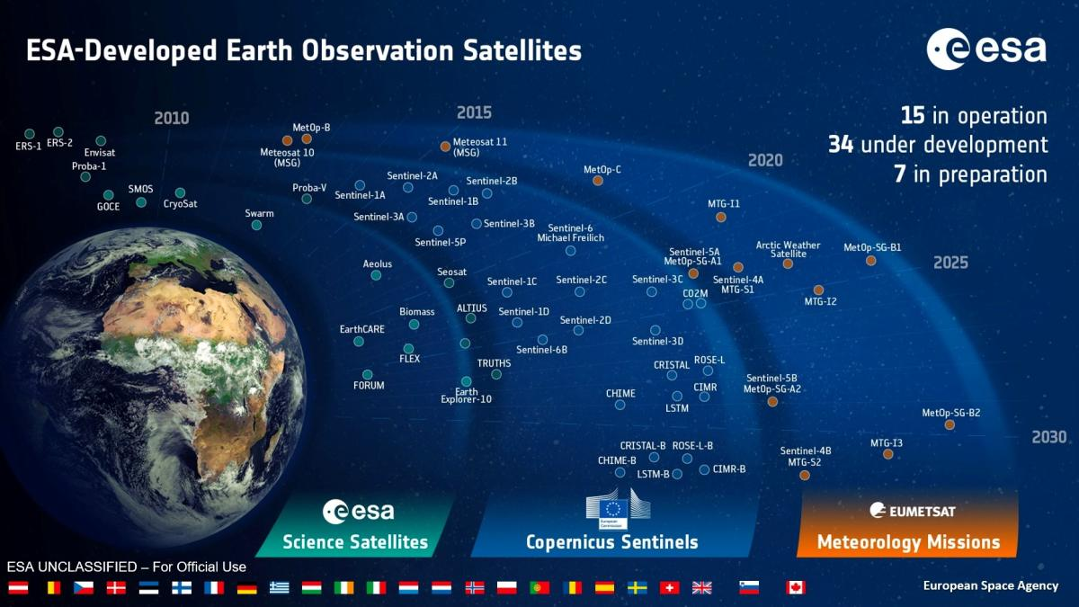

Slide 4

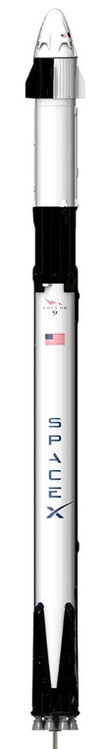
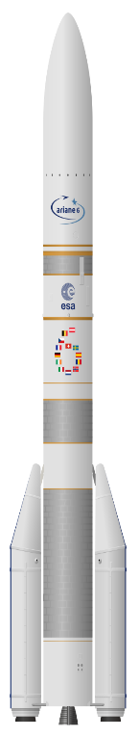
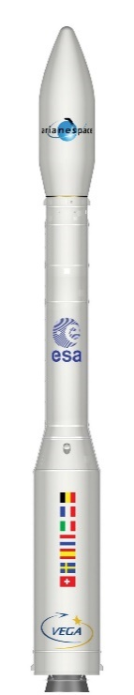
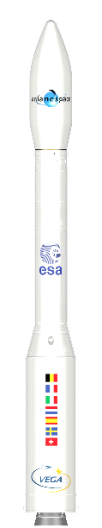
Recent and imminent Copernicus launches
* launch paid by EUMETSAT
** launch paid by NASA
18 launches
in next MMF
Sentinel-2C (Vega)
Sentinel-1C
(Vega C)
Sentinel-4A
(Falcon 9) *
Sentinel-5A
(Ariane 6) *
Sentinel-1D
(Ariane 6)
Sentinel-6B
(Falcon 9) **
Sentinel-3C
(Vega C)
CO2M-A
(Vega C)
2024
2025
2026
2027

Slide 5
Future Copernicus launches (indicative)
* launch paid by EUMETSAT
+ Expansion missions recurring
+ NextGen Sentinels
Sentinel-3C
(Vega C)
CO2M-A
(Vega C)
CO2M-B
(Vega C)
Cristal-A
(Vega C)
Sentinel-2D
(tbd)
CO2M-C
(tbd)
Sentinel-3D
(tbd)
CIMR-A
(tbd)
CHIME-A
(tbd)
ROSE-L-A
(tbd)
LSTM-A
(tbd)
Sentinel-5B
(Ariane 6) *
Sentinel-4B
(Ariane 6) *
2026
2027
2028
2029
2030
2031
2032
2034

Slide 6
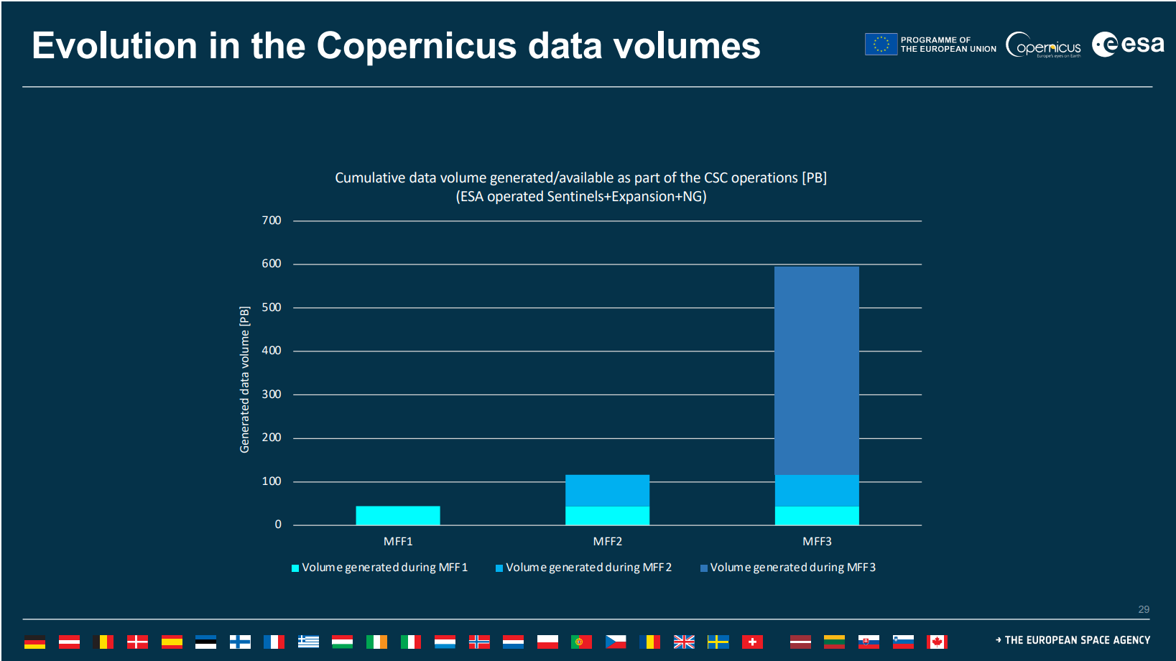

(35 Terabytes/day of data currently published)
MFF1 = 2014-2020
MFF2 = 2021-2027
MFF3 = 2028-2034

Slide 7






Outlook Copernicus Services
Policy driven: contribute to key policies, notably Green Deal & Preparedness
To improve:
Even better co-design with policy users (national, EU, UN);
Scaleup "policy ready" products;
Land Monitoring
Marine Env. Monitoring
Atmosphere Monitoring
Climate Change
Emergency Management
Security Service
EO Governmental
Increased use of Digital capacities (AI, Cloud, High Performance Computing); To improve:
Better integration of digital capacities (e.g. artificial intelligence) into image acquisition, processing and interpretation.
Copernicus Data Space
EO Governmental Service Today: pilot with SatCen, feasibility studies.
Next MFF:
Proposal as a separate sub-component
Common Elements

Slide 8




Three pillars of User Uptake
Knowledge Centre on Earth Observation (KCEO)
Work with Policy DG through targeted dialogues, deep dives, etc.
Increased uptake of Copernicus in legislation:
11 references to Copernicus in EU legislation 2015-2020
85+ references to Copernicus in EU legislation since 2021 so far
National Collaboration Programmes
Services run grant actions with national agencies.
Overcome barriers to uptake in the national public sector
Adjust to national context and, importantly, language
Use of Copernicus products to support national initiatives
Stimulate continuous & tailored user engagement
Co-design of products and use cases with national users
MAXIMISE VALUE TO EU27 & Participating COUNTRIES
User Consultation Platform (for all Components of the space programme)
Foster the user uptake of Other Copernicus in close cooperation with the entrusted entities
Creation of a business-friendly ecosystem to foster user uptake, including actions for entrepreneurship
Copernicus core users are Union institutions and public bodies in the Union or Participating States with a public service mission and with the additional role of driving the evolution of Copernicus;
Other users
include commercial and private bodies, research and education organisations, charities, non-governmental organisations, and international organisations

Slide 9
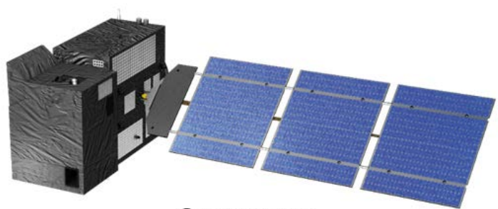
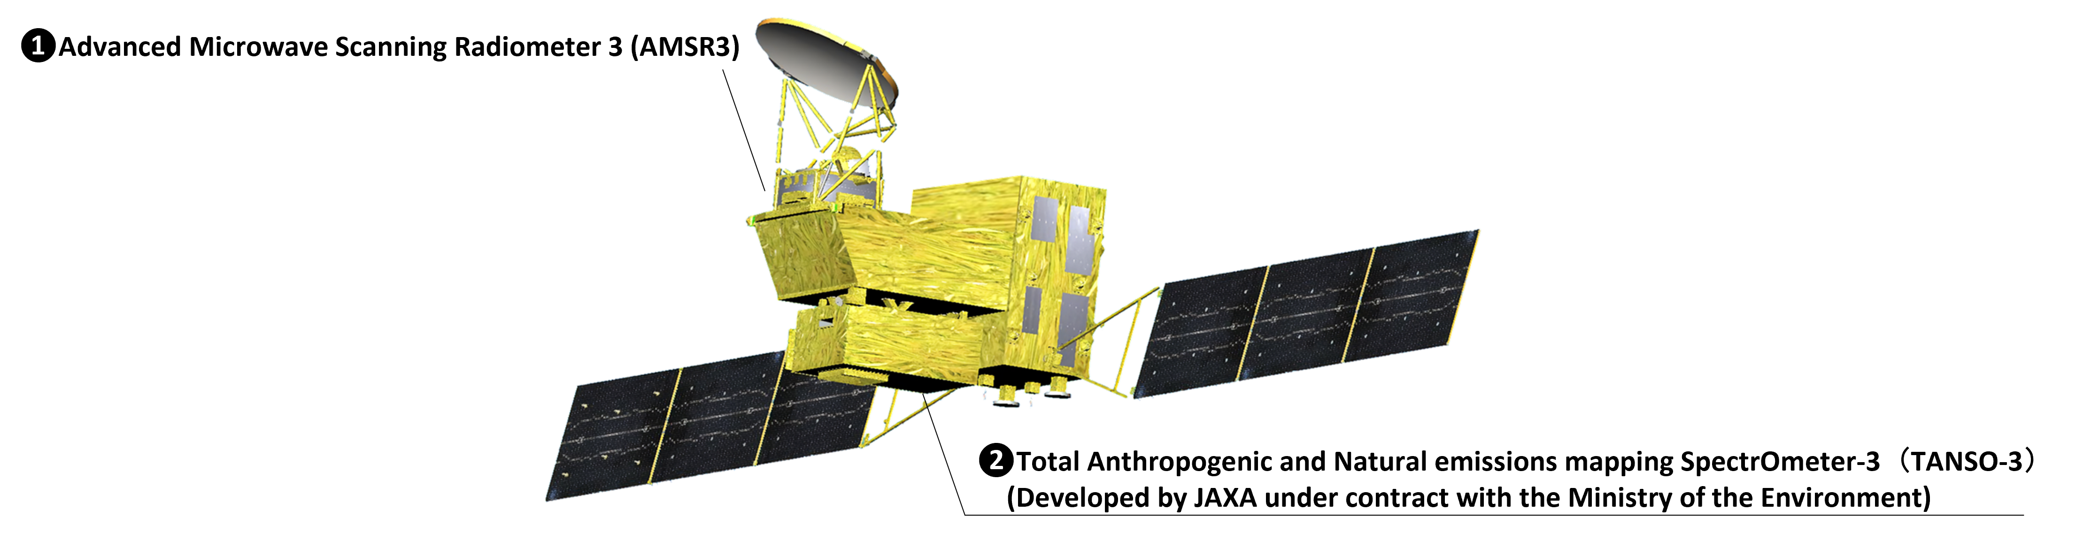

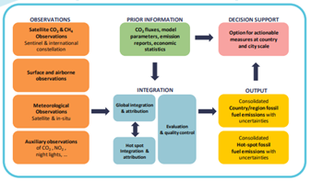


Ex: GHG Monitoring and Verification Support
GOSAT-GW
MicroCarb
CO2M
Technical Assessment
COP33
Information Collection and Preparation
IPCC AR7 WGx
IPCC AR7 SYR
Best Available Science
GHG MVS
Full Operational Capability
GHG Products
CAMS Portfolio
GHG MVS
Initial Operational Capability
Notes:
GOSAT-GW 28.6.25
MicroCarb 25.7.25

Slide 10
European Commission
Recent Achievements and Outlook
Hugo Zunker European Commission
Agenda Item 2.1

Slide 11
Presenter Guidelines 1
Presenters should name their file using the following convention:
AgendaItemNumber_LastName_Subject_Version (e.g., 1.1_Su_Welcome_v1)
Documents and presentations should be uploaded to the shared folder to allow for streamlined self service
Shared Presentation Folder (default view only, ask for upload/edit permission as required)
For support contact Libby/Wenying: libby@symbioscomms.com / wenying.su-1@nasa.gov
Meeting website: https://ceos.org/meetings/wgclimate-24/

